Slide 1

11 CNN Image Data Preparation
Peter H. Chen

Slide 2
11 CNN Image Data Preparation
https://www.youtube.com/watch?v=LhEMXbjGV_4&list=PLZbbT5o_s2xrwRnXk_yCPtnqqo4_u2YGL&index=11
CNN Image Data Preparation
We discuss the CNN Image Data Preparation.

Slide 3
11 CNN Image Data Preparation
https://www.youtube.com/watch?v=LhEMXbjGV_4&list=PLZbbT5o_s2xrwRnXk_yCPtnqqo4_u2YGL&index=11
Download Image Data
We discuss the dogs and cats classifier
Download the dogs and cats image data from using:
https://www.kaggle.com/c/dogs-vs-cats/data
We have 25,000 images in cat and dog folder, respectively.
The images in train folder are labeled with cat or dog (e.g., cat.0, dog.12499)
The images in test folder have no label (e.g., 0-12499)
Copy the Create ‘data’ folder and move the ‘dogs-vs-cats’ into ‘data’ folder.

Slide 4
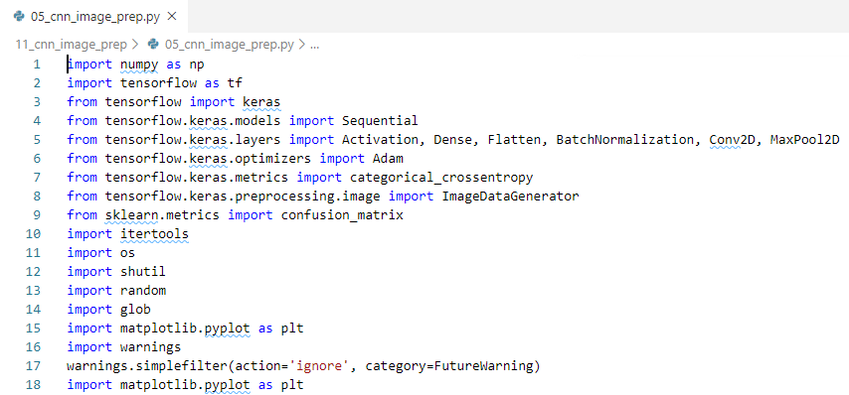
11 CNN Image Data Preparation
https://www.youtube.com/watch?v=LhEMXbjGV_4&list=PLZbbT5o_s2xrwRnXk_yCPtnqqo4_u2YGL&index=11
Import Libraries:

Slide 5
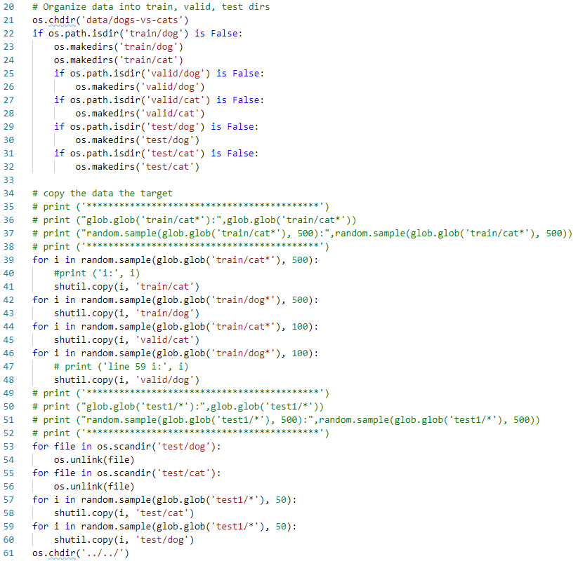
11 CNN Image Data Preparation
https://www.youtube.com/watch?v=LhEMXbjGV_4&list=PLZbbT5o_s2xrwRnXk_yCPtnqqo4_u2YGL&index=11
Processed Data:
After we get all the data, we need to re-organized the dataset.
Go to data/dogs-vs/cats folder:
Randomly select from train/cat* files and copy into folder train/cat/cat* and valid/cat/cat*.
Randomly select from train/dog* and copy into folder train/dog/dog* and valid/dog/dog*.
Clean up files in test/dog and test/cat
Randomly select from test1/* into copy into test/cat/*.
Randomly select from test1/* and copy into test/dog/*.

Slide 6
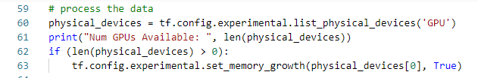
11 CNN Image Data Preparation
https://www.youtube.com/watch?v=LhEMXbjGV_4&list=PLZbbT5o_s2xrwRnXk_yCPtnqqo4_u2YGL&index=11
Read the Data:
Check the GPU.

Slide 7
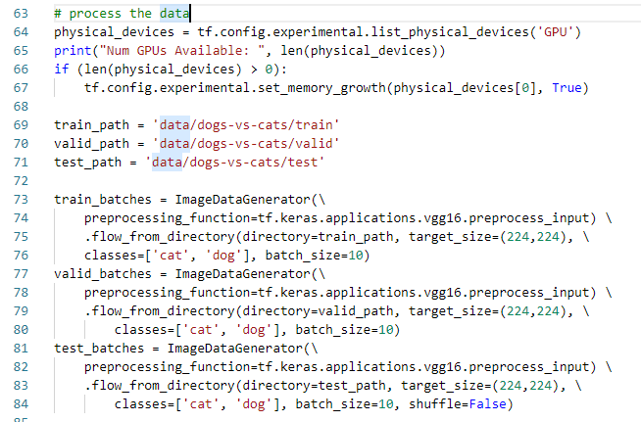
11 CNN Image Data Preparation
https://www.youtube.com/watch?v=LhEMXbjGV_4&list=PLZbbT5o_s2xrwRnXk_yCPtnqqo4_u2YGL&index=11
Read the Data:
ImageDataGenerator.flow_from_directory() creates training, validation, and test data.
ImageDataGenerator.flow_from_directory() creates a DirectoryIterator, which generates batches of normalized tensor image data from the respective data directories.
DirectoryIterator object are used to store training, validation, and test data.

Slide 8
11 CNN Image Data Preparation
https://www.youtube.com/watch?v=LhEMXbjGV_4&list=PLZbbT5o_s2xrwRnXk_yCPtnqqo4_u2YGL&index=11
Read the Data:
Notice, to ImageDataGenerator for each of the data sets, we specify preprocessing_function=tf.keras.applications.vgg16.preprocess_input.
For now, just understand this does an additional processing step on the images.
We'll cover what exactly this processing is when we work with the pre-trained VGG16 CNN in next discussion.

Slide 9
11 CNN Image Data Preparation
https://www.youtube.com/watch?v=LhEMXbjGV_4&list=PLZbbT5o_s2xrwRnXk_yCPtnqqo4_u2YGL&index=11
Read the Data:
To flow_from_directory(), we first specify the path for the data. We then specify the target_size of the images, which will resize all images to the specified size. The size we specify here is determined by the input size that the neural network expects.
The classes parameter expects a list that contains the underlying class names, and lastly, we specify the batch_size.

Slide 10
11 CNN Image Data Preparation
https://www.youtube.com/watch?v=LhEMXbjGV_4&list=PLZbbT5o_s2xrwRnXk_yCPtnqqo4_u2YGL&index=11
Read the Data:
We also specify shuffle=False only for test_batches. That's because, later when we plot the evaluation results from the model to a confusion matrix, we'll need to able to access the unshuffled labels for the test set.
By default, the data sets are shuffled.
Note, in the case where you do not know the labels for the test data, you will need to modify the test_batches variable.
Specifically, the change will be to set the parameters classes = None and class_mode = None in flow_from_directory().

Slide 11
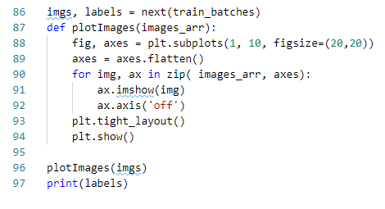
11 CNN Image Data Preparation
https://www.youtube.com/watch?v=LhEMXbjGV_4&list=PLZbbT5o_s2xrwRnXk_yCPtnqqo4_u2YGL&index=11
Display Image
We now call next(train_batches) to generate a batch of images and labels from the training set. Note that the size of this batch is determined by the batch_size we set when we created train_batches.
We then plot the image by matplotlib.pyplot.

Slide 12
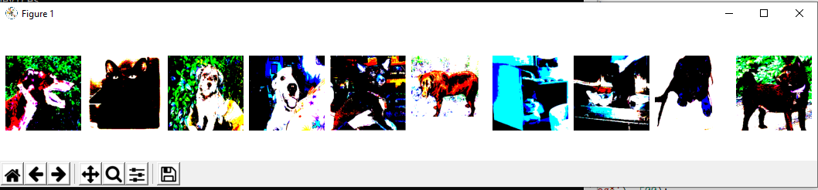
11 CNN Image Data Preparation
https://www.youtube.com/watch?v=LhEMXbjGV_4&list=PLZbbT5o_s2xrwRnXk_yCPtnqqo4_u2YGL&index=11
Display Result

Slide 13
11.1 Quiz

Slide 14
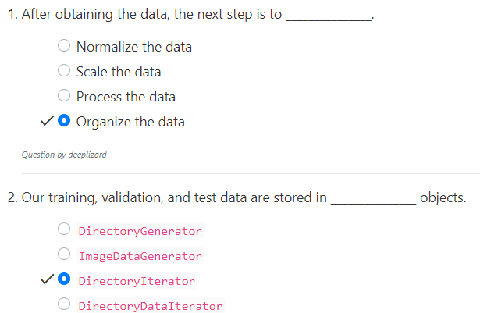
11.1 Quiz
https://www.youtube.com/watch?v=LhEMXbjGV_4&list=PLZbbT5o_s2xrwRnXk_yCPtnqqo4_u2YGL&index=11
Quiz

Slide 15
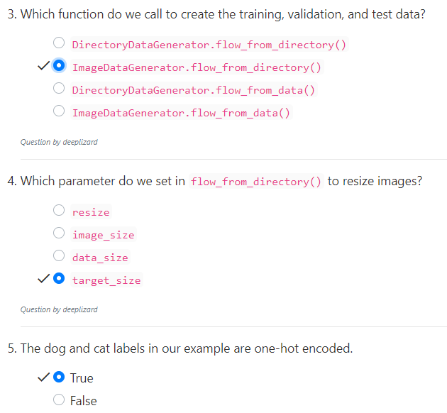
11.1 Quiz
https://www.youtube.com/watch?v=LhEMXbjGV_4&list=PLZbbT5o_s2xrwRnXk_yCPtnqqo4_u2YGL&index=11
Quiz

Slide 16
End of Chapter

