Slide 1

12 CNN Image Classifier
Peter H. Chen

Slide 2
12 CNN Image Classifier
https://www.youtube.com/watch?v=daovGOlMbT4&list=PLZbbT5o_s2xrwRnXk_yCPtnqqo4_u2YGL&index=12
Image Classifier
We discuss how to build CNN Classifier.

Slide 3
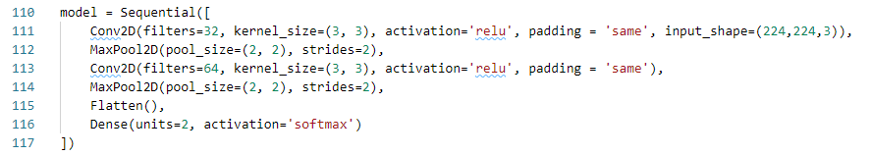
12 CNN Image Classifier
https://www.youtube.com/watch?v=daovGOlMbT4&list=PLZbbT5o_s2xrwRnXk_yCPtnqqo4_u2YGL&index=12
Build CNN
Use Sequential model to build CNN.
The first layer in the model is a 2-dimensional convolutional layer.
This layer will have 32 output filters each with a kernel size of 3x3, and we’ll use the relu activation function.
Note that the choice for the number of output filters specified is arbitrary, and the chosen kernel size of 3x3 is generally a very common size to use.
You can experiment by choosing different values for these parameters.

Slide 4
12 CNN Image Classifier
https://www.youtube.com/watch?v=daovGOlMbT4&list=PLZbbT5o_s2xrwRnXk_yCPtnqqo4_u2YGL&index=12
We enable zero-padding by specifying padding = 'same’.
On the first layer only, we also specify the input_shape, which is the shape of our data. Our images are 224 pixels high and 224 pixels wide and have 3 color channels: RGB. This gives us an input_shape of (224,224,3).
We then add a max pooling layer to pool and reduce the dimensionality of the data. Note, to gain a fundamental understanding of max pooling, zero padding, convolutional filters, and convolutional neural networks.
We add another convolutional layer with the exact specs as the earlier one, except for this second Conv2D layer has 64 filters. The choice of 64 here is again arbitrary, but the general choice of having more filters in later layers than in earlier ones is common. This layer is again followed by the same type of MaxPool2D layer.

Slide 5
12 CNN Image Classifier
https://www.youtube.com/watch?v=daovGOlMbT4&list=PLZbbT5o_s2xrwRnXk_yCPtnqqo4_u2YGL&index=12
We then Flatten the output from the convolutional layer and pass it to a Dense layer.
This Dense layer is the output layer of the network, and so it has 2 nodes, one for cat and one for dog.
We’ll use the softmax activation function on our output so that the output for each sample is a probability distribution over the outputs of cat and dog.

Slide 6
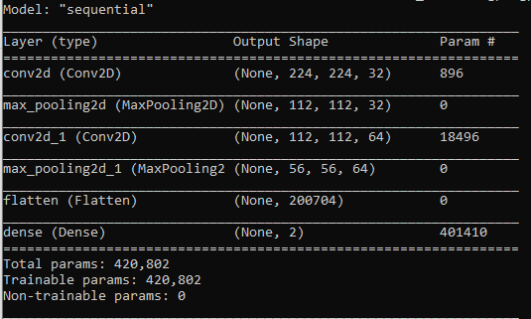
12 CNN Image Classifier
https://www.youtube.com/watch?v=daovGOlMbT4&list=PLZbbT5o_s2xrwRnXk_yCPtnqqo4_u2YGL&index=12
Model Summary
Check summary: model.summary().

Slide 7
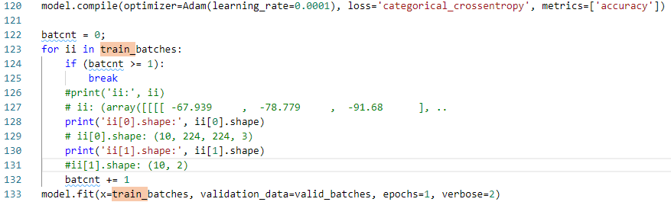
12 CNN Image Classifier
https://www.youtube.com/watch?v=daovGOlMbT4&list=PLZbbT5o_s2xrwRnXk_yCPtnqqo4_u2YGL&index=12
Compile Model
Now that the model is built, we compile the model using the Adam optimizer with a learning rate of 0.0001, a loss of categorical_cross_entropy, and we’ll look at accuracy as our performance metrics.

Slide 8
12 CNN Image Classifier
https://www.youtube.com/watch?v=daovGOlMbT4&list=PLZbbT5o_s2xrwRnXk_yCPtnqqo4_u2YGL&index=12
Compile Fit
We've already introduced the model.fit() function to train a model.
We pass in our newly introduced DirectoryIterators train_batches and valid_batches to train and validate the model.
We’re specifying 10 (We set to 1 to save run time).
Set the verbose parameter to 2.

Slide 9
12.1 Quiz

Slide 10
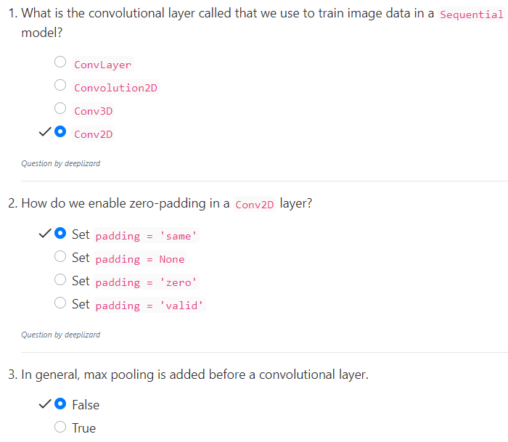
12.1 Quiz
https://www.youtube.com/watch?v=daovGOlMbT4&list=PLZbbT5o_s2xrwRnXk_yCPtnqqo4_u2YGL&index=12
Quiz

Slide 11
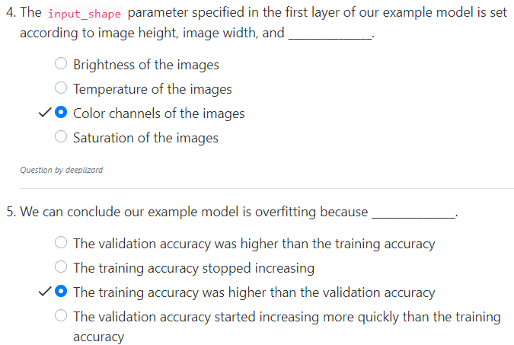
12.1 Quiz
https://www.youtube.com/watch?v=daovGOlMbT4&list=PLZbbT5o_s2xrwRnXk_yCPtnqqo4_u2YGL&index=12
Quiz

Slide 12
End of Chapter

