Slide 1

13 CNN Image Prediction
Peter H. Chen

Slide 2
13 CNN Image Prediction
https://www.youtube.com/watch?v=bfQBPNDy5EM&list=PLZbbT5o_s2xrwRnXk_yCPtnqqo4_u2YGL&index=13
CNN Image Prediction
We discuss how to perform the CNN Prediction.
In this last discussion, we built and trained the first CNN. We will use model to predict the dog and cat in the test set.

Slide 3
13 CNN Image Prediction
https://www.youtube.com/watch?v=bfQBPNDy5EM&list=PLZbbT5o_s2xrwRnXk_yCPtnqqo4_u2YGL&index=13
Prepare Test Data
We have built the Model.
Now, run next(test_batches) to extract a batch of images and their corresponding labels from the test set.

Slide 4
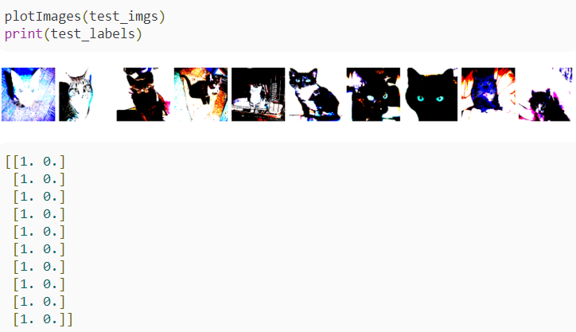
13 CNN Image Prediction
https://www.youtube.com/watch?v=bfQBPNDy5EM&list=PLZbbT5o_s2xrwRnXk_yCPtnqqo4_u2YGL&index=13
The test_batches was created in previous discussion and was created using Keras ImageDataGenerator.flow_from_directory() to generate batches of data from the test set that resides on disk.
We uses the plotImages() function to see what this batch of test data looks like.
Just as we saw before, cats are labeled with a one-hot encoding of [1,0], and dogs are labeled as [0,1].

Slide 5
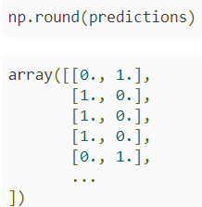
13 CNN Image Prediction
https://www.youtube.com/watch?v=bfQBPNDy5EM&list=PLZbbT5o_s2xrwRnXk_yCPtnqqo4_u2YGL&index=13
Predicting On The Test Data
We use built-model and call model.predict() to have the model predict on the test set.
We pass in the test set, test_batches, and set verbose=0 to see no output during the evaluation process.
After running the predictions, we can print our the rounded predictions see what they look like.
These are the labels that the model is predicting for our images

Slide 6
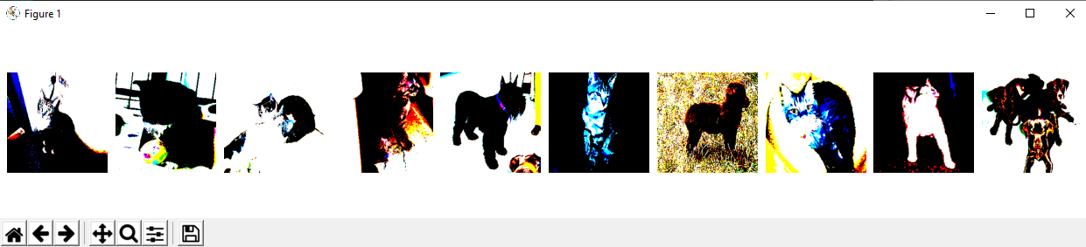
13 CNN Image Prediction
https://www.youtube.com/watch?v=bfQBPNDy5EM&list=PLZbbT5o_s2xrwRnXk_yCPtnqqo4_u2YGL&index=13
We transform the one-hot encoded predicted labels to be in the same format as the true labels by only selecting the element with the highest value for each prediction using np.argmax(predictions, axis=-1).
We then define the plot_confusion_matrix() function that is copied directly from scikit-learn.

Slide 7
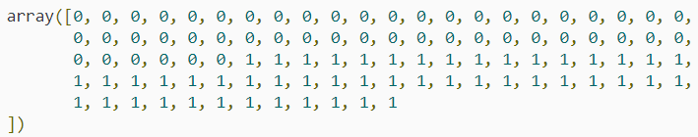
13 CNN Image Prediction
https://www.youtube.com/watch?v=bfQBPNDy5EM&list=PLZbbT5o_s2xrwRnXk_yCPtnqqo4_u2YGL&index=13
Plotting Predictions With A Confusion Matrix
We create the confusion matrix using scikit-learn, which we imported a couple episodes back.
cm = confusion_matrix(y_true=test_batches.classes, y_pred=np.argmax(predictions, axis=-1))
To the confusion matrix, we pass the true labels of the test set, along with the predicted labels for the test set from the model.
Note, we can access the unshuffled true labels for the test set by calling test_batches.classes.

Slide 8
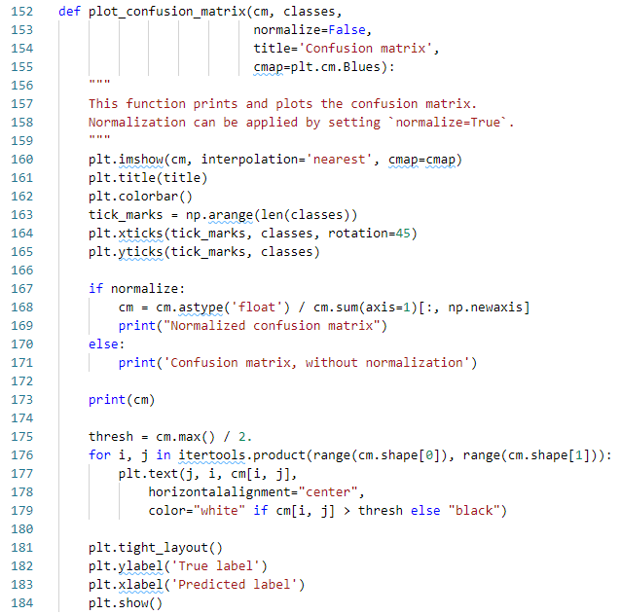
13 CNN Image Prediction
https://www.youtube.com/watch?v=bfQBPNDy5EM&list=PLZbbT5o_s2xrwRnXk_yCPtnqqo4_u2YGL&index=13
We transform the one-hot encoded predicted labels to be in the same format as the true labels by only selecting the element with the highest value for each prediction using np.argmax(predictions, axis=-1).
We then define the plot_confusion_matrix() function that is copied directly from scikit-learn.

Slide 9

13 CNN Image Prediction
https://www.youtube.com/watch?v=bfQBPNDy5EM&list=PLZbbT5o_s2xrwRnXk_yCPtnqqo4_u2YGL&index=13
Plotting Predictions With A Confusion Matrix
To get a better visualization of these results, we’ll plot them in a confusion matrix.
We create the confusion matrix using scikit-learn, which we imported a couple episodes back.
To the confusion matrix, we pass the true labels of the test set, along with the predicted labels for the test set from the model.
Note, we can access the unshuffled true labels for the test set by calling test_batches.classes.

Slide 10
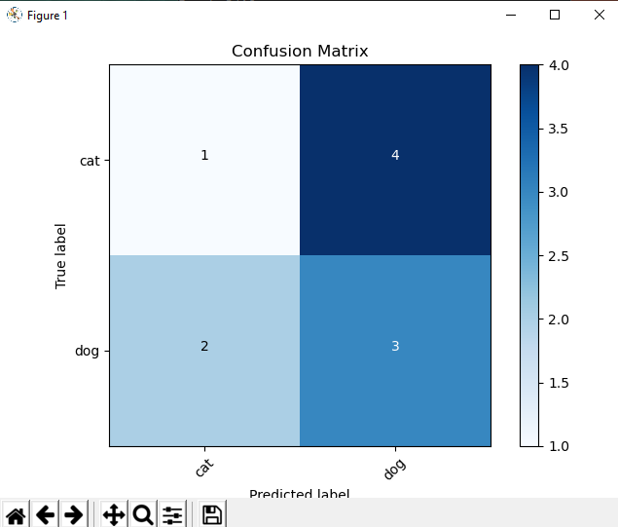
13 CNN Image Prediction
https://www.youtube.com/watch?v=bfQBPNDy5EM&list=PLZbbT5o_s2xrwRnXk_yCPtnqqo4_u2YGL&index=13
We transform the one-hot encoded predicted labels to be in the same format as the true labels by only selecting the element with the highest value for each prediction using np.argmax(predictions, axis=-1).
We then define the plot_confusion_matrix() function that is copied directly from scikit-learn.

Slide 11
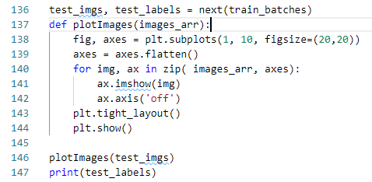
13 CNN Image Prediction
https://www.youtube.com/watch?v=bfQBPNDy5EM&list=PLZbbT5o_s2xrwRnXk_yCPtnqqo4_u2YGL&index=13
Keras Code: Get Test data

Slide 12
13 CNN Image Prediction
https://www.youtube.com/watch?v=bfQBPNDy5EM&list=PLZbbT5o_s2xrwRnXk_yCPtnqqo4_u2YGL&index=13
Keras Code: Predict

Slide 13
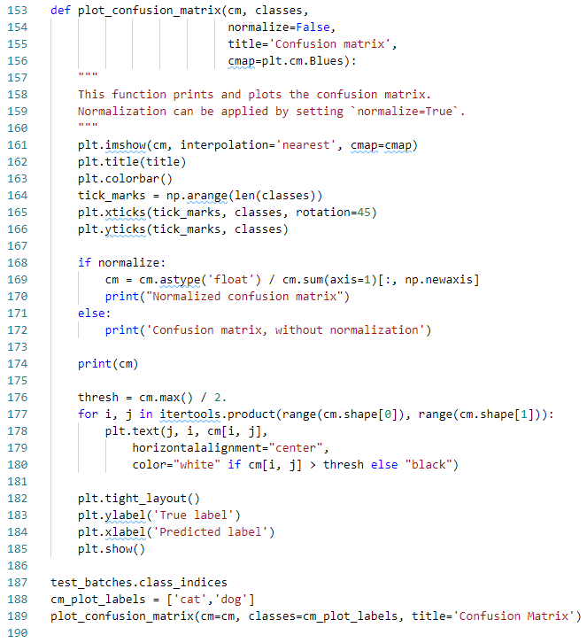
13 CNN Image Prediction
https://www.youtube.com/watch?v=bfQBPNDy5EM&list=PLZbbT5o_s2xrwRnXk_yCPtnqqo4_u2YGL&index=13
Keras Code: Plot confusion Matrix.

Slide 14
13.1 Quiz

Slide 15
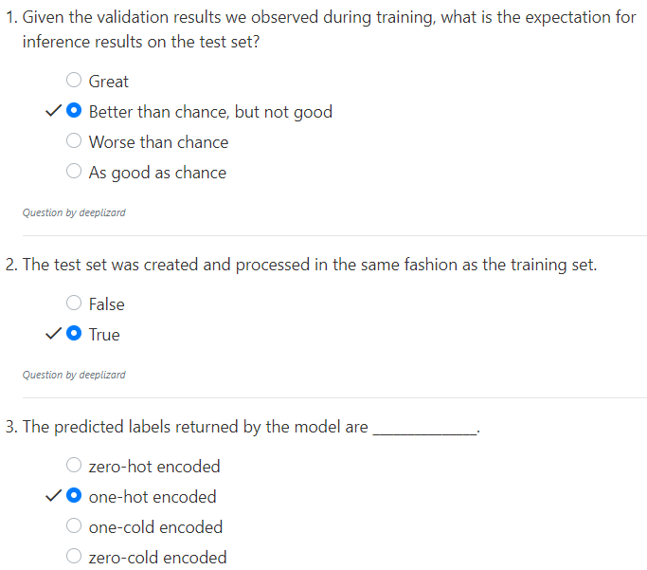
13.1 Quiz
https://www.youtube.com/watch?v=bfQBPNDy5EM&list=PLZbbT5o_s2xrwRnXk_yCPtnqqo4_u2YGL&index=13
Quiz
Better than chance, i.e., random shuffle.
Validate is special pickup.

Slide 16
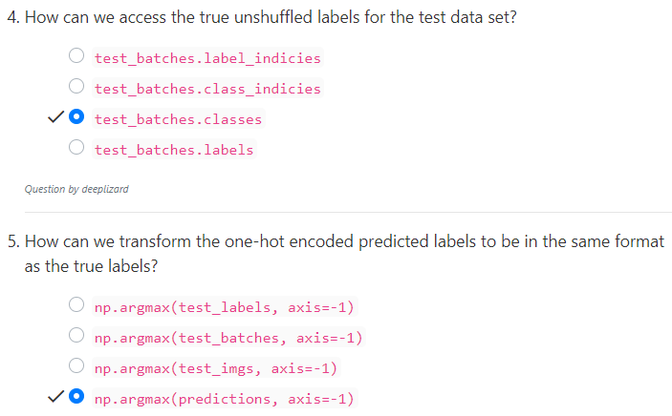
13.1 Quiz
https://www.youtube.com/watch?v=bfQBPNDy5EM&list=PLZbbT5o_s2xrwRnXk_yCPtnqqo4_u2YGL&index=13
Quiz
Test classes contains unlabeled data.
One hot encoded from predictions. [c0, c1].
Columns c1 and column c-1 are the same position.

Slide 17
End of Chapter

