Slide 1

14 Fine Tune CNN: Part 1 (Build): Part 1 (Build)
Peter H. Chen

Slide 2
14 Fine Tune CNN: Part 1 (Build)
https://www.youtube.com/watch?v=oDHpqu52soI&list=PLZbbT5o_s2xrwRnXk_yCPtnqqo4_u2YGL&index=14
Fine Tune CNN: Part 1 (Build)
We discuss Fine Tune CNN.

Slide 3
14 Fine Tune CNN: Part 1 (Build)
https://www.youtube.com/watch?v=oDHpqu52soI&list=PLZbbT5o_s2xrwRnXk_yCPtnqqo4_u2YGL&index=14
VGG16 and ImageNet
The pre-trained model we'll be working with to classify images of cats and dogs is called VGG16, which is the model that won the 2014 ImageNet competition.
In the ImageNet competition, multiple teams compete to build a model that best classifies images from the ImageNet library.
The ImageNet library includes thousands of images belonging to 1000 different categories.
We will import this VGG16 model and then fine-tune it using Keras.
The fine-tuned model will not classify images as 1000 categories.
We will reduce 1000 categories into 2 categories, i.e., cats and dogs.

Slide 4


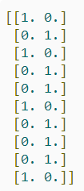
14 Fine Tune CNN: Part 1 (Build)
https://www.youtube.com/watch?v=oDHpqu52soI&list=PLZbbT5o_s2xrwRnXk_yCPtnqqo4_u2YGL&index=14
VGG16 Preprocessing
Let's first check out a batch of training data using the plotting function we brought in previously.

Slide 5
14 Fine Tune CNN: Part 1 (Build)
https://www.youtube.com/watch?v=oDHpqu52soI&list=PLZbbT5o_s2xrwRnXk_yCPtnqqo4_u2YGL&index=14
VGG16 Preprocessing
When we inspected these images, we briefly discussed that the color data was skewed as a result of preprocessing the images using the tf.keras.applications.vgg16.preprocess_input function.
To understand what preprocessing is needed for images that will be passed to a VGG16 model, we can look at the VGG16 paper.
Under the 2.1 Architecture section, we can see that the authors stated that, "The only preprocessing we do is subtracting the mean RGB value, computed on the training set, from each pixel.“
This is the preprocessing that was used on the original training data, and therefore, this is the way we need to process images before passing them to VGG16 or a fine-tuned VGG16 model.
This processing is what is causing the underlying color data to look distorted.

Slide 6
14.1 View Original VGG16_Model

Slide 7
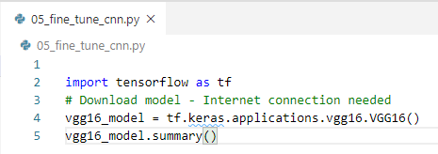
14.1 View Original VGG16_Model
https://www.youtube.com/watch?v=oDHpqu52soI&list=PLZbbT5o_s2xrwRnXk_yCPtnqqo4_u2YGL&index=14
Building A Fine-Tuned Model
Let’s start to build the VGG16 model.
First, we import tensroflow and VGG16 model from Keras.
It will download the data through the internet.
Note: an internet connection is needed to download this model.
VGG16 has the pre-built read dataset and vgg16 mode as below.

Slide 8
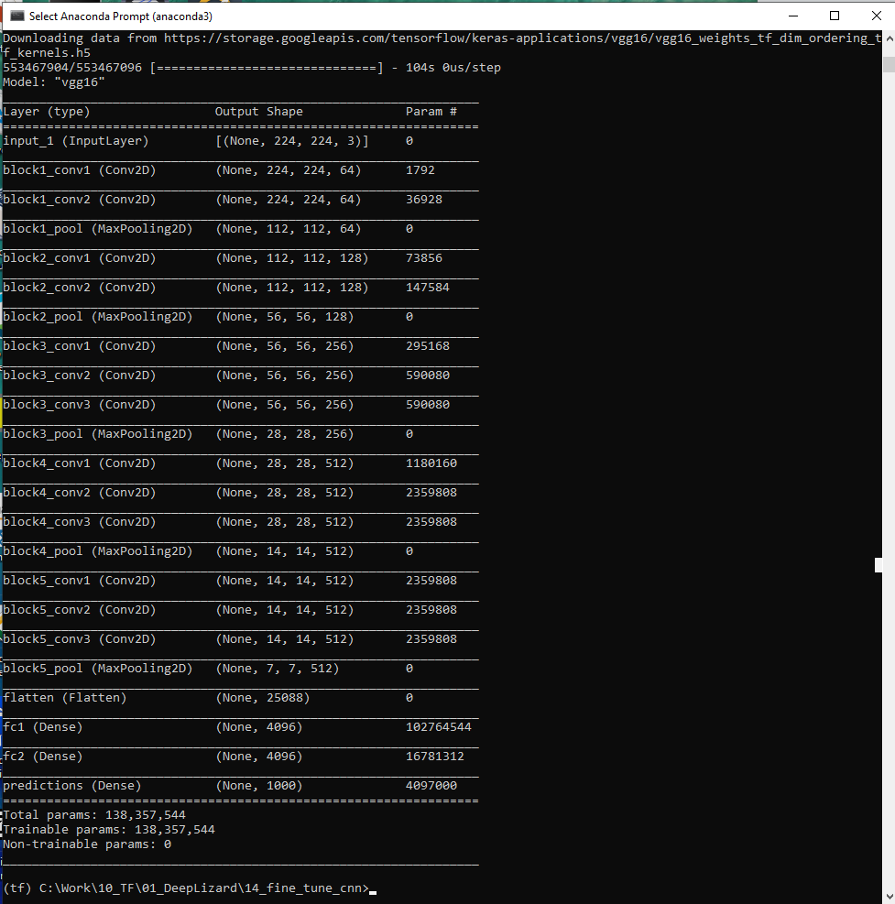
14.1 View Original VGG16_Model
https://www.youtube.com/watch?v=oDHpqu52soI&list=PLZbbT5o_s2xrwRnXk_yCPtnqqo4_u2YGL&index=14
> pyhton 05_fine_tune_cnn.py
Download the images from https://storage.googleapis.com/tensorflow/keras-applicaiotns/vgg16/...
As we run, we get the VGG16 model summary below.
The model we worked before have just one conv layer and one linear layer.
The VGG16 is very complicate.

Slide 9
14.1 View Original VGG16_Model
https://www.youtube.com/watch?v=oDHpqu52soI&list=PLZbbT5o_s2xrwRnXk_yCPtnqqo4_u2YGL&index=14
Building A Fine-Tuned Model
Model: "vgg16"
_________________________________________________________________
Layer (type) Output Shape Param #
=================================================================
input_1 (InputLayer) [(None, 224, 224, 3)] 0
_________________________________________________________________
block1_conv1 (Conv2D) (None, 224, 224, 64) 1792
_________________________________________________________________
block1_conv2 (Conv2D) (None, 224, 224, 64) 36928
_________________________________________________________________
block1_pool (MaxPooling2D) (None, 112, 112, 64) 0
_________________________________________________________________
block2_conv1 (Conv2D) (None, 112, 112, 128) 73856
_________________________________________________________________
block2_conv2 (Conv2D) (None, 112, 112, 128) 147584
_________________________________________________________________
block2_pool (MaxPooling2D) (None, 56, 56, 128) 0
_________________________________________________________________
block3_conv1 (Conv2D) (None, 56, 56, 256) 295168
_________________________________________________________________
block3_conv2 (Conv2D) (None, 56, 56, 256) 590080
_________________________________________________________________
block3_conv3 (Conv2D) (None, 56, 56, 256) 590080
_________________________________________________________________
block3_pool (MaxPooling2D) (None, 28, 28, 256) 0
_________________________________________________________________
block4_conv1 (Conv2D) (None, 28, 28, 512) 1180160
_________________________________________________________________
block4_conv2 (Conv2D) (None, 28, 28, 512) 2359808 _________________________________________________________________ block4_conv3 (Conv2D) (None, 28, 28, 512) 2359808 _________________________________________________________________ block4_pool (MaxPooling2D) (None, 14, 14, 512) 0 _________________________________________________________________ block5_conv1 (Conv2D) (None, 14, 14, 512) 2359808 _________________________________________________________________ block5_conv2 (Conv2D) (None, 14, 14, 512) 2359808 _________________________________________________________________ block5_conv3 (Conv2D) (None, 14, 14, 512) 2359808 _________________________________________________________________ block5_pool (MaxPooling2D) (None, 7, 7, 512) 0 _________________________________________________________________
flatten (Flatten) (None, 25088) 0 _________________________________________________________________
fc1 (Dense) (None, 4096) 102764544 _________________________________________________________________
fc2 (Dense) (None, 4096) 16781312 _________________________________________________________________ predictions (Dense) (None, 1000) 4097000 =================================================================
Total params: 138,357,544 Trainable params: 138,357,544 Non-trainable params: 0 _________________________________________________________________

Slide 10
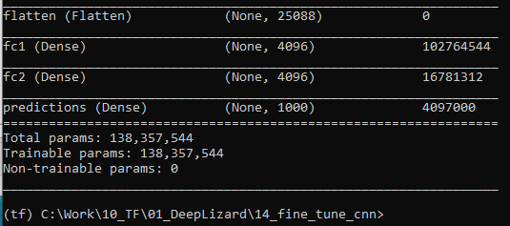
14.1 View Original VGG16_Model
https://www.youtube.com/watch?v=oDHpqu52soI&list=PLZbbT5o_s2xrwRnXk_yCPtnqqo4_u2YGL&index=14
Let’s look at the bottom of the VGG16 model.
The last output layer is prediction layer with 1000 categories.
We are not going to classify 1000 categories. We are going to categorize two categories, i.e., cat and dog.
We need to modify this model.

Slide 11
14.2 Create Our Model Sequential

Slide 12
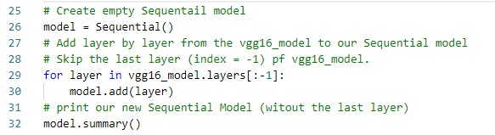
14.2 Create Our Model Sequential
https://www.youtube.com/watch?v=oDHpqu52soI&list=PLZbbT5o_s2xrwRnXk_yCPtnqqo4_u2YGL&index=14
Create out Model Sequential
Create empty mode sequential.
Loop through the vgg16_model and copy the layer from vgg16_model to our created model Sequential except the last layer (index with -1)
The last output layer is still empty.

Slide 13
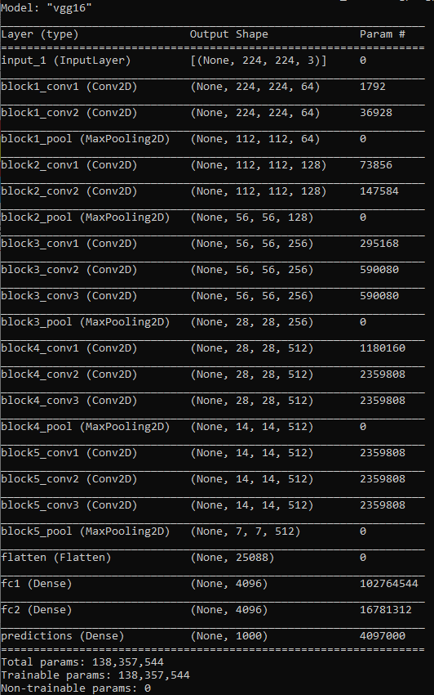
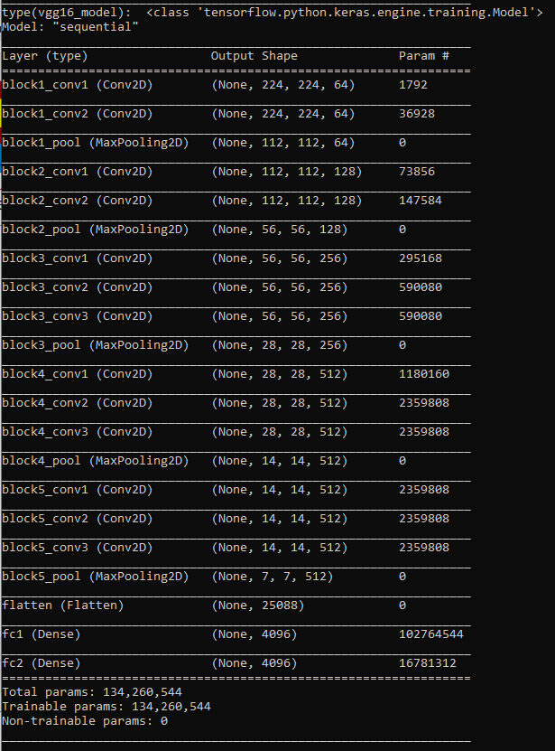
14.2 Create Our Model Sequential
https://www.youtube.com/watch?v=oDHpqu52soI&list=PLZbbT5o_s2xrwRnXk_yCPtnqqo4_u2YGL&index=14
View our new created model Sequential.
We see the last layer prediction of model vgg16_model is removed in our model Sequential.

Slide 14
14.3 Add Last Layer to Our Model

Slide 15
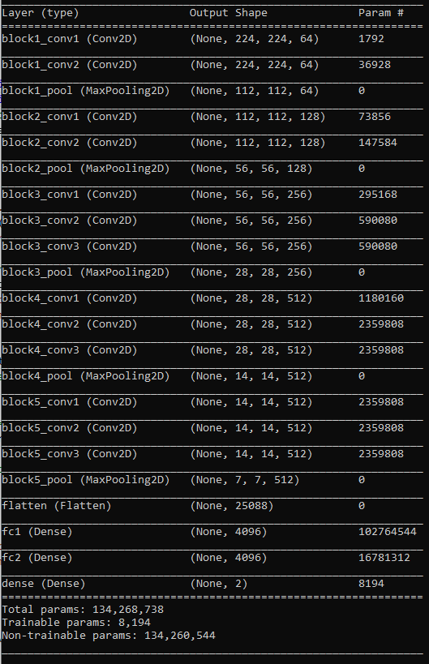
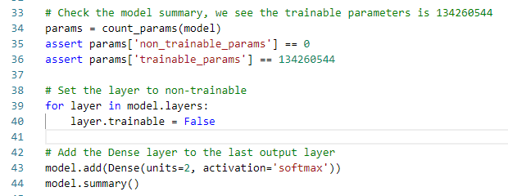
14.3 Add Last Layer to Our Model
https://www.youtube.com/watch?v=oDHpqu52soI&list=PLZbbT5o_s2xrwRnXk_yCPtnqqo4_u2YGL&index=14
Add the last layer Dense
We iterate over each of the layers in our new Sequential model and set them to be non-trainable.
We freezes the trainable parameters (weights and bias) in each layer.
These trainable parameters (weights and bias) will not be trained or updated. We will use the same parameter for our prediction.

Slide 16
14.3 Add Last Layer to Our Model
https://www.youtube.com/watch?v=oDHpqu52soI&list=PLZbbT5o_s2xrwRnXk_yCPtnqqo4_u2YGL&index=14
Building A Fine-Tuned Model
Model: "sequential_1"
_________________________________________________________________
Layer (type) Output Shape Param #
=================================================================
block1_conv1 (Conv2D) (None, 224, 224, 64) 1792
_________________________________________________________________
block1_conv2 (Conv2D) (None, 224, 224, 64) 36928
_________________________________________________________________
block1_pool (MaxPooling2D) (None, 112, 112, 64) 0
_________________________________________________________________
block2_conv1 (Conv2D) (None, 112, 112, 128) 73856
_________________________________________________________________
block2_conv2 (Conv2D) (None, 112, 112, 128) 147584
_________________________________________________________________
block2_pool (MaxPooling2D) (None, 56, 56, 128) 0
_________________________________________________________________
block3_conv1 (Conv2D) (None, 56, 56, 256) 295168
_________________________________________________________________
block3_conv2 (Conv2D) (None, 56, 56, 256) 590080
_________________________________________________________________
block3_conv3 (Conv2D) (None, 56, 56, 256) 590080
_________________________________________________________________
block3_pool (MaxPooling2D) (None, 28, 28, 256) 0
_________________________________________________________________
block4_conv1 (Conv2D) (None, 28, 28, 512) 1180160
_________________________________________________________________
block4_conv2 (Conv2D) (None, 28, 28, 512) 2359808
_________________________________________________________________
block4_conv3 (Conv2D) (None, 28, 28, 512) 2359808
_________________________________________________________________
block4_pool (MaxPooling2D) (None, 14, 14, 512) 0
_________________________________________________________________
block5_conv1 (Conv2D) (None, 14, 14, 512) 2359808 _________________________________________________________________
block5_conv2 (Conv2D) (None, 14, 14, 512) 2359808 _________________________________________________________________
block5_conv3 (Conv2D) (None, 14, 14, 512) 2359808
_________________________________________________________________
block5_pool (MaxPooling2D) (None, 7, 7, 512) 0
_________________________________________________________________
flatten (Flatten) (None, 25088) 0 _________________________________________________________________
fc1 (Dense) (None, 4096) 102764544 _________________________________________________________________
fc2 (Dense) (None, 4096) 16781312 _________________________________________________________________
dense_1 (Dense) (None, 2) 8194 ================================================================= Total params: 134,268,738 T
rainable params: 8,194
Non-trainable params: 134,260,544

Slide 17
14.4 Summary

Slide 18
14.4 Summary
https://www.youtube.com/watch?v=oDHpqu52soI&list=PLZbbT5o_s2xrwRnXk_yCPtnqqo4_u2YGL&index=14
Summary
In this discussion,
Create our model called Sequential
Move all the layer from vgg16 to our model Sequential except the last output layer.
Create the our last output layer Dense
Lock all the trainable parameters (weight and bias) from vgg16_model.

Slide 19
14.5 Quiz

Slide 20
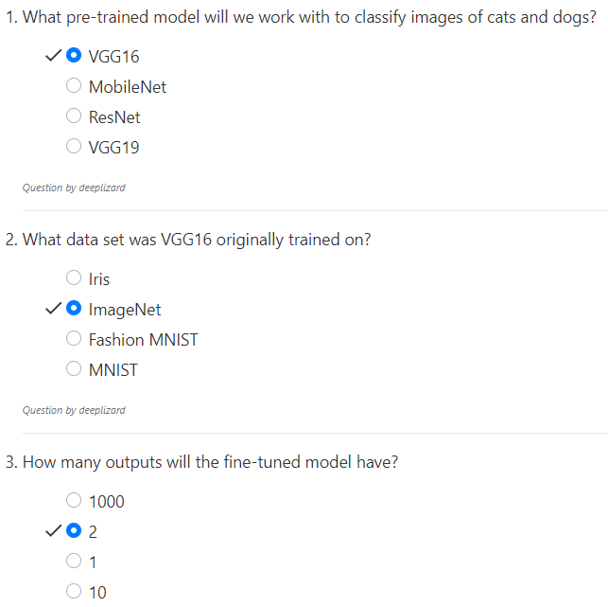
14.5 Quiz
https://www.youtube.com/watch?v=oDHpqu52soI&list=PLZbbT5o_s2xrwRnXk_yCPtnqqo4_u2YGL&index=14
Quiz

Slide 21
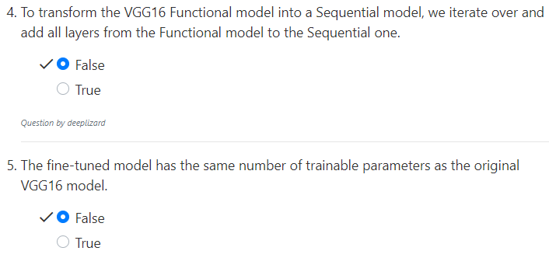
14.5 Quiz
https://www.youtube.com/watch?v=oDHpqu52soI&list=PLZbbT5o_s2xrwRnXk_yCPtnqqo4_u2YGL&index=14
Quiz

Slide 22
End of Chapter

