Slide 1

15 Fine Tune CNN: Part 2 (Train)
Peter H. Chen

Slide 2
15 Fine Tune CNN: Part 2 (Train)
https://www.youtube.com/watch?v=INaX55V1zpY&list=PLZbbT5o_s2xrwRnXk_yCPtnqqo4_u2YGL&index=15
Fine Tune CNN: Part 2 (Train)
We discuss how to train Fine Tune CNN.
We will train vgg16_model that we built and fine-tuned in the last discussion to classify an image is a cat or dog.
We have built simple one convolution layer and one dense layer, it performed very poorly. It is no better than chance (randomly guess = 50%) of predictions.
Now, we move on fine-tune an existing model called vgg16_model to classify images as cats or dogs.
Now, we will fine-tuned model that we just build and seeing how it performed and compared its metrics to our model that we originally built.

Slide 3
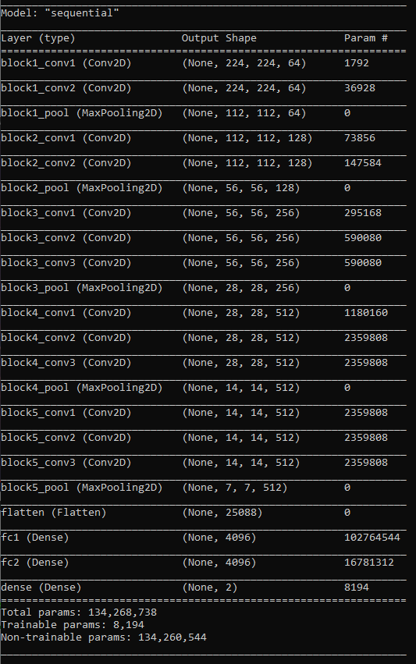
15 Fine Tune CNN: Part 2 (Train)
https://www.youtube.com/watch?v=INaX55V1zpY&list=PLZbbT5o_s2xrwRnXk_yCPtnqqo4_u2YGL&index=15
Fine Tune CNN: Part 2 (Train)
This is the model.summary of we built in the last discussion.
This is the same as vgg16_model except the last layer we changed to an output size of 1000 into an output size with 2, i.e., cats and dogs.

Slide 4
15.1 Compile and Build

Slide 5
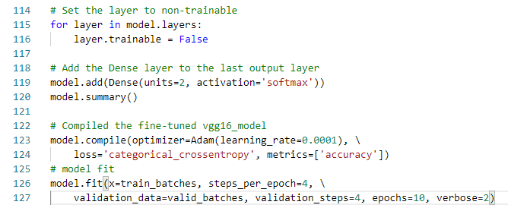
15.1 Compile and Build
https://www.youtube.com/watch?v=INaX55V1zpY&list=PLZbbT5o_s2xrwRnXk_yCPtnqqo4_u2YGL&index=15
Compile Model and Build
We compile this model with the Adam optimizer with a learning rate of 0.0001, categorical_crossentropy as our loss, and ‘accuracy’ as our metric.
Now, we’ll train the model using model.fit().
Note that the call to fit() is exactly the same as it was when we used it on the original CNN we built from scratch, except for we're only running (5 or 10).

Slide 6
15.1 Compile and Build
https://www.youtube.com/watch?v=INaX55V1zpY&list=PLZbbT5o_s2xrwRnXk_yCPtnqqo4_u2YGL&index=15
Compile Model and Build
Note:
“layer.trainable = False” is used to transfer weight and bias from vgg16_model to our model Sequential without change.
When we perform the new training with the new dataset, the weight will be modified again.

Slide 7
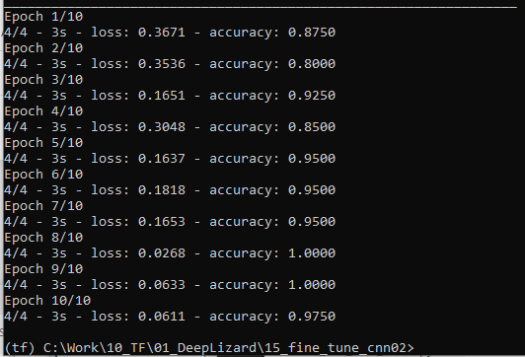
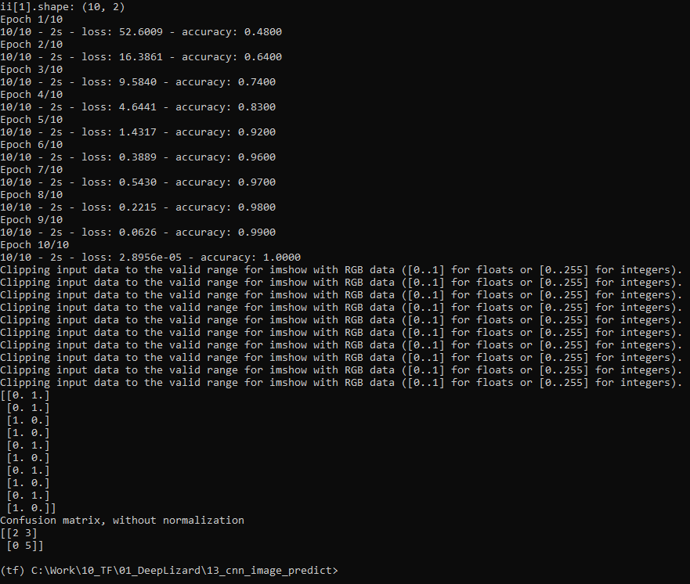
15.1 Compile and Build
https://www.youtube.com/watch?v=INaX55V1zpY&list=PLZbbT5o_s2xrwRnXk_yCPtnqqo4_u2YGL&index=15
Compile Model and Build
vgg16_model is very accurate.
Compile Model and Build
Simple model in ch13 has very high chance to have wrong prediction.

Slide 8
15.2 Quiz

Slide 9
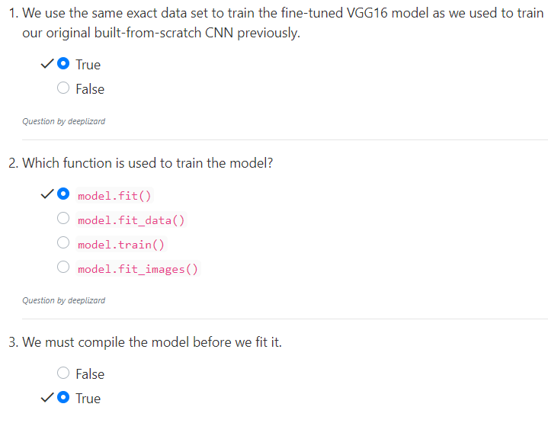
15.2 Quiz
https://www.youtube.com/watch?v=INaX55V1zpY&list=PLZbbT5o_s2xrwRnXk_yCPtnqqo4_u2YGL&index=15
Quiz
“layer.trainable = False” is used to transfer weight and bias from vgg16_model to our model Sequential without change.
When we perform the new training with the new dataset, the weight will be modified again.

Slide 10
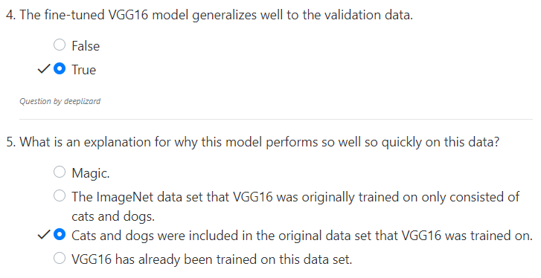
15.2 Quiz
https://www.youtube.com/watch?v=INaX55V1zpY&list=PLZbbT5o_s2xrwRnXk_yCPtnqqo4_u2YGL&index=15
Quiz

Slide 11
End of Chapter

