Slide 1

16 Fine Tune CNN: Part 3 (Predict)
Peter H. Chen

Slide 2
16 Fine Tune CNN: Part 3 (Predict)
https://www.youtube.com/watch?v=HDom7mAxCdc&list=PLZbbT5o_s2xrwRnXk_yCPtnqqo4_u2YGL&index=16
Fine Tune CNN: Part 3 (Predict)
We are going to use fine-tuned vgg16_model we built to predict the images from our test set are either cats or dogs.
We will compare the predictions of vgg16_model with simple model.

Slide 3
16.1 vgg16_model: Predict

Slide 4

16.1 vgg16_model: Predict
https://www.youtube.com/watch?v=HDom7mAxCdc&list=PLZbbT5o_s2xrwRnXk_yCPtnqqo4_u2YGL&index=16
Fine Tune CNN: Part 3 (Predict)
We are going to use fine-tuned vgg16_model we built to predict the images from our test set are either cats or dogs.
We will compare the predictions of vgg16_model with simple model.

Slide 5
16.2 Confusion Matrix

Slide 6
16.2 Confusion Matrix
https://www.youtube.com/watch?v=HDom7mAxCdc&list=PLZbbT5o_s2xrwRnXk_yCPtnqqo4_u2YGL&index=16
Confusion Matrix
Convert prediction to confusion matrix.

Slide 7
16.3 Plot Confusion Matrix

Slide 8
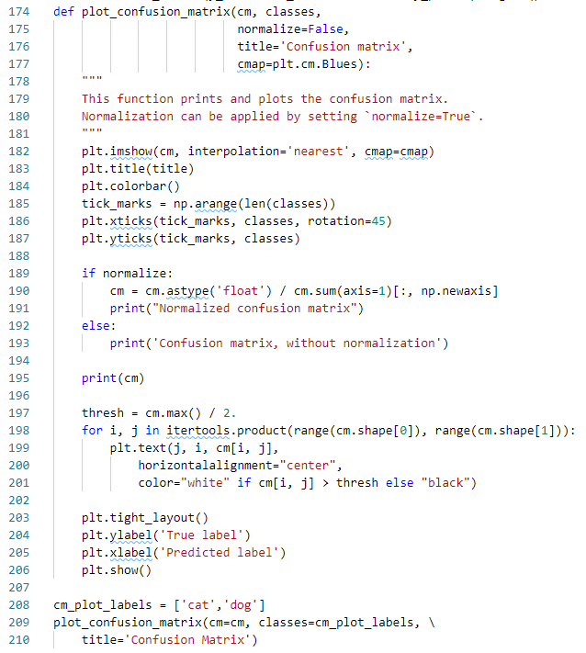
16.3 Plot Confusion Matrix
https://www.youtube.com/watch?v=HDom7mAxCdc&list=PLZbbT5o_s2xrwRnXk_yCPtnqqo4_u2YGL&index=16
Plot Confusion Matrix
Plot confusion matrix.

Slide 9
16.4 Display Result

Slide 10
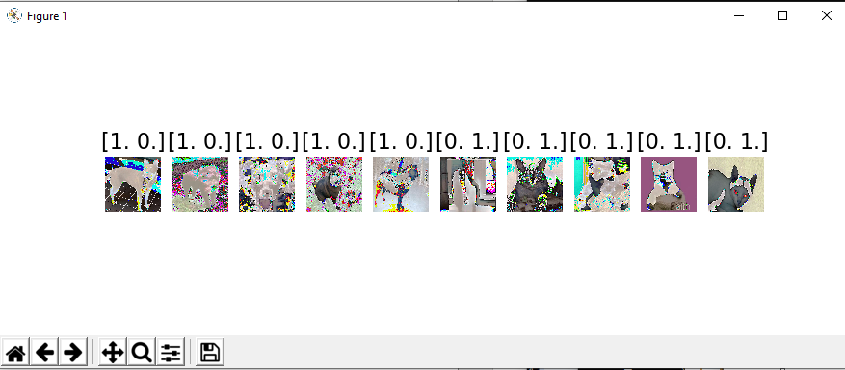
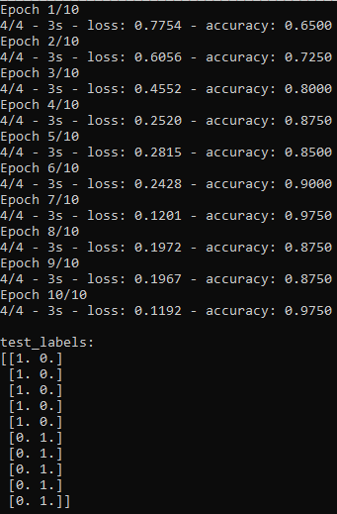
16.4 Display Result
https://www.youtube.com/watch?v=HDom7mAxCdc&list=PLZbbT5o_s2xrwRnXk_yCPtnqqo4_u2YGL&index=16
Display Test Image
> python 05_fine_tune_cnn03.py

Slide 11
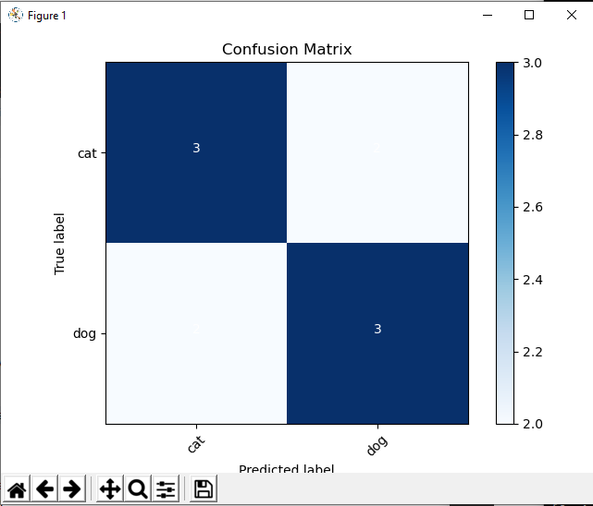
16.4 Display Result
https://www.youtube.com/watch?v=HDom7mAxCdc&list=PLZbbT5o_s2xrwRnXk_yCPtnqqo4_u2YGL&index=16
Display Confusion Matrix
> python 05_fine_tune_cnn03.py

Slide 12
16.5 Quiz

Slide 13
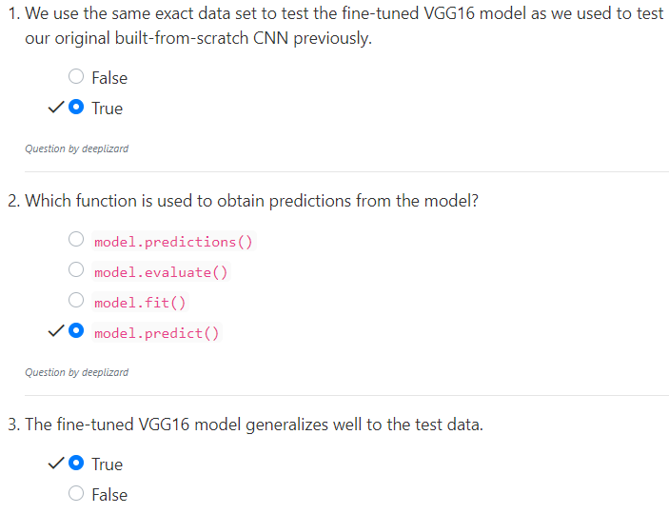
16.5 Quiz
https://www.youtube.com/watch?v=HDom7mAxCdc&list=PLZbbT5o_s2xrwRnXk_yCPtnqqo4_u2YGL&index=16
Quiz

Slide 14
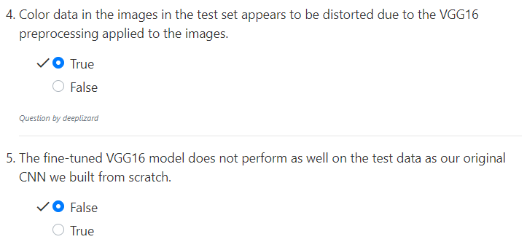
16.5 Quiz
https://www.youtube.com/watch?v=HDom7mAxCdc&list=PLZbbT5o_s2xrwRnXk_yCPtnqqo4_u2YGL&index=16
Quiz

Slide 15
End of Chapter

