Slide 1

1 Keras with Tensorflow
Peter H. Chen

Slide 2
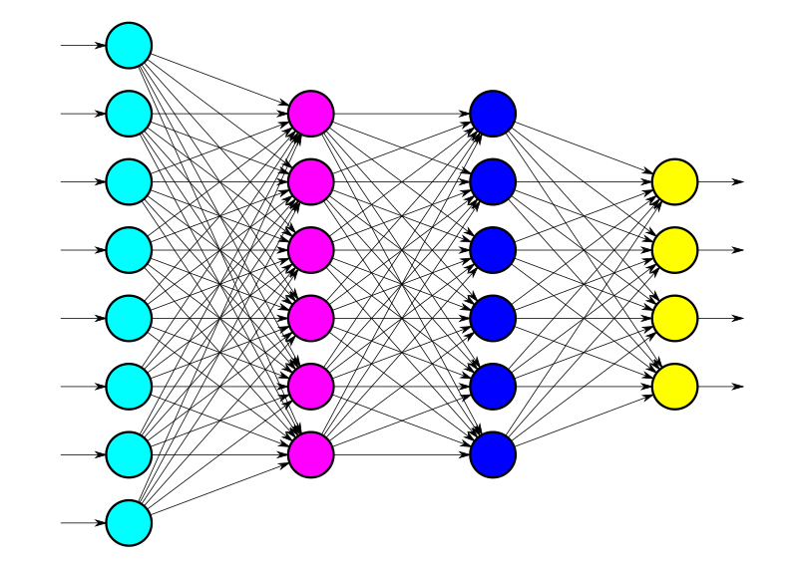
1 Keras with Tensorflow
https://www.youtube.com/watch?v=8j3mmr2coQ8&list=PLZbbT5o_s2xrwRnXk_yCPtnqqo4_u2YGL
Keras with Tensorflow
We discuss how to use Keras and a neural network API written in Python.

Slide 3
1 Keras with Tensorflow
https://www.youtube.com/watch?v=8j3mmr2coQ8&list=PLZbbT5o_s2xrwRnXk_yCPtnqqo4_u2YGL
Outline:
PART 1: ARTIFICIAL NEURAL NETWORK BASICS
Section 1: Intro to Keras and neural networks
Processing data
Buiding and training neural networks
Validation and inference
Saving and loading models
Section 2: Convolutional Neural Networks (CNNs)
Image processing
Building and training CNNs
Using CNNs for inference
Section 3: Fine-tuning and transfer learning
Intro to fine-tuning and VGG16 model
Implement fine-tuning on VGG16 model
Using fine-tuned models for inference
Section 4: Additional topics
Data augmentation
Keras' image labeling implementation
Achieving reproducible results
Learnable parameters
PART 2: NEURAL NETWORK MODEL DEPLOYMENT
Section 1: Deployment with Flask
Introduction to Flask and web services
Build a simple Flask app and web app
Send and receive data with Flask
Host neural network with Flask
Build neural network web app to interact with Flask service
Integrating data visualization with D3, DC, Crossfilter
Alternative ways to access neural network from Powershell and Curl
Information privacy and data protection
Section 2: MobileNet
Intro to MobileNet
Fine-tune MobileNet on subset of data
Fine-tune MobileNet on custom data set
Section 3: Deployment with TensorFlow.js
Introduction to client-side neural networks
Convert Keras model to TFJS model
Set up Node.js and Express
Build UI for neural network web app
Host a neural network with TFJS
Explore tensor operations through image processing
Examine tensor operations with debugger
Broadcasting tensors
Efficiency of hosting MobileNet in the browser

Slide 4
1.1 Quiz

Slide 5
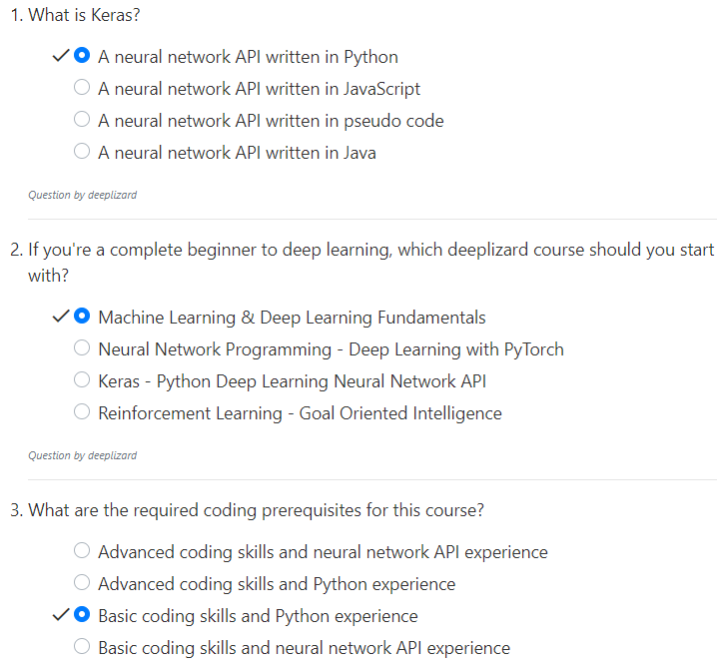
1.1 Quiz
https://www.youtube.com/watch?v=8j3mmr2coQ8&list=PLZbbT5o_s2xrwRnXk_yCPtnqqo4_u2YGL
Quiz

Slide 6
End of Chapter

