Slide 1

2 Get Started with Tensorflow
Peter H. Chen

Slide 2
2 Get Started with Tensorflow
https://www.youtube.com/watch?v=GCFmqet--Lc&list=PLZbbT5o_s2xrwRnXk_yCPtnqqo4_u2YGL&index=2
https://www.tutorialspoint.com/tensorflow/tensorflow_installation.htm
We need to create a totally clean enviornemnt for tensorflow and GPU.
> conda create --name tf python=3.7
> cond activate tf
(tf) > pip install tensorflow
(tf) > pip install tensorflow-gpu
(tf) > pip install scikit-learn # for sklearn
> conda deactivate
We will use the environment in this discussion.
How to remove the conda envoriment?
> conda remove tf # remove environemt

Slide 3

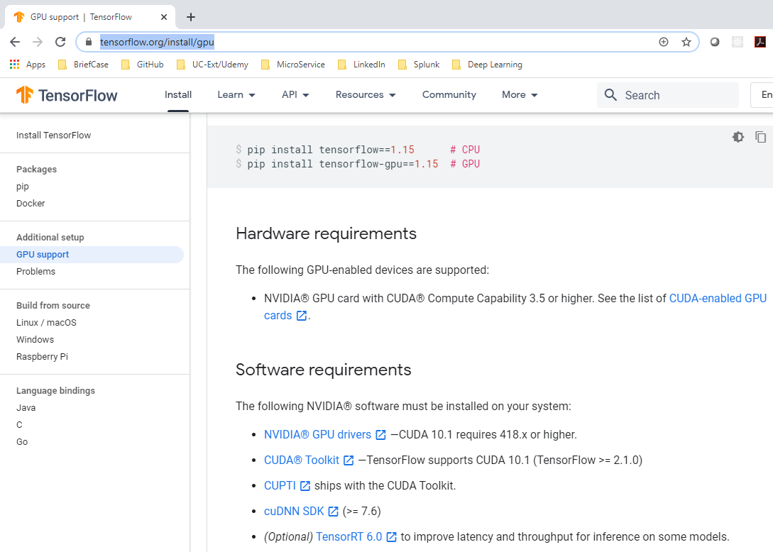
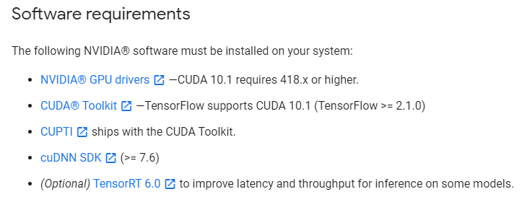
2 Get Started with Tensorflow
conda create --name tensorflow python = 3.5
https://www.youtube.com/watch?v=GCFmqet--Lc&list=PLZbbT5o_s2xrwRnXk_yCPtnqqo4_u2YGL&index=2
https://www.tutorialspoint.com/tensorflow/tensorflow_installation.htm
https://www.tensorflow.org/install/gpu
(tf) > python 01_tf_ver.py
TF 2.2.0 only work cuda 10.1.

Slide 4
2 Get Started with Tensorflow
conda create --name tensorflow python = 3.5
https://www.youtube.com/watch?v=GCFmqet--Lc&list=PLZbbT5o_s2xrwRnXk_yCPtnqqo4_u2YGL&index=2
https://www.tutorialspoint.com/tensorflow/tensorflow_installation.htm
Activate and deactivate
(base) > conda activate tf
(tf) > conda deactivate
(base) >

Slide 5
2 Get Started with Tensorflow
https://www.youtube.com/watch?v=GCFmqet--Lc&list=PLZbbT5o_s2xrwRnXk_yCPtnqqo4_u2YGL&index=2
History Of Keras
Keras was originally created by François Chollet. Historically, Keras was a high-level API that sat on top of one of three lower level neural network APIs and acted as a wrapper to to these lower level libraries. These libraries were referred to as Keras backend engines.
You could choose TensorFlow, Theano, or CNTK as the backend engine you’d like to work with.
  TensorFlow
  Theano
  CNTK
Ultimately, TensorFlow became the most popular backend engine for Keras.

Slide 6
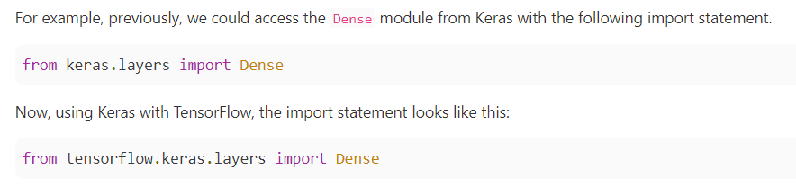
2 Get Started with Tensorflow
https://www.youtube.com/watch?v=GCFmqet--Lc&list=PLZbbT5o_s2xrwRnXk_yCPtnqqo4_u2YGL&index=2
Import

Slide 7

2 Get Started with Tensorflow
https://www.youtube.com/watch?v=GCFmqet--Lc&list=PLZbbT5o_s2xrwRnXk_yCPtnqqo4_u2YGL&index=2
Install Keras (Tensorflow)

Slide 8
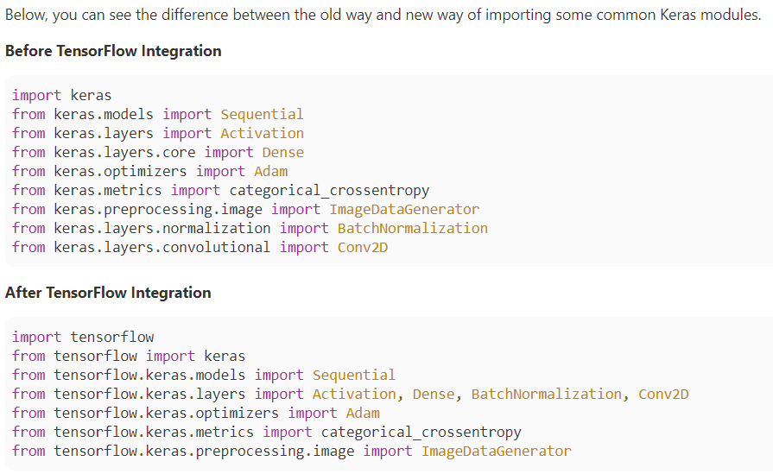
2 Get Started with Tensorflow
https://www.youtube.com/watch?v=GCFmqet--Lc&list=PLZbbT5o_s2xrwRnXk_yCPtnqqo4_u2YGL&index=2
Import

Slide 9
2.1 Quiz

Slide 10
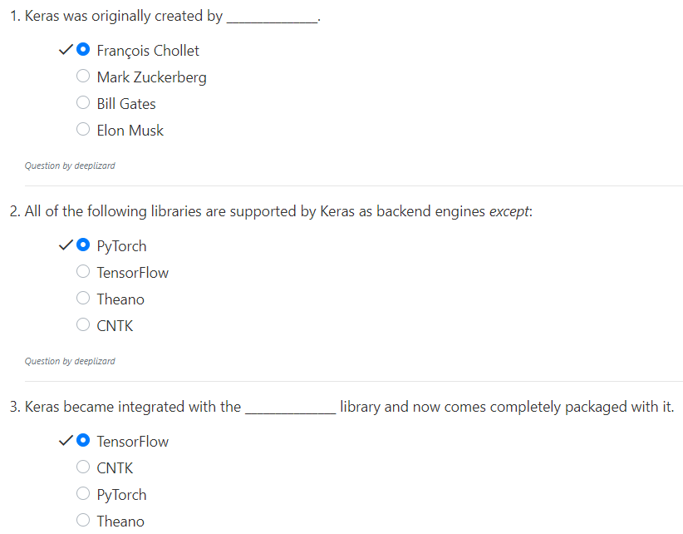
2.1 Quiz
https://www.youtube.com/watch?v=GCFmqet--Lc&list=PLZbbT5o_s2xrwRnXk_yCPtnqqo4_u2YGL&index=2
Quiz

Slide 11
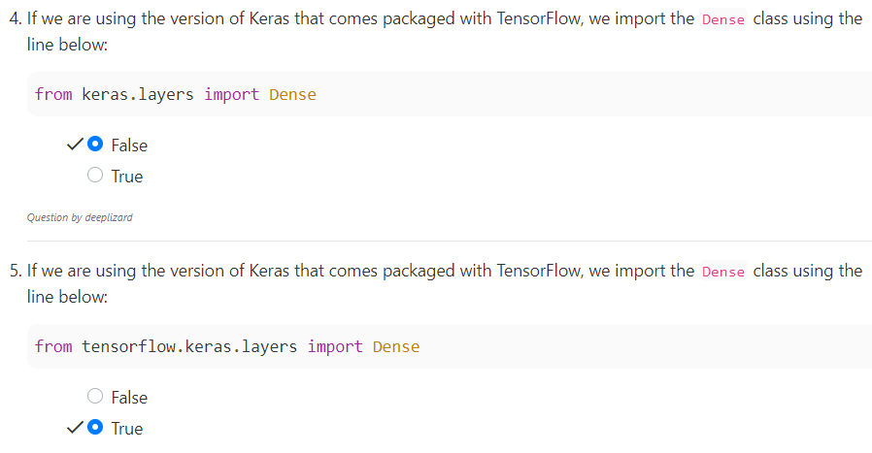
2.1 Quiz
https://www.youtube.com/watch?v=GCFmqet--Lc&list=PLZbbT5o_s2xrwRnXk_yCPtnqqo4_u2YGL&index=2
Quiz

Slide 12
End of Chapter

