Slide 1

3 Cuda
Peter H. Chen

Slide 2

3 Cuda
https://www.youtube.com/watch?v=IubEtS2JAiY&list=PLZbbT5o_s2xrwRnXk_yCPtnqqo4_u2YGL&index=3
How To Run Code On The GPU
We discuss the GPU support for Tensorflow, Keras API integration, and run GPU.
GPU Support For TensorFlow
TensorFlow code, including Keras, will transparently run on a single GPU with no explicit code configuration required.
TensorFlow GPU support is currently available for Ubuntu and Windows systems with CUDA-enabled cards.

Slide 3
3 Cuda
https://www.youtube.com/watch?v=IubEtS2JAiY&list=PLZbbT5o_s2xrwRnXk_yCPtnqqo4_u2YGL&index=3
Install CuDNN
Now we need to install the cuDNN SDK. Navigate again to Nvidia’s website.
https://developer.nvidia.com/developer-program/signup
To gain access to the download, you must first create a free account and go through a quick email verification.
Next, choose to download the version of cuDNN that corresponds to the TensorFlow-supported version of the CUDA Toolkit that you downloaded in the last step.
After download completes, the installation process requires moving the downloaded files into the appropriate locations within the CUDA Toolkit installation path on disk, as well as verifying environment variables. The detailed steps are discussed here, as well as in the corresponding video.

Slide 4
3 Cuda
https://www.youtube.com/watch?v=IubEtS2JAiY&list=PLZbbT5o_s2xrwRnXk_yCPtnqqo4_u2YGL&index=3
Verify Tensorflow Detect the GPU
How to install Cuda under Anaconda?
https://towardsdatascience.com/setup-an-environment-for-machine-learning-and-deep-learning-with-anaconda-in-windows-5d7134a3db10
We already setup the tensorflow under the Anaconda.
Now, we need to install Cuda under Analconda.

Slide 5
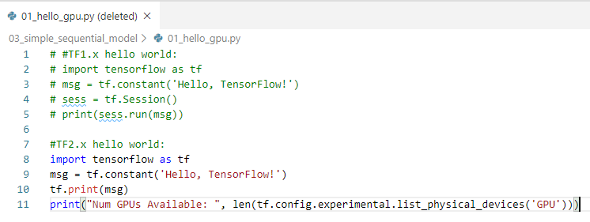

3 Cuda
https://www.youtube.com/watch?v=IubEtS2JAiY&list=PLZbbT5o_s2xrwRnXk_yCPtnqqo4_u2YGL&index=3
Verify Tensorflow Detect the GPU
How to install Cuda under Anaconda?
https://developer.nvidia.com/cuda-downloads
(base) > conda activate tf
(tf) > pip install tensorflow-gpu
(tf) > python 01_hello_gpu.py

Slide 6
3 Cuda
https://www.youtube.com/watch?v=IubEtS2JAiY&list=PLZbbT5o_s2xrwRnXk_yCPtnqqo4_u2YGL&index=3
Verify Tensorflow Detect the GPU
If the output is 1, then TensorFlow has successfully identified your GPU. If the output is 0, then it has not.

Slide 7
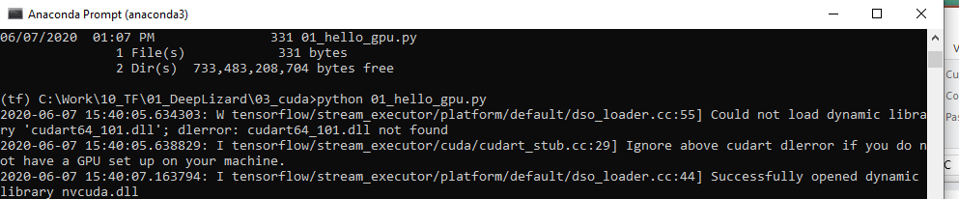
3 Cuda
https://www.youtube.com/watch?v=IubEtS2JAiY&list=PLZbbT5o_s2xrwRnXk_yCPtnqqo4_u2YGL&index=3
Verify Tensorflow Detect the GPU
If you receive a 0, then check the console from which you started your Jupyter Notebook for any messages. If you receive the error below, verify your CUDA environment variable as discussed in the cuDNN installation steps, restart your machine, and try again.
Note:
Tensorflow 2.0 cannot see the cuda dll library.

Slide 8
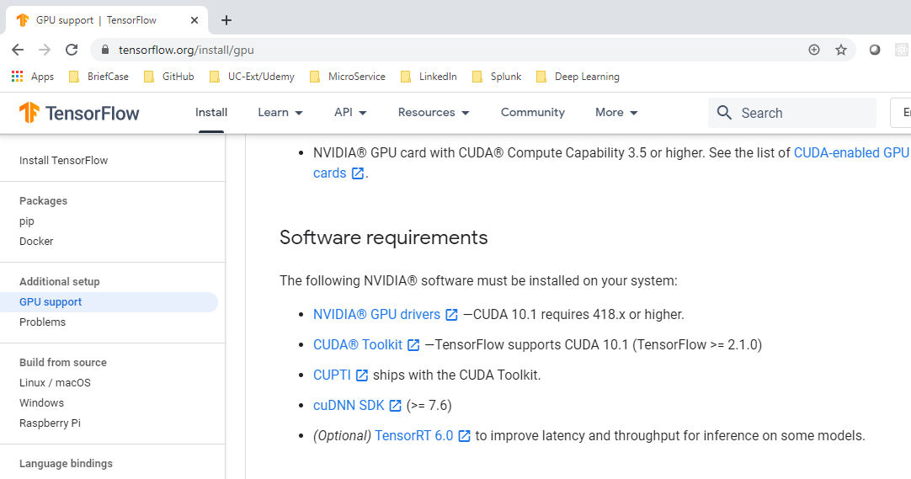
3 Cuda
https://www.youtube.com/watch?v=IubEtS2JAiY&list=PLZbbT5o_s2xrwRnXk_yCPtnqqo4_u2YGL&index=3
Verify Tensorflow Detect the GPU
Tenforflow.org/install/gpu
Tensorflow >= 2.1 only support Cuda 10.1 (Cuda 11.0 does not include cudart64_101.dll driver)

Slide 9
3 Cuda
https://www.youtube.com/watch?v=IubEtS2JAiY&list=PLZbbT5o_s2xrwRnXk_yCPtnqqo4_u2YGL&index=3
Verify Tensorflow Detect the GPU
To get cuDNN for neural network, we need to have account on NVIDIA.
NVIDIA account setup have error. Need support help to create an account.
Currently, I can only run TensorFlow without cuda.

Slide 10
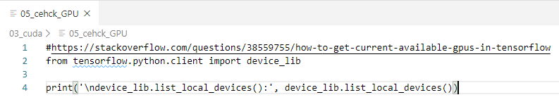
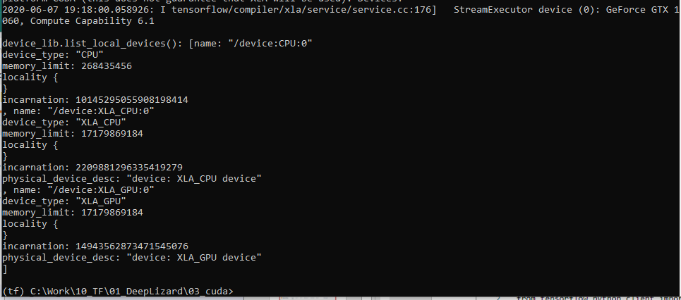
3 Cuda
https://www.youtube.com/watch?v=IubEtS2JAiY&list=PLZbbT5o_s2xrwRnXk_yCPtnqqo4_u2YGL&index=3
Verify Tensorflow Detect the GPU
https://stackoverflow.com/questions/38559755/how-to-get-current-available-gpus-in-tensorflow

Slide 11
3.1 Quiz

Slide 12
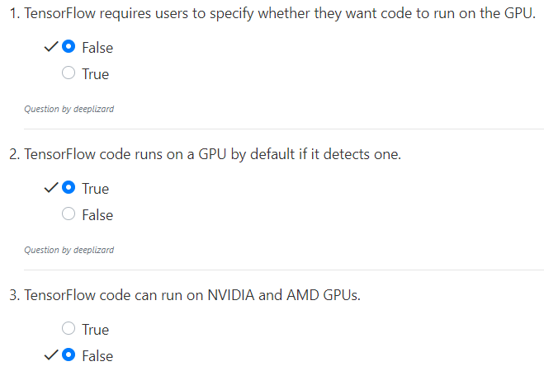
3.1 Quiz
https://www.youtube.com/watch?v=IubEtS2JAiY&list=PLZbbT5o_s2xrwRnXk_yCPtnqqo4_u2YGL&index=3
Quiz

Slide 13
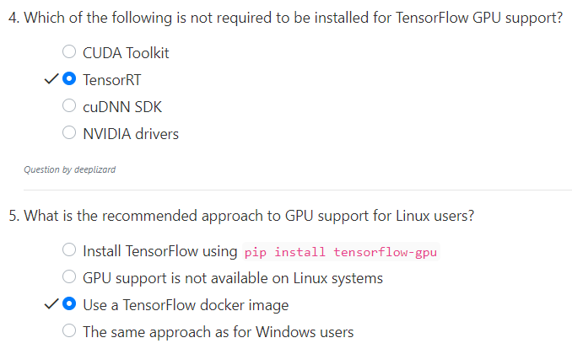
3.1 Quiz
https://www.youtube.com/watch?v=IubEtS2JAiY&list=PLZbbT5o_s2xrwRnXk_yCPtnqqo4_u2YGL&index=3
Quiz
Linux has to use docker image to run GPU

Slide 14
End of Chapter

