Slide 1

4 Data Process
Peter H. Chen

Slide 2
4 Data Process
https://www.youtube.com/watch?v=3FwGDUD_ZuQ&list=PLZbbT5o_s2xrwRnXk_yCPtnqqo4_u2YGL&index=4
Data Process for Neural Network Training
We discuss Data Processing for Neural Network Training.

Slide 3
4 Data Process
https://www.youtube.com/watch?v=3FwGDUD_ZuQ&list=PLZbbT5o_s2xrwRnXk_yCPtnqqo4_u2YGL&index=4
Samples And Labels
To train any neural network in a supervised learning task, we first need a data set of samples and the corresponding labels for those samples.
When referring to samples, we're just referring to the underlying data set, where each individual item or data point within that set is called a sample. Labels are the corresponding labels for the samples.
If we were to train a model to do sentiment analysis on headlines from a media source, for example, the corresponding label for each sample headline from the media source could be “positive” or “negative.”
If we were training a model on images of cats and dogs, then the label for each of the images would either be “cat” or “dog.”
Note that in deep learning, samples are also commonly referred to as input data or inputs, and labels are also commonly referred to as target data or targets.
Note:
Samples = data = inputs
Labels = target data = targets

Slide 4
4 Data Process
https://www.youtube.com/watch?v=3FwGDUD_ZuQ&list=PLZbbT5o_s2xrwRnXk_yCPtnqqo4_u2YGL&index=4
Expected Data Format
When preparing data, we first need to understand the format that the data need to be in for the end goal we have in mind. In our case, we want our data to be in a format that we can pass to a neural network model.
The first model we'll build in an upcoming episode will be a Sequential model from the Keras API integrated within TensorFlow.
We'll discuss the details of this type of model in that future episode, but for now, we just need to understand the type of data that is expected by a Sequential model.
The Sequential model receives data during training, which occurs when we call the fit() function on the model. Therefore, we need to check the type of data this function expects.

Slide 5
4 Data Process
https://www.youtube.com/watch?v=3FwGDUD_ZuQ&list=PLZbbT5o_s2xrwRnXk_yCPtnqqo4_u2YGL&index=4
Expected Data Format
Per the documentation of the fit() function, the input data x need to be one of the following data types.
A Numpy array (or array-like), or a list of arrays (in case the model has multiple inputs).
A TensorFlow tensor, or a list of tensors (in case the model has multiple inputs).A dict mapping input names to the corresponding array/tensors, if the model has named inputs.
A tf.data dataset. Should return a tuple of either (inputs, targets) or (inputs, targets, sample_weights).
A generator or keras.utils.Sequence returning (inputs, targets) or (inputs, targets, sample_weights).
So, when we aggregate our data, we need to ensure that it is contained in one of the above types of data structures. The corresponding labels y for the data are expected to be formatted similarly.

Slide 6
4 Data Process
https://www.youtube.com/watch?v=3FwGDUD_ZuQ&list=PLZbbT5o_s2xrwRnXk_yCPtnqqo4_u2YGL&index=4
Expected Data Format
Like the input data x, the corresponding label data y can also either be a Numpy array(s) or TensorFlow tensor(s). Note, y should be consistent with x. We cannot have Numpy samples and tensor labels, or vice-versa.
Note that if x is a dataset, generator, or keras.utils.Sequence instance, y should not be specified (since labels will be obtained from x). We'll see examples of this later in the course.
Aside from formatting the data to make the it meet the format required by the model, another reason to format or process the data is to transform it in such a way that it that may make it easier, faster, or more efficient for the network to learn from. We can do this through data normalization or standardization techniques.

Slide 7
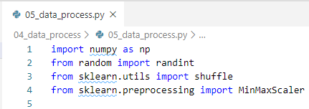
4 Data Process
https://www.youtube.com/watch?v=3FwGDUD_ZuQ&list=PLZbbT5o_s2xrwRnXk_yCPtnqqo4_u2YGL&index=4
Process Data In Code
Data processing for deep learning will vary greatly depending on the type of data we're working with and the type of task we'll be using the network for.
We'll start out with a very simple classification task using a simple numerical data set. Later in the course, we'll work with other types of data and other tasks.
We first need to import the libraries we’ll be working with.

Slide 8

4 Data Process
https://www.youtube.com/watch?v=3FwGDUD_ZuQ&list=PLZbbT5o_s2xrwRnXk_yCPtnqqo4_u2YGL&index=4
Process Data In Code
Next, we create two empty lists.
One will hold the input data, the other will hold the target data.

Slide 9
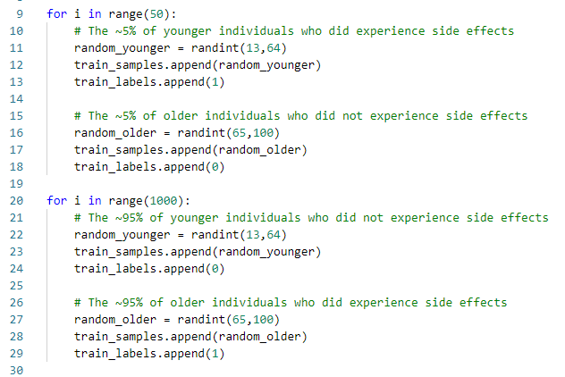
4 Data Process
https://www.youtube.com/watch?v=3FwGDUD_ZuQ&list=PLZbbT5o_s2xrwRnXk_yCPtnqqo4_u2YGL&index=4
Data Creation
Create example data set of an experimental drug test
Total number of trial had 2100 participants.
Age is ranging from age 13 to 100.
50% participants were under 65 years old (13 to 49), and 50% was 65 years of age or older (65 to 100).
95% of patients 65 or older experienced side effects from the drug
95% of patients under 65 experienced no side effects..

Slide 10
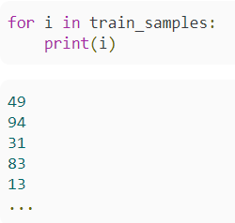
4 Data Process
https://www.youtube.com/watch?v=3FwGDUD_ZuQ&list=PLZbbT5o_s2xrwRnXk_yCPtnqqo4_u2YGL&index=4
Data Creation
This code creates 2100 samples and stores the age of the individuals in the train_samples list and stores whether or not the individuals experienced side effects in the train_labels list.
This is what the train_samples data looks like.

Slide 11
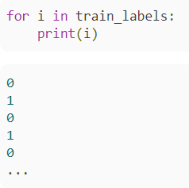
4 Data Process
https://www.youtube.com/watch?v=3FwGDUD_ZuQ&list=PLZbbT5o_s2xrwRnXk_yCPtnqqo4_u2YGL&index=4
Data Creation
This is just ages ranging anywhere from 13 to 100 years old.
This is what the train_labels look like.
A 0 indicates that an individual did not experience a side effect, and a 1 indicates that an individual did experience a side effect.

Slide 12

4 Data Process
https://www.youtube.com/watch?v=3FwGDUD_ZuQ&list=PLZbbT5o_s2xrwRnXk_yCPtnqqo4_u2YGL&index=4
Data Processing
We now convert both lists into numpy arrays due to what we discussed the fit() function expects, and we then shuffle the arrays to remove any order that was imposed on the data during the creation process.

Slide 13
4 Data Process
https://www.youtube.com/watch?v=3FwGDUD_ZuQ&list=PLZbbT5o_s2xrwRnXk_yCPtnqqo4_u2YGL&index=4
Data Processing
In this form, we now have the ability to pass the data to the model because it is now in the required format, however, before doing that, we'll first scale the data down to a range from 0 to 1.
We'll use scikit-learn’s MinMaxScaler class to scale all of the data down from a scale ranging from 13 to 100 to be on a scale from 0 to 1.
We reshape the data as a technical requirement just since the fit_transform() function doesn’t accept 1D data by default.

Slide 14
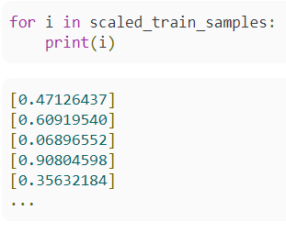
4 Data Process
https://www.youtube.com/watch?v=3FwGDUD_ZuQ&list=PLZbbT5o_s2xrwRnXk_yCPtnqqo4_u2YGL&index=4
Data Processing
Now that the data has been scaled, let’s iterate over the scaled data to see what it looks like now.

Slide 15
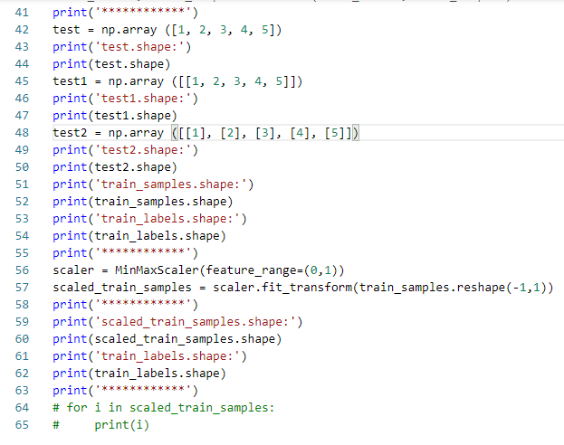
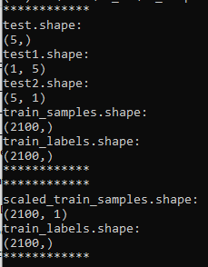
4 Data Process
https://www.youtube.com/watch?v=3FwGDUD_ZuQ&list=PLZbbT5o_s2xrwRnXk_yCPtnqqo4_u2YGL&index=4
Kera Code

Slide 16
4 Data Process
https://www.youtube.com/watch?v=3FwGDUD_ZuQ&list=PLZbbT5o_s2xrwRnXk_yCPtnqqo4_u2YGL&index=4
Kera Code

Slide 17
4.1 Quiz

Slide 18
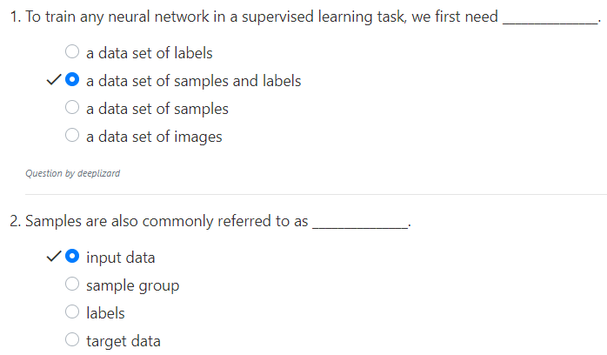
4.1 Quiz
https://www.youtube.com/watch?v=3FwGDUD_ZuQ&list=PLZbbT5o_s2xrwRnXk_yCPtnqqo4_u2YGL&index=4
Quiz
Samples = input data = inputs

Slide 19
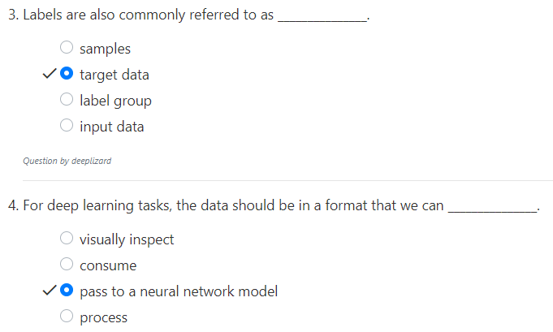
4.1 Quiz
https://www.youtube.com/watch?v=3FwGDUD_ZuQ&list=PLZbbT5o_s2xrwRnXk_yCPtnqqo4_u2YGL&index=4
Quiz
Labels = target data = targets

Slide 20
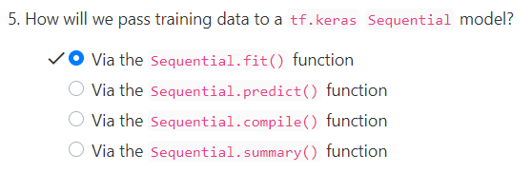
4.1 Quiz
https://www.youtube.com/watch?v=3FwGDUD_ZuQ&list=PLZbbT5o_s2xrwRnXk_yCPtnqqo4_u2YGL&index=4
Quiz

Slide 21
End of Chapter

