Slide 1

5 ANN Keras
Peter H. Chen

Slide 2
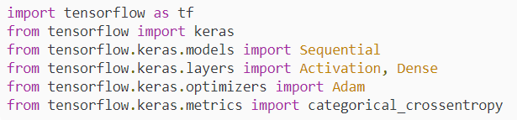
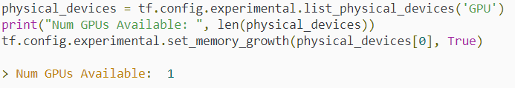
5 ANN Keras
https://www.youtube.com/watch?v=Boo6SmgmHuM&list=PLZbbT5o_s2xrwRnXk_yCPtnqqo4_u2YGL&index=5
Create Artificial Neural Network with Keras
We discuss how to create artificial Neural Network with Keras.
Code Setup
Import libraries
Enable memory growth of GPU.

Slide 3

5 ANN Keras
https://www.youtube.com/watch?v=Boo6SmgmHuM&list=PLZbbT5o_s2xrwRnXk_yCPtnqqo4_u2YGL&index=5
First Hidden Layer
Our first hidden layer I a Dense Layer. This type of layer is our standard fully-connected or densely-connected neural network layer.
The first required parameter that the Dense layer expect is the number of neurons or units the layer has, and we arbitrarily setting this to 16.
The model needs to know the shape of the input data.
We specify the shape of the input data in the first hidden layer. The parameter called input_shape.
The will be training our network on data. The data is one-dimensional. The input_shaep parameter expects a tuple of integers that matched the shape of the input data. (1,) for input_shape of our one-dimensional data.
The input_shape is an implicit input layer.
We do not explicitly create the input layer. The first Dense layer is acutally the firs hidden layer.

Slide 4
5 ANN Keras
https://www.youtube.com/watch?v=Boo6SmgmHuM&list=PLZbbT5o_s2xrwRnXk_yCPtnqqo4_u2YGL&index=5
First Hidden Layer
Our first hidden layer I a Dense Layer. This type of layer is our standard fully-connected or densely-connected neural network layer.
The first required parameter that the Dense layer expect is the number of neurons or units the layer has, and we arbitrarily setting this to 16.
The model needs to know the shape of the input data.
We specify the shape of the input data in the first hidden layer. The parameter called input_shape.
The will be training our network on data. The data is one-dimensional. The input_shape parameter expects a tuple of integers that matched the shape of the input data. (1,) for input_shape of our one-dimensional data.
The input_shape is an implicit input layer.
We do not explicitly create the input layer. The first Dense layer is acutally the firs hidden layer.

Slide 5
5 ANN Keras
https://www.youtube.com/watch?v=Boo6SmgmHuM&list=PLZbbT5o_s2xrwRnXk_yCPtnqqo4_u2YGL&index=5
First Hidden Layer
We set the optional parameter is activation=‘relu’.
If you do not specify the activation function, Keras wull use the linear activation function.

Slide 6
5 ANN Keras
https://www.youtube.com/watch?v=Boo6SmgmHuM&list=PLZbbT5o_s2xrwRnXk_yCPtnqqo4_u2YGL&index=5
Second Hidden Layer
The second hidden layer is also the Dense layer.
It is 32 nodes.
How my neurons? It is also arbitrary.
We create the simple model and then test and experiment with it.
If we notice that it is insufficient, we can troubleshoot the issues and experiment and change the number of layers, nodes, and etc.
The Dense layer will also have relu as the activation function.

Slide 7
5 ANN Keras
https://www.youtube.com/watch?v=Boo6SmgmHuM&list=PLZbbT5o_s2xrwRnXk_yCPtnqqo4_u2YGL&index=5
Output Layer
The output layer is also a Dense Layer.
The output layer have 2 neurons. This because we have two possible outputs, either a patient experience side effect, or the patient did not have experience side effect.
The Activation function we use is softmax, which will give us a probability distribution among the possible outputs.

Slide 8

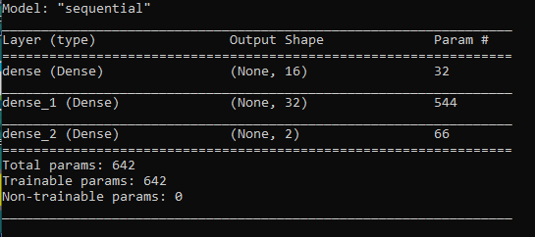
5 ANN Keras
https://www.youtube.com/watch?v=Boo6SmgmHuM&list=PLZbbT5o_s2xrwRnXk_yCPtnqqo4_u2YGL&index=5
Model Summary
Model.summary() is used to visualize the model.

Slide 9
5.1 Quiz

Slide 10
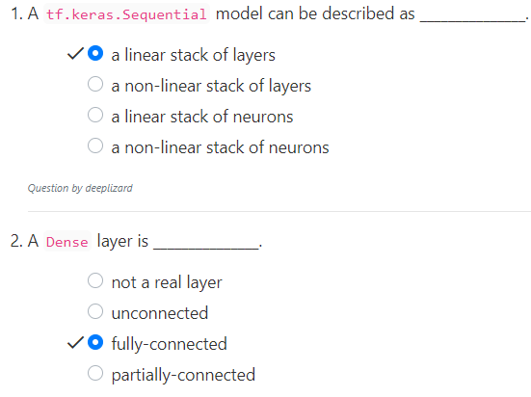
5.1 Quiz
https://www.youtube.com/watch?v=Boo6SmgmHuM&list=PLZbbT5o_s2xrwRnXk_yCPtnqqo4_u2YGL&index=5
Quiz

Slide 11
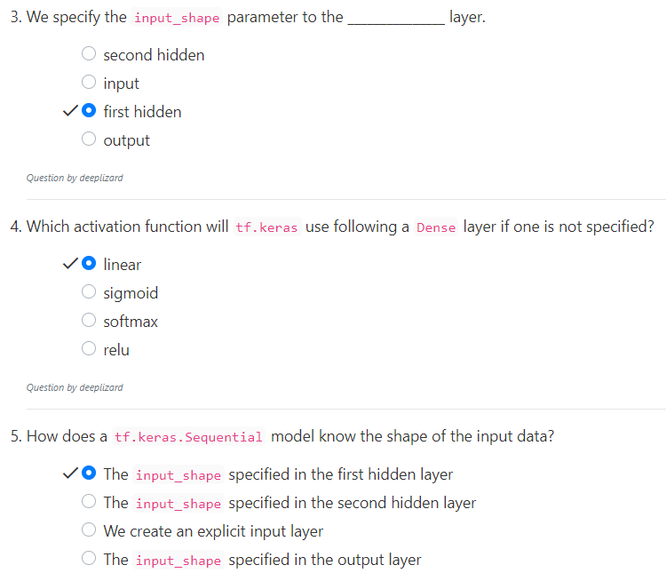
5.1 Quiz
https://www.youtube.com/watch?v=Boo6SmgmHuM&list=PLZbbT5o_s2xrwRnXk_yCPtnqqo4_u2YGL&index=5
Quiz

Slide 12
End of Chapter

