Slide 1

6 ANN Train
Peter H. Chen

Slide 2
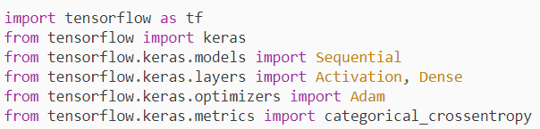
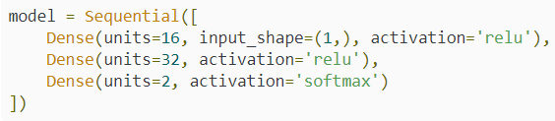
6 ANN Train
https://www.youtube.com/watch?v=EHbay6hDZGA&list=PLZbbT5o_s2xrwRnXk_yCPtnqqo4_u2YGL&index=6
Import the libraries
Build model:

Slide 3
6 ANN Train
https://www.youtube.com/watch?v=EHbay6hDZGA&list=PLZbbT5o_s2xrwRnXk_yCPtnqqo4_u2YGL&index=6
Compile the Model
We compile the model ready to training by compile() function.
model.compile(optimizer=Adam(learning_rate=0.0001), loss='sparse_categorical_crossentropy', metrics=['accuracy'])
This function configures the model for training and expects a number of parameters.
First parameter: optimizer
optimizer = Adam. Adam accepts an optional parameter learning_rate = 0.0001.
https://deeplizard.com/learn/video/jWT-AX9677k
The gradients will then get multiplied by the learning rate: gradients * learning rate
The learning_rate is a small number between 0.01 and 0.0001.
Weight Update: new weight = old weight – (learning rate * gradient)

Slide 4
6 ANN Train
https://www.youtube.com/watch?v=EHbay6hDZGA&list=PLZbbT5o_s2xrwRnXk_yCPtnqqo4_u2YGL&index=6
Compile the Model
model.compile(optimizer=Adam(learning_rate=0.0001), loss='sparse_categorical_crossentropy', metrics=['accuracy'])
Second parameter: loss
Parameter loss set to ‘sparse_categorical_crossentropy’ for integer format. The output is two classes (experience with side effect or have no experience with side effect). We can have one output instead of two classes.
If we used one output, we use ‘binary_crossentropy’. If we have two classes, we use ‘categorical_crossentropy’. Both option can achieve the same result.
With ‘binrary_crossentropy’, the last layer use ‘sigmoid’ function.
Third parameter: metrics
Use metrics form to evaluate the training and testing result. Set to accuracy.

Slide 5
6 ANN Train
https://www.youtube.com/watch?v=EHbay6hDZGA&list=PLZbbT5o_s2xrwRnXk_yCPtnqqo4_u2YGL&index=6
Training the Model
After the model is compiled, we can train it by fit() function.
model.fit(x=scaled_train_samples, y=train_labels, batch_size=10, epochs=30, verbose=2)
The first parameter the training set x. x = scaled_train_samples.
The second parameter is training set y. y = train_labels.
The third parameter is batch_size. It process the data into 10 batches.
The fourth parameter is epoch. Epoch set to 30 times. We run 30 times for batches of data we passed into class Network().
The fifth parameter is verbose, 0 for least verbose and 2 for most verbose.

Slide 6
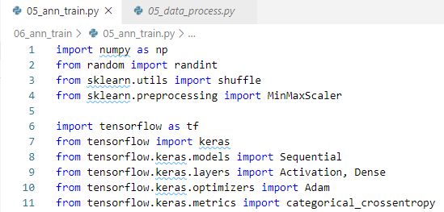
6 ANN Train
https://www.youtube.com/watch?v=EHbay6hDZGA&list=PLZbbT5o_s2xrwRnXk_yCPtnqqo4_u2YGL&index=6
Keras Code:
Import libraries.

Slide 7
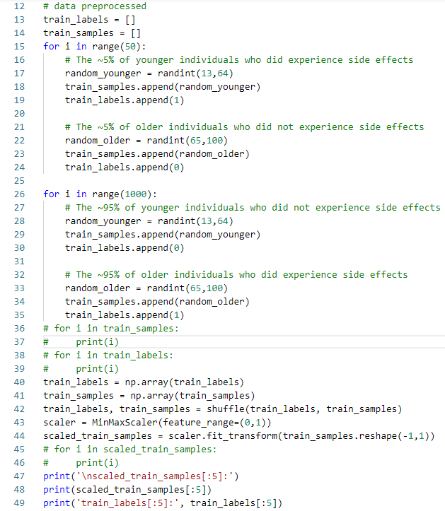
6 ANN Train
https://www.youtube.com/watch?v=EHbay6hDZGA&list=PLZbbT5o_s2xrwRnXk_yCPtnqqo4_u2YGL&index=6
Keras Code:
Prepare data:

Slide 8
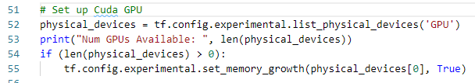
6 ANN Train
https://www.youtube.com/watch?v=EHbay6hDZGA&list=PLZbbT5o_s2xrwRnXk_yCPtnqqo4_u2YGL&index=6
Keras Code:
Setup Cuda GPU:

Slide 9
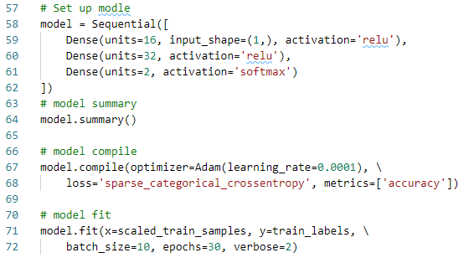
6 ANN Train
https://www.youtube.com/watch?v=EHbay6hDZGA&list=PLZbbT5o_s2xrwRnXk_yCPtnqqo4_u2YGL&index=6
Keras Code:
Setup Model, model summary, compile model into static graph, model fit data.

Slide 10
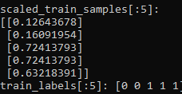
6 ANN Train
https://www.youtube.com/watch?v=EHbay6hDZGA&list=PLZbbT5o_s2xrwRnXk_yCPtnqqo4_u2YGL&index=6
Keras Code:
Prepared Data Result:

Slide 11
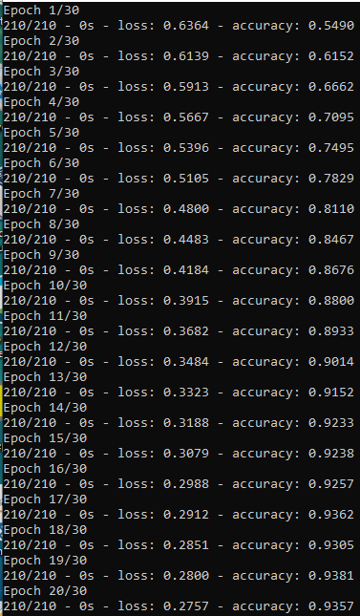
6 ANN Train
https://www.youtube.com/watch?v=EHbay6hDZGA&list=PLZbbT5o_s2xrwRnXk_yCPtnqqo4_u2YGL&index=6
Keras Code:
Simulation for 30 epoch.
The accuracy improved from 5.4490 to 0.6, 0.7, 0.8, 0.9, and etc.

Slide 12
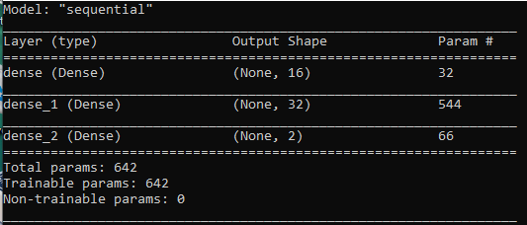
6 ANN Train
https://www.youtube.com/watch?v=EHbay6hDZGA&list=PLZbbT5o_s2xrwRnXk_yCPtnqqo4_u2YGL&index=6
Keras Code:
Model Summary:

Slide 13
6.1 Quiz

Slide 14
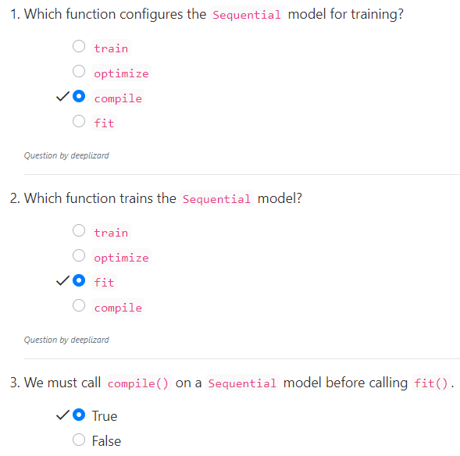
6.1 Quiz
https://www.youtube.com/watch?v=EHbay6hDZGA&list=PLZbbT5o_s2xrwRnXk_yCPtnqqo4_u2YGL&index=6
Quiz

Slide 15
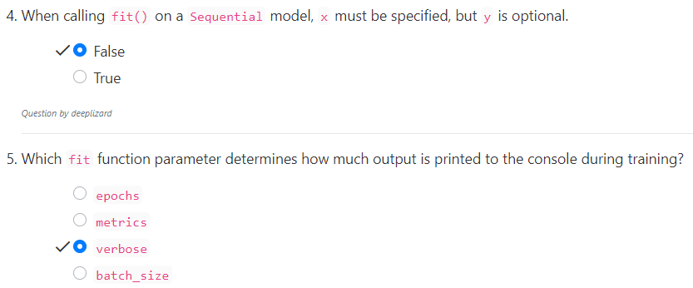
6.1 Quiz
https://www.youtube.com/watch?v=EHbay6hDZGA&list=PLZbbT5o_s2xrwRnXk_yCPtnqqo4_u2YGL&index=6
Quiz

Slide 16
End of Chapter

