Slide 1

7 Validate
Peter H. Chen

Slide 2
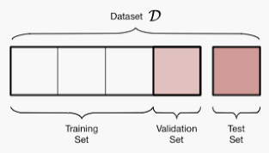
7 Validate
https://www.youtube.com/watch?v=dzoh8cfnvnI&list=PLZbbT5o_s2xrwRnXk_yCPtnqqo4_u2YGL&index=7
Validate
We create validation set on-the-fly during training.
What is a Validation Set?
Validation dataset is part of training dataset.
We build a validate dataset to train our model.
Before the training begins, we can remove part of the training set and place them into validation set. During the training, the model will only use the training dataset to train. We use the validation dataset to validate the model by the data.
(60%)
(20%)
(20%)

Slide 3
7 Validate
https://www.youtube.com/watch?v=dzoh8cfnvnI&list=PLZbbT5o_s2xrwRnXk_yCPtnqqo4_u2YGL&index=7
What is a Validation?
The data model learn and train from the features data in the training dataset.
The model is used to predict the data by the validate dataset.
During each epoch of the training and validation, we see both loss and accuracy results.
The validation dataset is used to see how well of the model which is generalizing on the training dataset. The validation dataset is not part of training dataset.
The training dataset can be used to see the model is underfitting.
The validation dataset is used to see the model is overfitting. Overfitting occurs when specific training data is fit but not generalized well on validation dataset.
(60%)
(20%)
(20%)

Slide 4
7 Validate
https://www.youtube.com/watch?v=dzoh8cfnvnI&list=PLZbbT5o_s2xrwRnXk_yCPtnqqo4_u2YGL&index=7
Create a Validation Dataset
There are two ways to create a validate set.
The first way is to create a separate dataset to hold validation dataset.
The data structure is a tuple valid_set = (x_val, y_val) of Numpy array or tensors.
When we call model.fit(), we pass in validation data set in the parameters.
model.fit(x=scaled_train_samples, y=train_labels, validation_data=valid_set, batch_size=10, epochs=30, verbose=2)
When we train model, we only use the x=scaled_traing_samples and y=train_labels and it also validate the data.

Slide 5
7 Validate
https://www.youtube.com/watch?v=dzoh8cfnvnI&list=PLZbbT5o_s2xrwRnXk_yCPtnqqo4_u2YGL&index=7
Create a Validation Dataset
The second way is to use model.fit(). We can use validation_split parameter to split out the validation dataset.
Below example split 0.1 out of the training set into validation dataset.
model.fit(x=scaled_train_samples, y=train_labels, validation_split=0.1, batch_size=10, epochs=30, verbose=2)
Note:
The fit() function shuffles the data before each epoch by default.
When specifying the valiation_split parameter, however, the validation data is selected from the last samples in the x and y data before shuffling.

Slide 6
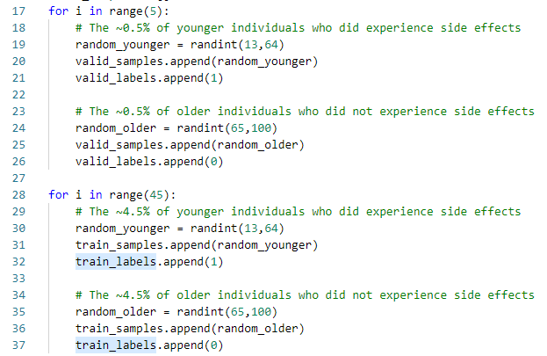
7 Validate
https://www.youtube.com/watch?v=dzoh8cfnvnI&list=PLZbbT5o_s2xrwRnXk_yCPtnqqo4_u2YGL&index=7
Keras code for Validation spit:
Frist way: separate structure

Slide 7
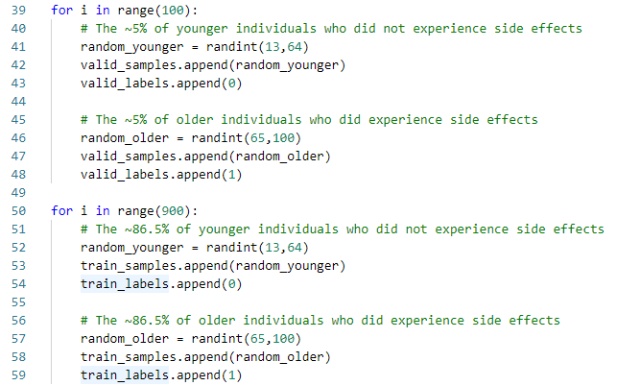
7 Validate
https://www.youtube.com/watch?v=dzoh8cfnvnI&list=PLZbbT5o_s2xrwRnXk_yCPtnqqo4_u2YGL&index=7
Keras code for Validation spit:
Frist way: separate structure

Slide 8
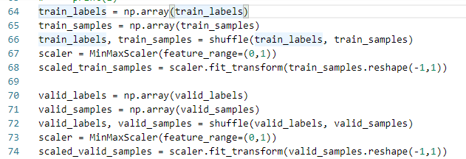

7 Validate
https://www.youtube.com/watch?v=dzoh8cfnvnI&list=PLZbbT5o_s2xrwRnXk_yCPtnqqo4_u2YGL&index=7
Keras code for Validation spit:
Frist way: separate structure

Slide 9

7 Validate
https://www.youtube.com/watch?v=dzoh8cfnvnI&list=PLZbbT5o_s2xrwRnXk_yCPtnqqo4_u2YGL&index=7
Keras code for Validation spit:
Second way: split in the model.fit()

Slide 10
7.1 Quiz

Slide 11
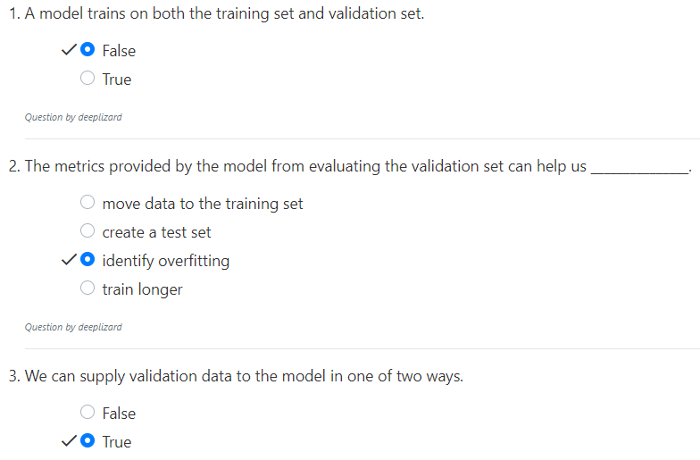
7.1 Quiz
https://www.youtube.com/watch?v=dzoh8cfnvnI&list=PLZbbT5o_s2xrwRnXk_yCPtnqqo4_u2YGL&index=7
Quiz

Slide 12
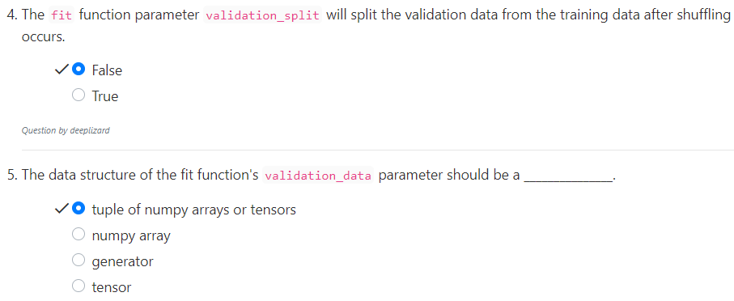
7.1 Quiz
https://www.youtube.com/watch?v=dzoh8cfnvnI&list=PLZbbT5o_s2xrwRnXk_yCPtnqqo4_u2YGL&index=7
Quiz

Slide 13
End of Chapter

