Slide 1

10 Save and Load
Peter H. Chen

Slide 2
10 Save and Load
https://www.youtube.com/watch?v=km7pxKy4UHU&list=PLZbbT5o_s2xrwRnXk_yCPtnqqo4_u2YGL&index=9
Save and Load
This save functions saves:
The architecture of the model, allowing to re-create the model.
The weights of the model.
The training configuration (loss, optimizer).
The state of the optimizer, allowing to resume training exactly where you left off.
The code examples we created:
model.save()
Model.to_json()
model.save_weight()

Slide 3
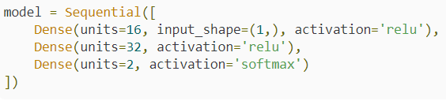
10 Save and Load
https://www.youtube.com/watch?v=km7pxKy4UHU&list=PLZbbT5o_s2xrwRnXk_yCPtnqqo4_u2YGL&index=9
Save and Load
We discuss how to save and Load a tf.keras.Sequential neural network.
We create and train this model:

Slide 4
10 Save and Load
https://www.youtube.com/watch?v=km7pxKy4UHU&list=PLZbbT5o_s2xrwRnXk_yCPtnqqo4_u2YGL&index=9
Save Keras Model
If we want to save a model at its current state after it was trained so that we could make use of it later, we can call the save() function on the model.
To save(), we pass in the file path and name of the file we want to save the model to with an h5 extension

Slide 5
10 Save and Load
https://www.youtube.com/watch?v=km7pxKy4UHU&list=PLZbbT5o_s2xrwRnXk_yCPtnqqo4_u2YGL&index=9
Load Keras Model
Now that we have this model saved, we can load the model at a later time.
To do so, we first import the load_model() function. Then, we can call the function to load the model by pointing to the saved model on disk.

Slide 6
10 Save and Load
https://www.youtube.com/watch?v=km7pxKy4UHU&list=PLZbbT5o_s2xrwRnXk_yCPtnqqo4_u2YGL&index=9
Very Load Model
We can also inspect attributes about the model, like the optimizer and loss by calling model.optimizer and model.loss on the loaded model and compare the results to the previously saved model.

Slide 7
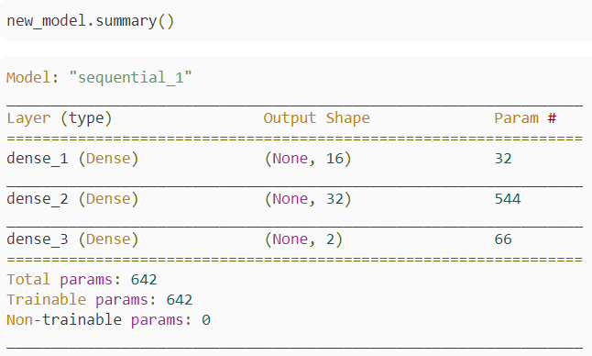
10 Save and Load
https://www.youtube.com/watch?v=km7pxKy4UHU&list=PLZbbT5o_s2xrwRnXk_yCPtnqqo4_u2YGL&index=9
Very Load Model
We can verify that the loaded model has the same architecture and weights as the saved model by calling summary() and get_weights() on the model.

Slide 8

10 Save and Load
https://www.youtube.com/watch?v=km7pxKy4UHU&list=PLZbbT5o_s2xrwRnXk_yCPtnqqo4_u2YGL&index=9
Save and Load of Architecture
There is another way we save only the architecture of the model. This will not save the model weights, configurations, optimizer, loss or anything else. This only saves the architecture of the model.
We can do this by calling model.to_json(). This will save the architecture of the model as a JSON string. If we print out the string, we can see exactly what this looks like.

Slide 9

10 Save and Load
https://www.youtube.com/watch?v=km7pxKy4UHU&list=PLZbbT5o_s2xrwRnXk_yCPtnqqo4_u2YGL&index=9
Save and Load of Architecture
Now that we have this saved, we can create a new model from it.
First we’ll import the needed model_from_json function, and then we can load the model architecture.

Slide 10
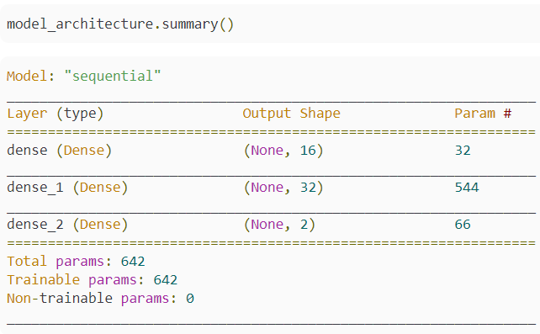
10 Save and Load
https://www.youtube.com/watch?v=km7pxKy4UHU&list=PLZbbT5o_s2xrwRnXk_yCPtnqqo4_u2YGL&index=9
By printing the summary of the model, we can verify that the new model has the same architecture of the model that was previously saved.

Slide 11
10 Save and Load
https://www.youtube.com/watch?v=km7pxKy4UHU&list=PLZbbT5o_s2xrwRnXk_yCPtnqqo4_u2YGL&index=9
Note, we can also use this same approach to saving and loading the model architecture to and from a YAML string.
To do so, we use the funtions to_yaml() and model_from_yaml() in the same fashion as we called the json functions.

Slide 12

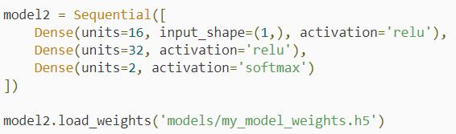
10 Save and Load
https://www.youtube.com/watch?v=km7pxKy4UHU&list=PLZbbT5o_s2xrwRnXk_yCPtnqqo4_u2YGL&index=9
Saving And Loading The Weights Of The Model
The last saving mechanism we’ll discuss only saves the weights of the model.
We can do this by calling model.save_weights() and passing in the path and file name to save the weights to with an h5 extension.
At a later point, we could then load the saved weights in to a new model, but the new model will need to have the same architecture as the old model before the weights can be saved.

Slide 13
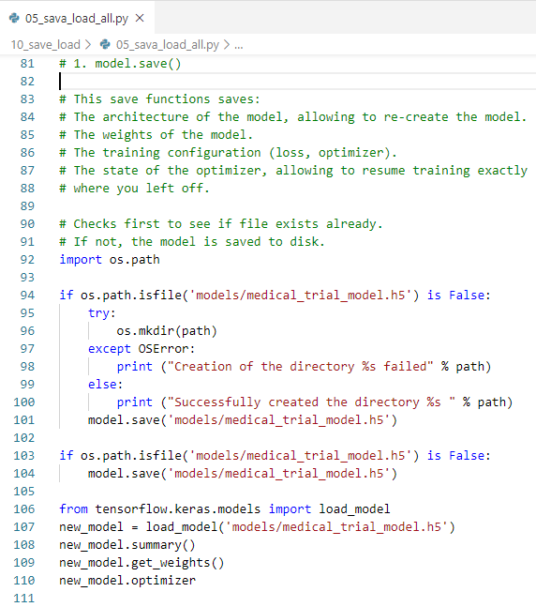
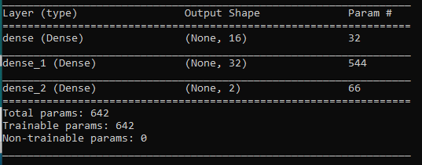
10 Save and Load
https://www.youtube.com/watch?v=km7pxKy4UHU&list=PLZbbT5o_s2xrwRnXk_yCPtnqqo4_u2YGL&index=9
Keras Code for Save and Load:
model.save()
load_model()

Slide 14
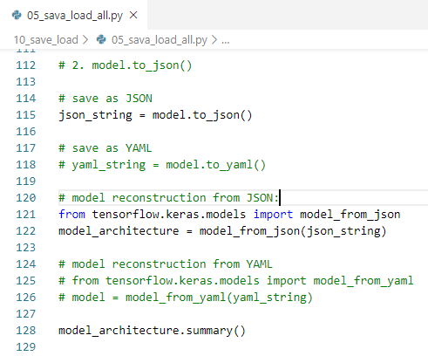
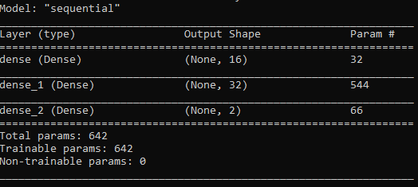
10 Save and Load
https://www.youtube.com/watch?v=km7pxKy4UHU&list=PLZbbT5o_s2xrwRnXk_yCPtnqqo4_u2YGL&index=9
Keras Code for save json:
model.to_json()
model_from_json()

Slide 15
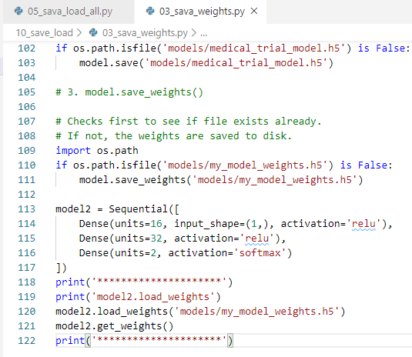

10 Save and Load
https://www.youtube.com/watch?v=km7pxKy4UHU&list=PLZbbT5o_s2xrwRnXk_yCPtnqqo4_u2YGL&index=9
Keras Code for Save weight:
model.to_weights()
Model.get_weights()

Slide 16
10.1 Quiz

Slide 17
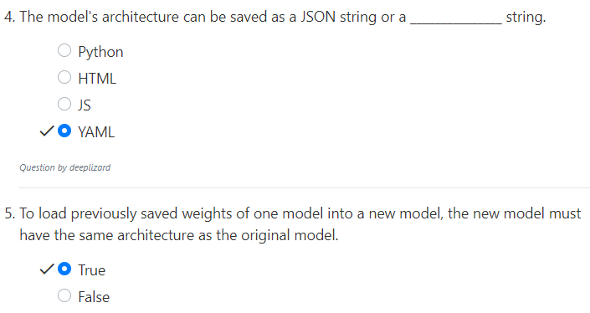
10.1 Quiz
https://www.youtube.com/watch?v=km7pxKy4UHU&list=PLZbbT5o_s2xrwRnXk_yCPtnqqo4_u2YGL&index=9
Quiz

Slide 18
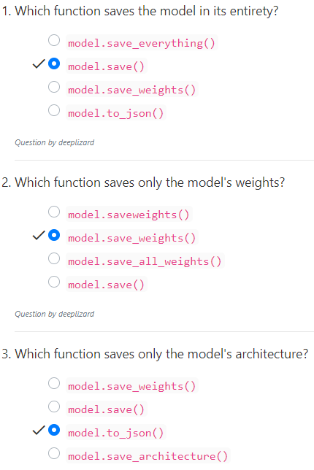
10.1 Quiz
https://www.youtube.com/watch?v=km7pxKy4UHU&list=PLZbbT5o_s2xrwRnXk_yCPtnqqo4_u2YGL&index=9
Quiz

Slide 19
End of Chapter

