Slide 1

80 Build gem5-alddin/test_load_test
Peter H. Chen

Slide 2
80 Build gem5-alddin/test_load_test
https://github.com/harvard-acc/gem5-aladdin
Build Gem5-Alddin test_load_store
Below are the description of instructions to build the integration tests provided by Gem5-Aladdin Team Sam Xi.
gem5-cpu: Builds a version of the binary that runs on the CPU in gem5
gem5-accel: Builds a version of the binary that runs the accelerated function in Aladdin and the rest on the CPU.
gem: Builds both gem5-cpu and gem5-accel.
dma-trace-binary: Builds a version of the binary that is instrumented with LLVM-Tracer. Run this binary to generate a new dynamic_trace.gz. This binary is NOT meant to be simulated in gem5, so do not replace this with test_load_store - they serve completely different purposes.

Slide 3
80 Build gem5-alddin/test_load_store
https://github.com/harvard-acc/gem5-aladdin
Build Gem5-Alddin test_load_store
So, to rebuild and rerun a simulation of one of the integration tests:
> make clean
> make dma-trace-binary
> ./test_load_store-instrumented # This will generate a new dynamic_trace.gz
> make gem5-accel
> sh run.sh

Slide 4
80.1 make clean

Slide 5
80.1 make clean
https://github.com/harvard-acc/gem5-aladdin
Make clean
> ls
> make clean

Slide 6
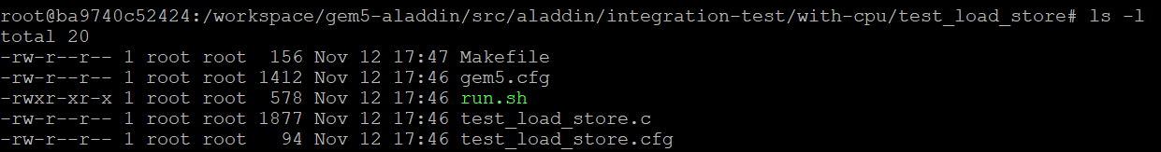
80.1 make clean
https://github.com/harvard-acc/gem5-aladdin
Make dma-trace-binary
> ls -l
Before compile, we have
1. Makefile
2. test_load_store.c
3. gem5.cfg: Gem5 Configuration
4. test_load_store.cfg: test load and store configuration
5. run.sh: run the test

Slide 7
80.2 make dma-trace-binary

Slide 8
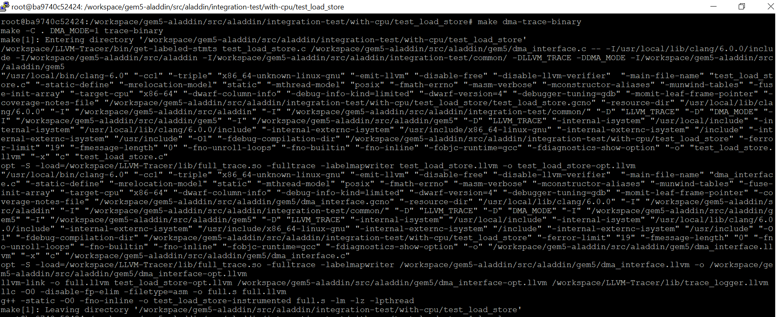
80.2 make dma-trace-binary
https://github.com/harvard-acc/gem5-aladdin
Make dma-trace-binary
> make dma-trace-binary

Slide 9
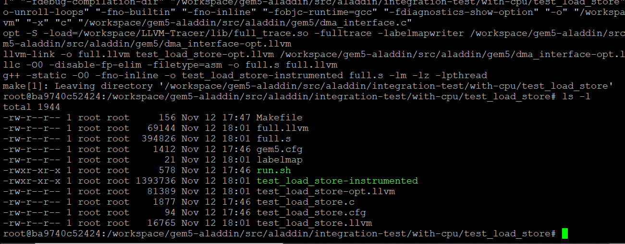
80.2 make dma-trace-binary
https://github.com/harvard-acc/gem5-aladdin
Make dma-trace-binary
> ls -l
dma trace binaries are generated:
1. full.llvm
2. full.s
3. lablemap
4. test_load_store-instrumented
5. test_load_store-opt.llvm
6. test_load_store.llvm

Slide 10
80.3 Generate Trace

Slide 11
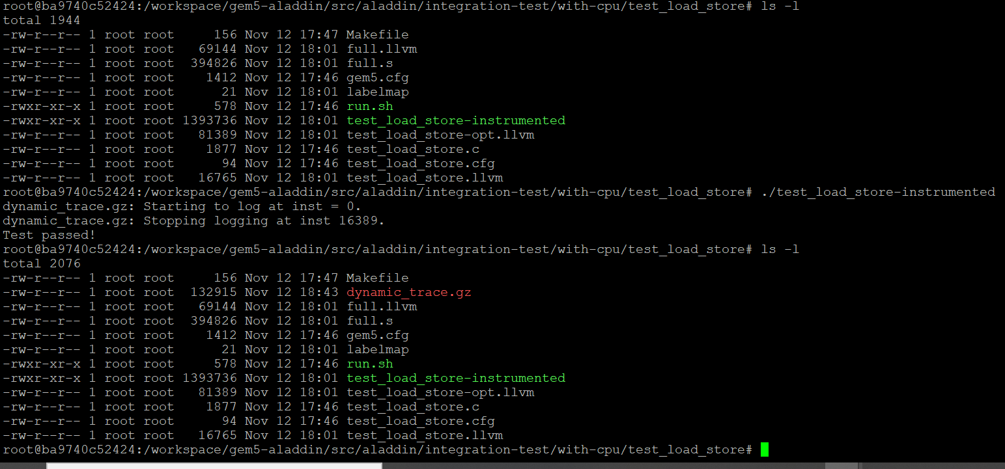
80.3 Generate Trace
https://github.com/harvard-acc/gem5-aladdin
Generate Trace
We use instrumented binary to generate the dynamic trace
> ./test_load_store-instrumented # This will generate a new dynamic_trace.gz
On the right, we see the dynamic_trace.gz is generated.

Slide 12
80.4 Generate Gem5 Accelerator

Slide 13
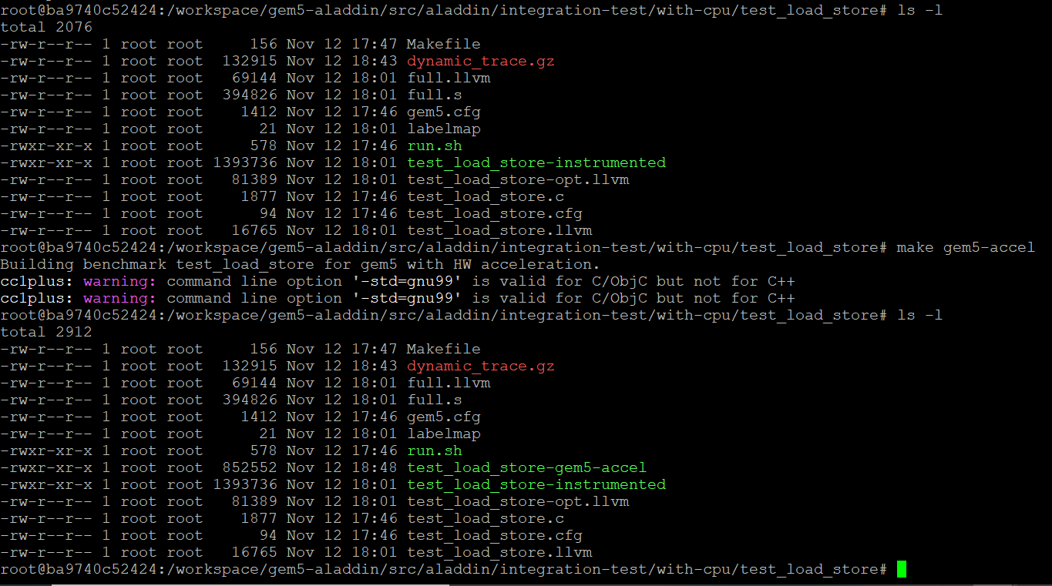
80.4 Generate Gem5 Accelerator
https://github.com/harvard-acc/gem5-aladdin
Generate Gem5 Accelerator
> make gem5-accel
The gem5 accelerator is generated as below.

Slide 14
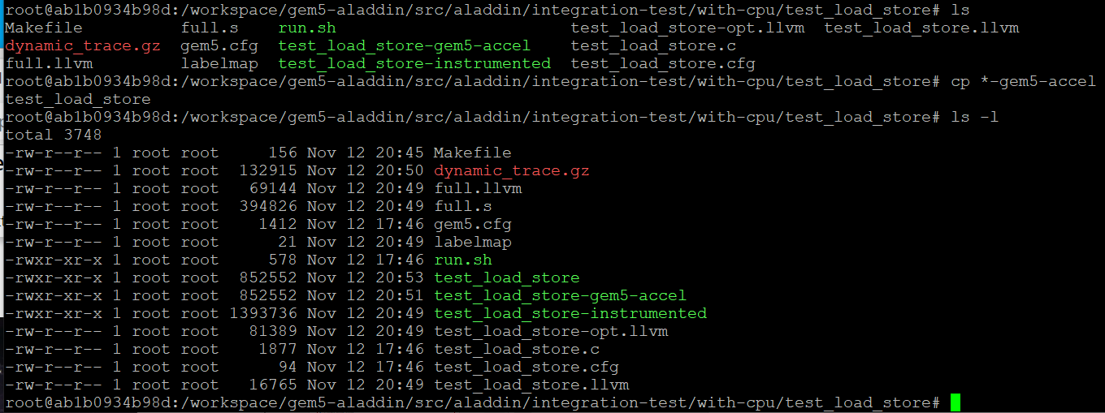
80.4 Generate Gem5 Accelerator
https://github.com/harvard-acc/gem5-aladdin
Generate Gem5 Accelerator
The test_load_store_gem5-accel is the compiled gem5/accelerator executable file.
copy test_load_store-gem5_accel into test_load_store
> cp test_load_store-gem5_accel test_load_store

Slide 15
80.5 Run run.sh

Slide 16
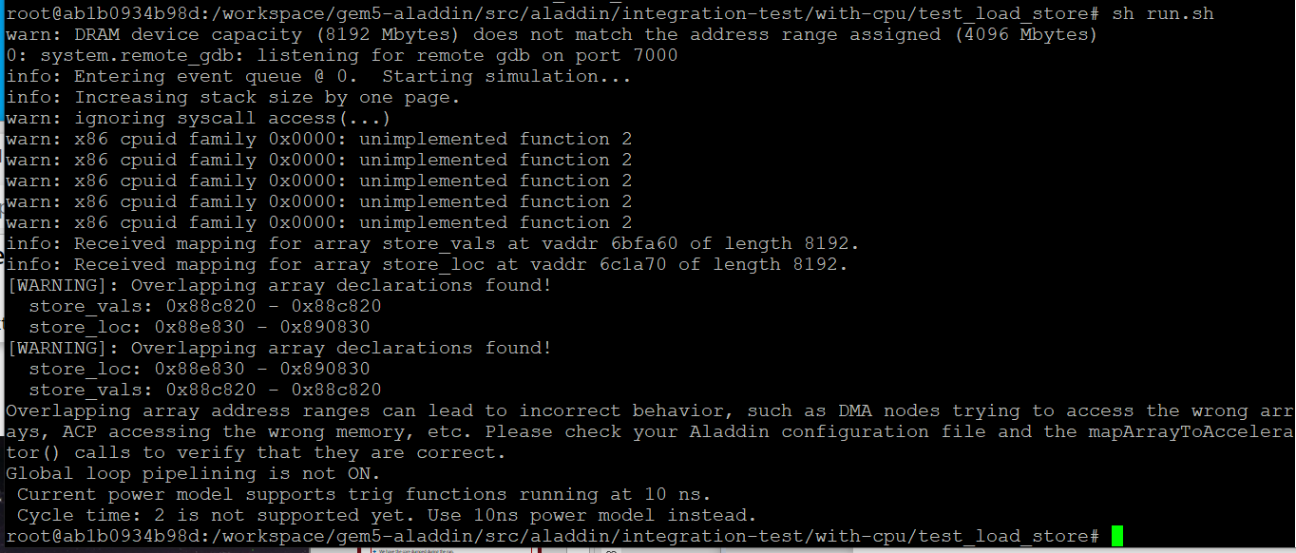
80.5 Run.sh
https://github.com/harvard-acc/gem5-aladdin
Run run.sh
> sh run.sh

Slide 17
80.6 Verify Result

Slide 18
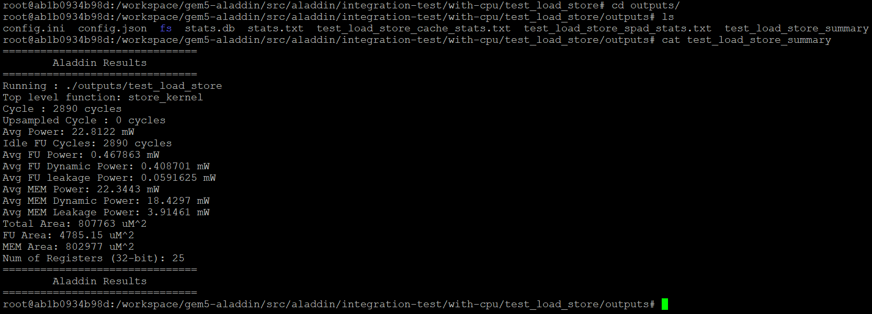
80.7 Verify Aladdin Result
https://github.com/harvard-acc/gem5-aladdin
Verify Aladdin Result
> cd outputs
> cat test_load_summary
We have cycle: 2890 cycles, Avg Power: 22.8122 mW, and Total Area: 807763 uM^2

Slide 19
80.7 Calculate IPC (Instruction Per Cycle)

Slide 20
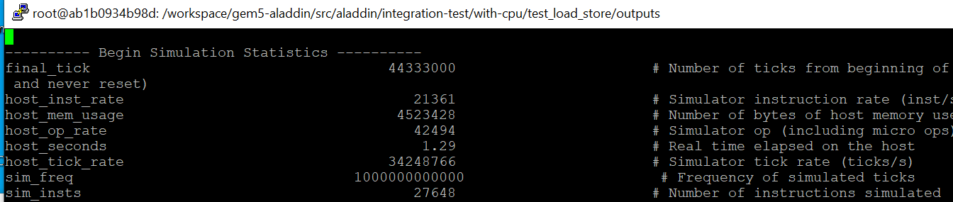
80.7 Calculate IPC (Instruction Per Cycle)
https://github.com/harvard-acc/gem5-aladdin
Calculate IPC (Instruction Per Cycle)
In the outputs directory
> vi stats.txt
We have number of instructions: 27648

Slide 21
80.7 Calculate IPC (Instruction Per Cycle)
https://github.com/harvard-acc/gem5-aladdin
Calculate IPC (Instruction Per Cycle)
We have cycles: 2890 cycles and number of instructions: 27648
IPC (Instruction per cycle) = 27648/2980 = 9.27785

Slide 22
80.8 Summary

Slide 23
80.8 Summary
https://github.com/harvard-acc/gem5-aladdin
Summary
IPC (Instruction per cycle) = 9.27785
Power: 22.8122 mW, and
Total Area: 807763 uM^2

Slide 24
End

