Slide 1

2 Dockerize Python Application
Peter H. Chen

Slide 2
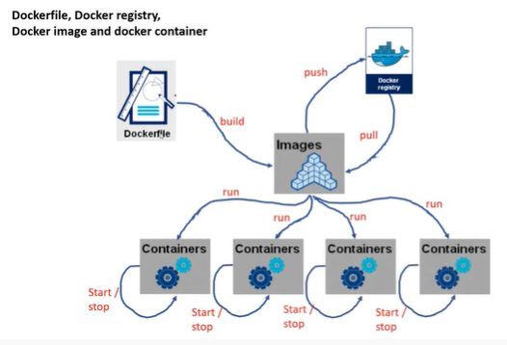
2 Dockerize Python Application
https://www.youtube.com/watch?v=8uaDoMuDK6E
Dockerize Python Application
This document describes how to dockerize the Python Application.
We have python application and we dockerize the application and run inside the specific docker container.
We start with a Docker file and how to build with image.
We will take the Python code, move into the docker container, run inside the docker container, and get the result out of container.

Slide 3
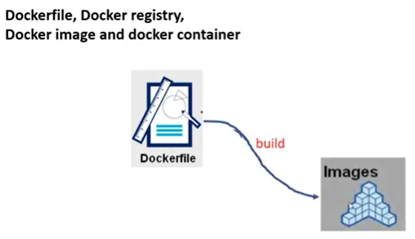
2 Dockerize Python Application
https://www.youtube.com/watch?v=8uaDoMuDK6E
Docker File
We start with a Docker file.
The Docker file contains the set of instructions on how to build a docker image.

Slide 4
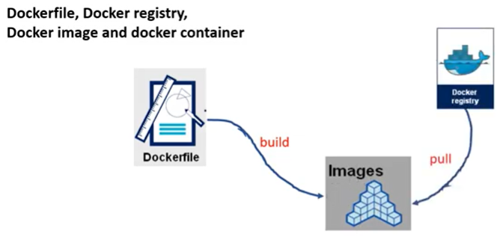
2 Dockerize Python Application
https://www.youtube.com/watch?v=8uaDoMuDK6E
Docker File
…and any missing elements are download from the docker registry

Slide 5
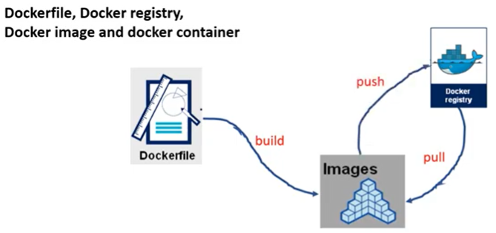
2 Dockerize Python Application
https://www.youtube.com/watch?v=8uaDoMuDK6E
Docker File
…and if you have any updated image, you can push it to the registry
…so, others can benefit from your update.

Slide 6
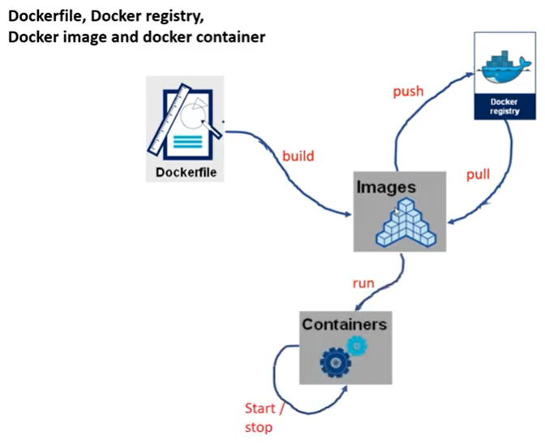
2 Dockerize Python Application
https://www.youtube.com/watch?v=8uaDoMuDK6E
Docker File
…but once we have docker image, then we can run many containers.

Slide 7
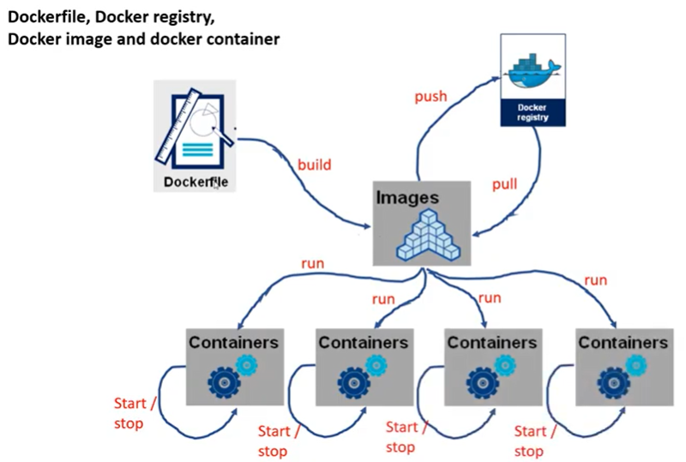
2 Dockerize Python Application
https://www.youtube.com/watch?v=8uaDoMuDK6E
Docker File
…so, this is the concept.

Slide 8
2.1 Python Code Outside Container

Slide 9
2.1 Python Code Outside Container
https://www.youtube.com/watch?v=8uaDoMuDK6E
Python Code Outside Container
Let’s start with the Docker File.
…and then create an image
…and then run the containers.

Slide 10
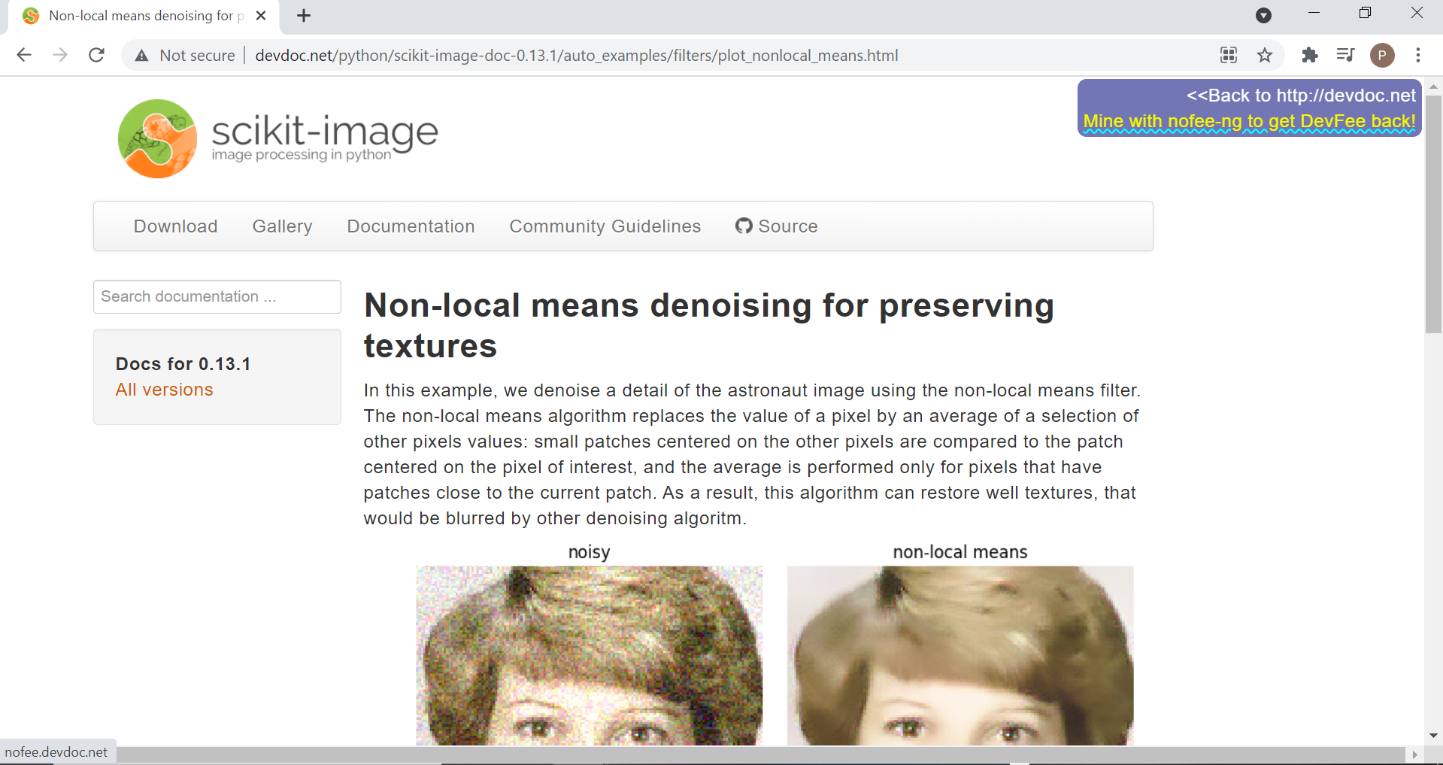
2.1 Python Code Outside Container
https://www.youtube.com/watch?v=8uaDoMuDK6E
Python Code Outside Container
Search for “scikit image” for “non-local means denoising for preserving textrues”
http://devdoc.net/python/scikit-image-doc-0.13.1/auto_examples/filters/plot_nonlocal_means.html

Slide 11
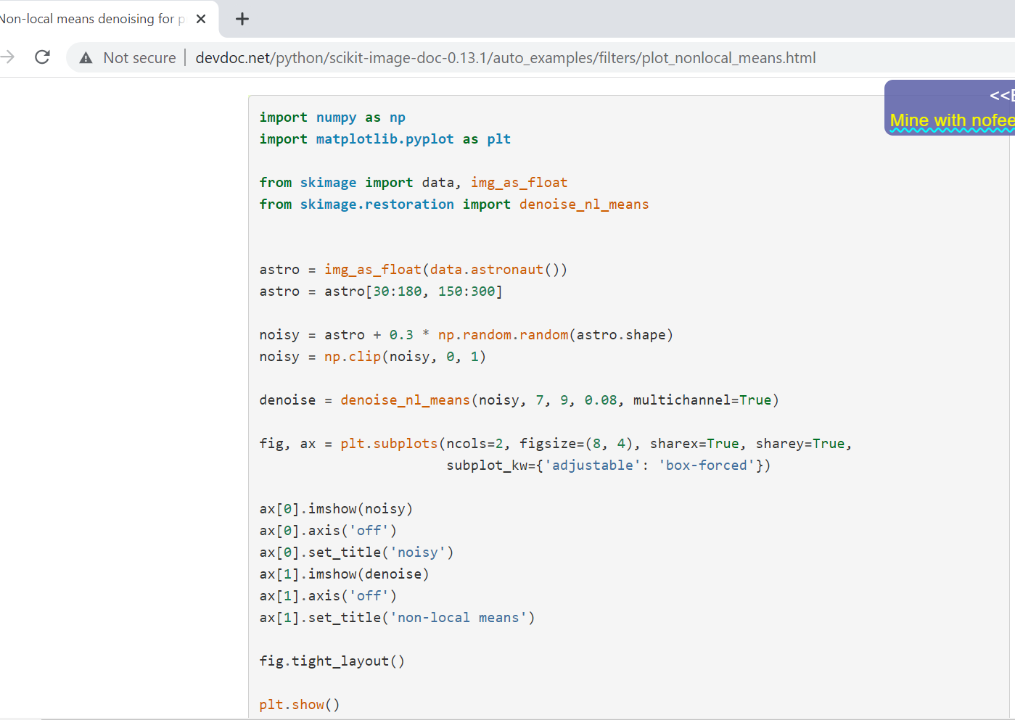
2.1 Python Code Outside Container
https://www.youtube.com/watch?v=8uaDoMuDK6E
Python Code Outside Container
http://devdoc.net/python/scikit-image-doc-0.13.1/auto_examples/filters/plot_nonlocal_means.html
This is the code we will use.

Slide 12
2.2 Run Python Code Outside Container

Slide 13
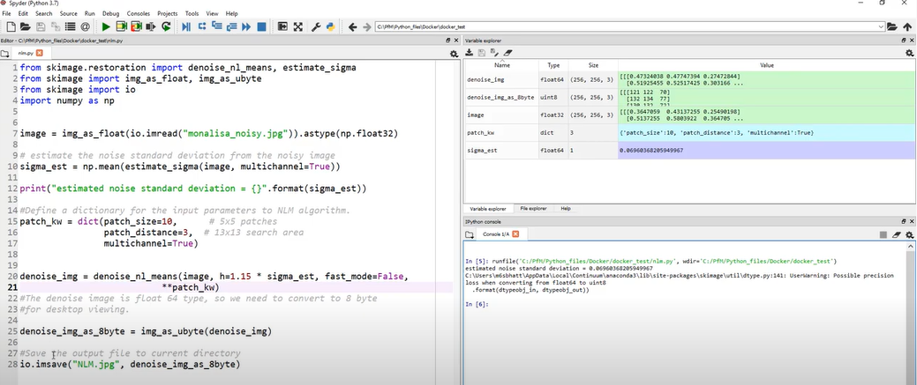
2.2 Run Python Code Outside Container
https://www.youtube.com/watch?v=8uaDoMuDK6E
Run Python Code Outside Container
http://devdoc.net/python/scikit-image-doc-0.13.1/auto_examples/filters/plot_nonlocal_means.html
It runs as below.

Slide 14
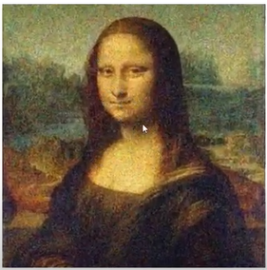
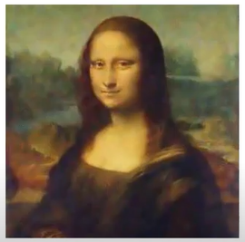
2.2 Run Python Code Outside Container
https://www.youtube.com/watch?v=8uaDoMuDK6E
Run Python Code Outside Container
http://devdoc.net/python/scikit-image-doc-0.13.1/auto_examples/filters/plot_nonlocal_means.html
The original image is on the left. The denoise image in on the right.
Original Image: monalisa_noisy.jpg
Denoise Image

Slide 15
2.2 Create Dockerfile

Slide 16
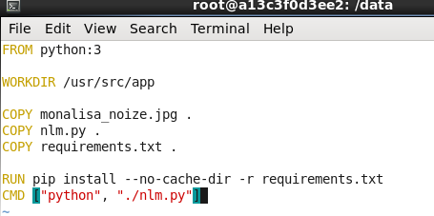
2.2 Create Dockerfile
https://www.youtube.com/watch?v=8uaDoMuDK6E
Create Dockerfile
Create a Dockerfile.
The first line is the base image that you are going to download from repository.
In Dockerfile, “FROM python:3” is the image in Docker hub.
“WORKDIR /usr/src/app”: This is not the working directory in your Linux. This is the working directory in the docker virtual environment
COPY monalisa_noisy.pjg .
We copy the Monalisa_noisy.jpg to . (current working directory WORKDIR /usr/src/app)
We copy nlm.py to .
We copy requirements.txt to working directory.
We install the requirements.txt
We start the command “python ./nlm.py”

Slide 17
2.3 Docker Build

Slide 18
2.3 Docker Build
https://www.youtube.com/watch?v=8uaDoMuDK6E
Docker Build
> docker build -t ‘nlm’ .
The create image name is ‘nlm’. It create at current working directory.

Slide 19
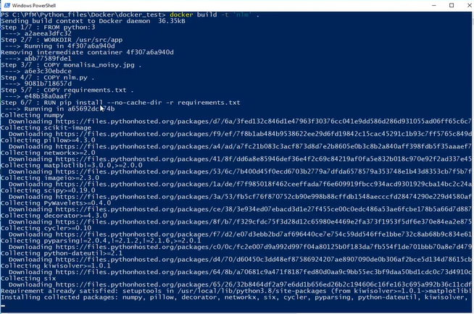
2.3 Docker Build
https://www.youtube.com/watch?v=8uaDoMuDK6E
Docker Build
> docker build -t ‘nlm’ .
Docker build and run in the current directory.

Slide 20
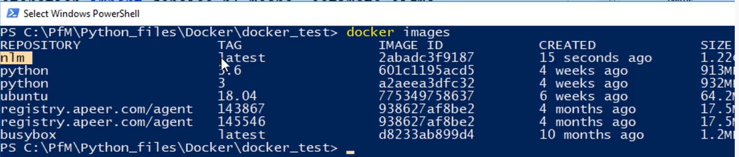
2.3 Docker Build
https://www.youtube.com/watch?v=8uaDoMuDK6E
Docker Build
> docker images
We can see “nlm” image created.

Slide 21
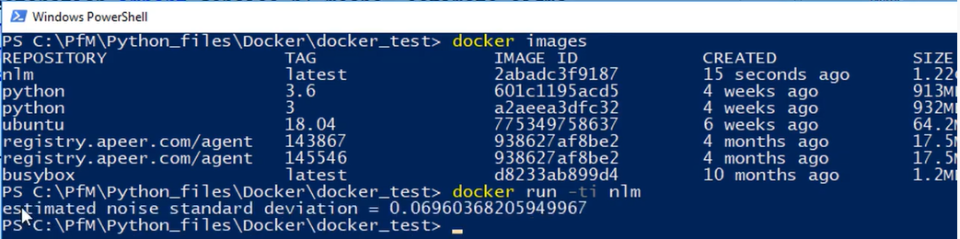
2.3 Docker Build
https://www.youtube.com/watch?v=8uaDoMuDK6E
Docker Build
> docker run -it nlm
It print out the message from the application.
It is same thing we run outside the container.

Slide 22
2.4 Check Built Image

Slide 23
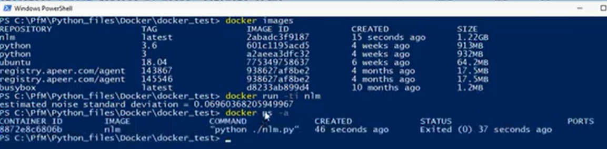
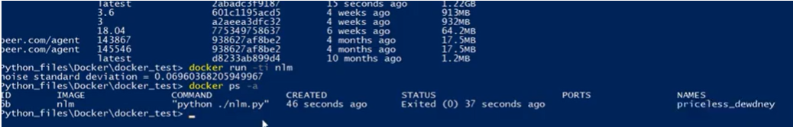
2.4 Check Built Image
https://www.youtube.com/watch?v=8uaDoMuDK6E
Check Built Imaged
So, where is the final output of the image?
First, we check the
> docker ps -a

Slide 24
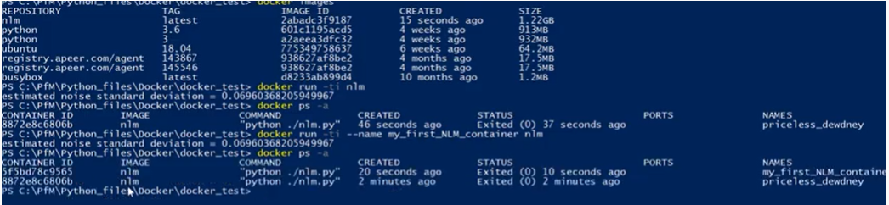
2.4 Check Built Image
https://www.youtube.com/watch?v=8uaDoMuDK6E
Check Built Image
> docker run -it --name my_first_NLM_container nlm
> docker ps -a

Slide 25
2.5 Copy Result Outside Container

Slide 26
2.5 Copy Result Outside Container
https://www.youtube.com/watch?v=8uaDoMuDK6E
Copy Result Outside Container
So, again, where is the final output of the image?
In the current working directory:
C:\Pfm|Python_files\Docker\docker_test>
> docker run -v C:\Pfm|Python_files\Docker\docker_test:/usr/src/app nlm
-v: tell the system that I will map the working directory. This is the directory that I would like the result should be stored.
/usr/src/app is the location for docker file.
“nlm” is the image name we want to run.

Slide 27
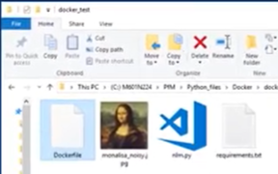
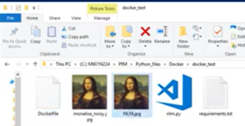
2.5 Copy Result Outside Container
https://www.youtube.com/watch?v=8uaDoMuDK6E
Copy Result Outside Container
We will see the new non-noisy file copy to our folder now.
Originally, we have nosisy.jpg to our working directory.
Copy the non-nosisy.jpg to our working directory.

Slide 28
End

