Slide 1

3 Dockerize Python Application
Peter H. Chen

Slide 2
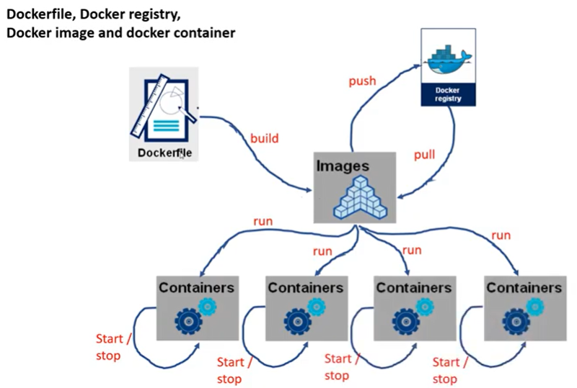
3 Dockerize Python Application
https://www.youtube.com/watch?v=8uaDoMuDK6E
Dockerize Python Application
Dockerize Python Application

Slide 3
3 Dockerfile
https://www.youtube.com/watch?v=8uaDoMuDK6E
Dockerfile
FROM: gem5-aladdin_autotest (import and included pyTorch )
WORKDIR /workspace/dataset
COPY gem5_aladdin_dataset.py .
COPY gem5_aladdin_parameter.txt .
CMD [“python”, “gem5_aladdin_dataset.py”

Slide 4
3 Dockerfile
https://www.youtube.com/watch?v=8uaDoMuDK6E
Generate Dataset
In gem5_aladdin_dataset.py:
1 .Parsing gem5_aladdin_parameter.txt
2. Compile C File into Aladdin Trace.
3. Loop using PyTorch RunManager
3.1 Setup parameters
3.2 pyTorch RunManager for parameters looping [Cartesian product = L1 cache (10) x L2 cache (10) x MMU (10) x etc. = 10^Y loop (rows)]
3.3 run.sh
4. Post processing results into load_store_dataset.csv
5. Host: docker run
6. Copy from Container to Host: docker cp outputs/load_store_dataset.csv (comma separate value) .

Slide 5
3.1 Python Code Outside Container

Slide 6
3.1 Python Code Outside Container
https://www.youtube.com/watch?v=8uaDoMuDK6E
Python Code Outside Container
Let’s start with the Docker File.
…and then create an image
…and then run the containers.

Slide 7
End

