Slide 1

5 Copy Docker Container Output to Host
Peter H. Chen

Slide 2
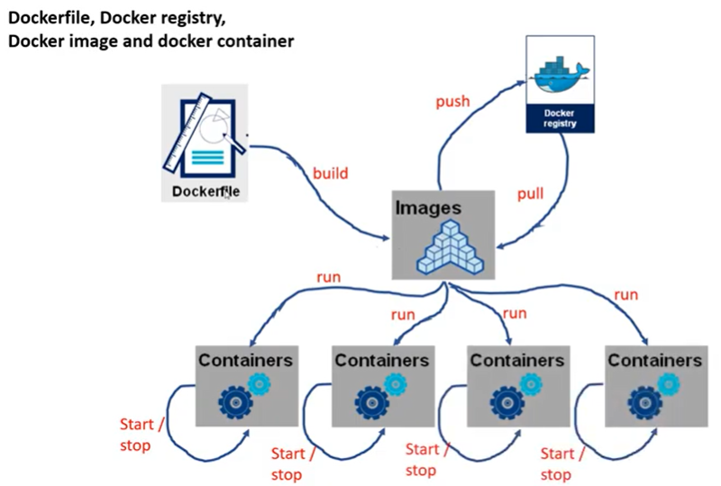
5 Copy Docker Container Output to Host
https://www.youtube.com/watch?v=8uaDoMuDK6E
Copy Docker Container Output to Host
In this document, we discuss how to copy the Docker Container Result.
> docker run gme5-aladdin_autotest
>> got the docker_id = 82e73c32f22
Copy from Container to the Host:
> docker cp 82e73c32f22:/workspace/gem5-aladdin/src/aladdin/integration_test/with-cpu/test_load_store/outputs .

Slide 3
5.1 cp_dataset.py Code

Slide 4
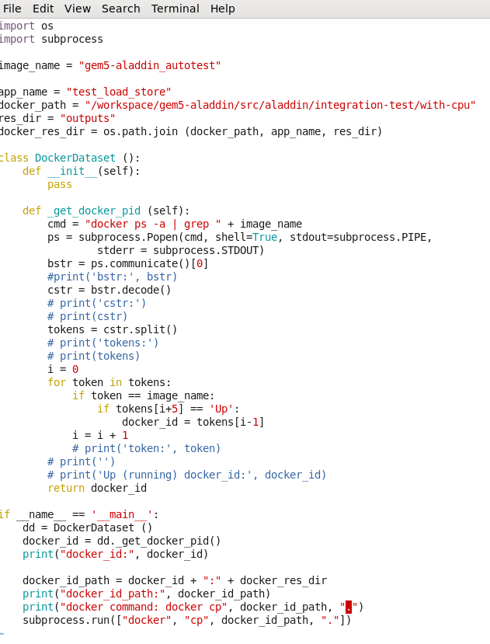
5.1 cp_dataset.py Code
https://www.youtube.com/watch?v=8uaDoMuDK6E
cp_dataset.cp Code
1. Find the docker ID with Up running.
2. Copy from container to the Host
> docker cp Docker_ID:path .

Slide 5
5.2 Run cp_dataset.py

Slide 6
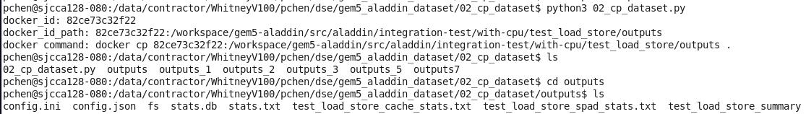
5.2 Run cp_dataset.py
https://www.youtube.com/watch?v=8uaDoMuDK6E
Run cp_dataset.py

Slide 7
5.3 Result Verification

Slide 8
5.3 Result Verification
https://www.youtube.com/watch?v=8uaDoMuDK6E
Result Verification

Slide 9
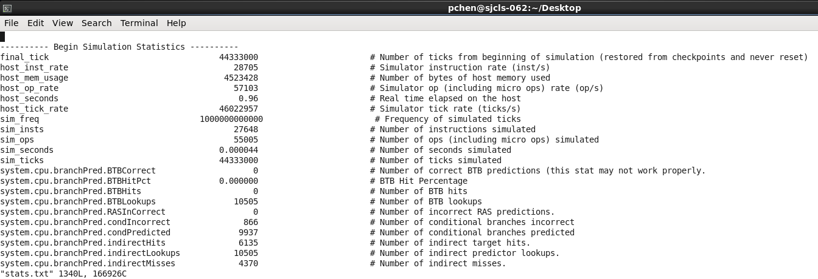
5.3 Result Verification
https://www.youtube.com/watch?v=8uaDoMuDK6E
Result Verification
Check stats.txt

Slide 10
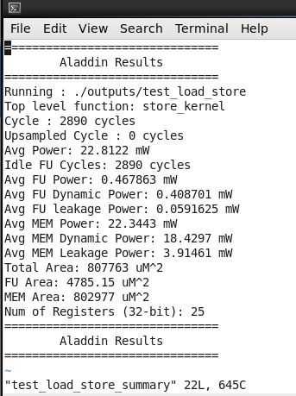
5.3 Result Verification
https://www.youtube.com/watch?v=8uaDoMuDK6E
Result Verification
Check test_load_store_summary

Slide 11
End

