Slide 1

3 test_array_func_arg Script
Peter H. Chen

Slide 2
3 test_array_func_arg Script
https://github.com/harvard-acc/gem3-aladdin
test_array_func_arg Script
We discuss how to build the integration tests for Gem3-Aladdin Team.
gem3-cpu: Builds a version of the binary that runs on the CPU in gem3
gem3-accel: Builds a version of the binary that runs the accelerated function in Aladdin and the rest on the CPU.
gem: Builds both gem3-cpu and gem3-accel.
dma-trace-binary: Builds a version of the binary that is instrumented with LLVM-Tracer. Run this binary to generate a new dynamic_trace.gz. This binary is NOT meant to be simulated in gem3, so do not replace this with test_load_store - they serve completely different purposes.

Slide 3
3 test_array_func_arg Script
https://github.com/harvard-acc/gem3-aladdin
test_array_func_arg Script
So, to rebuild and rerun a simulation of one of the integration tests:
1. > make clean
2. > make dma-trace-binary
3. > ./test_load_store-instrumented # This will generate a new dynamic_trace.gz
4. > make gem3-accel
> cp test_load_store-ge3-accel test_load_store
3. > sh run.sh

Slide 4
3.1 test_array_func_arg.scr

Slide 5
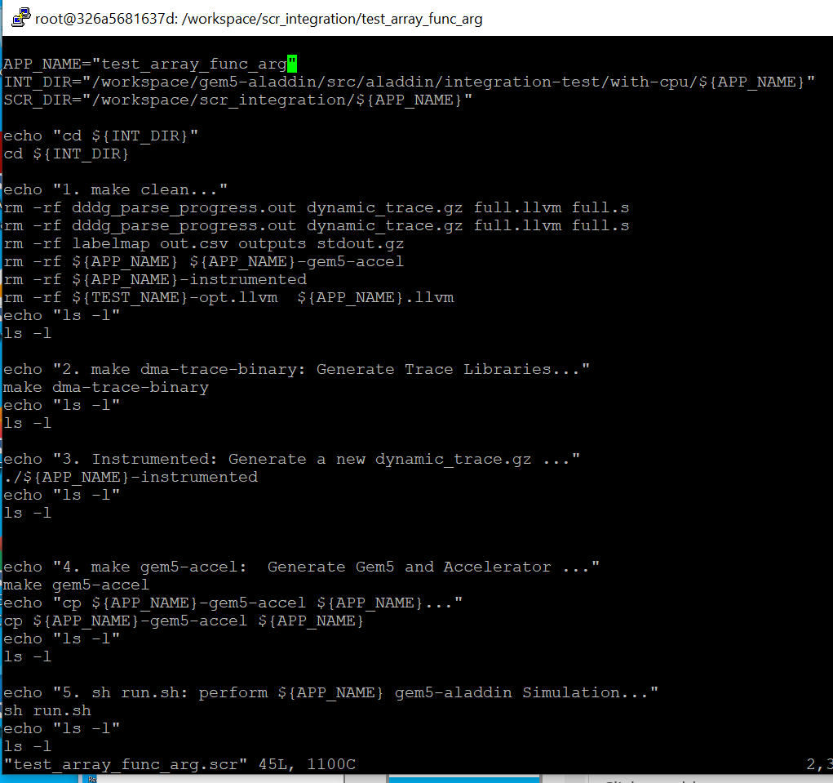
3.1 test_array_func_arg.scr
https://github.com/harvard-acc/gem3-aladdin
test_array_func_arg.scr

Slide 6
3.2 Run test_array_func_arg.scr

Slide 7
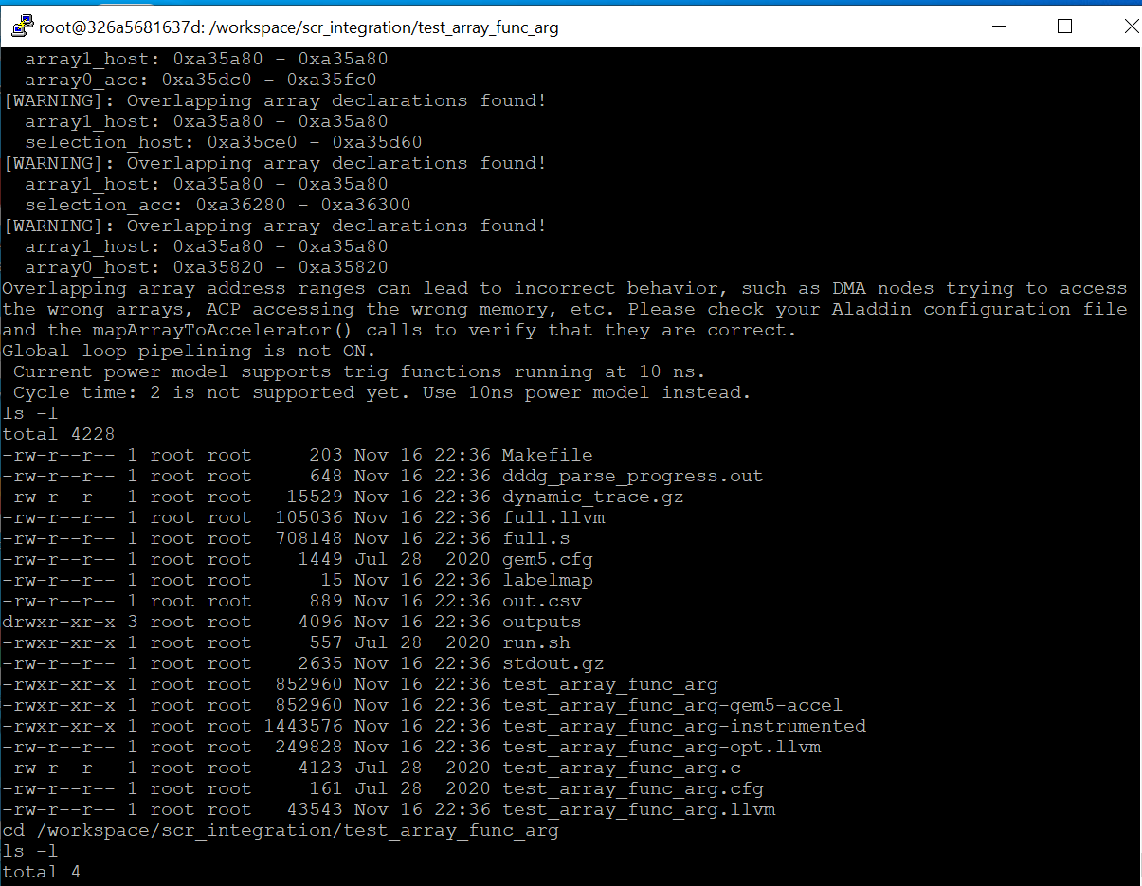
3.2 Run test_array_func_arg.scr
https://github.com/harvard-acc/gem3-aladdin
Run test_array_func_arg.scr

Slide 8
End

