Slide 1

4 test_array_func_indexing Script
Peter H. Chen

Slide 2
4 test_array_func_indexing Script
https://github.com/harvard-acc/gem5-aladdin
test_array_func_indexing Script
We discuss how to build the integration tests for gem5-Aladdin Team.
gem5-cpu: Builds a version of the binary that runs on the CPU in gem5
gem5-accel: Builds a version of the binary that runs the accelerated function in Aladdin and the rest on the CPU.
gem: Builds both gem5-cpu and gem5-accel.
dma-trace-binary: Builds a version of the binary that is instrumented with LLVM-Tracer. Run this binary to generate a new dynamic_trace.gz. This binary is NOT meant to be simulated in gem5, so do not replace this with test_load_store - they serve completely different purposes.

Slide 3
4 test_array_func_indexing Script
https://github.com/harvard-acc/gem5-aladdin
test_array_func_indexing Script
So, to rebuild and rerun a simulation of one of the integration tests:
1. > make clean
2. > make dma-trace-binary
4. > ./test_load_store-instrumented # This will generate a new dynamic_trace.gz
4. > make gem5-accel
> cp test_load_store-ge4-accel test_load_store
4. > sh run.sh

Slide 4
4.1 test_array_func_indexing.scr

Slide 5
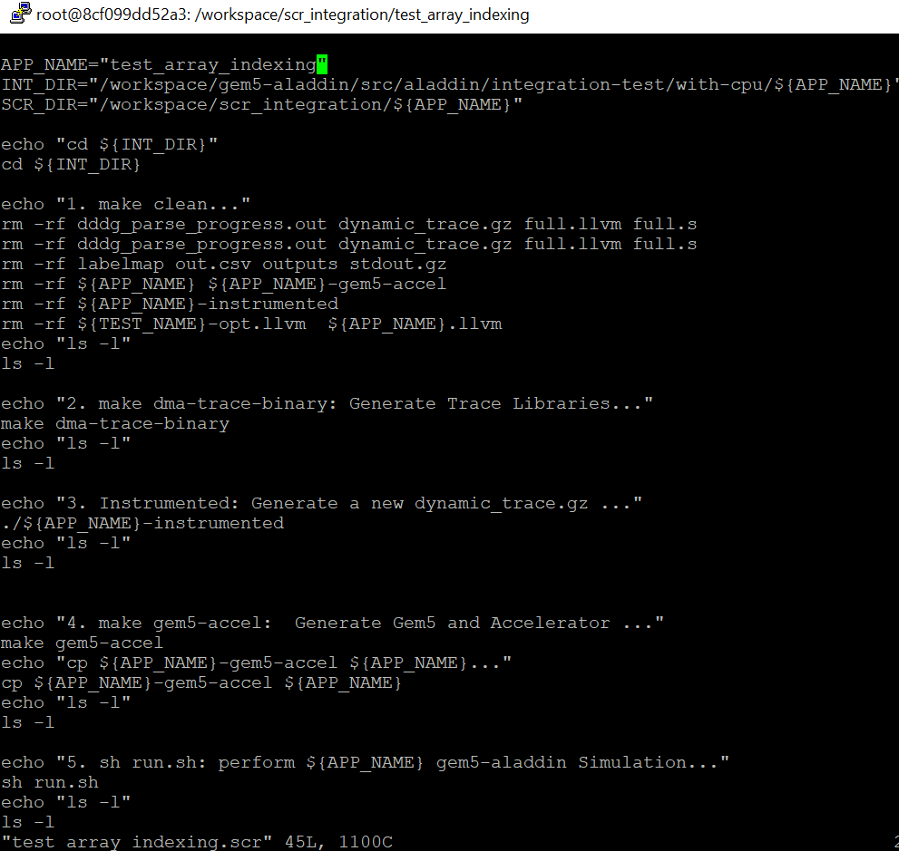
4.1 test_array_func_indexing.scr
https://github.com/harvard-acc/gem5-aladdin
test_array_func_indexing.scr

Slide 6
4.2 Run test_array_func_indexing.scr

Slide 7
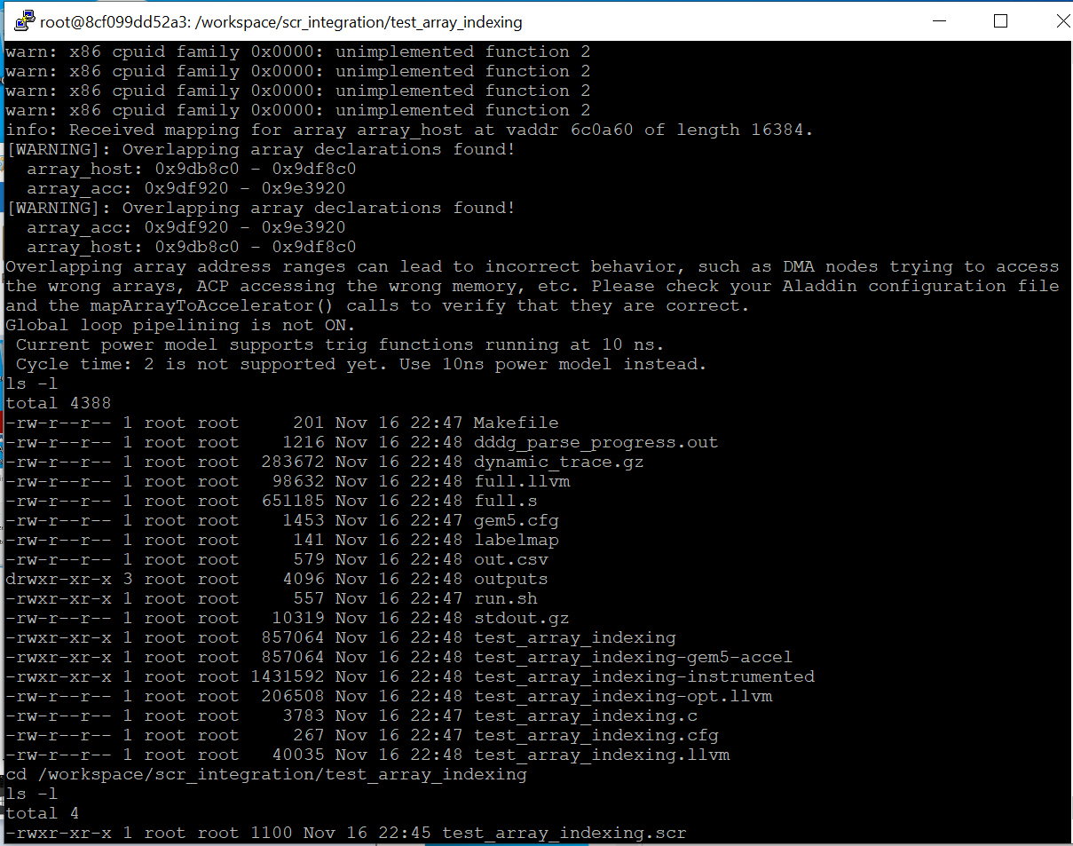
4.2 Run test_array_func_indexing.scr
https://github.com/harvard-acc/gem5-aladdin
Run test_array_func_indexing.scr

Slide 8
End

