Slide 1

12 gem5-alddin/test_load_store Script
Peter H. Chen

Slide 2
12 gem5-alddin/test_load_store Script
https://github.com/harvard-acc/gem5-aladdin
Gem5-Alddin test_load_store Script
We discuss how to build the integration tests for Gem5-Aladdin Team.
gem5-cpu: Builds a version of the binary that runs on the CPU in gem5
gem5-accel: Builds a version of the binary that runs the accelerated function in Aladdin and the rest on the CPU.
gem: Builds both gem5-cpu and gem5-accel.
dma-trace-binary: Builds a version of the binary that is instrumented with LLVM-Tracer. Run this binary to generate a new dynamic_trace.gz. This binary is NOT meant to be simulated in gem5, so do not replace this with test_load_store - they serve completely different purposes.

Slide 3
12 gem5-alddin/test_load_store Script
https://github.com/harvard-acc/gem5-aladdin
Gem5-Alddin test_load_store Script
So, to rebuild and rerun a simulation of one of the integration tests:
1. > make clean
2. > make dma-trace-binary
3. > ./test_load_store-instrumented # This will generate a new dynamic_trace.gz
4. > make gem5-accel
> cp test_load_store-gem5-accel test_load_store
5. > sh run.sh s

Slide 4
12.1 test_load_store.scr

Slide 5
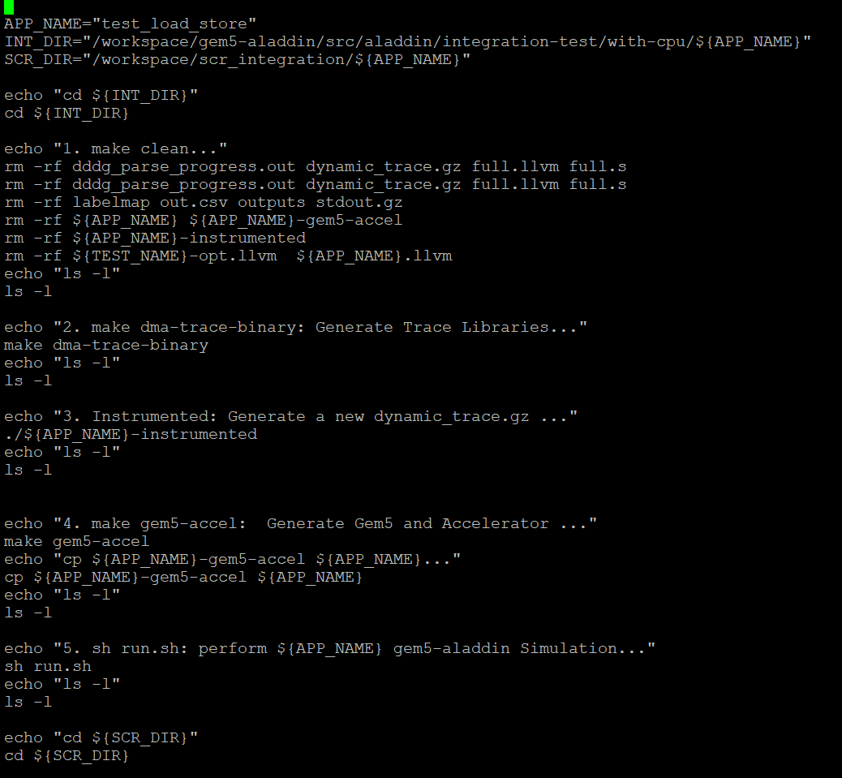
12.1 test_load_store.scr
https://github.com/harvard-acc/gem5-aladdin
test_load_store.scr
> docker run -it gem5-aladdin_autotest
> cd /workspace/scr_integration/test_load_store
> vi test_load_store.scr

Slide 6
12.2 Run test_load_store.scr

Slide 7
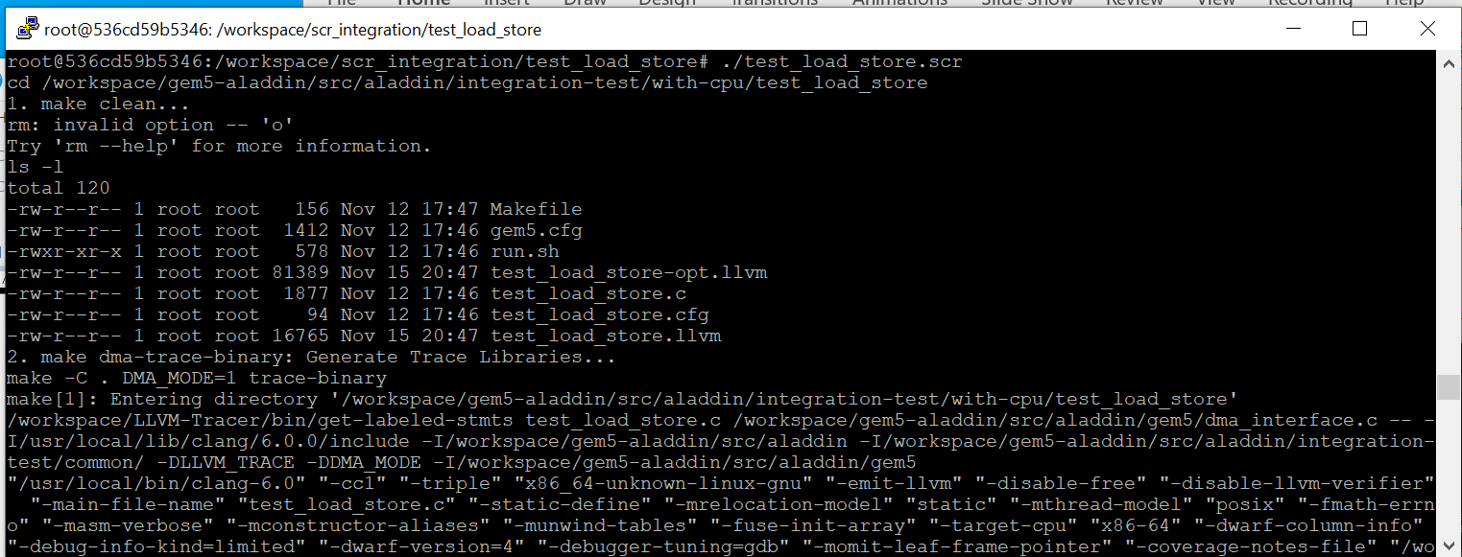
12.2 Run test_load_store.scr
https://github.com/harvard-acc/gem5-aladdin
Run test_load_store.scr
> ./test_load_store.scr

Slide 8
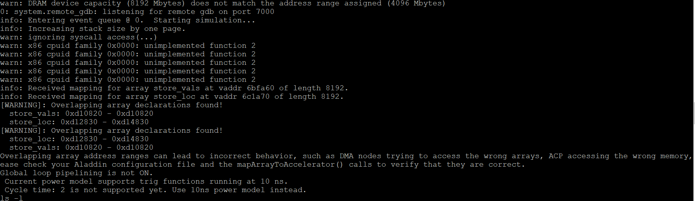
12.2 Run test_load_store.scr
https://github.com/harvard-acc/gem5-aladdin
Run test_load_store.scr
Check the simulation message with out error.

Slide 9
12.3 Check Result

Slide 10
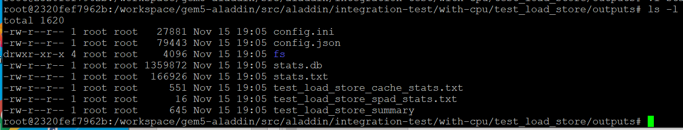
12.3 Check Result
https://github.com/harvard-acc/gem5-aladdin
Check Result
Go to /workspace/gem5-aladdin/src/aladdin/integration-test/with-cpu/test_load_store/outputs
> ls -l
We see the stats.txt and test_load_store summary

Slide 11
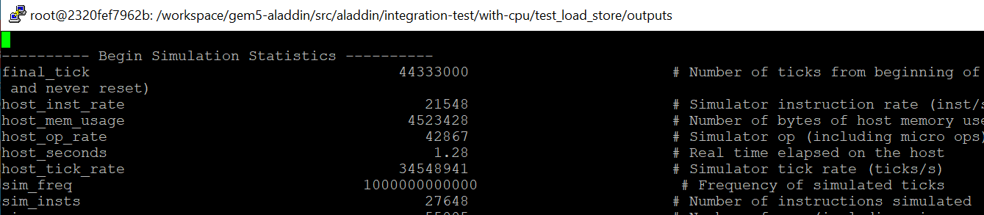
12.3 Check Result
https://github.com/harvard-acc/gem5-aladdin
Check Result
Check instruction data: the stats.txt with “sim_insts” entry.

Slide 12
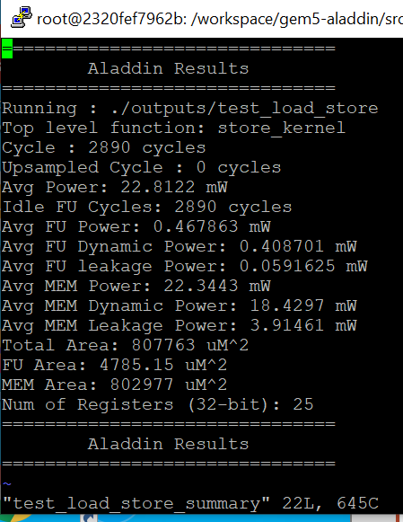
12.3 Check Result
https://github.com/harvard-acc/gem5-aladdin
Check Result
Check the test_load_store_summary

Slide 13
End

