Slide 1

13 test_loop_sampling Script
Peter H. Chen

Slide 2
13 test_loop_sampling Script
https://github.com/harvard-acc/gem5-aladdin
Test_loop_sampling Script
We discuss how to build the integration tests for Gem5-Aladdin Team.
gem5-cpu: Builds a version of the binary that runs on the CPU in gem5
gem5-accel: Builds a version of the binary that runs the accelerated function in Aladdin and the rest on the CPU.
gem: Builds both gem5-cpu and gem5-accel.
dma-trace-binary: Builds a version of the binary that is instrumented with LLVM-Tracer. Run this binary to generate a new dynamic_trace.gz. This binary is NOT meant to be simulated in gem5, so do not replace this with test_load_store - they serve completely different purposes.

Slide 3
13 test_loop_sampling Script
https://github.com/harvard-acc/gem5-aladdin
Test_loop_sampling Script
So, to rebuild and rerun a simulation of one of the integration tests:
1. > make clean
2. > make dma-trace-binary
3. > ./test_load_store-instrumented # This will generate a new dynamic_trace.gz
4. > make gem5-accel
> cp test_load_store-gem5-accel test_load_store
5. > sh run.sh s

Slide 4
13.1 test_loop_sampling.scr

Slide 5
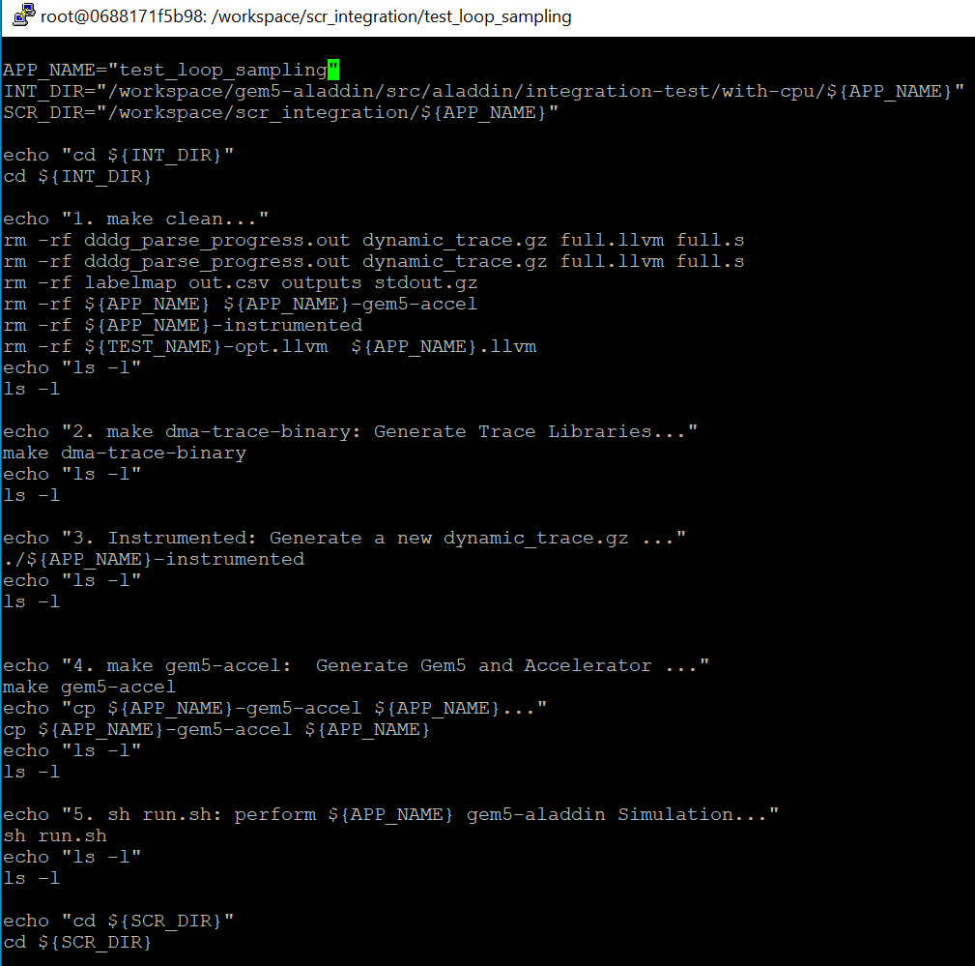
13.1 test_loop_sampling.scr
https://github.com/harvard-acc/gem5-aladdin
Test_loop_sampling.scr

Slide 6
13.2 Run test_loop_sampling.scr

Slide 7
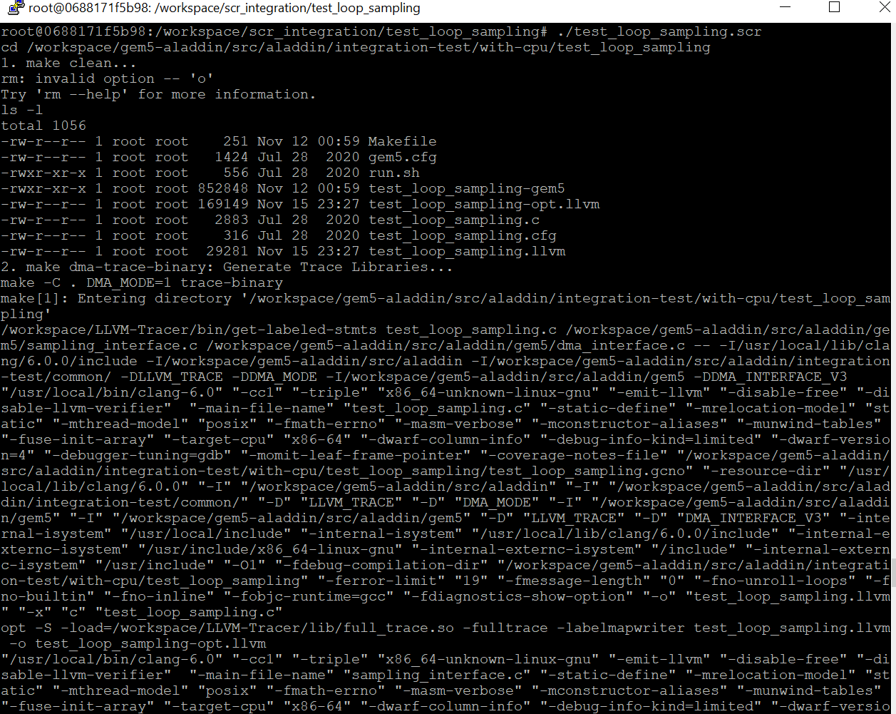
13.2 Run test_loop_sampling.scr
https://github.com/harvard-acc/gem5-aladdin
Run test_loop_sampling.scr

Slide 8
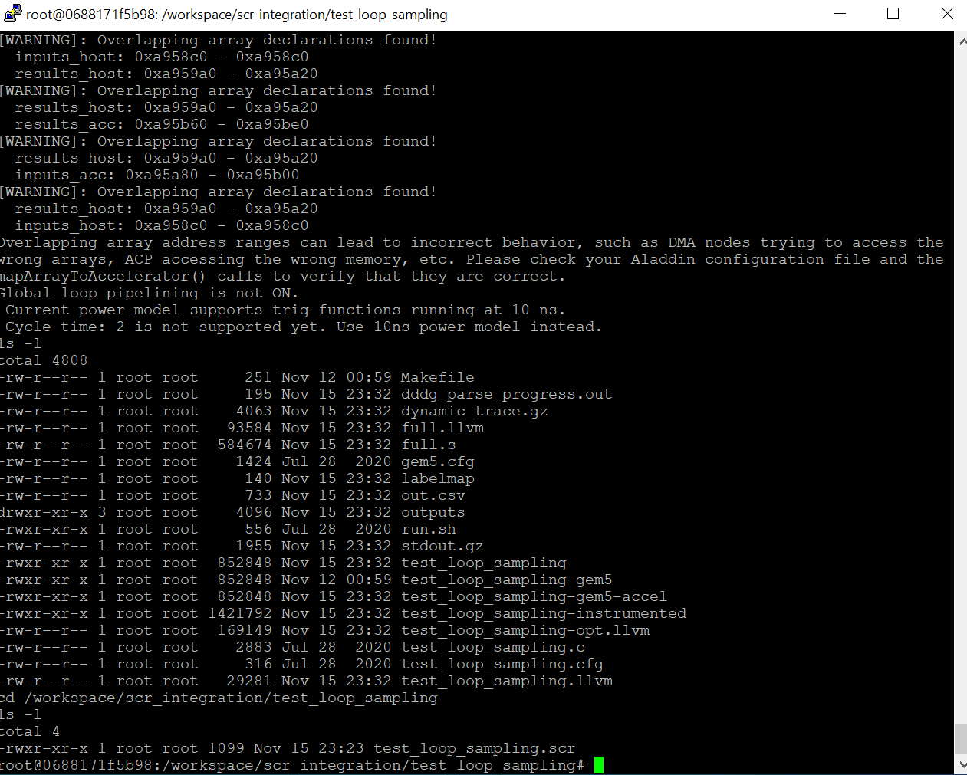
13.2 Run test_loop_sampling.scr
https://github.com/harvard-acc/gem5-aladdin
Run test_loop_sampling.scr

Slide 9
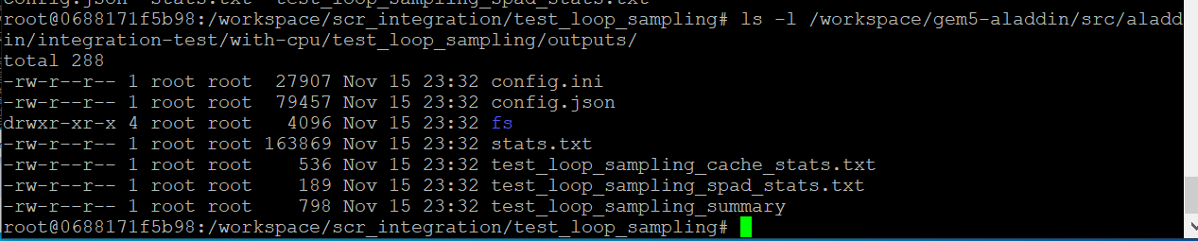
13.2 Run test_loop_sampling.scr
https://github.com/harvard-acc/gem5-aladdin
Run test_loop_sampling.scr

Slide 10
End

