Slide 1

1 Putty to Access Common Zone
Peter H. Chen

Slide 2
1 Putty to Access Common Zone
https://github.com/harvard-acc/ALADDIN
Use Putty to Access Common Zone
Ask Chao Ma to add our group members for putty connection
Note:
1. This is gem5-aladdin Official site is: https://github.com/harvard-acc/ALADDIN. This site may not have “build” folder.
2. The Illinoi University has complete “build” folder for gem5-Aladdin. It was one year ago and can be built. https://gitlab.engr.illinois.edu/ayooshb2/gem5-aladdin
3. This site has “build_opts” folder but does not have ”build” folder. https://github.com/harvard-acc/gem5-aladdin
4. So far, no good user guide for installation and user manual yet.
5. Below document based on experiment and inputs from Noah.
6. We are keeping contact with Aladdin team to collect more information.

Slide 3
1.1 Connect Network

Slide 4
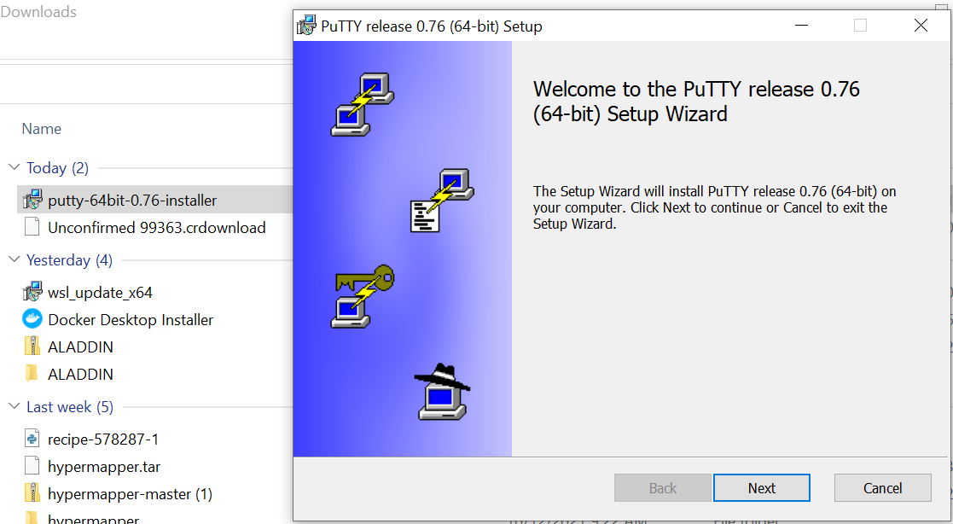
1.1 Install Putty
https://github.com/harvard-acc/ALADDIN
Install Putty
Go to:
https://www.chiark.greenend.org.uk/~sgtatham/putty/latest.html
To download the Putty and install it.

Slide 5
1.2 Connect Network

Slide 6
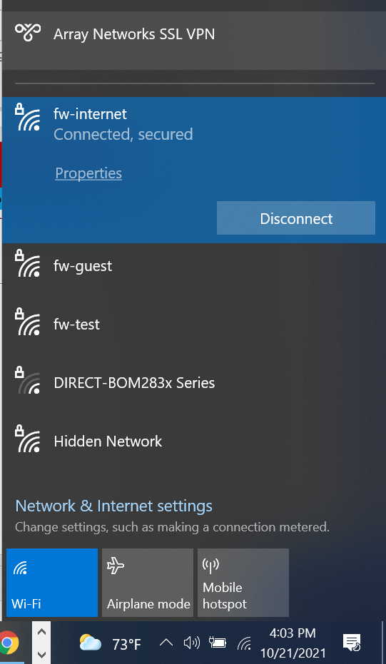
1.2 Connect Network
https://github.com/harvard-acc/ALADDIN
Connect Network
Check fw-internet
Make sure connected and secured.

Slide 7
1.3 MotionPro for Common Zone Connection

Slide 8
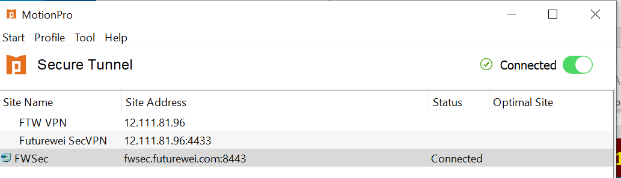
1.3 MotionPro for Common Zone Connection
https://github.com/harvard-acc/ALADDIN
Use MotionPro for Common Zone Connection
Make sure we are connected to the common zone.

Slide 9

1.4 PuTTY Connection

Slide 10
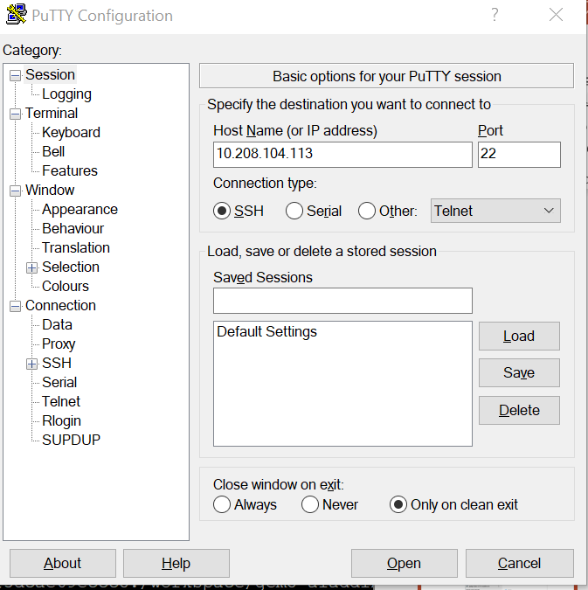
1.4 PuTTY Connection
https://github.com/harvard-acc/ALADDIN
PuTTY Connection
Use PuTTY to connect
> IP Address: 10/208/104.113

Slide 11
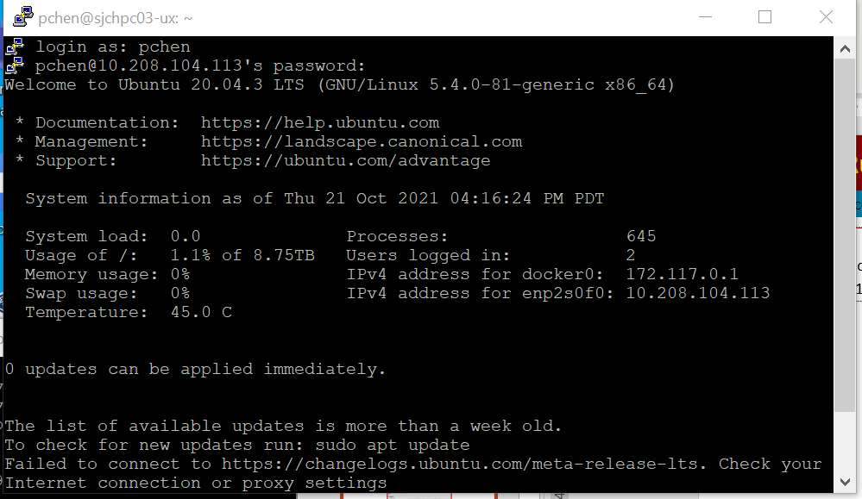
1.4 PuTTY Connection
https://github.com/harvard-acc/ALADDIN
PuTTY Connection
User name: pchen
Password: Pcxxxxxx

Slide 12
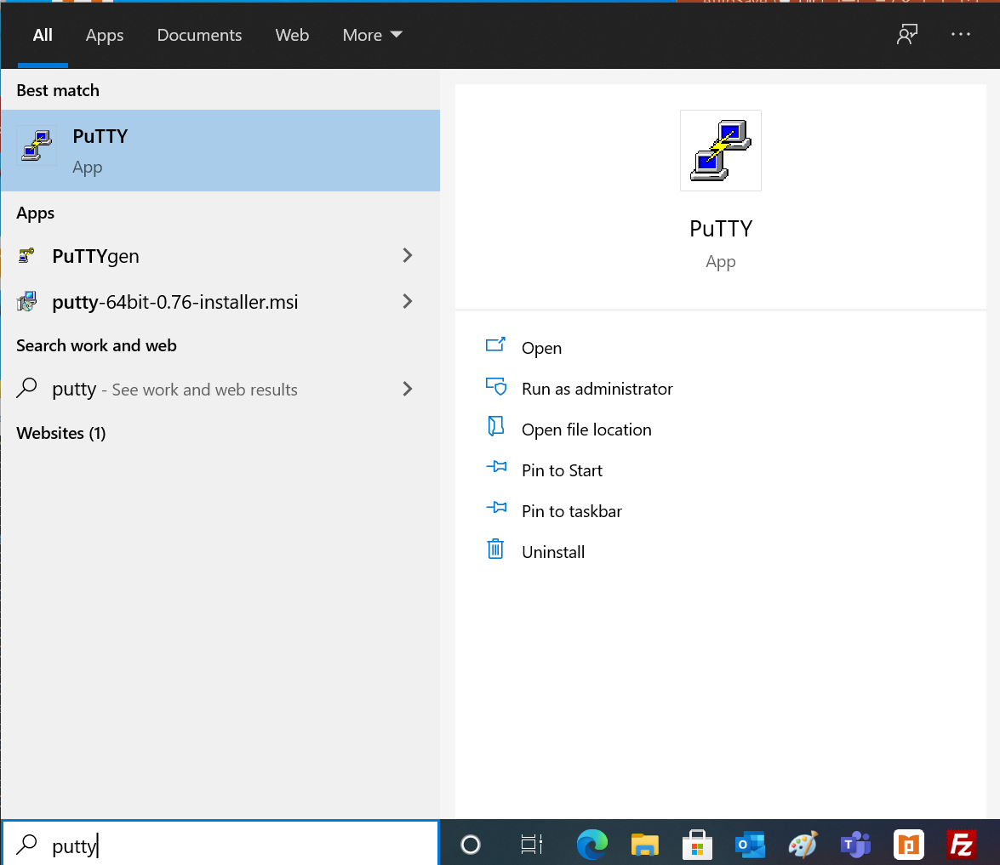
1.4 PuTTY Connection
https://github.com/harvard-acc/ALADDIN
PuTTY Connection
Test to pull the easiest image ubuntu:
> docker pull gem5-aladdin

Slide 13
1.5 Docker Run

Slide 14
1.5 Docker Run
https://github.com/harvard-acc/ALADDIN
Docker Run
Noah already built the Docker Aladdin for us.
We just need to “docker run”
> docker run -it gem5-aladdin

Slide 15
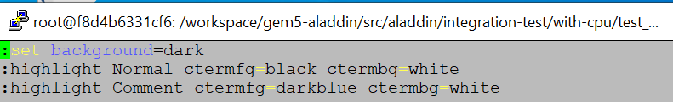
1.5 Docker Run
https://github.com/harvard-acc/ALADDIN
Set vim color for /workspace
I have difficult to use vim color.
Set the vim color as follow:
> echo $HOME
>> /root
> vi $HOME/.vimrc
In $HOME/.vimrc, change the “comment (// or /* … */) color into “dark blue”.
Note: ctermfg stand for Color Terminal foreground.

Slide 16
1.6 Aladdin Executable Location

Slide 17
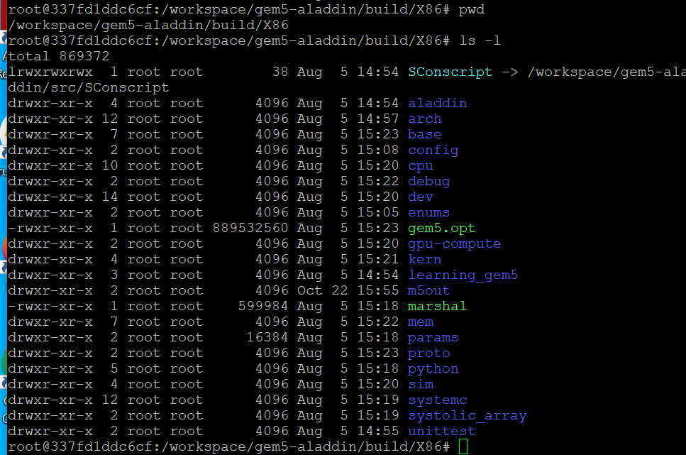
1.6 Aladdin Executable Location
https://github.com/harvard-acc/ALADDIN/
Aladdin Executable Location
In the docker image, Aladdin executable file is located at: /workspace/gem5-aladdin/build/X86/gem5.opt

Slide 18
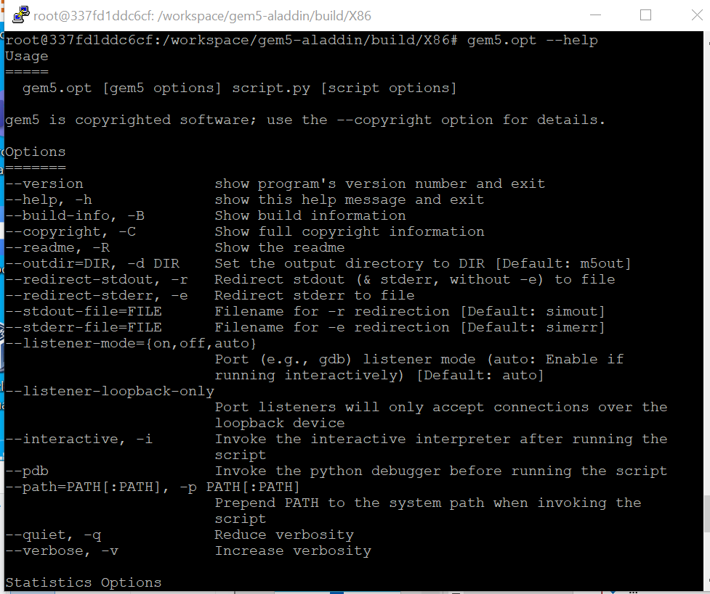
1.6 Aladdin Executable Location
https://github.com/harvard-acc/ALADDIN/
Aladdin Executable Location
> gem5.opt --help
>> gem5.opt [gem5 options] script.py [script options]
…

Slide 19
1.7 Example: test_load_store

Slide 20
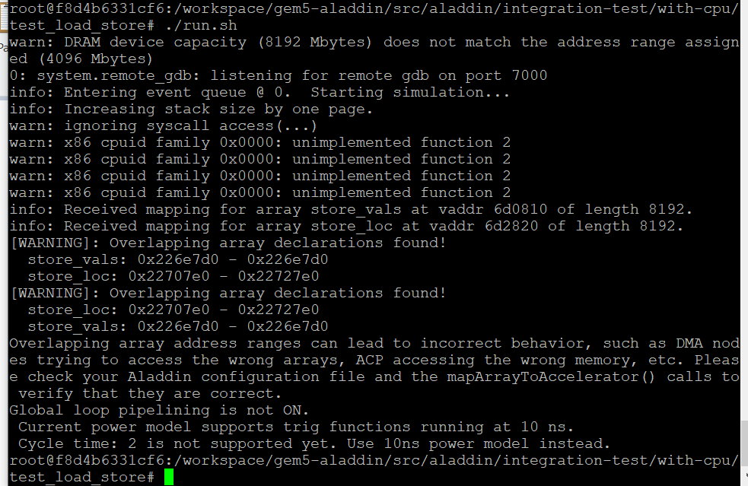
1.7 Example: test_load_store
https://github.com/harvard-acc/ALADDIN/
Example: test_load_store
> cd /workspace/gem5-aladdin/src/aladdin/integration-test/with-cpu/test_load_store
Change the run script to executable.
> chmod 755 run.sh
> ./run.sh

Slide 21
1.8 Example: test_acp

Slide 22
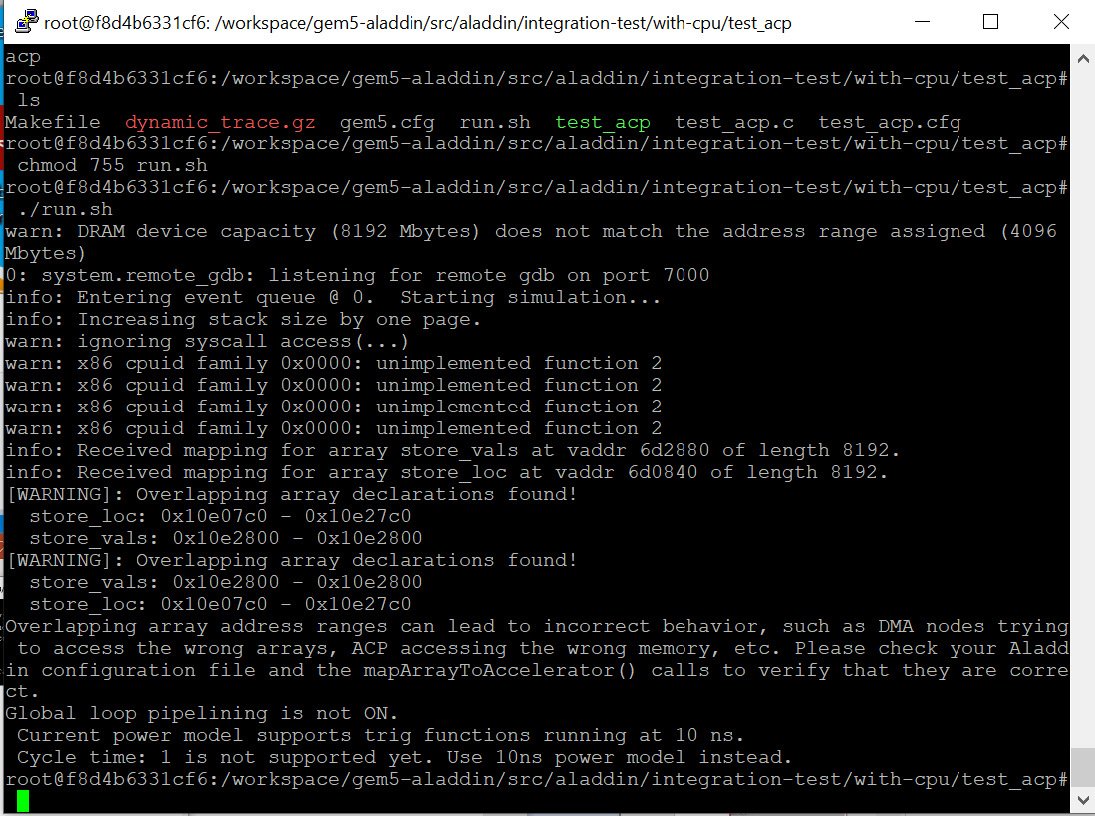
1.8 Example: test_acp
https://github.com/harvard-acc/ALADDIN/
Example: test_acp
> cd /workspace/gem5-aladdin/src/aladdin/integration-test/with-cpu/test_acp
Change the run script to executable.
> chmod 755 run.sh
> ./run.sh

Slide 23
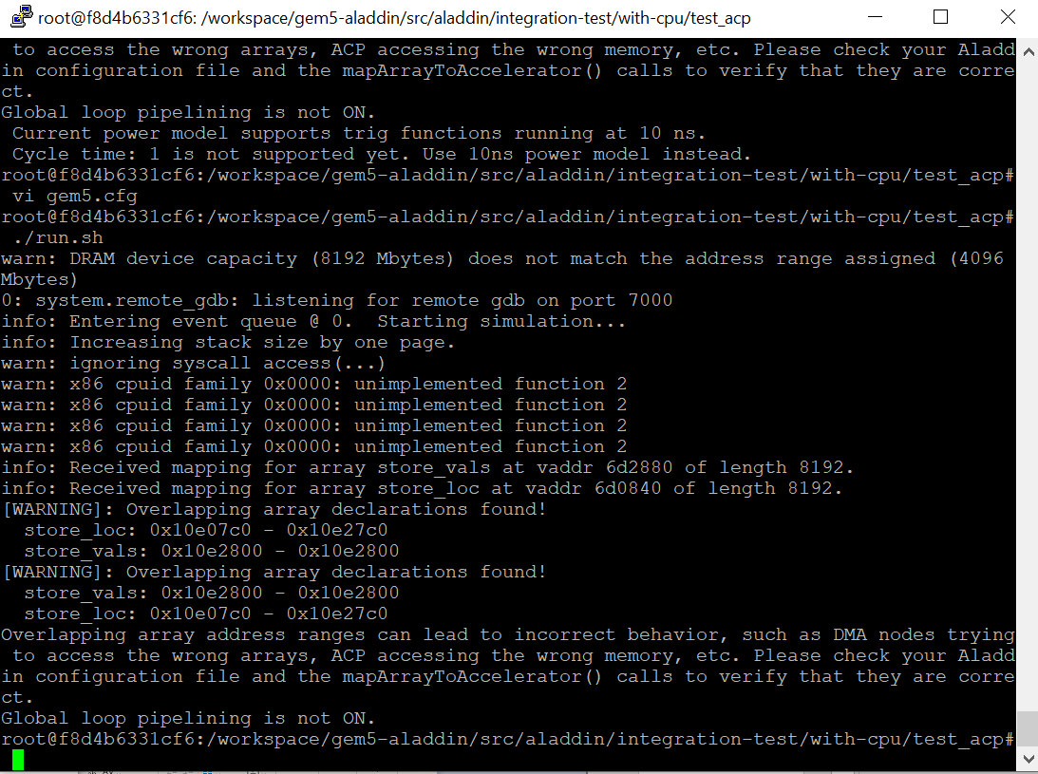
1.8 Example: test_acp
https://github.com/harvard-acc/ALADDIN/
Example: test_acp
Cycle time is 10ns

Slide 24
End

