Slide 1

2 Gem5-Aladdin on Secure Zone
Peter H. Chen

Slide 2
2 Gem5-Aladdin on Secure Zone
https://github.com/harvard-acc/ALADDIN
How to Use Gem5-Aladdin on Secure Zone
This document shows how to run Gem5-Aladdin on secure zone.

Slide 3
1.1 Connect Network

Slide 4
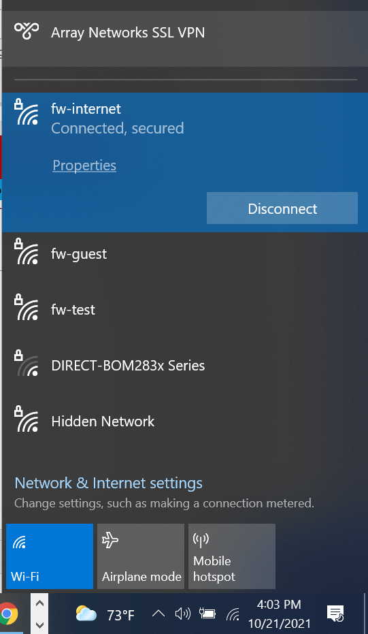
1.2 Connect Network
https://github.com/harvard-acc/ALADDIN
Connect Network
Check fw-internet
Make sure connected and secured.

Slide 5
2.2 MotionPro for Common Zone Connection

Slide 6
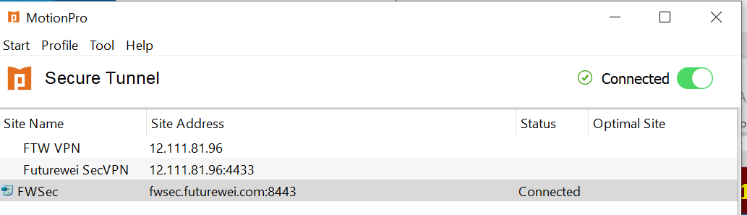
2.2 MotionPro for Common Zone Connection
https://github.com/harvard-acc/ALADDIN
Use MotionPro for Common Zone Connection
Make sure we are connected to the common zone.

Slide 7

2.4 Connect Secure Zone by Exceed

Slide 8
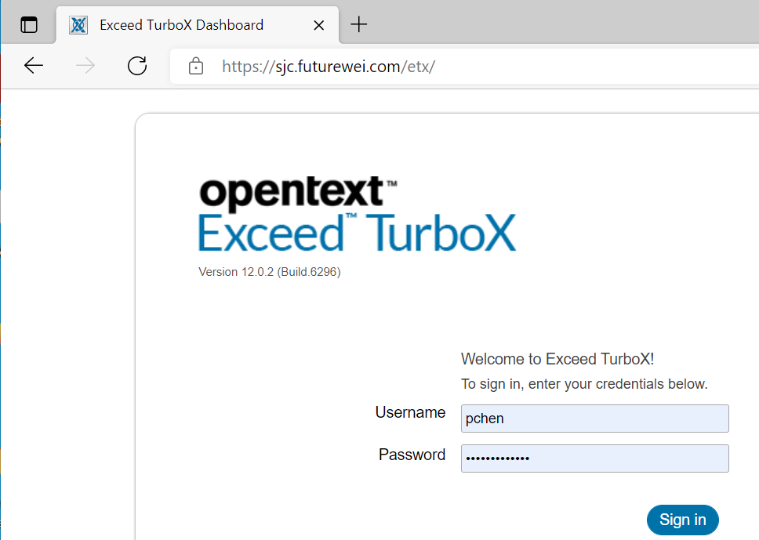
2.4 Connect Secure Zone by Exceed
https://github.com/harvard-acc/ALADDIN
Connect Secure Zone by Exceed
Open Chrome
> https://sjc.Futurewei.com/etx/

Slide 9
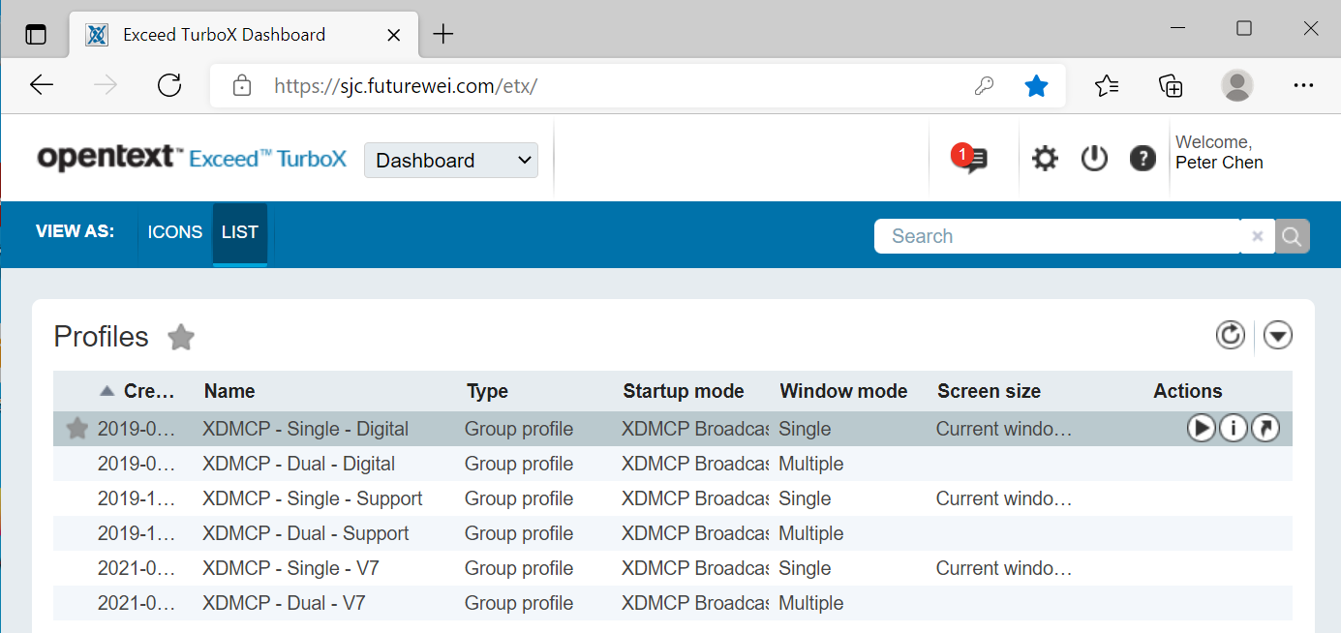
2.4 Connect Secure Zone by Exceed
https://github.com/harvard-acc/ALADDIN
Connect Secure Zone by Exceed
Select and run “XDMCP – Single –Digital” for computer without docking station computer.
Select “XDMCP – Dual –Digital” for computer with docking station computer.

Slide 10
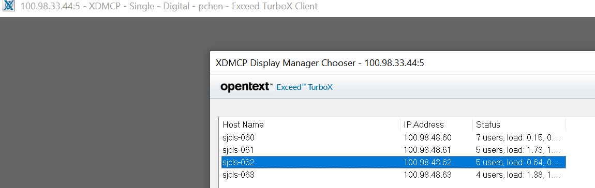
2.4 Connect Secure Zone by Exceed
https://github.com/harvard-acc/ALADDIN
Connect Secure Zone by Exceed
Select any servers (sjc-60, sjc-61, sjc-62, sjc63) to run.

Slide 11
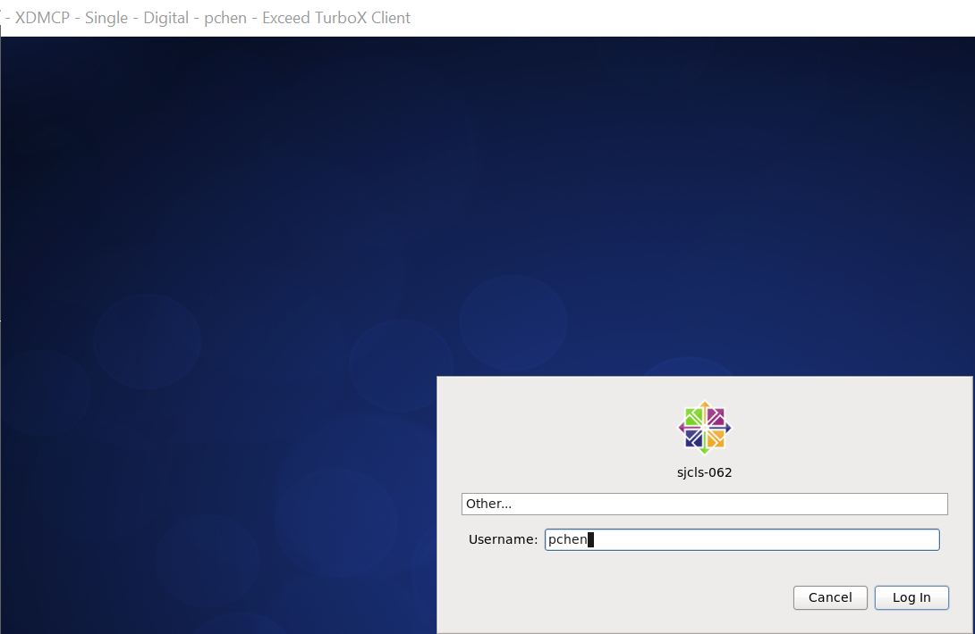
2.4 Connect Secure Zone by Exceed
https://github.com/harvard-acc/ALADDIN
Connect Secure Zone by Exceed
Login to the secure zone.

Slide 12
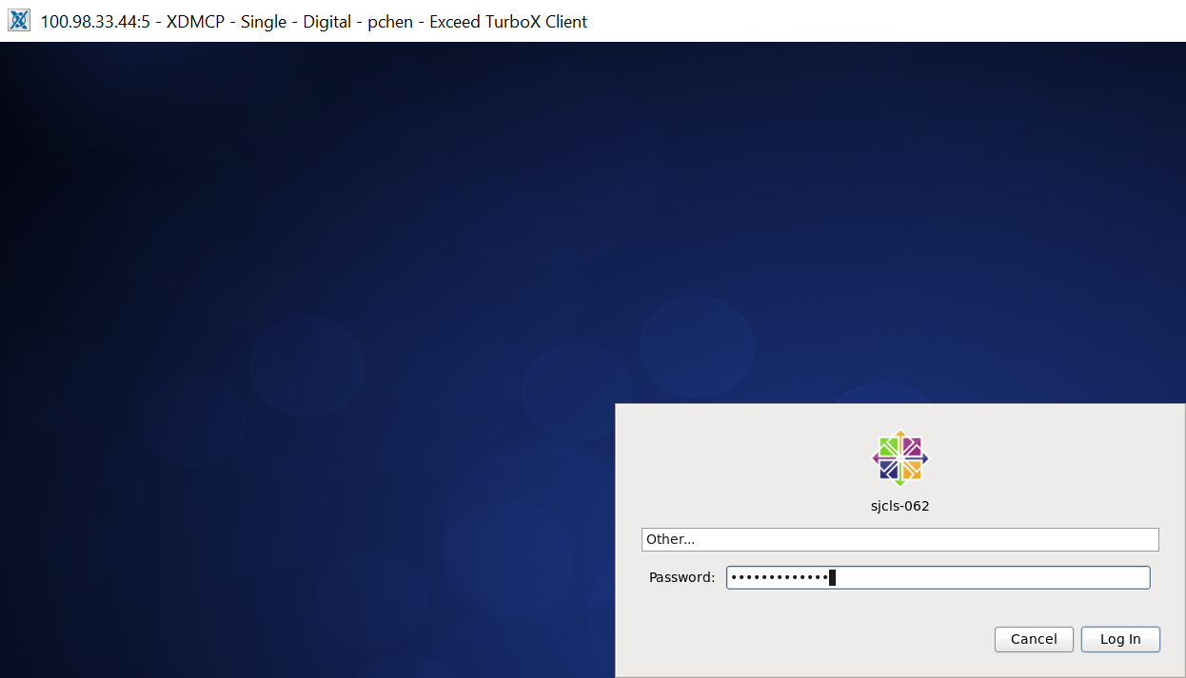
2.4 Connect Secure Zone by Exceed
https://github.com/harvard-acc/ALADDIN
Connect Secure Zone by Exceed
Login to the secure zone with password that Chao-Ma give to you.

Slide 13
2.5 Get into Project Zone

Slide 14
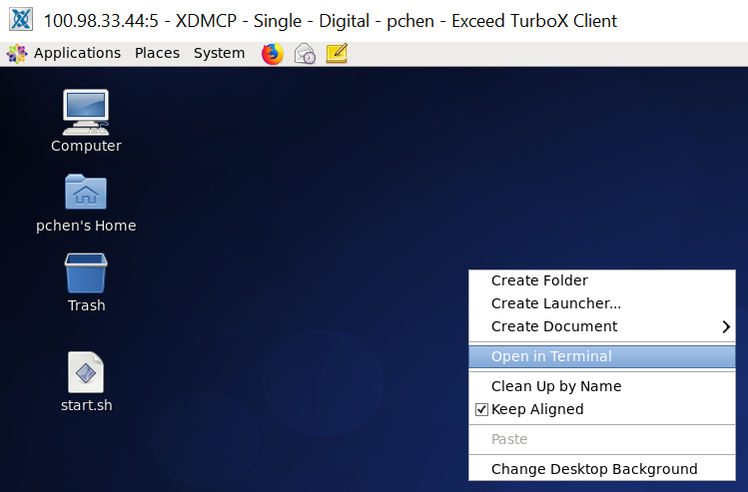
2.5 Get into Project Zone
https://github.com/harvard-acc/ALADDIN
Get into Project Zone
Right-Mouse Button to popup menu.
Select “Open in Terminal”.

Slide 15
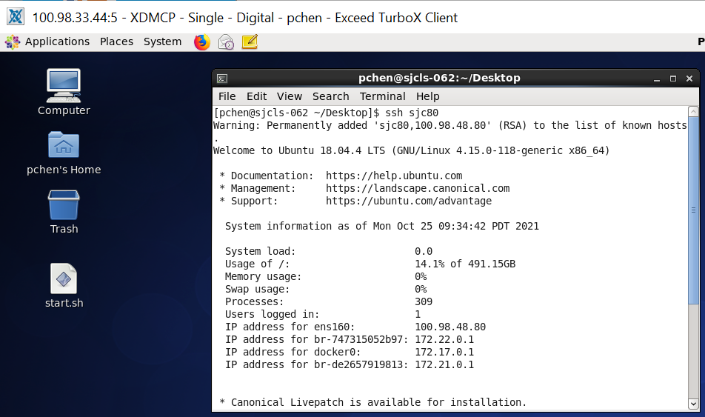
2.5 Get into Project Zone
https://github.com/harvard-acc/ALADDIN
Get into Project Zone
> ssh sjc80
We are in secure project zone.

Slide 16

2.5 Get into Project Zone
https://github.com/harvard-acc/ALADDIN
Get into Project Zone
> bash
Get into the bash she.

Slide 17
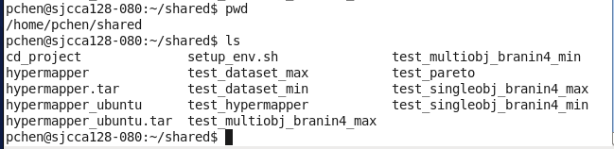
2.5 Get into Project Zone
https://github.com/harvard-acc/ALADDIN
Get into Project Zone
> cp /home/pchen/shared/setup_env.sh
> vi setup_env.sh.

Slide 18
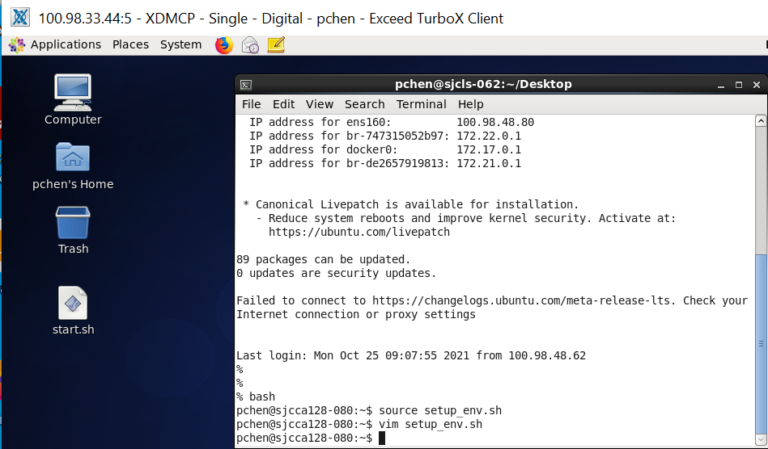
2.5 Get into Project Zone
https://github.com/harvard-acc/ALADDIN
Get into Project Zone
> source setup_env.sh

Slide 19
2.6 Docker Run

Slide 20
1.5 Docker Run
https://github.com/harvard-acc/ALADDIN
Docker Run
> docker run -it gem5-aladdin
Note:
you can find “docker_run_aladdin.scr” script in the /home/pchen/shared folder.

Slide 21

1.5 Docker Run
https://github.com/harvard-acc/ALADDIN
Set vim color for /workspace
> cd /workspace
> ls
You can see two folders:
>> LLVM and gem5-aladdin

Slide 22
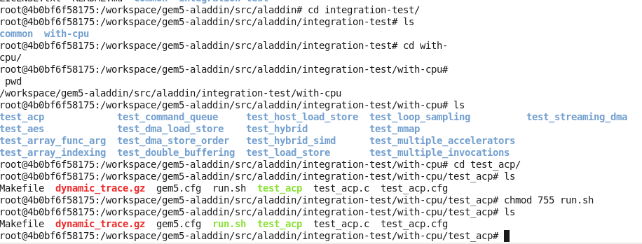
1.5 Docker Run
https://github.com/harvard-acc/ALADDIN
Set vim color for /workspace
> cd /workspace/gem5-aladdin/src/aladdin/integration-test/with-cpu/test_acp
> chmod 755 runs.sh

Slide 23
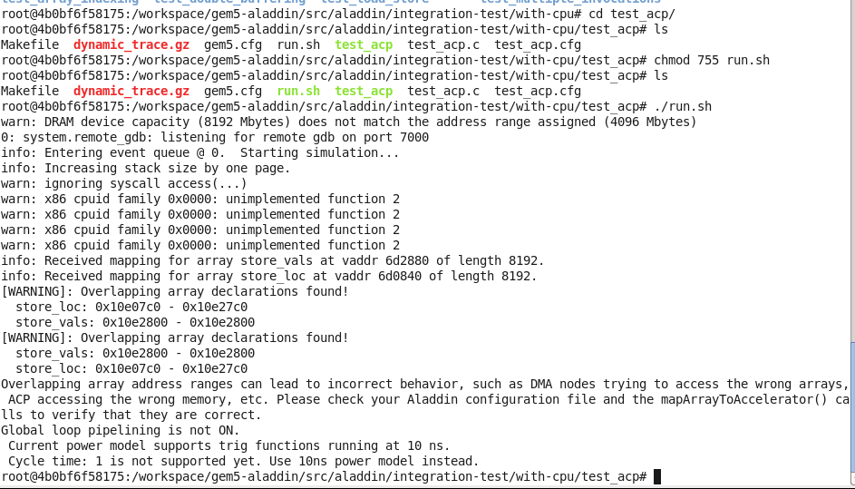
1.5 Docker Run
https://github.com/harvard-acc/ALADDIN
Set vim color for /workspace
> ./run.sh

Slide 24
End

