Slide 1

1 Aladdin Summary
Peter H. Chen

Slide 2
1.0 Summary
https://www.cs.virginia.edu/~smk9u/CS6501F16/p97-shao.pdf
Key Features Summary
1. High Level Design Exploration (not low-level Simulator) for Accelerator. No clock tree or IO pin.
2. Aladdin build knowledge-based DDDG (Dynamic Data Dependency Graph) to solve the NP (Non-Polynomial) problems in EDA tools.
3. Pre-RTL (Verilog Behavioral, no Gate-Level Synthesis) for Datapath circuits, such as, FFT, adders, and shifters (Multiplication/Division). Fit the need of CUDA Parallel Computing, Mathematical Machine Learning (hypermapper or scikit-learn), and Neural Networking Deep Learning (PyTorch and Tensorflow).
4. Accuracy: Performance 0.9%, Power 4.9%, and Area 6.6%.
5. Test Case: 7min in Aladdin vs. 52 hours current EDA flow.

Slide 3
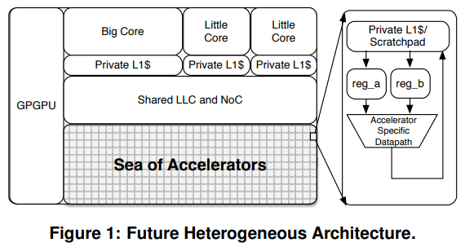
1.1 Introduction
https://www.cs.virginia.edu/~smk9u/CS6501F16/p97-shao.pdf
Introduction

Slide 4
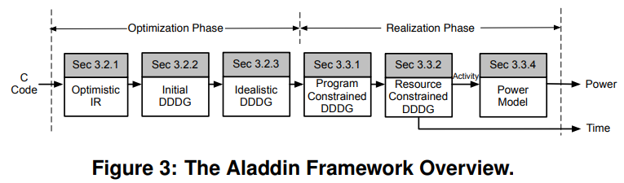
3.1 Aladdin Framework
https://www.cs.virginia.edu/~smk9u/CS6501F16/p97-shao.pdf
The Aladdin Framework

Slide 5
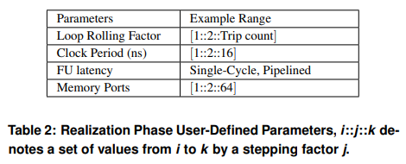
3.3.2 Resource-Constrained DDDG
https://www.cs.virginia.edu/~smk9u/CS6501F16/p97-shao.pdf
Resource-Constrained DDDG

Slide 6
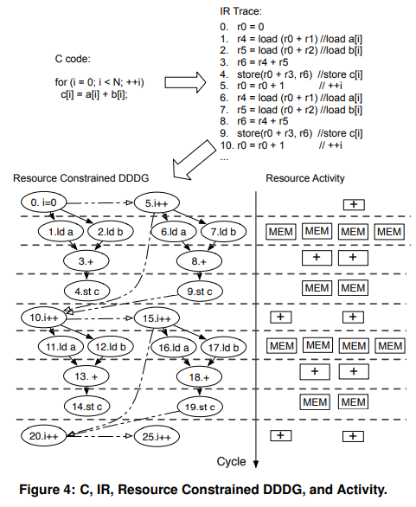
3.3.3 An Example
https://www.cs.virginia.edu/~smk9u/CS6501F16/p97-shao.pdf
An Example

Slide 7
3.3.4 Power and Area Models
https://www.cs.virginia.edu/~smk9u/CS6501F16/p97-shao.pdf
Power Model
To accurately model the power of accelerators, we need:
(a) precise activities and
(b) accurate power characterization of different DDDG components.
We uniquely characterize switching, internal, and leakage power from Design Compiler for each type of DDDG node (multipliers, adders, shifters, etc.) and registers.
The characterization accounts for different timing requirements, BW (bitwidths), and switching activity.
Switching and internal power are due to capacitive charging/discharging of output load and internal transistors of the logic gates, respectively.
While switching and internal power are both dynamic, we found internal power weakly dependent on activity because internal nodes can switch without the gate output switching.

Slide 8
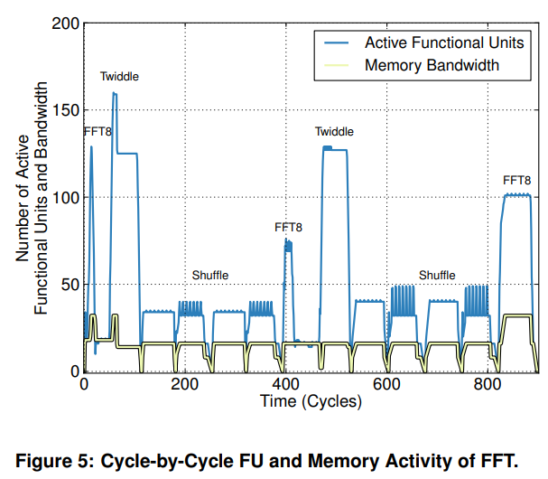
3.3.4 Power and Area Models
https://www.cs.virginia.edu/~smk9u/CS6501F16/p97-shao.pdf
Cycle-Level Activity

Slide 9
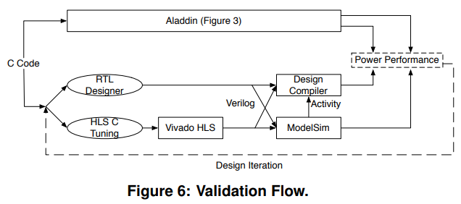
4.1 Validation Flow
https://www.cs.virginia.edu/~smk9u/CS6501F16/p97-shao.pdf
4.1 Validation Flow

Slide 10
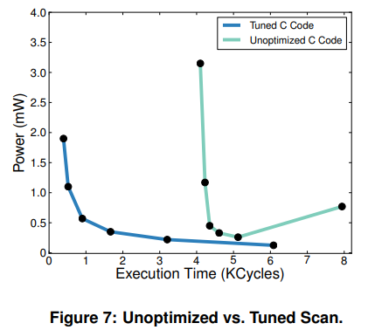
4.1.1 HLS Tuning
https://www.cs.virginia.edu/~smk9u/CS6501F16/p97-shao.pdf
4.1.1 HLS Tuning

Slide 11
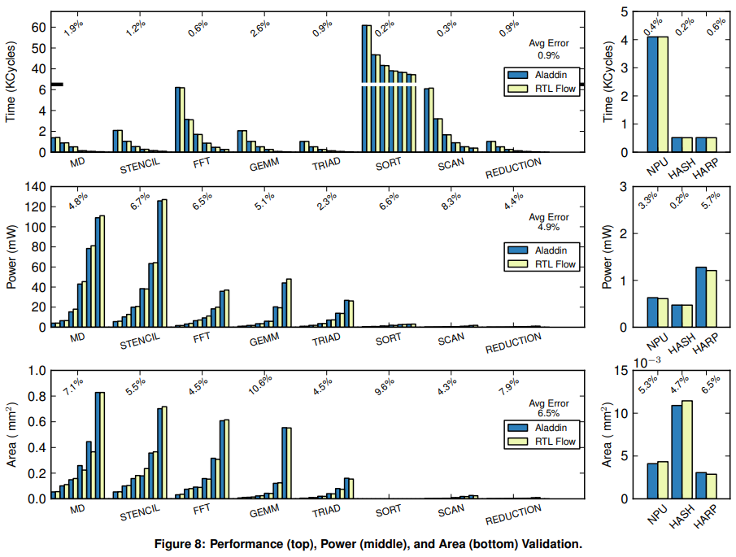
4.3 Validation
https://www.cs.virginia.edu/~smk9u/CS6501F16/p97-shao.pdf
4.3 Validation

Slide 12
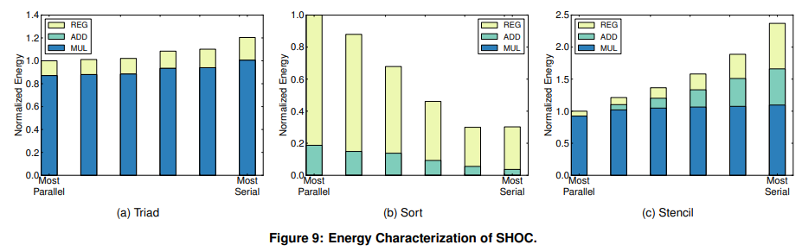
4.3 Validation
https://www.cs.virginia.edu/~smk9u/CS6501F16/p97-shao.pdf
4.3 Validation (5)
Pareto Analysis
Aladdin’s detailed power model enables energy breakdowns for adders, multipliers, and registers.
The six bars of each benchmark are normalized to the leftmost bar to facilitate comparisons.

Slide 13
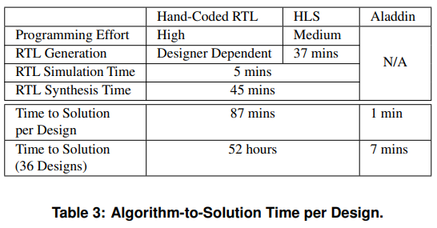
4.4 Algorithm-to-Solution Time
https://www.cs.virginia.edu/~smk9u/CS6501F16/p97-shao.pdf
4.4 Algorithm-to-Solution Time

Slide 14
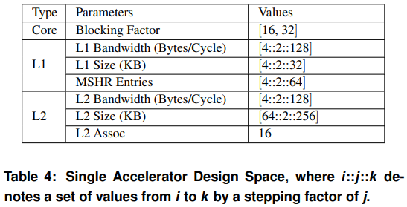
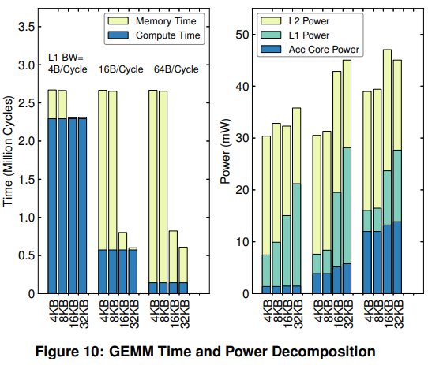
5.1 Execution Time Decomposition
https://www.cs.virginia.edu/~smk9u/CS6501F16/p97-shao.pdf
5.1 Execution Time Decomposition

Slide 15
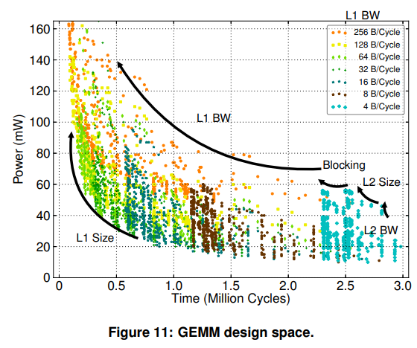
5.2 Accelerator Design Space
https://www.cs.virginia.edu/~smk9u/CS6501F16/p97-shao.pdf
5.2 Accelerator Design Space

Slide 16
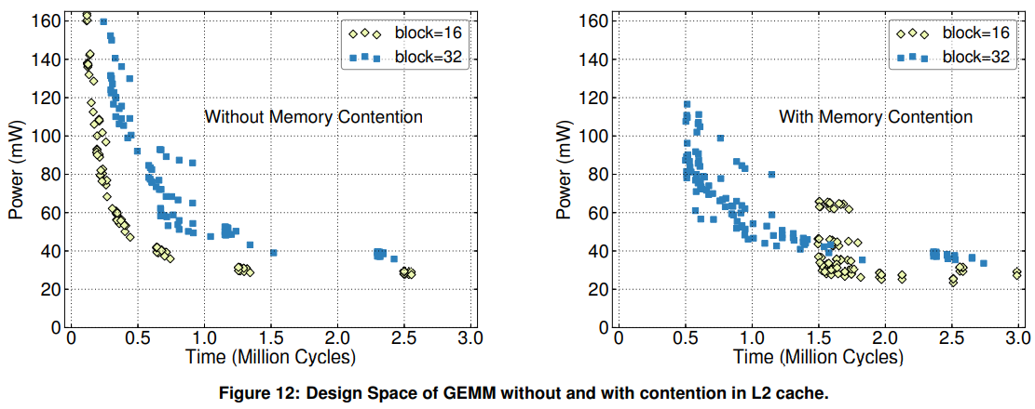
5.3 Resource-Sharing Effects
https://www.cs.virginia.edu/~smk9u/CS6501F16/p97-shao.pdf
5.3 Resource-Sharing Effects in Heterogenous SoC (2)

Slide 17
End

