Slide 1

50 Build/Run Gem5 in VirtualBox/Ubuntu
Peter H. Chen

Slide 2
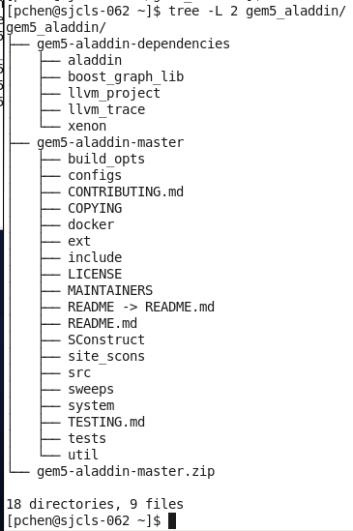
50 Build/Run Gem5 Dependency in VirtualBox/Ubuntu
https://github.com/harvard-acc/gem5-aladdin
Build/Run Gem5 Dependency in VirtualBox/Ubuntu
This document describes how to build Gem5-Aladdin.
We assume you download all the files on the right.

Slide 3
50 Build/Run Gem5 Dependency in VirtualBox/Ubuntu
https://github.com/harvard-acc/gem5-aladdin
Build/Run Gem5-Aladdin in VirtualBox/Ubuntu
The gem5-aladdin simulator integrate the following dependencies:
gem5-aladdin framework: https://github.com/harvard-acc/gem5-aladdin
gem5-alddin dependencies:
1. gem5 dependencies: https://www.gem5.org/
2. aladdin dependencies:
2.1 Aladdin source code/installation: https://github.com/harvard-acc/ALADDIN
2.2 Boost Graph Library source code and installation
https://www.boost.org/doc/libs/1_72_0/more/getting_started/unix-variants.html
2.3 LLVM Tracer source code/installation: https://github.com/harvard-acc/LLVM-Tracer
2.4 llvm_project for headers and development: https://llvm.org/docs/GettingStarted.html#checkout
3. Xenon Design Sweep Generation
https://github.com/xyzsam/xenon

Slide 4
50.1 Download Packages

Slide 5

50.1 Download Packages
https://www.youtube.com/watch?v=SW63HJ0nW90
Download Packages
Linux Update/Upgrade:
> sudo apt-get update
> sudo apt-get upgrade

Slide 6
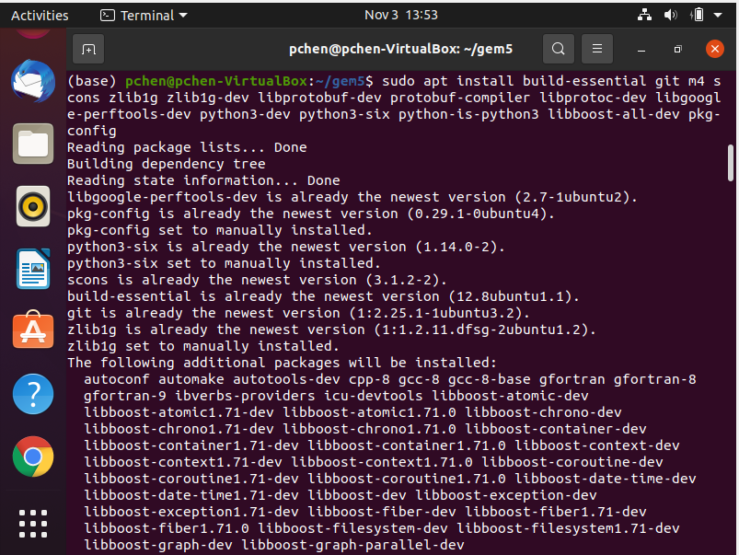
50.1 Download Packages
https://www.youtube.com/watch?v=SW63HJ0nW90
Setup Gem5 environment Packages
For Linux 20.04:
> sudo apt install build-essential git m4 scons zlib1g zlib1g-dev libprotobuf-dev protobuf-compiler libprotoc-dev libgoogle-perftools-dev python3-dev python3-six python-is-python3 libboost-all-dev pkg-config

Slide 7
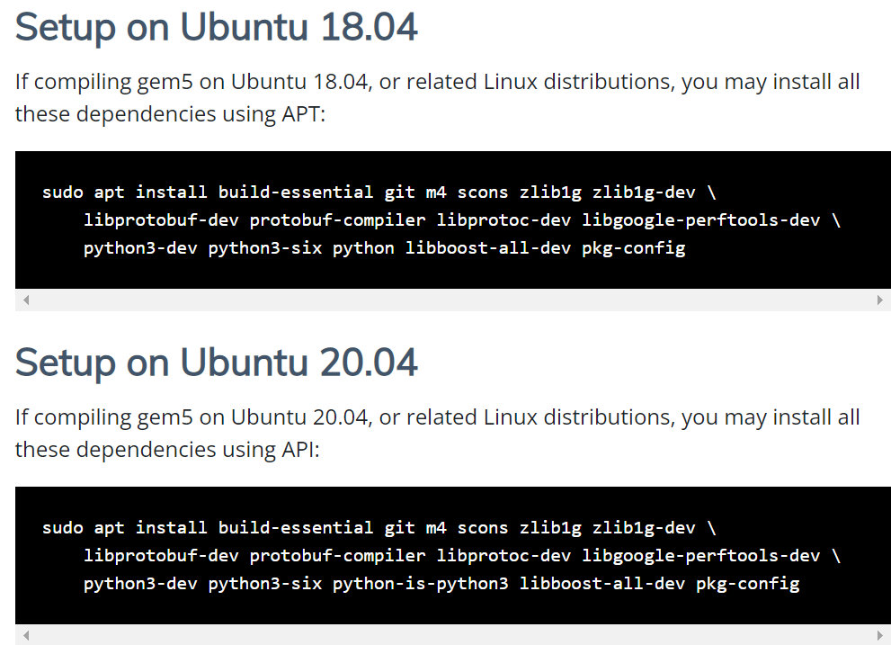
50.1 Download Packages
https://www.youtube.com/watch?v=SW63HJ0nW90
Setup Gem5 environment Packages
gem5.org/documentation/general_docs/building
For VirtualBox/Ubuntu Linux is 18.04:
> sudo apt install build-essential git m4 scons zlib1g zlib1g-dev libprotobuf-dev protobuf-compiler libprotoc-dev libgoogle-perftools-dev python3-dev python3-six python libboost-all-dev pkg-config

Slide 8
50.1 Download Packages
https://www.youtube.com/watch?v=SW63HJ0nW90
Install Gem5
This give us all gem5 we need. The gem5 is the simulate processor with various architecture like ARM, x86.
m4 is GNU macro processor.
python --version 2.7.17; python-dev for C API.
Libgoogle-perfortools-dev: Google package for performance tools for C++ program.
g++: 7.5.0
Note:
For VirtualBox/Ubuntu, I asked the system administrator help to install for us.
Alright, we got all the packages what we are going to do is we are going to be in the home directory.

Slide 9
50.2 Install Gem5

Slide 10
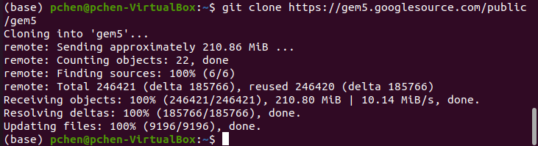
50.2 Install Gem5
https://www.youtube.com/watch?v=SW63HJ0nW90
Install Gem5
Now, we clone gem5 with the following command.
https://www.gem5.org/getting_started/
> git clone https://gem5.googlesource.com/public
We just getting some source files and once we get those. We are going to use scons to build the ARM 5 architecture.
Note: on VirtualBox/Ubuntu, I download from windows and used FileZilla to transfer into the VirtualBox/Ubuntu (to_sj_red folder). Then, in VirtualBox/Ubuntu, I used “gftp” to drag-and -drop into the VirtualBox/Ubuntu.

Slide 11
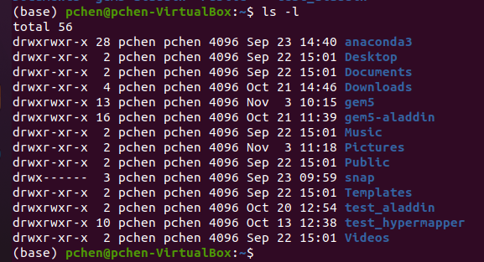
50.1 Install Gem5
https://www.youtube.com/watch?v=SW63HJ0nW90
Install Gem5
Alright, we got all the files, we are in home directory.
We can see the gem5 on the home directory.

Slide 12
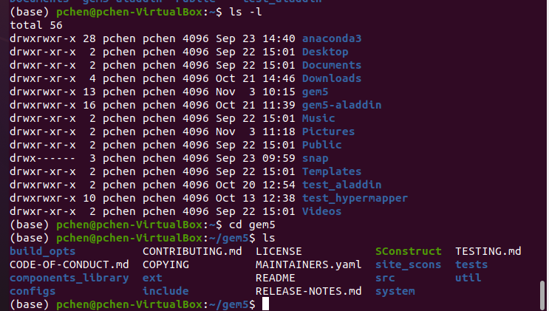
50.1 Install Gem5
https://www.youtube.com/watch?v=SW63HJ0nW90
Install Gem5
We change the directory to “gem5”
> cd gem5
> ls

Slide 13
50.3 Build ARM/gem5.opt

Slide 14
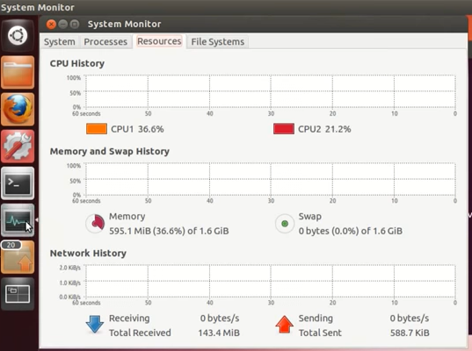
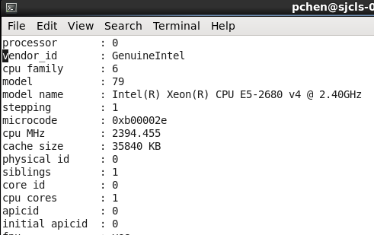
50.3 Build ARM/gem5.opt
https://www.youtube.com/watch?v=SW63HJ0nW90
Build ARM/gem5.opt
Since I have two processors available.

Slide 15
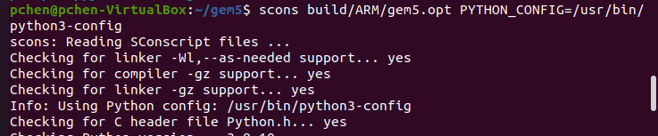
50.3 Build ARM/gem5.opt
https://www.youtube.com/watch?v=SW63HJ0nW90
Build ARM/gem5.opt
Gem5.opt (gem with 5 optimizations) is the executable file that we want to build for running.
Here, we use the “scons” to create “build” folder, the most popular “ARM” architecture, and final executable file is “gem5.opt”.
The gem5.opt stand for the number of optimization is 5. Rather than saying performance monitor or debugging mode.
https://groups.google.com/g/gem5-gpu-dev/c/eBYX06KlkdM
Specify the PYTHON_CONFIG = /usr/bin/python3-config
> scons build/ARM/gem5.opt PYTHON_CONFIG=/usr/bin/python3-config

Slide 16
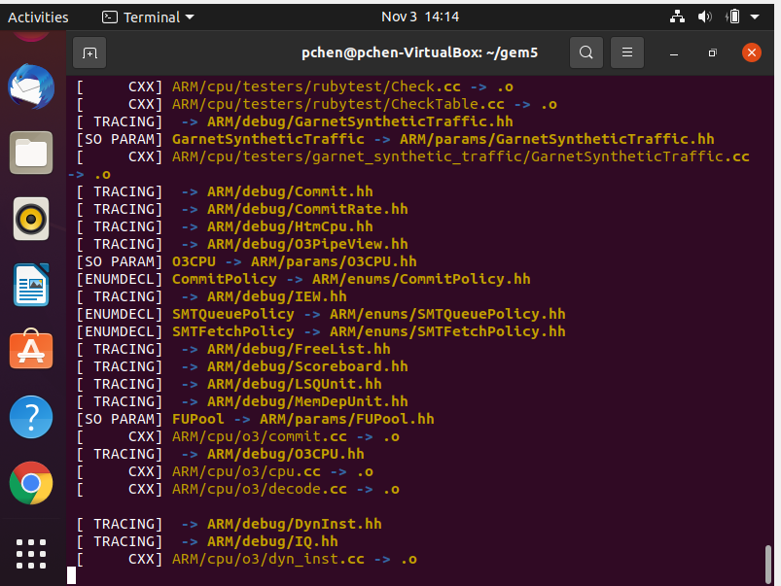
50.3 Build ARM/gem5.opt
https://www.youtube.com/watch?v=SW63HJ0nW90
Build ARM/gem5.opt
Building message:

Slide 17
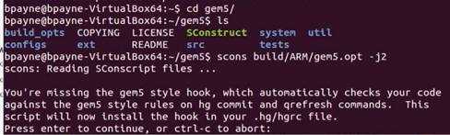
50.3 Build ARM/gem5.opt
https://github.com/harvard-acc/gem5-aladdin
Install Gem5
https://www.youtube.com/watch?v=SW63HJ0nW90
I am using an optional switch -j2 instead of using scons in serial.
It takes the advantage of multiple processes. It will be a little bit faster when build.
> scons build/ARM/gem5.opt -j2 PYTHON_CONFIG=/usr/bin/python3-config

Slide 18
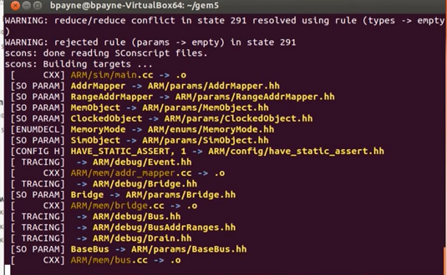
50.3 Build ARM/gem5.opt
https://www.youtube.com/watch?v=SW63HJ0nW90
Build ARM/gem5.opt
> scons build/ARM/gem5.opt -j2 PYTHON_CONFIG=/usr/bin/python3-config
We are building gem5.opt. It will take hours to build.

Slide 19
50.3 Build ARM/gem5.opt
https://www.youtube.com/watch?v=SW63HJ0nW90
Build ARM/gem5.opt
On VirtualBox/Ubuntu:
> python3 `which scons` build/X86/gem5.opt –j9

Slide 20
50.4 Test ARM/gem5.opt

Slide 21
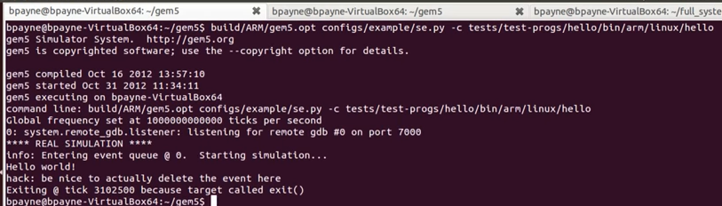
50.4 Test ARM/gem5.opt
https://github.com/harvard-acc/gem5-aladdin
Test ARM/gem5.opt
https://www.youtube.com/watch?v=SW63HJ0nW90
We just finished the CPU emulator for the ARM architecture.
Now, we are going to test it works or not.
> build/ARM/gem5.opt configs/example/se.py -c tests/test-progs/hello/bin/arm/linux/hello
Here, we use “/build/ARM/gem5.opt” just built.
We call “configs/example/se.py” “se” stand for system emulation mode.
We are going to use pre-compiled binary called “hello” that is in the “tests/test-progs/hello/bin/arm/linux” directory. This is a pre-compiled binary, static binary.

Slide 22
50.4 Test ARM/gem5.opt
https://github.com/harvard-acc/gem5-aladdin
Test ARM/gem5.opt
https://www.youtube.com/watch?v=SW63HJ0nW90
Here, we see this is the command option we supplied.
This is the frequency at tick/sec.
The “hello world” is the only output from the code.

Slide 23
50.5 Verify C Code

Slide 24
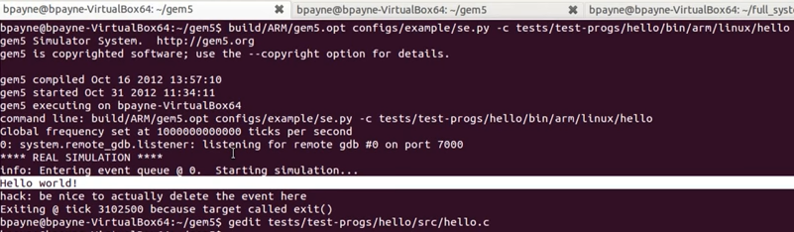
50.5 Verify C Code
https://github.com/harvard-acc/gem5-aladdin
Verify C Code
https://www.youtube.com/watch?v=SW63HJ0nW90
Now look at the code
> vi tests/test-progs/hello/src/hello.c

Slide 25
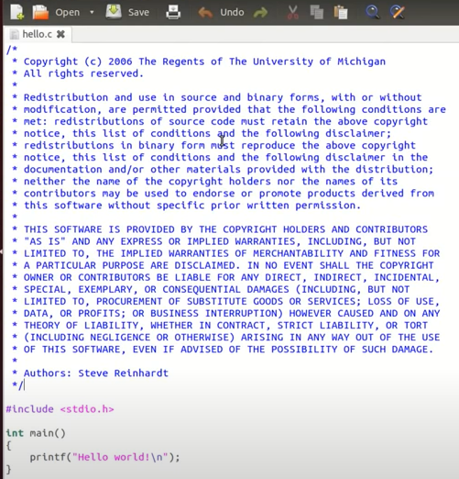
50.5 Verify C Code
https://github.com/harvard-acc/gem5-aladdin
Verify C Code
https://www.youtube.com/watch?v=SW63HJ0nW90
Now look at the code
> vi tests/test-progs/hello/src/hello.c

Slide 26
50.6 Build X86/gem5.prof

Slide 27
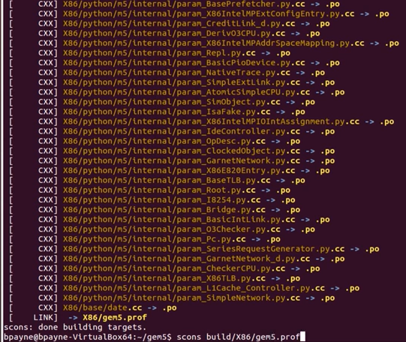
50.6 Build X86/gem5.prof
https://www.youtube.com/watch?v=SW63HJ0nW90
Build X86/gem5.opt
Now, we try another architecture for x86.
> scons build/X86/gem5.prof PYTHON_CONFIG=/usr/bin/python3-config
Note: gem5 has debug (debugging without optimization), opt (optimization mode), fast (fast mode without debugging), prof (use gprof profiling tool), perf (Use google Perftools)

Slide 28
50.7 ARM Architecture

Slide 29
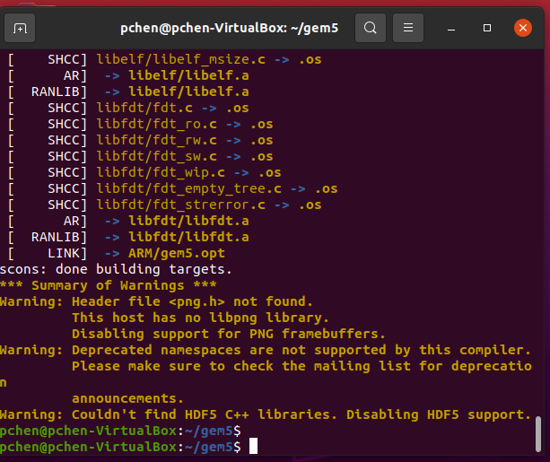
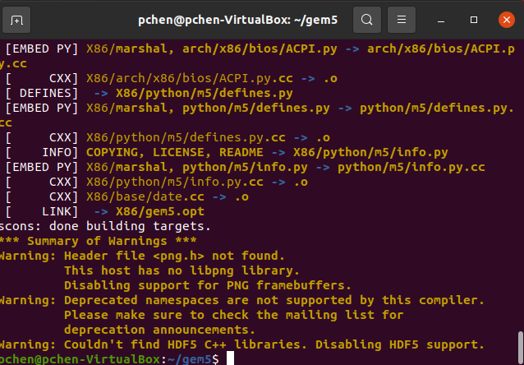
50.7 ARM Architecture
https://github.com/harvard-acc/gem5-aladdin
ARM Architecture
ARM and X86 building done.

Slide 30
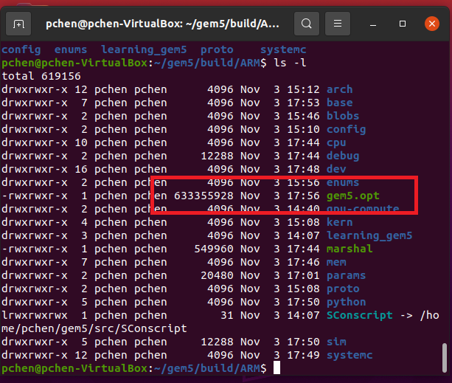
50.7 ARM Architecture
https://github.com/harvard-acc/gem5-aladdin
ARM Architecture
ARM Architecture is the most popular one.
Based gem5.opt based on Ubuntu 20.04, Python 3.6.8.

Slide 31
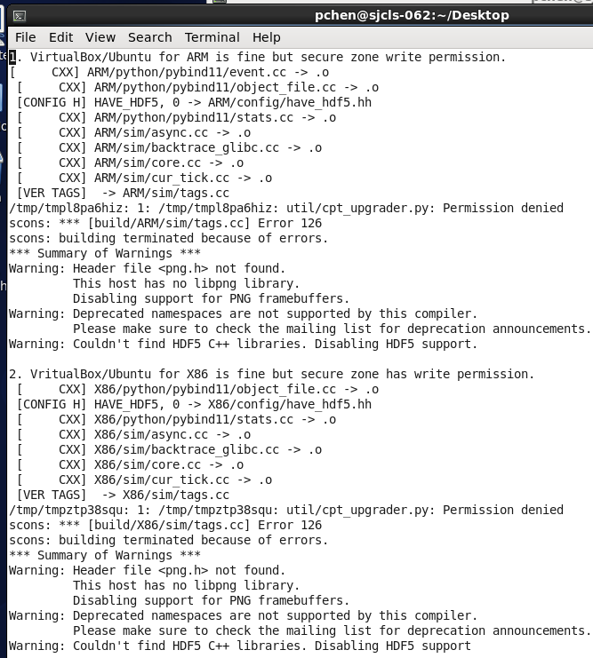
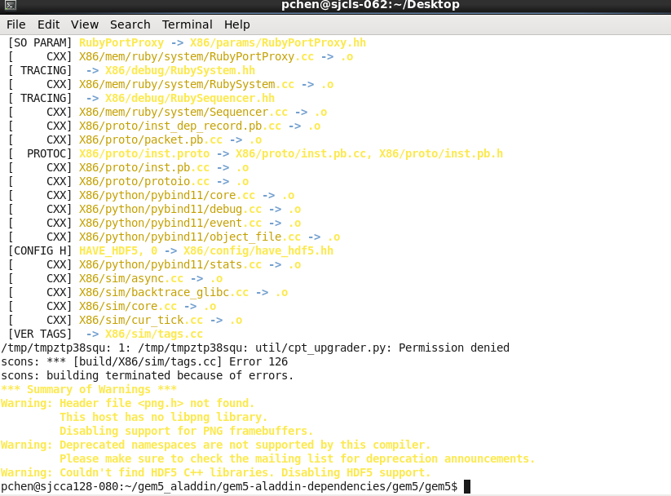
50.7 ARM Architecture
https://github.com/harvard-acc/gem5-aladdin
ARM Architecture
In VirtualBox/Ubuntu, there is a write permission in both X86 and ARM architectures and cannot finish building.

Slide 32
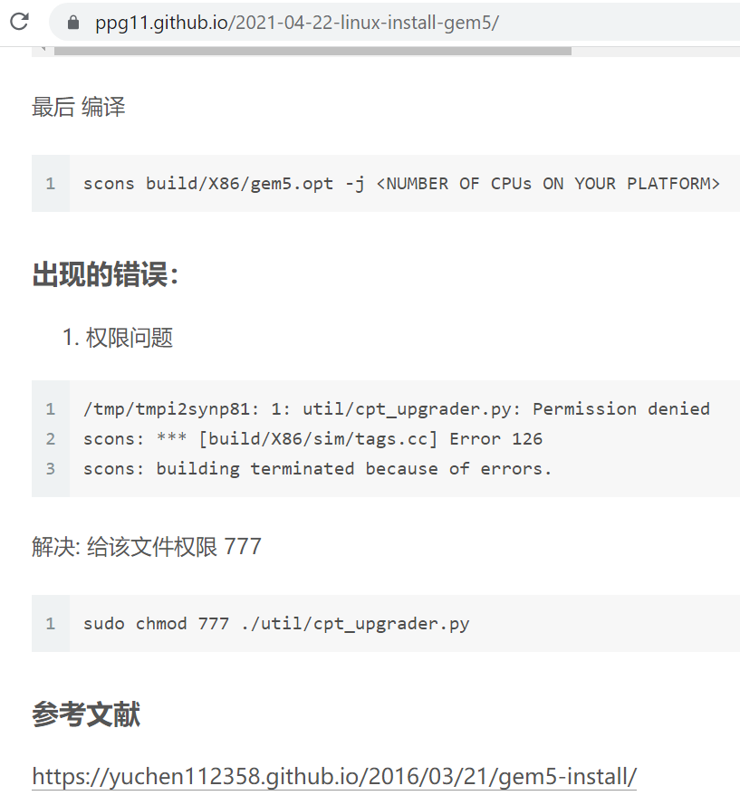
50.7 ARM Architecture
https://github.com/harvard-acc/gem5-aladdin
ARM Architecture
How to fix “permission error”?
https://ppg11.github.io/2021-04-22-linux-install-gem5/

Slide 33
50.8 Build Architectures

Slide 34
50.8 Build Architectures
https://www.youtube.com/watch?v=SW63HJ0nW90
Build Architectures for X86, ARM, MIPS, POWER, RISCV, and SPARC
> cd ../gem5
> /usr/bin/env python3 $(which scons) build/X86/gem5.opt –j2 PYTHON_CONFIG=/usr/bin/python3-config
> /usr/bin/env python3 $(which scons) build/ARM/gem5.opt –j2 PYTHON_CONFIG=/usr/bin/python3-config
> /usr/bin/env python3 $(which scons) build/MIPS/gem5.opt –j2 PYTHON_CONFIG=/usr/bin/python3-config
> /usr/bin/env python3 $(which scons) build/POWER/gem5.opt –j2 PYTHON_CONFIG=/usr/bin/python3-config
> /usr/bin/env python3 $(which scons) build/RISCV/gem5.opt –j2 PYTHON_CONFIG=/usr/bin/python3-config
> /usr/bin/env python3 $(which scons) build/SPARC/gem5.opt –j2 PYTHON_CONFIG=/usr/bin/python3-config

Slide 35
50.9 Compile C Code

Slide 36
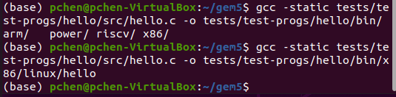
50.9 Compile C Code
https://github.com/harvard-acc/gem5-aladdin
Compile/Run C Code
https://www.youtube.com/watch?v=SW63HJ0nW90
Now, we try another architecture for x86.
> gcc -static tests/test-progs/hello/src/hello.c -o tests/test-progs/hello/bin/x86/linux/hello

Slide 37
50.10 Run X86 Code

Slide 38
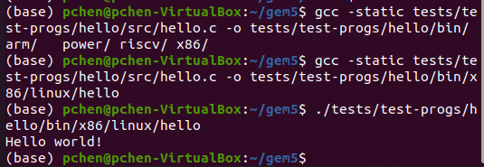
50.10 Run X86 Code
https://github.com/harvard-acc/gem5-aladdin
Run X86 Code
https://www.youtube.com/watch?v=SW63HJ0nW90
Since we are on x86 machine, we can directory run the binary in the host system.
> ./tests/test-progs/hello/bin/x86/linux/hello

Slide 39
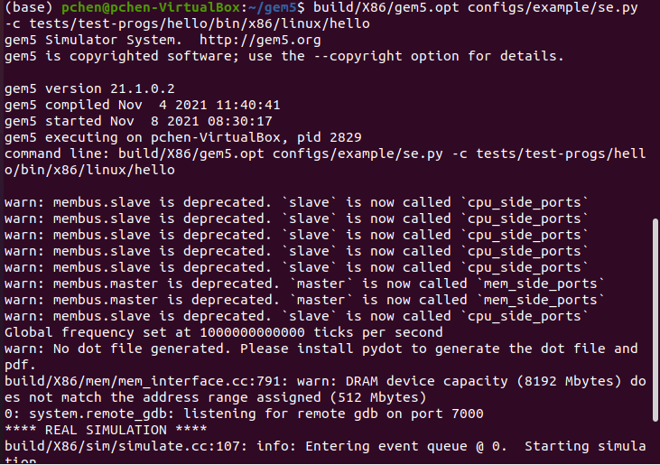
50.10 Run X86 Code
https://www.youtube.com/watch?v=SW63HJ0nW90
Run X86 Code
Now, we can run using the x86 architecture.
> build/X86/gem5.opt configs/example/se.py -c tests/test-progs/hello/bin/x86/linux/hello
This is built on x86/gem5.prof and we use the same system emulation mode.
…and then our binary lives in x86 linux hello.

Slide 40
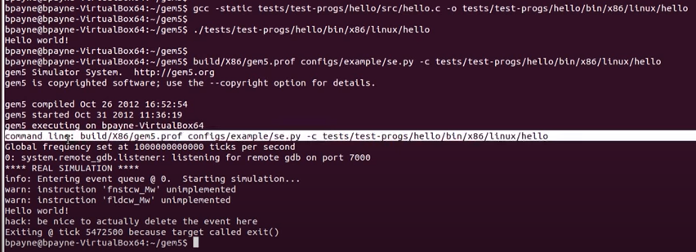
50.10 Run X86 Code
https://www.youtube.com/watch?v=SW63HJ0nW90
Run X86 Code
The first one is we run on host x86 system.
..and the second one is we run on x86 emulator.
1
2

Slide 41
50.10 Run X86 Code
https://www.youtube.com/watch?v=SW63HJ0nW90
Run X86 Code
This is the first one. We run on host x86 system.
1

Slide 42
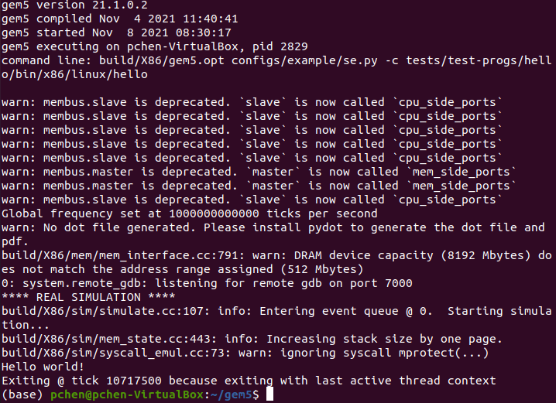
50.10 Run X86 Code
https://www.youtube.com/watch?v=SW63HJ0nW90
Run X86 Code
This is the second one. We run on x86 emulator.
2
2

Slide 43
50.11 Summary

Slide 44
50.11 Summary
https://github.com/harvard-acc/gem5-aladdin
Command Summary
Download gem5:
> git clone https://gem5.googlesource.com/public
We just getting some source files and once we get those. We are going to use scons to build the ARM 5 architecture.
Note: on VirtualBox/Ubuntu, I download from windows and used FileZilla to transfer into the VirtualBox/Ubuntu (to_sj_red folder). Then, in VirtualBox/Ubuntu, I used “gftp” to drag-and -drop into the VirtualBox/Ubuntu.
Setup Gem5 environment Packages:
> sudo apt install build-essential git m4 scons zlib1g zlib1g-dev libprotobuf-dev protobuf-compiler libprotoc-dev libgoogle-perftools-dev python3-dev python3-six python-is-python3 libboost-all-dev pkg-config

Slide 45
50.11 Summary
https://github.com/harvard-acc/gem5-aladdin
Command Summary
Build Gem5:
On Ubuntu 20.x for scons
> scons build/ARM/gem5.opt -j2 PYTHON_CONFIG=/usr/bin/python3-config
On VirtualBox/Ubuntu (reset python 2 into Python3) for scons
/usr/bin/python3 $(which scons) build/ARM/gem5.opt -j2 PYTHON_CONFIG=/usr/bin/python3-config
# Remove character ‘\r’ from python’\r’
#> testVar=$(which python3)
#> MY_NEW_VAR=$(echo $testVar | tr -d ‘\r’)
#> ${MY_NEW_VAR} $(which scons) build/ARM/gem5.opt -j2 PYTHON_CONFIG=/usr/bin/python3-config

Slide 46
End

