Slide 1

70 Build/Run Gem5-Aladdin on Docker
Peter H. Chen

Slide 2
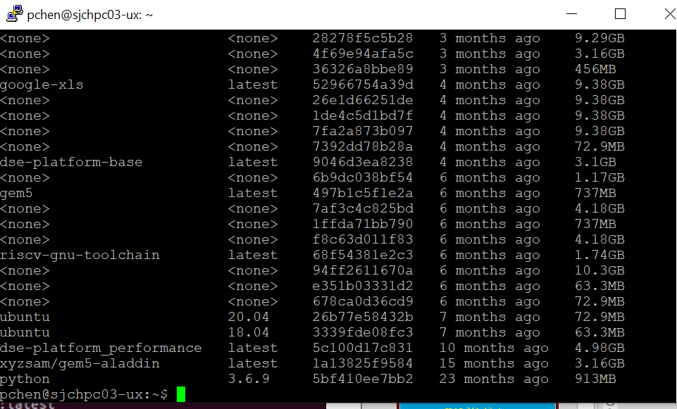
70 Build/Run Gem5-Aladdin on Docker
https://www.youtube.com/watch?v=SW63HJ0nW90
Build/Run Gem5-Alddin on Docker
> docker pull xyzsam/gem5-aladdin
We need Chao Ma to give you the “pull” permission from Docker-Hub.
Check available images on local repository:
> docker images

Slide 3
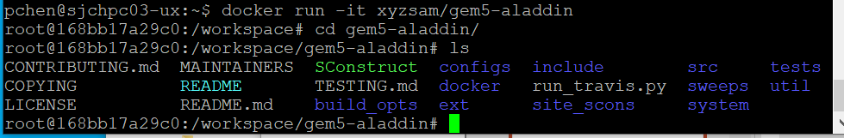
70 Build/Run Gem5-Aladdin on Docker
https://www.youtube.com/watch?v=SW63HJ0nW90
Build/Run Gem5-Alddin on Docker
> docker run -it xyzsam/gem5-aladdin
> cd /workspace/gem5-aladdin
> ls

Slide 4
52.1 Build Architecture

Slide 5
52.1 Build Architecture
https://www.youtube.com/watch?v=SW63HJ0nW90
Build Architecture
> cd /workspace/gem5-aladdin
> python2.7 `which scons` build/X86/gem5.opt (OK)
> python2.7 `which scons` build/ARM/gem5.opt (Error)
> python2.7 `which scons` build/MIPS/gem5.opt (Error)
> python2.7 `which scons` build/POWER/gem5.opt (Error)
> python2.7 `which scons` build/RISCV/gem5.opt (Error)
> python2.7 `which scons` build/SPARC/gem5.opt (Error)

Slide 6
52.2 Check Modified/Working Image

Slide 7
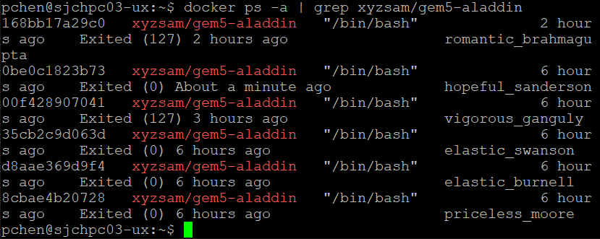
52.2 Check Modified/Working Image
https://www.youtube.com/watch?v=SW63HJ0nW90
Check Modified/Working Image
> exit
> docker ps -a | grep xyzsam/gem5-aladdin
Exit (0) About a minute ago is the image we want to save. Its ID is: 0bec1823b73.

Slide 8
52.3 Save Modified Image into New Name

Slide 9
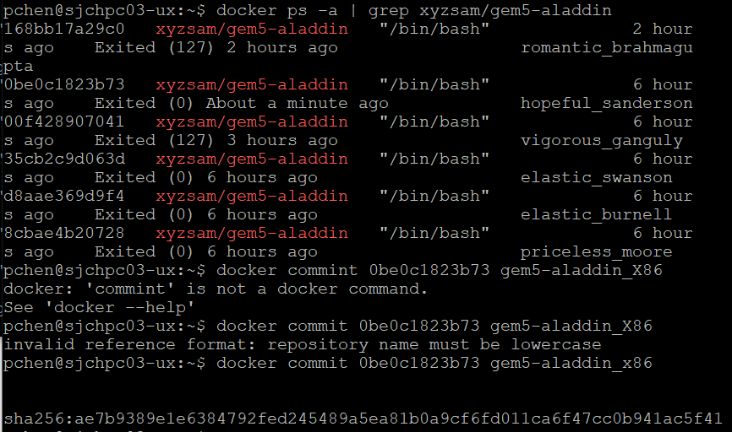
52.3 Save Modified Image into New Name
https://www.youtube.com/watch?v=SW63HJ0nW90
Save Modified Image into New Name
> docker commit 0be0c1823b73 gem5-aladdin_x86.
Image name only lower cases is allowed.

Slide 10
52.4 Check Saved Image

Slide 11
52.4 Check Saved Image
https://www.youtube.com/watch?v=SW63HJ0nW90
Check Saved Image
Check saved image gem5-aladdin_x86
> docker images | grep x86

Slide 12
52.5 Run Saved Image

Slide 13
52.5 Run Saved Image
https://www.youtube.com/watch?v=SW63HJ0nW90
Run Saved Image
Run saved image gem5-aladdin_x86
> docker run -it gem5-aladdin_x86

Slide 14
52.6 Verify Image Content

Slide 15
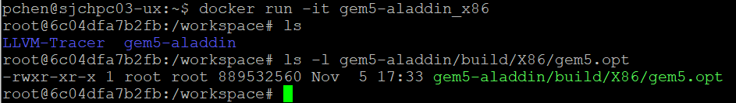
52.6 Verify Image Content
https://www.youtube.com/watch?v=SW63HJ0nW90
Verify Image Content
Run saved image gem5-aladdin_x86
> docker run -it gem5-aladdin_x86
Verify the build/X86/gem5.opt is there.
> ls -l gem5-aladdin/build/X86/gem5.opt

Slide 16
End

