Slide 1

71 Compile/Run Gem5-Aladdin C Code on Common Zone
Peter H. Chen

Slide 2

71.1 Compile Code on Gem5-Aladdin
https://www.youtube.com/watch?v=SW63HJ0nW90
Compile/Run Gem5-Alddin C-Code on Common Zone
Previously, we save the xyzsam/gem5-alddin into gem5-aladdin_x86. Now, we start from gem5-aladdin_x86 and continue to work.
> docker run -it gem5-aladdin_x86
>>/workspace> ls

Slide 3
71.1 Compile Code on Gem5-Aladdin

Slide 4
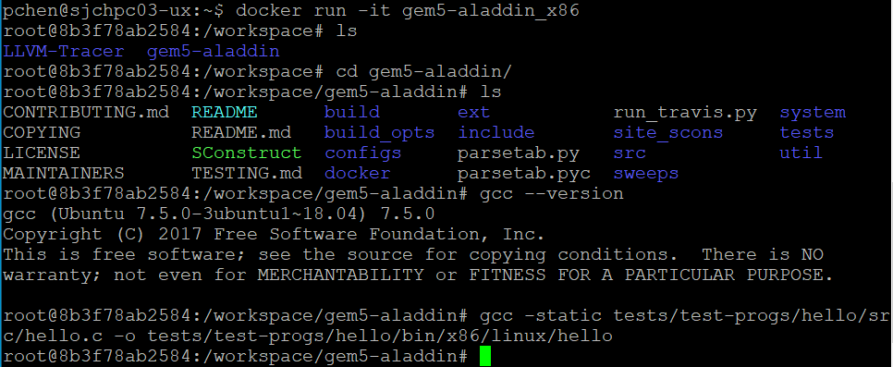
71.1 Compile Code on Gem5-Aladdin
https://www.youtube.com/watch?v=SW63HJ0nW90
Compile Code on Gem5-Aladdin
>> workspace> cd gem5-aladdin
>> workspace/gem5-aladdin> gcc -static tests/test-progs/hello/src/hello.c –o tests/test-progs/hello/bin/x86/linux/hello

Slide 5
71.2 Run Compiled hello.c

Slide 6
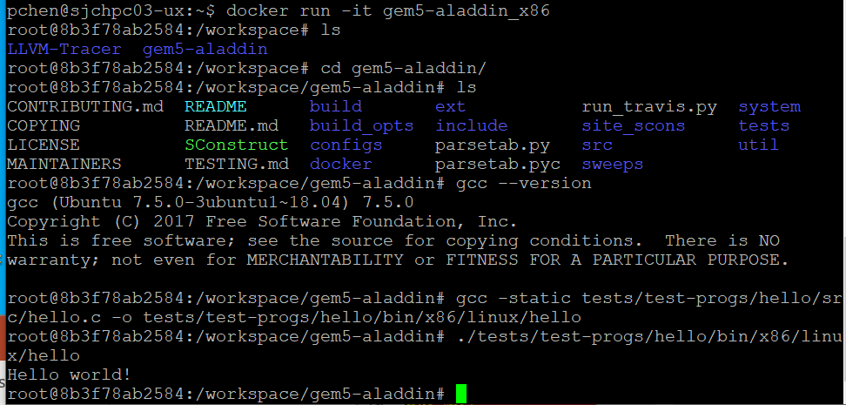
71.2 Run Compiled hello.c
https://www.youtube.com/watch?v=SW63HJ0nW90
Run Compiled hello.c
>> /workspace/gem5-aladdin > ./tests/test-progs/hello/bin/x86/linux/hello
>> Hello World!

Slide 7
71.3 Build/Run hello.c on Gem5-Aladdin/Emulator X86

Slide 8
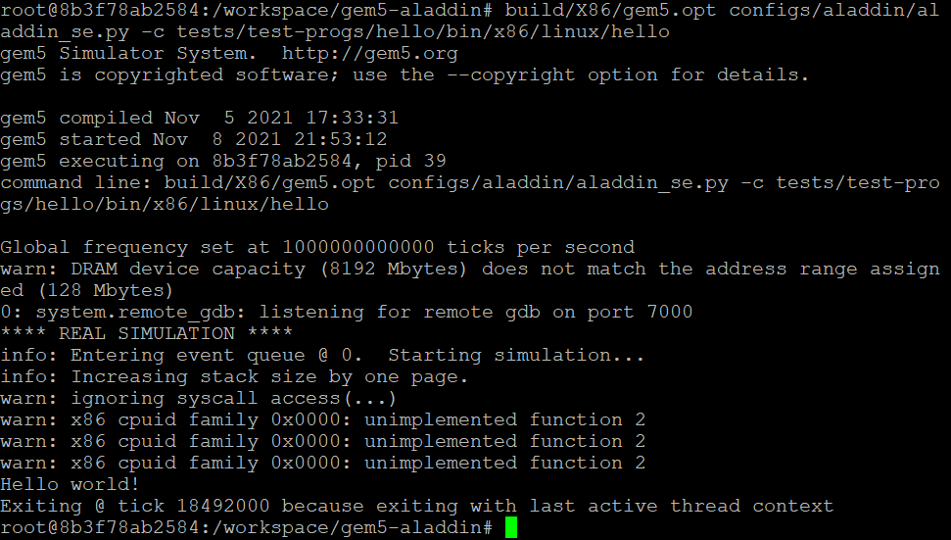
71.3 Build/Run hello.c on Gem5-Aladdin/Emulator X86
https://www.youtube.com/watch?v=SW63HJ0nW90
Build/Run hello.c on Gem5-Aladdin/Emulator X86
>> /workspace/gem5-aladdin > build/X86/gem5.opt configs/aladdin/aladdin_se.py –c tests/test-progs/hello/bin/x86/linux/hello
>> Hello World!

Slide 9
71.4 Save into gem5-aladdin_hello

Slide 10
71.4 Save into gem5-aladdin_hello
https://www.youtube.com/watch?v=SW63HJ0nW90
Save into gem5-aladdin_hell
> docker ps –a | grep _x86
Carefully check the ID 0443997f06c8
> docker commit 0443997f06c8 gem5-aladdin_hello

Slide 11
71.5 Docker run gem5-aladdin_hello

Slide 12
71.5 Docker run gem5-aladdin_hello
https://www.youtube.com/watch?v=SW63HJ0nW90
Docker run gem5-aladdin_hello
> docker ps –a | grep hello

Slide 13
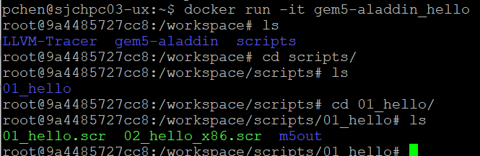
71.5 Docker run gem5-aladdin_hello
https://www.youtube.com/watch?v=SW63HJ0nW90
Docker run gem5-aladdin_hello
> docker run –it gem5-aladdin_hello

Slide 14
End

