Slide 1

72 Gem5-Aladdin Auto Test: test_load_store
Peter H. Chen

Slide 2
72 Gem5-Aladdin Auto Test: test_load_store
https://www.youtube.com/watch?v=SW63HJ0nW90
Gem5-Alddin Auto Test: test_load_store
We write the script to do the integration_test/test_load_store
Copy the gem5-aladdin-hello to gem5-aladdin_autotest
> docker gem5-aladdin-hello gem5_aladdin_autotest
> docker images | grep autotest
> docker images | grep hello

Slide 3
72.1 Clean up test_load_store

Slide 4
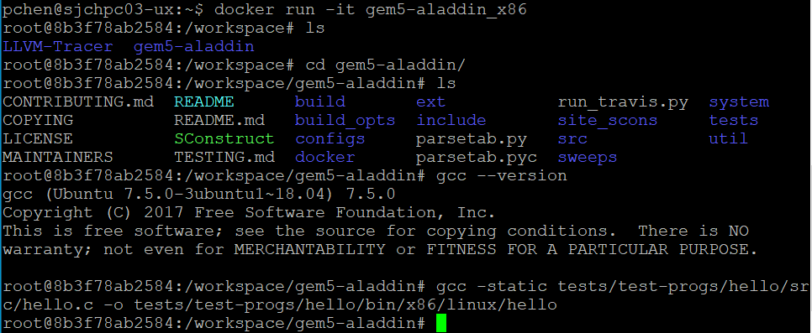
72.1 Clean up test_load_store
https://www.youtube.com/watch?v=SW63HJ0nW90
Clean up test_load_store
>> workspace> cd gem5-aladdin
>> workspace/gem5-aladdin> gcc -static tests/test-progs/hello/src/hello.c –o tests/test-progs/hello/bin/x86/linux/hello

Slide 5
72.2 Run Compiled hello.c

Slide 6
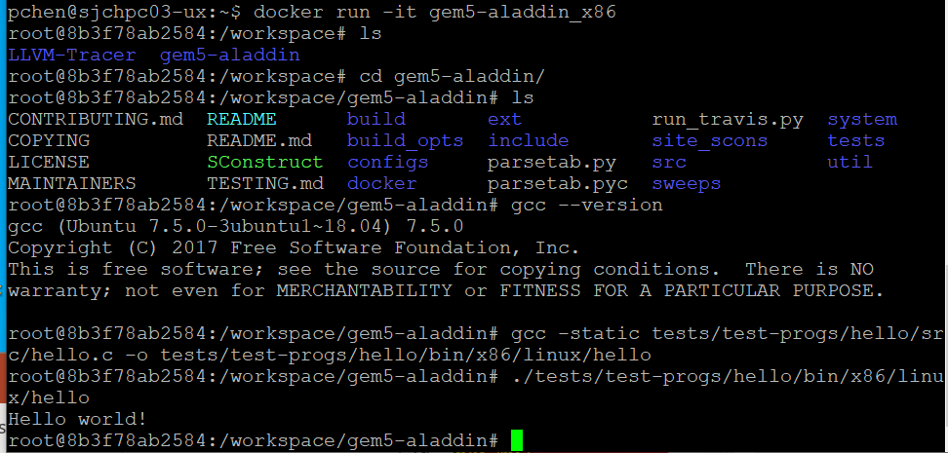
72.2 Run Compiled hello.c
https://www.youtube.com/watch?v=SW63HJ0nW90
Run Compiled hello.c
>> /workspace/gem5-aladdin > ./tests/test-progs/hello/bin/x86/linux/hello
>> Hello World!

Slide 7
72.3 Build/Run hello.c on Gem5-Aladdin/Emulator X86

Slide 8
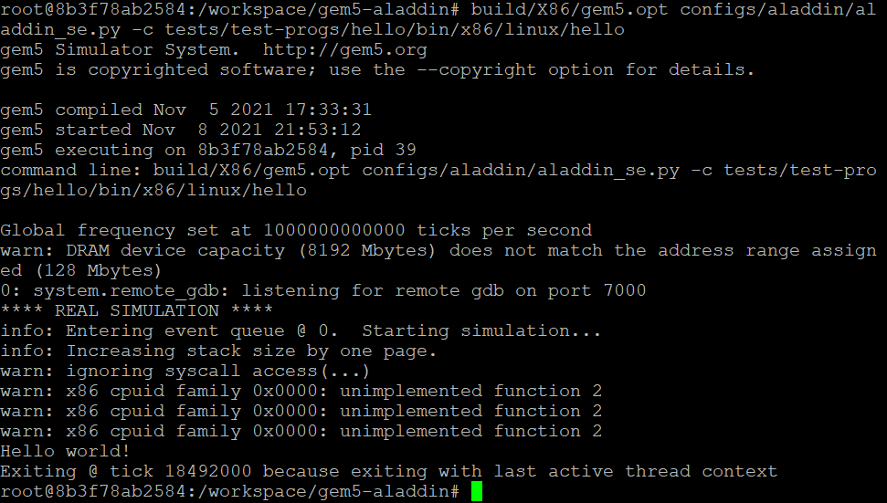
72.3 Build/Run hello.c on Gem5-Aladdin/Emulator X86
https://www.youtube.com/watch?v=SW63HJ0nW90
Build/Run hello.c on Gem5-Aladdin/Emulator X86
>> /workspace/gem5-aladdin > build/X86/gem5.opt configs/aladdin/aladdin_se.py –c tests/test-progs/hello/bin/x86/linux/hello
>> Hello World!

Slide 9
72.4 Save into gem5-aladdin_hello

Slide 10
72.4 Save into gem5-aladdin_hello
https://www.youtube.com/watch?v=SW63HJ0nW90
Save into gem5-aladdin_hell
> docker ps –a | grep _x86
Carefully check the ID 0443997f06c8
> docker commit 0443997f06c8 gem5-aladdin_hello

Slide 11
72.5 Docker run gem5-aladdin_hello

Slide 12
72.5 Docker run gem5-aladdin_hello
https://www.youtube.com/watch?v=SW63HJ0nW90
Docker run gem5-aladdin_hello
> docker ps –a | grep hello

Slide 13
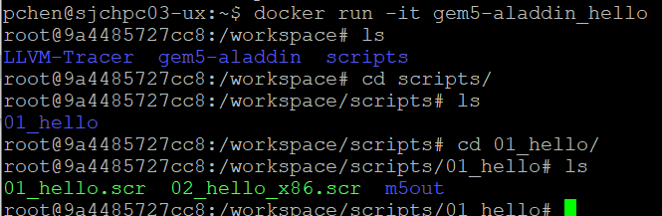
72.5 Docker run gem5-aladdin_hello
https://www.youtube.com/watch?v=SW63HJ0nW90
Docker run gem5-aladdin_hello
> docker run –it gem5-aladdin_hello

Slide 14
End

