Slide 1

75 Gem5-Aladdin test_load_store
Peter H. Chen

Slide 2
75 Gem5-Aladdin test_load_store
https://github.com/harvard-acc/gem5-aladdin
Gem5-Aladdin test_load_store
This document describes the test_load_store for Aladdin Accelerator.
1. The test_load_store only uses the caches only.
2. The test_dma_load_store uses DMA only.
Both tests prepare data on the CPU, transfer the data into accelerator, and expect the accelerator to modify the data and write into the memory system.
Currently, gem5-aladdin does not support full-system simulation.
> docker run –it gem5-aladdin_hello
> cd /workspace/gem5-aladdin/src/alddin/integration-test.with-cpu/test_load_store
> chmod 755 run.sh
> ./run.sh

Slide 3
75.1 run.sh

Slide 4
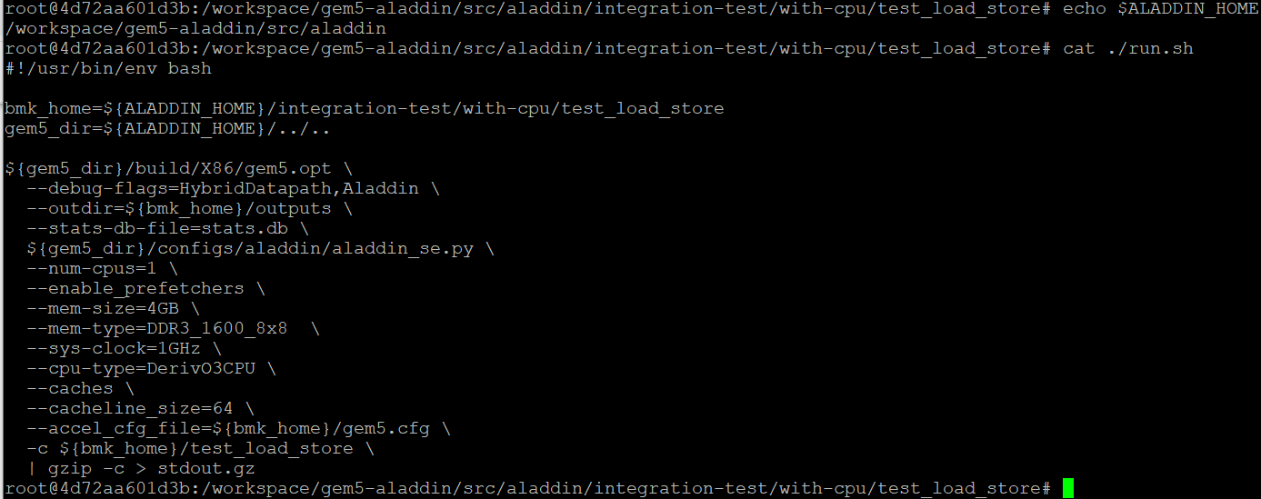
75.1 run.sh
https://github.com/harvard-acc/gem5-aladdin
run.sh
$ALADDIN_HOME = /workspace/gem5-aladdin/src/aladdin
In test_load_store, parameters are:
1. emulator is aladdin_se.py
2. number of CPU = 1
3. memory size = 4GB
4. System clock = 4GB
5. Cache Line size = 64 bits
6. Accelerator Configure file = gem5.cfg
The final binary file is pre-compiled as “test_load_store”.

Slide 5
75.2 test_store_load.cfg

Slide 6
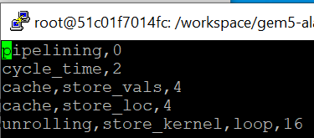
75.2 test_store_load.cfg
https://github.com/harvard-acc/gem5-aladdin
Test_store_load.cfg
Test Load Configuration

Slide 7
75.3 Accelerator Configuration: gem5.cfg

Slide 8
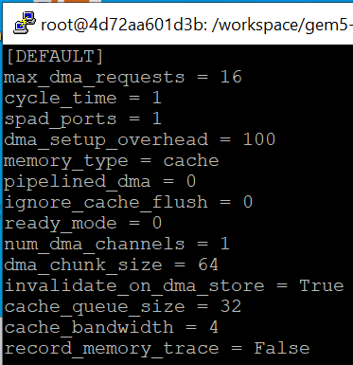
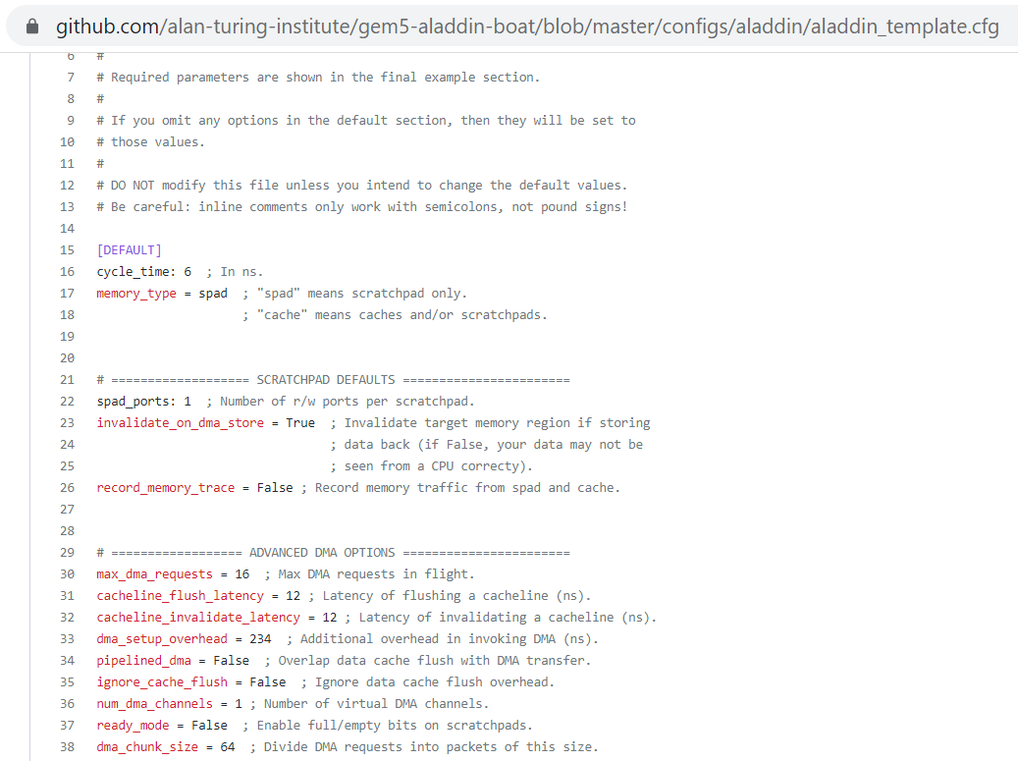
75.3 Accelerator Configuration: gem5.cfg
https://github.com/harvard-acc/gem5-aladdin
Accelerator Configuration: gem5.cfg Default Configuration
https://github.com/alan-turing-institute/gem5-aladdin-boat/blob/master/configs/aladdin/aladdin_template.cfg
scratchpad refers to a special high-speed memory circuit used to hold small items of data for rapid retrieval.

Slide 9
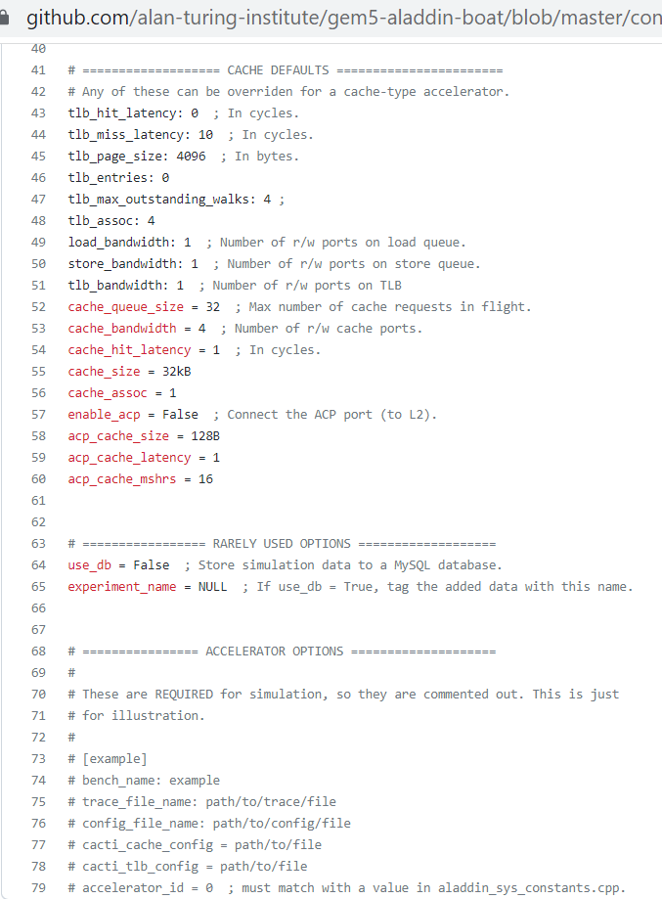
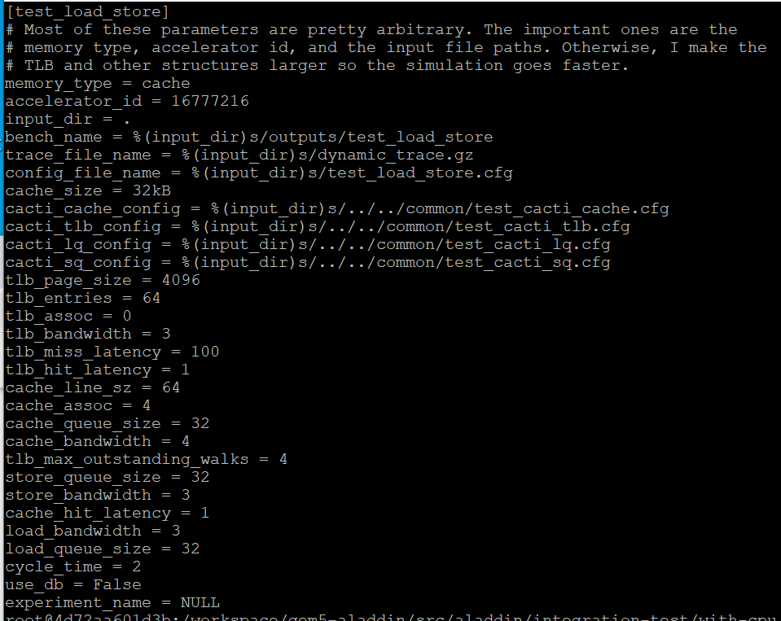
75.3 Accelerator Configuration: gem5.cfg
https://github.com/harvard-acc/gem5-aladdin
Accelerator Configuration: gem5.cfg
> test_load_store configuration.

Slide 10
75.4 Number of Instructions

Slide 11
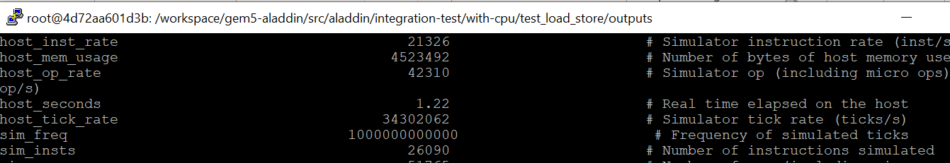
75.4 Number of Instructions
https://github.com/harvard-acc/gem5-aladdin
Number of Instructions
In outputs/stats.txt, we get Number of instructions: 26069 (sim_insts)

Slide 12
75.5 Outputs/Summary

Slide 13
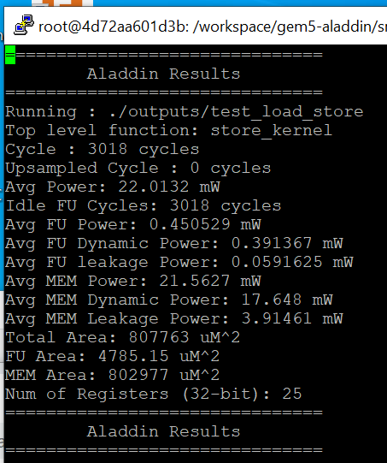
75.5 Outputs/Summary
https://github.com/harvard-acc/gem5-aladdin
Outputs/Summary
Cycle time = 3018 cycles
Overall Power: 22.0132 mW
Total Area: 807763 uM^2

Slide 14
75.6 IPC (Instruction Per Cycle)

Slide 15
75.6 IPC (Instruction Per Cycle)
https://github.com/harvard-acc/gem5-aladdin
ICP (Instruction Per Cycle)
We calculate the IPC (Instruction Per Cycle) = (Number of instruction)/(Cycle Time) = 26069/3018 = 8.637
IPC = 8.637
Overall Power: 22.0132 mW
Total Area: 807763 uM^2

Slide 16
End

