Slide 1

79 Gem5-Aladdin Summary
Peter H. Chen

Slide 2
79 Gem5-Aladdin Summary
https://github.com/harvard-acc/gem5-aladdin
Gem5-Aladdin Summary
This document discuss Gem5-Aladdin Accelerator.
1. Compile hello.c into binary and build X86 Aladdin SE (System Emulator)
2. The test_load_store only uses the caches only.
3. The test_dma_load_store uses DMA only.
Tests 2 and 3 prepare data on the CPU, transfer the data into accelerator, and expect the accelerator to modify the data and write into the memory system. Currently, gem5-aladdin does not support full-system simulation.

Slide 3
79 Gem5-Aladdin Summary
https://github.com/harvard-acc/gem5-aladdin
Gem5-Aladdin Summary
gem5-aladdin docker image
Advantage:
1. gem5-aladdin docker image contains the dependencies: gem5-aladdin, gem5, Boost Graph, LLVM, LLVM-Tracer, and Xenon. Easy for beginner.
2. Easy to run pre-built cases
Disadvantage:
1. Build Architecture based on python2.7 (gem5 already moved to Python 3.8.8).
2. gem5-aladdin can only compile X86 architecture. Gem5 can build X86, ARM, MIPS, POWER, RISCV, SPARC, ALPHA on my VirtualBox/Ubuntu.
3. Currently, failed in re-compile test_load_store and test_dma_load_store,

Slide 4
79.1 Build/Run hello.c on X86

Slide 5
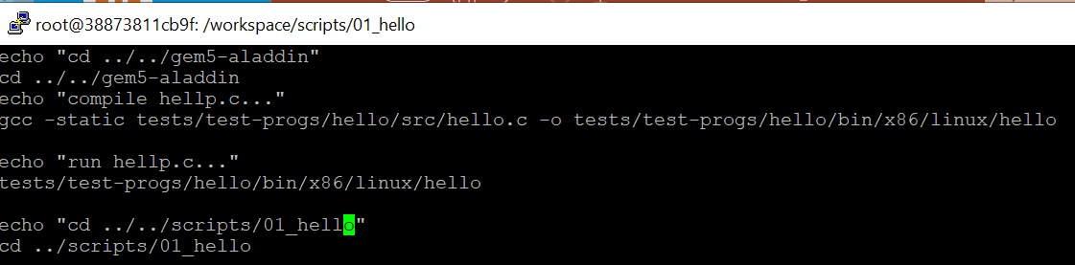
79.1 Build/Run hello.c on X86
https://github.com/harvard-acc/gem5-aladdin
Build/Run hello.c on X86
Start docker-aladdin_hello
> docker run -it gem5-aladdin_hello
> cd scripts/01_hello
Compile hello.c into hello binary
> ./01_hello.scr
>> gcc –static …/hello.c –o …/hello

Slide 6
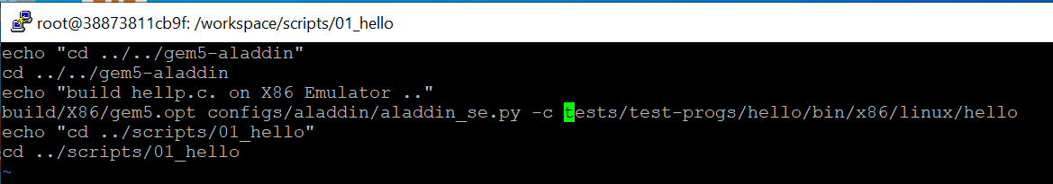
79.1 Build/Run hello.c on X86
https://github.com/harvard-acc/gem5-aladdin
Build/Run hello.c on X86
Build hello X86 binary with aladdin_se.py (System Emulator) and run.
> ./02_hello_x86.scr
>> build/X86/gem5.opt …/aladdin_se.py -c ../hello (X86 binary)

Slide 7
79.2 test_load_store case

Slide 8
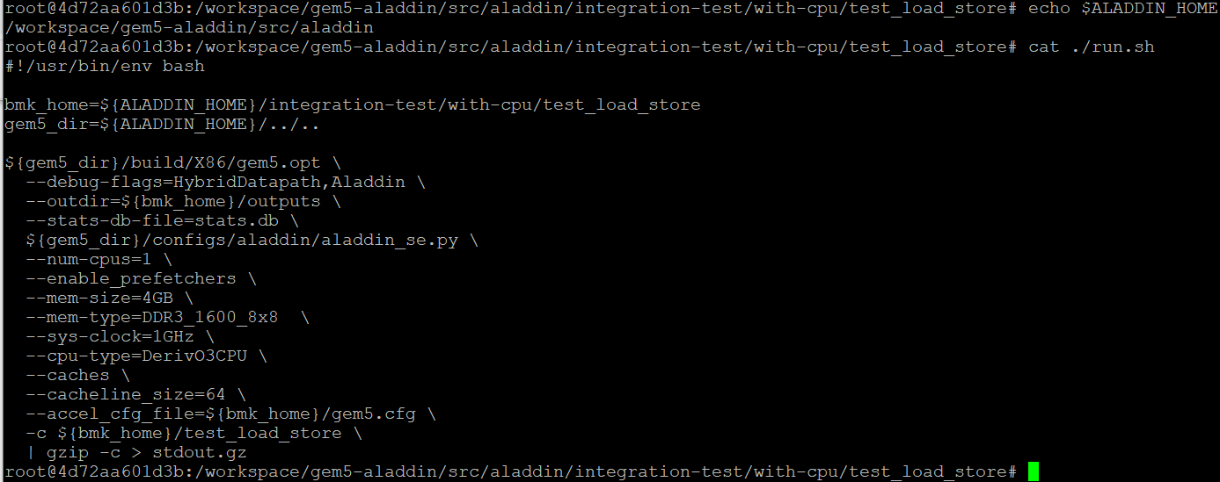
79.2 test_load_store case
https://github.com/harvard-acc/gem5-aladdin
test_load_store: run.sh
$ALADDIN_HOME = /workspace/gem5-aladdin/src/aladdin
In test_load_store, parameters are:
1. emulator is aladdin_se.py
2. number of CPU = 1
3. memory size = 4GB
4. System clock = 4GB
5. Cache Line size = 64 bits
6. Accelerator Configure file = gem5.cfg
The final binary file is pre-compiled as “test_load_store”.

Slide 9
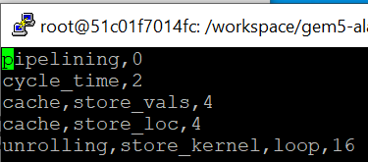
79.2 test_load_store case
https://github.com/harvard-acc/gem5-aladdin
Test_load_store: test_load_store.cfg
Test Load Configuration

Slide 10
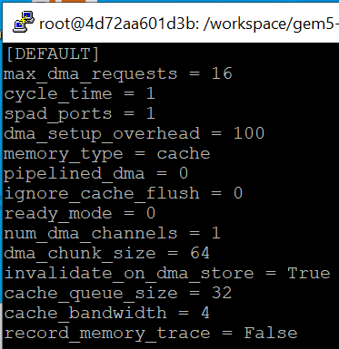
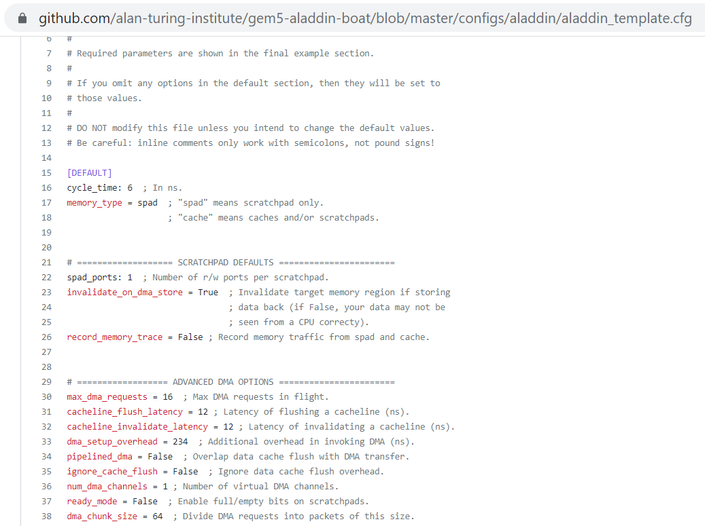
79.2 test_load_store case
https://github.com/harvard-acc/gem5-aladdin
Accelerator Configuration by gem5.cfg
https://github.com/alan-turing-institute/gem5-aladdin-boat/blob/master/configs/aladdin/aladdin_template.cfg
scratchpad refers to a special high-speed memory circuit used to hold small items of data for rapid retrieval.

Slide 11
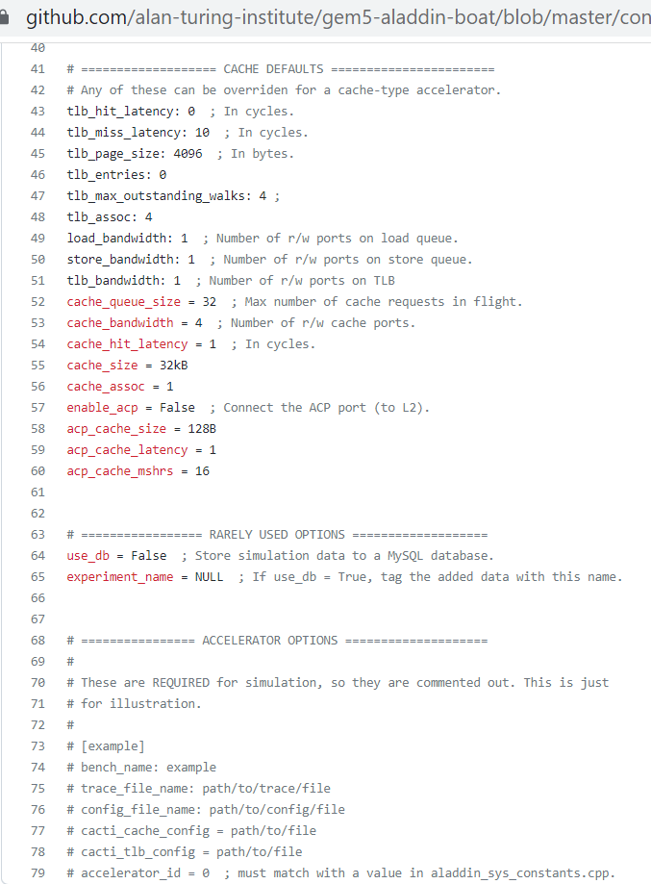
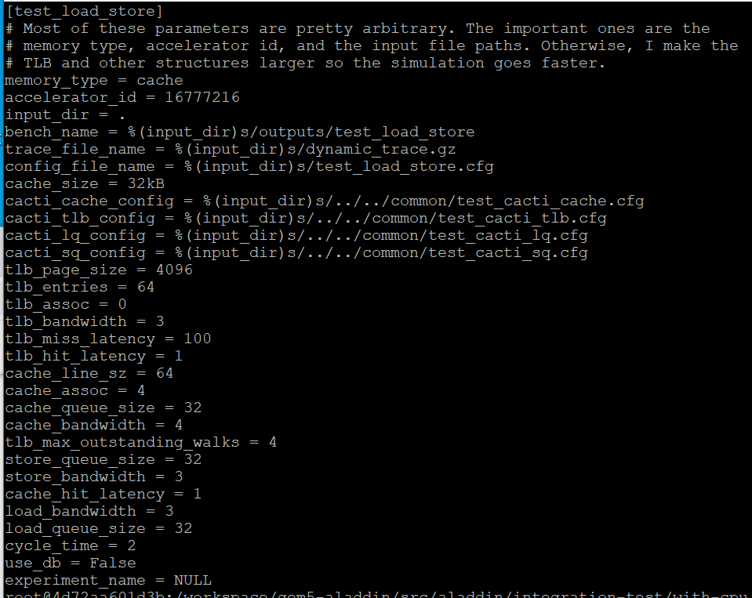
79.2 test_load_store case
https://github.com/harvard-acc/gem5-aladdin
Accelerator Configuration: gem5.cfg
> test_load_store configuration.

Slide 12
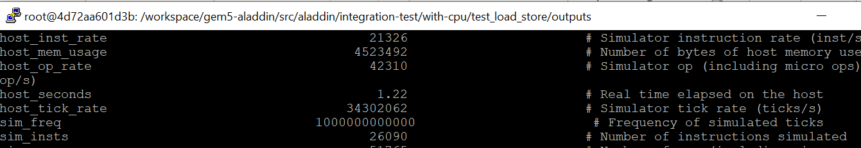
79.2 test_load_store case
https://github.com/harvard-acc/gem5-aladdin
Number of Instructions
In outputs/stats.txt, we get Number of instructions: 26069 (sim_insts)

Slide 13
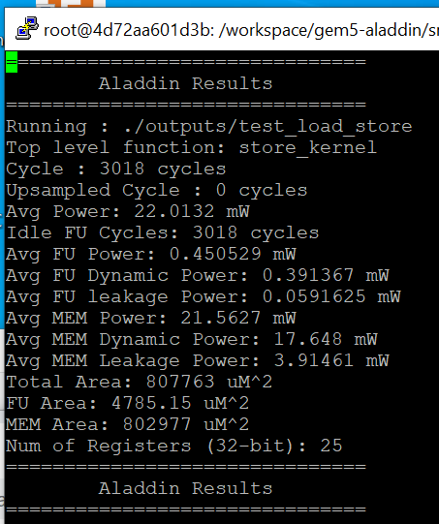
79.2 test_load_store case
https://github.com/harvard-acc/gem5-aladdin
Outputs/Summary
Cycle time = 3018 cycles
Overall Power: 22.0132 mW
Total Area: 807763 uM^2

Slide 14
79.2 test_load_store case
https://github.com/harvard-acc/gem5-aladdin
ICP (Instruction Per Cycle)
We calculate the IPC (Instruction Per Cycle) = (Number of instruction)/(Cycle Time) = 26069/3018 = 8.637
IPC = 8.637
Overall Power: 22.0132 mW
Total Area: 807763 uM^2

Slide 15
79.2 test_load_store case
https://github.com/harvard-acc/gem5-aladdin
Summary of test_load_store
1. Prebuilt is running with number of instructions, cycle time, power, and area.
2. re-compile test_load_store-instrumented is not run due to memory address mapping.
3. > strip –s (strip all) file size is different from prebuilt. Need to know how gem5-aladdin build the bimary.

Slide 16
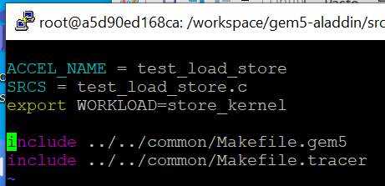
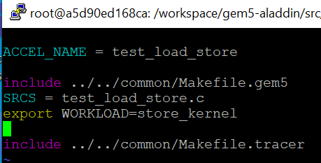
79.2 test_load_store case
https://github.com/harvard-acc/gem5-aladdin
Summary of test_load_store
How to fix the problem?
In the Makefile, move the include. ../../common/Makefile.gem5 before test_load_store.c.
> make
The test_load_store-gem binary is generated.
> cp test_load_store-gem5 test_load_store
> ./runs.sh

Slide 17
79.3 test_dma_load_store case

Slide 18
79.3 test_dma_load_store case
https://github.com/harvard-acc/gem5-aladdin
Test_dma_load_store case:
Two problems:
1. The outputs/stats.txt are empty. It should contain the number of instructions executed. We need to fix this problem.
2. The pre-built is running fine but re-compiled is broken.

Slide 19
End

