Slide 1

100 Gem5-Aladdin Dataset
Peter H. Chen

Slide 2
100 Download Gen5-Aladdin in Secure Zone
https://github.com/harvard-acc/gem5-aladdin
Download Gen5-Aladdin in Secure Zone
The gem5-aladdin simulator integrate the following dependencies:
gem5-aladdin framework: https://github.com/harvard-acc/gem5-aladdin
gem5-alddin dependencies:
1. gem5 dependencies: https://www.gem5.org/
2. aladdin dependencies:
2.1 Aladdin source code/installation: https://github.com/harvard-acc/ALADDIN
2.2 Boost Graph Library source code and installation
https://www.boost.org/doc/libs/1_72_0/more/getting_started/unix-variants.html
2.3 LLVM Tracer source code/installation: https://github.com/harvard-acc/LLVM-Tracer
2.4 llvm_project for headers and development: https://llvm.org/docs/GettingStarted.html#checkout
3. Xenon Design Sweep Generation
https://github.com/xyzsam/xenon

Slide 3
100 Gem5-Aladdin Dataset
https://www.youtube.com/watch?v=bi0cKgmRuiA
Gem5-Aladdin Dataset
This document describe how to generate the gem5-aladdin dataset.
What is difference between Gem5, Aladdin, and Gem5-aladdin?
https://groups.google.com/g/gem5-aladdin-users/c/ZYEajO4Iuiw?pli=1
1. gem5 gives you modeling capabilities for DRAM, caches, CPUs, and more. The dynamic trace is generated by LLVM-Tracer.
2. gem5-aladdin is the integrated simulator. The two simulators exchange actual data in the program (like the contents of an array) when you perform a DMA load/store, for example.
Answer: gem5-aladdin combines gem5 and aladdin simulator together.

Slide 4
100 Gem5-Aladdin Dataset
https://www.youtube.com/watch?v=bi0cKgmRuiA
Gem5-Aladdin Dataset
From Noah:
gem5-Aladdin is already built in the gem5-aladdin image.
DSE Platform further wraps that image in the dse-platform/gem5-aladdin image, which is one of the images that gets created when you run build.py.
It does this by adding app_wrapper_gem5_aladdin.py to the image as the main entry point.
build.py and launch.py invoke Docker Compose to build the images and launch the containers, respectively.
There is no $ALADDIN_HOME environment variable; the output is written to a generated path in the Docker volume.

Slide 5
51 Download Gen5-Aladdin in Secure Zone
https://github.com/harvard-acc/gem5-aladdin
Build Gen5-Aladdin in Secure Zone
Question 1: How to build Gem5-Aladdin?
From Noah:
I built gem5-Aladdin in the following way:
1. Start with xyzsam/gem5-aladdin image,
2. cd gem5-aladdin
3. python2.7 `which scons` build/X86/gem5.opt -j4
Binary is located at /workspace/gem5-aladdin/build/X86/gem5.opt.
The xyzsam/gem5-aladdin image had all of the dependencies required to build already loaded.
Building open-source software has cost many people many, many hours of work because it's usually not a straightforward process, and it is especially difficult in the secure zone due to the lack of internet access.
This is why we decided to rely on Docker images because only one person needs to build it once, and then everyone can use it in any Linux environment.
Concerning the disk space, you can talk to Chao about it; I don't have any control over that.

Slide 6
51 Download Gen5-Aladdin in Secure Zone
https://github.com/harvard-acc/gem5-aladdin
Build Gen5-Aladdin in Secure Zone
Question 2: When you build in image, can we copy the executable file out of Linux? Can you re-compile the application (*.c). Last time, I make change and make, it gave me the error.
Form Noah: Yes, you can copy the executable file out of the container. However, it probably will not run because there will likely be missing dependencies and differences in system libraries.
You should be able to recompile the application inside a container. However, I don't know if you can use make. The instructions I used indicated that it should be compiled with scons.
Question 3: How do you recompile appication inside the container? Is there any documents described how to recompile the application?
From: Noah
You do Steps 2 and 3 above.

Slide 7
51 Download Gen5-Aladdin in Secure Zone
https://github.com/harvard-acc/gem5-aladdin
Build Gen5-Aladdin in Secure Zone
Question 4: I modify the *.c files and make. It does not work.
From Noah:
The application (*.c file) cannot be changed. Only the configuration can be changed.
Question 5: How to change CPU technologies (Cortex M4, M5, A8, and etc.)?
Noah: No sure right now.

Slide 8
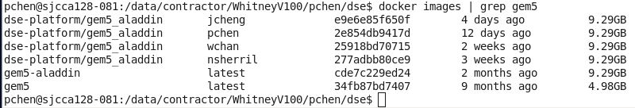
100 Gem5-Aladdin Dataset
https://www.youtube.com/watch?v=bi0cKgmRuiA
Gem5-Aladdin Dataset
To see the gem5-aladdin image on our system:
> docker images | grep gem5
The “gem5-aladdin” is generated “2 months ago”.
There are four people using DSE platform: jcheng (Jun Cheng), pchen (Peter Chen), wchan (Jason Waiyuen Chan), and nsherril (Noah Sherril)

Slide 9
100.1 Build X86, ARM, POWER, and ALPHA

Slide 10
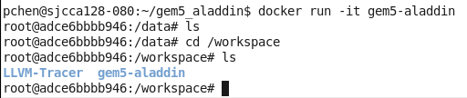
100.1 Build X86, ARM, POWER, and ALPHA
https://www.youtube.com/watch?v=bi0cKgmRuiA
Build X86, ARM, POWER, and ALPHA
Run Docker gem5_aladdin
> docker run gem5_aladdin
>> data #
> cd /workspace
> ls
>> LLVM-Tracer gem5-aladdin

Slide 11
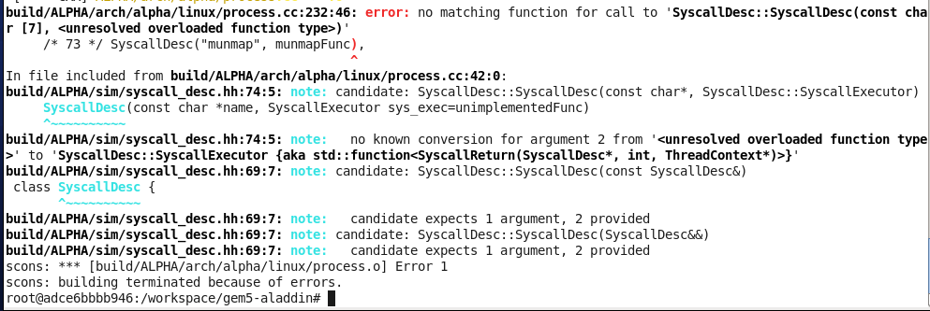
100.1 Build X86, ARM, POWER, and ALPHA
https://www.youtube.com/watch?v=bi0cKgmRuiA
Build X86, ARM, POWER, and ALPHA
> cd gem5-aladdin
> python2.7 `which scons` build/X86/gem5.opt -j4 # OK
> python2.7 `which scons` build/ARM/gem5.opt -j4 # Error
> python2.7 `which scons` build/ALPHA/gem5.opt -j4 # Error
> python2.7 `which scons` build/POWER/gem5.opt -j4 # Error

Slide 12
10.2 Set L1 Cache/L2 Cache

Slide 13
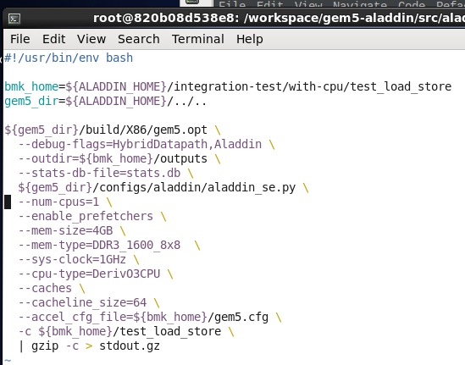
10.2 applications/gem5_aladdin
https://www.youtube.com/watch?v=bi0cKgmRuiA
Run.sh
In /workspace/gem5-alladin.src/aladdin/integration-test/with-cpu/test-load-store
> vi run.sh
COPY from gem5-aladdin container into local machine container.

Slide 14
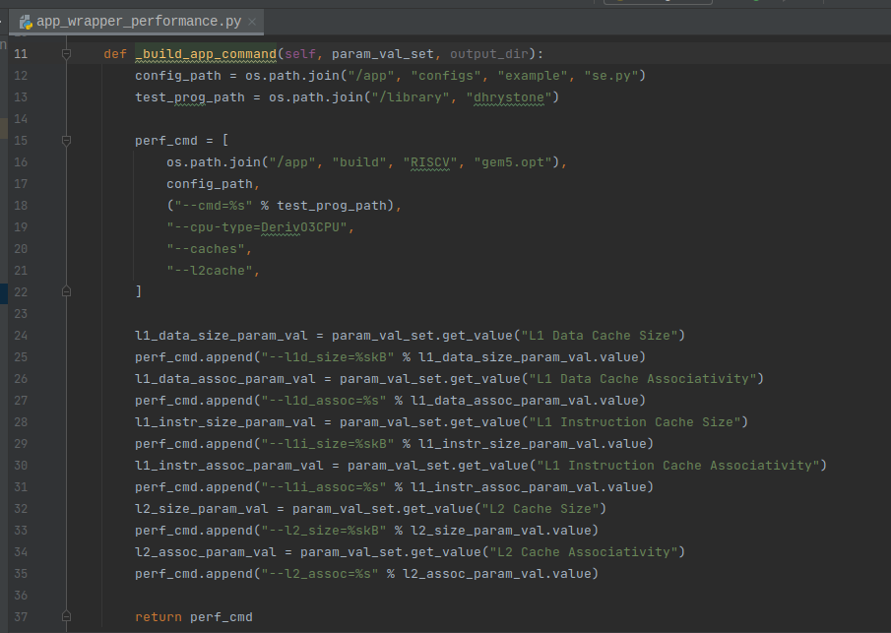
10.2 applications/gem5_aladdin
https://www.youtube.com/watch?v=bi0cKgmRuiA
Run.sh
https://gem5-users.gem5.narkive.com/4xVBlf3c/verify-cache-configuration
In dse/applications/performance/app_wrapper_pfermance.py
--l1d_size: L1 Data Cache Size
--l1d_assoc: L1 Data Associativity
--l1i_size: L1 Instruction Cache.
-- l1i_assoc; L1 Instruction Association
--l2_size, --l2_assoc

Slide 15
10.2 applications/gem5_aladdin
https://www.youtube.com/watch?v=bi0cKgmRuiA
Run.sh
In /workspace/gem5-alladin.src/aladdin/integration-test/with-cpu/test-load-store
> vi run.sh
COPY from gem5-aladdin container into local machine container.
AppWrapper._execute()
[app_wrapper.cpp]
AppWrapperPerforamce._build_app_command()
[app_wrapper_performance.cpp]

Slide 16
End

