Slide 1

53 Build Boost Graph Library
Peter H. Chen

Slide 2
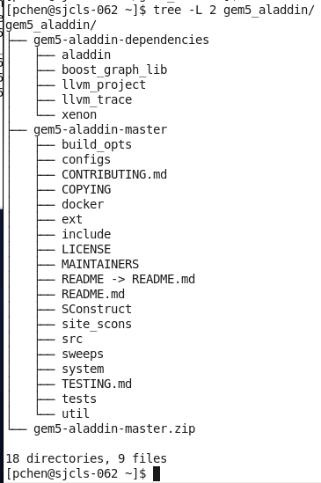
53 Build Boost Graph Library
https://github.com/harvard-acc/gem5-aladdin
Build Boost Graph in Secure Zone
This document describes how to build Gem5-Aladdin.
We assume you download all the files on the right.

Slide 3
53 Build Boost Graph Library
https://github.com/harvard-acc/gem5-aladdin
Build Boost Graph in Secure Zone
The gem5-aladdin simulator integrate the following dependencies:
gem5-aladdin framework: https://github.com/harvard-acc/gem5-aladdin
gem5-alddin dependencies:
1. gem5 dependencies: https://www.gem5.org/
2. aladdin dependencies:
2.1 Aladdin source code/installation: https://github.com/harvard-acc/ALADDIN
2.2 Boost Graph Library source code and installation
https://www.boost.org/doc/libs/1_72_0/more/getting_started/unix-variants.html
2.3 LLVM Tracer source code/installation: https://github.com/harvard-acc/LLVM-Tracer
2.4 llvm_project for headers and development: https://llvm.org/docs/GettingStarted.html#checkout
3. Xenon Design Sweep Generation
https://github.com/xyzsam/xenon

Slide 4
53 Build Boost Graph Library
https://github.com/harvard-acc/gem5-aladdin
Build Boost Graph in Secure Zone
Question 1: How to build Gem5-Aladdin?
From Noah:
I built gem5-Aladdin in the following way:
1. Start with xyzsam/gem5-aladdin image,
2. cd gem5-aladdin
3. python2.7 `which scons` build/X86/gem5.opt -j4
Binary is located at /workspace/gem5-aladdin/build/X86/gem5.opt.
The xyzsam/gem5-aladdin image had all of the dependencies required to build already loaded.
Building open-source software has cost many people many, many hours of work because it's usually not a straightforward process, and it is especially difficult in the secure zone due to the lack of internet access.
This is why we decided to rely on Docker images because only one person needs to build it once, and then everyone can use it in any Linux environment.
Concerning the disk space, you can talk to Chao about it; I don't have any control over that.

Slide 5
53 Build Boost Graph Library
https://github.com/harvard-acc/gem5-aladdin
Build Boost Graph in Secure Zone
Question 2: When you build in image, can we copy the executable file out of Linux? Can you re-compile the application (*.c). Last time, I make change and make, it gave me the error.
Form Noah: Yes, you can copy the executable file out of the container. However, it probably will not run because there will likely be missing dependencies and differences in system libraries.
You should be able to recompile the application inside a container. However, I don't know if you can use make. The instructions I used indicated that it should be compiled with scons.
Question 3: How do you recompile appication inside the container? Is there any documents described how to recompile the application?
From: Noah
You do Steps 2 and 3 above.

Slide 6
53 Build Boost Graph Library
https://github.com/harvard-acc/gem5-aladdin
Build Boost Graph in Secure Zone
Question 4: I modify the *.c files and make. It does not work.
From Noah:
The application (*.c file) cannot be changed. Only the configuration can be changed.
Question 5: How to change CPU technologies (Cortex M4, M5, A8, and etc.)?
Noah: No sure right now.

Slide 7
53.2 Build Boost Graph Library

Slide 8
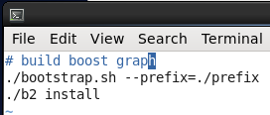
51.2 Build Boost Graph Library
https://github.com/harvard-acc/gem5-aladdin
Build Boost Graph Library
https://github.com/harvard-acc/ALADDIN
> cd ~/gem5-aladdin/gem5-aladdin-dependencies/boost_graph_lib/boost_1_72_0
> vi 01_build_boost.scr
>> ./boostrap.sh –prefix=./prefix
>> ./b2 install

Slide 9
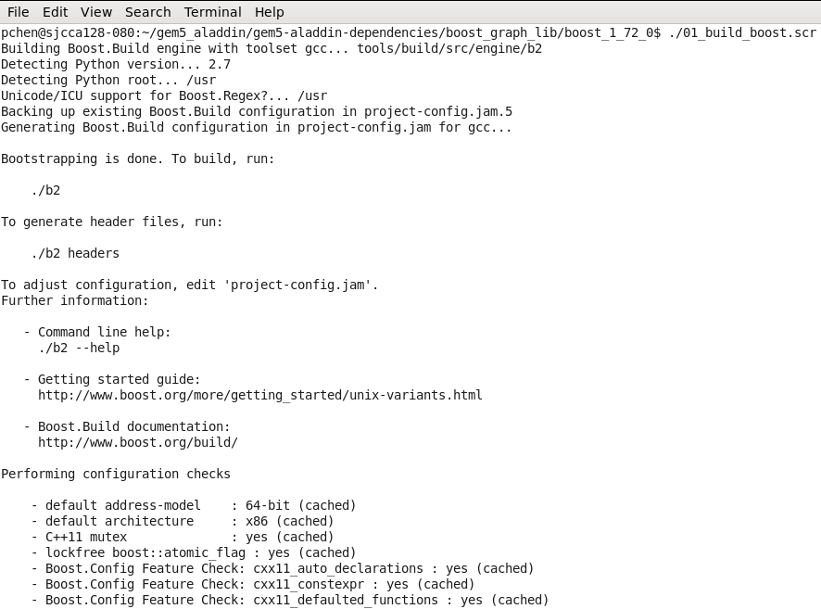
51.2 Build Boost Graph Library
https://github.com/harvard-acc/gem5-aladdin
Build Boost Graph Library
https://github.com/harvard-acc/ALADDIN
> ./01_build_boos.scr

Slide 10
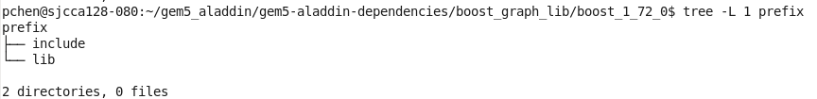
51.2 Build Boost Graph Library
https://github.com/harvard-acc/gem5-aladdin
Build Boost Graph Library
https://github.com/harvard-acc/ALADDIN
> ls prefix
Check generated boost graph library

Slide 11
End

