Slide 1

60 Build/Run Gem5 Dependency in Common Zone
Peter H. Chen

Slide 2
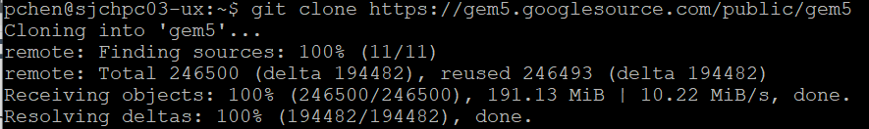
60 Download Packages
https://www.rosehosting.com/blog/how-to-install-anaconda-on-ubuntu-20-04/
Download Packages
> git clone https://gem5.googlesource.com/public/gem5

Slide 3
60.1 Setup Anaconda Environment
Peter H. Chen

Slide 4
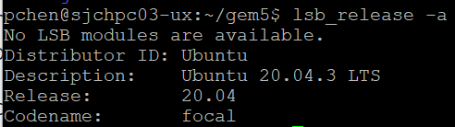
60.1 Setup Anaconda Environment
https://www.rosehosting.com/blog/how-to-install-anaconda-on-ubuntu-20-04/
Setup Anaconda Environment
We are going to setup the environment for Anaconda.
Anaconda is an intendent container without interfere other environments.
> lsb_release -a
We have Ubuntu 20.14

Slide 5
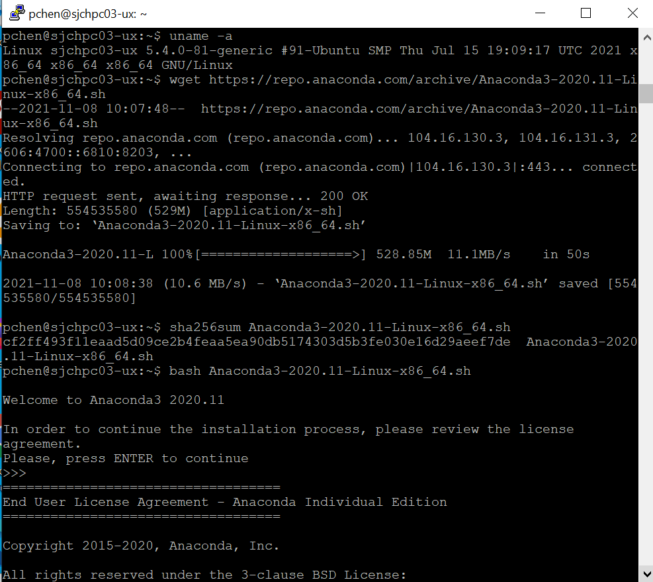
60.1 Setup Anaconda Environment
https://www.rosehosting.com/blog/how-to-install-anaconda-on-ubuntu-20-04/
Setup Anaconda Environment
Follow below link, install Anaconda3
https://www.rosehosting.com/blog/how-to-install-anaconda-on-ubuntu-20-04/

Slide 6
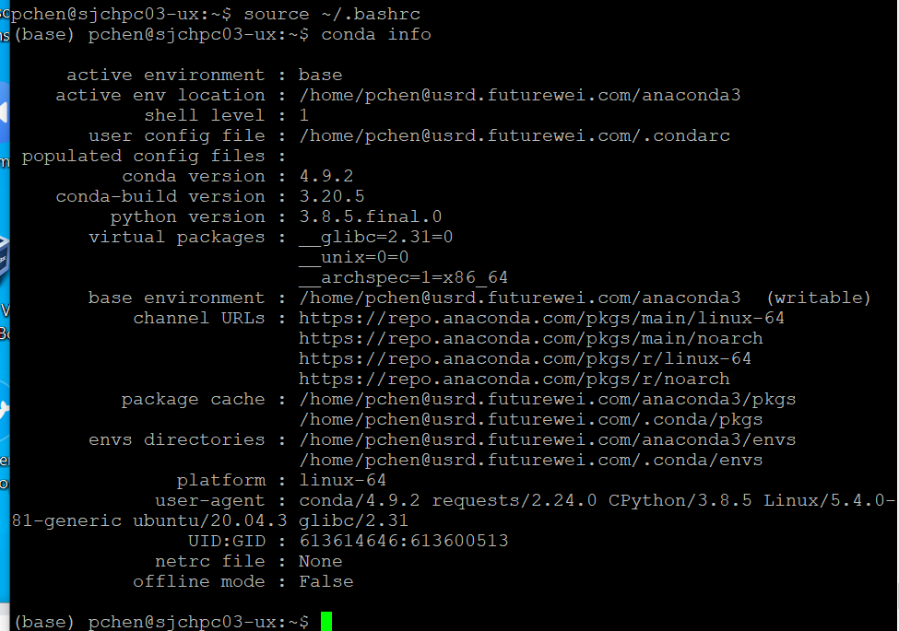
60.1 Setup Anaconda Environment
https://www.rosehosting.com/blog/how-to-install-anaconda-on-ubuntu-20-04/
Setup Anaconda Environment
> source ~/.bashrc
(base) pchen@sjchpc03-ux: ~$ conda info

Slide 7
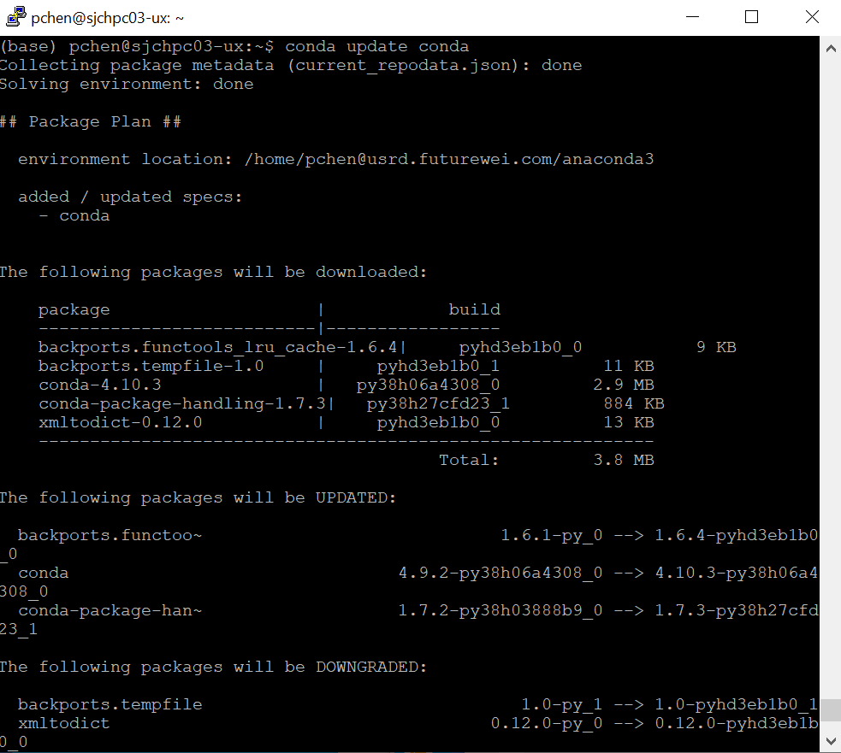
60.1 Setup Anaconda Environment
https://www.rosehosting.com/blog/how-to-install-anaconda-on-ubuntu-20-04/
Setup Anaconda Environment
(base) pchen@sjchpc03-ux: ~$ conda update conda

Slide 8
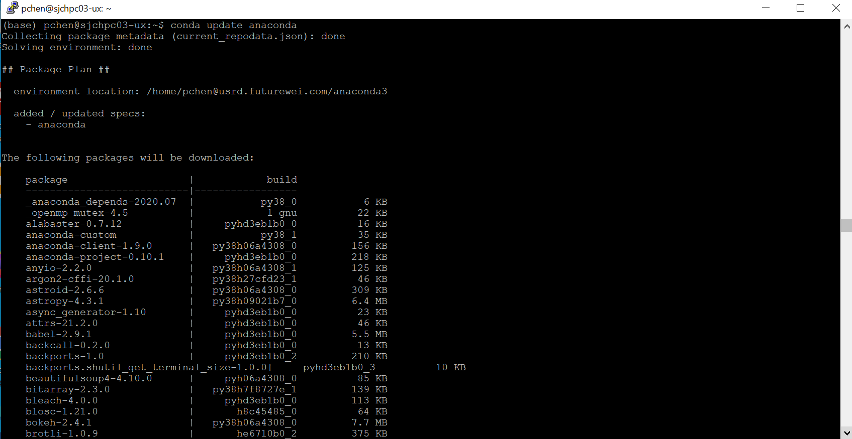
60.1 Setup Anaconda Environment
https://www.rosehosting.com/blog/how-to-install-anaconda-on-ubuntu-20-04/
Setup Anaconda Environment
(base) pchen@sjchpc03-ux: ~$ conda update anaconda

Slide 9
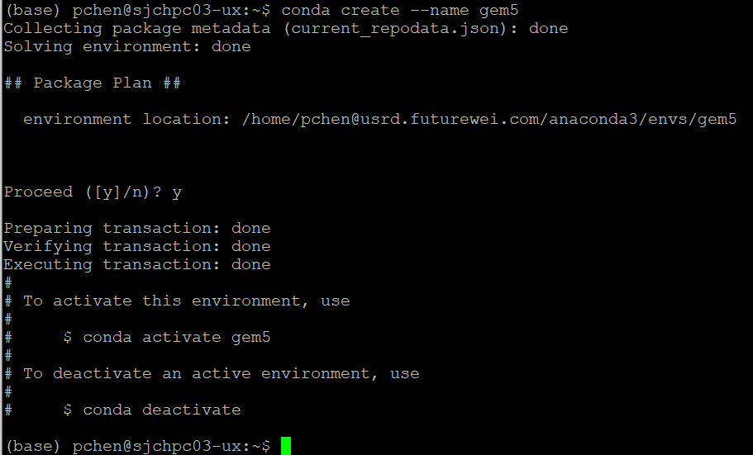
60.1 Setup Anaconda Environment
https://www.rosehosting.com/blog/how-to-install-anaconda-on-ubuntu-20-04/
Create Anaconda Environment
We create gem5 environment.
(base) pchen@sjchpc03-ux: ~$ conda create --name gem5

Slide 10
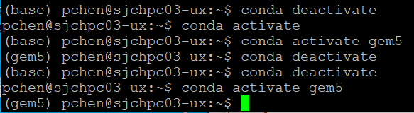
60.1 Setup Anaconda Environment
https://www.rosehosting.com/blog/how-to-install-anaconda-on-ubuntu-20-04/
Create Anaconda Environment
Activate gem5 environemnt
(base) pchen@sjchpc03-ux: ~$ conda activate gem5
(gem5) pchen@sjchpc03-ux: ~$
Note:
(gem5) pchen@sjchpc03-ux: ~$ conda deactivate
(base) pchen@sjchpc03-ux: ~$ conda deavtivate
pchen@sjchpc03-ux: ~$

Slide 11
60.2 Build gem5.opt In Anaconda gem5 Environment

Slide 12
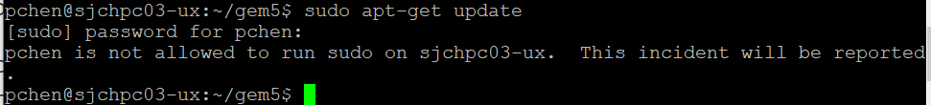
60.2 Build gem5.opt In Anaconda gem5 Environment
https://www.gem5.org/documentation/general_docs/building
Download Packages
Linux Update/Upgrade:
> sudo apt-get update
> sudo apt-get upgrade
Note: I am not sudo user. Cannot update

Slide 13
60.1 Setup Anaconda Environment
https://www.rosehosting.com/blog/how-to-install-anaconda-on-ubuntu-20-04/
Setup Gem5 environment Packages
For Linux 20.04:
> sudo apt install build-essential git m4 scons zlib1g zlib1g-dev libprotobuf-dev protobuf-compiler libprotoc-dev libgoogle-perftools-dev python3-dev python3-six python-is-python3 libboost-all-dev pkg-config
Note: Ask Chao Ma to install for us.

Slide 14
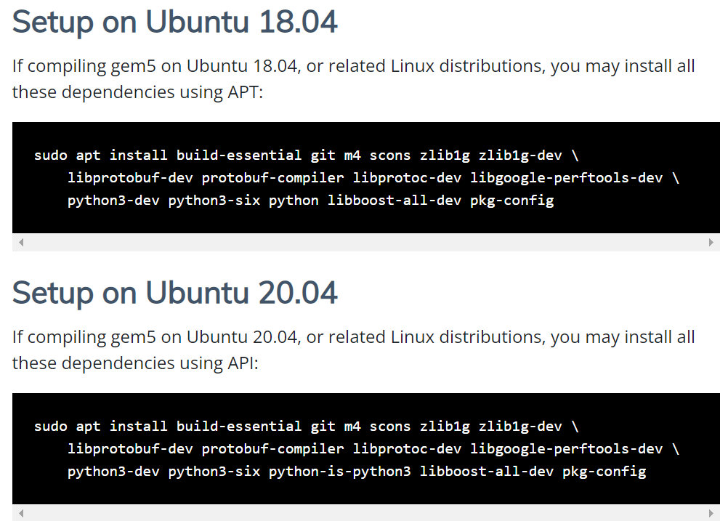
60.1 Setup Anaconda Environment
https://www.rosehosting.com/blog/how-to-install-anaconda-on-ubuntu-20-04/
Setup Gem5 environment Packages
gem5.org/documentation/general_docs/building
For Secure Zone Linux is 18.04:
> sudo apt install build-essential git m4 scons zlib1g zlib1g-dev libprotobuf-dev protobuf-compiler libprotoc-dev libgoogle-perftools-dev python3-dev python3-six python libboost-all-dev pkg-config

Slide 15
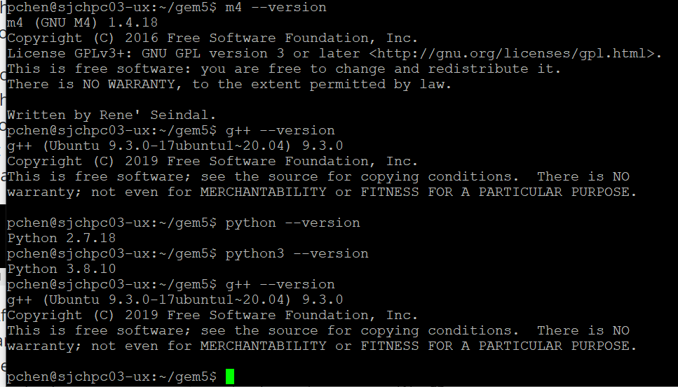
60.1 Setup Anaconda Environment
https://www.rosehosting.com/blog/how-to-install-anaconda-on-ubuntu-20-04/
Install Gem5
This give us all gem5 we need. The gem5 is the simulate processor with various architecture like ARM, x86.
m4 is GNU macro processor.
python --version 2.7.17; python-dev for C API.
Libgoogle-perfortools-dev: Google package for performance tools for C++ program.
g++: 7.5.0

Slide 16
52.2 Build ARM/gem5.opt

Slide 17
52.3 Build ARM/gem5.opt
https://www.rosehosting.com/blog/how-to-install-anaconda-on-ubuntu-20-04/
Build ARM/gem5.opt
> cd gem5
> python3 `which scons` build/ARM/gem5.opt-j9 PYTHON_CONFIG=/usr/bin/python3-config

Slide 18
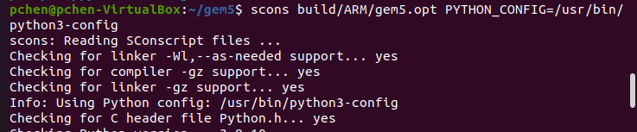
52.3 Build ARM/gem5.opt
https://www.rosehosting.com/blog/how-to-install-anaconda-on-ubuntu-20-04/
Build ARM/gem5.opt
Gem5.opt (gem with 5 optimizations) is the executable file that we want to build for running.
Here, we use the “scons” to create “build” folder, the most popular “ARM” architecture, and final executable file is “gem5.opt”.
The gem5.opt stand for the number of optimization is 5. Rather than saying performance monitor or debugging mode.
https://groups.google.com/g/gem5-gpu-dev/c/eBYX06KlkdM
Specify the PYTHON_CONFIG = /usr/bin/python3-config
> scons build/ARM/gem5.opt PYTHON_CONFIG=/usr/bin/python3-config

Slide 19
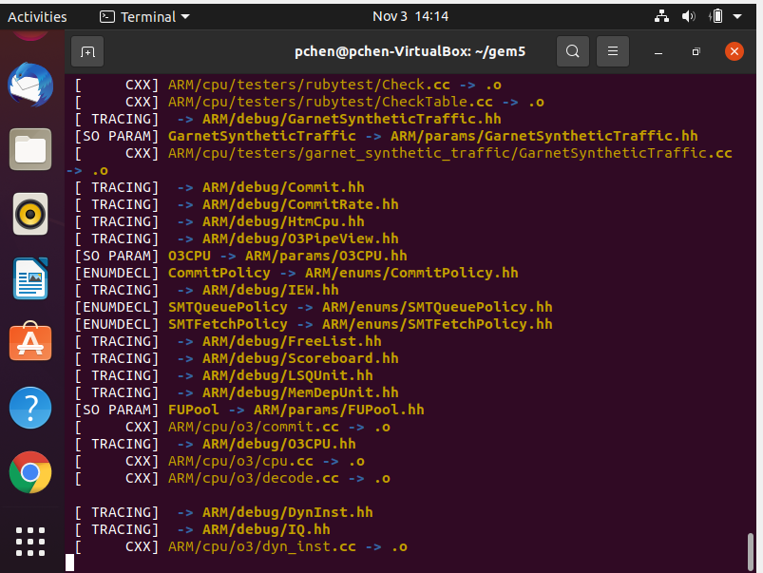
52.3 Build ARM/gem5.opt
https://www.rosehosting.com/blog/how-to-install-anaconda-on-ubuntu-20-04/
Build ARM/gem5.opt
Building message:

Slide 20
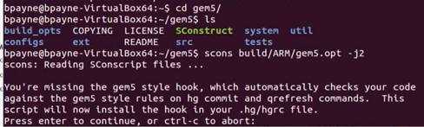
52.3 Build ARM/gem5.opt
https://github.com/harvard-acc/gem5-aladdin
Install Gem5
https://www.rosehosting.com/blog/how-to-install-anaconda-on-ubuntu-20-04/
I am using an optional switch -j2 instead of using scons in serial.
It takes the advantage of multiple processes. It will be a little bit faster when build.
> scons build/ARM/gem5.opt -j2 PYTHON_CONFIG=/usr/bin/python3-config

Slide 21
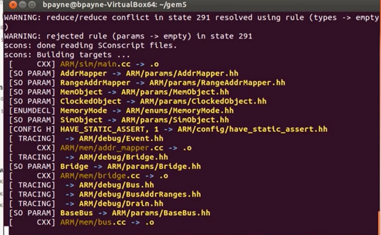
52.3 Build ARM/gem5.opt
https://www.rosehosting.com/blog/how-to-install-anaconda-on-ubuntu-20-04/
Build ARM/gem5.opt
> scons build/ARM/gem5.opt -j2 PYTHON_CONFIG=/usr/bin/python3-config
We are building gem5.opt. It will take hours to build.

Slide 22
52.3 Build ARM/gem5.opt
https://www.rosehosting.com/blog/how-to-install-anaconda-on-ubuntu-20-04/
Build ARM/gem5.opt
On secure zone:
> python3 `which scons` build/X86/gem5.opt –j9

Slide 23
52.4 Test ARM/gem5.opt

Slide 24
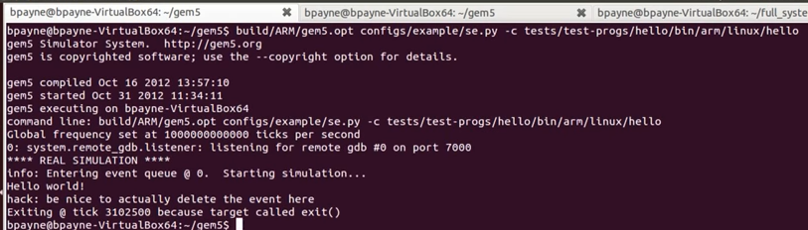
52.4 Test ARM/gem5.opt
https://github.com/harvard-acc/gem5-aladdin
Test ARM/gem5.opt
https://www.rosehosting.com/blog/how-to-install-anaconda-on-ubuntu-20-04/
We just finished the CPU emulator for the ARM architecture.
Now, we are going to test it works or not.
> build/ARM/gem5.opt configs/example/se.py -c tests/test-progs/hello/bin/arm/linux/hello
Here, we use “/build/ARM/gem5.opt” just built.
We call “configs/example/se.py” “se” stand for system emulation mode.
We are going to use pre-compiled binary called “hello” that is in the “tests/test-progs/hello/bin/arm/linux” directory. This is a pre-compiled binary, static binary.

Slide 25
52.4 Test ARM/gem5.opt
https://github.com/harvard-acc/gem5-aladdin
Test ARM/gem5.opt
https://www.rosehosting.com/blog/how-to-install-anaconda-on-ubuntu-20-04/
Here, we see this is the command option we supplied.
This is the frequency at tick/sec.
The “hello world” is the only output from the code.

Slide 26
52.5 Verify C Code

Slide 27
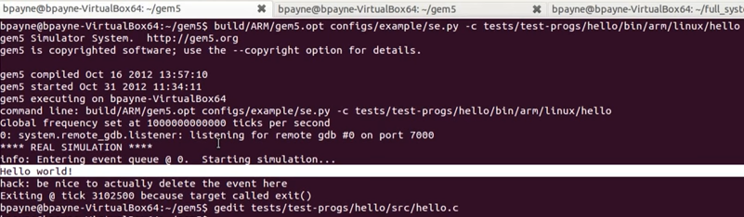
52.5 Verify C Code
https://github.com/harvard-acc/gem5-aladdin
Verify C Code
https://www.rosehosting.com/blog/how-to-install-anaconda-on-ubuntu-20-04/
Now look at the code
> vi tests/test-progs/hello/src/hello.c

Slide 28
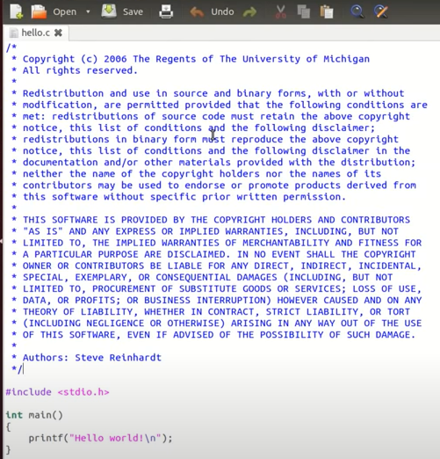
52.5 Verify C Code
https://github.com/harvard-acc/gem5-aladdin
Verify C Code
https://www.rosehosting.com/blog/how-to-install-anaconda-on-ubuntu-20-04/
Now look at the code
> vi tests/test-progs/hello/src/hello.c

Slide 29
52.6 Build X86/gem5.prof

Slide 30
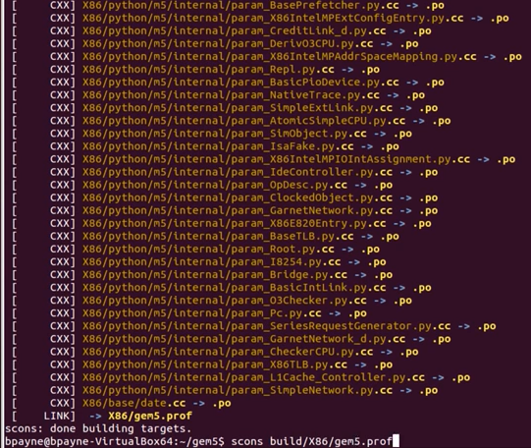
52.6 Build X86/gem5.prof
https://www.rosehosting.com/blog/how-to-install-anaconda-on-ubuntu-20-04/
Build X86/gem5.opt
Now, we try another architecture for x86.
> scons build/X86/gem5.prof PYTHON_CONFIG=/usr/bin/python3-config
Note: gem5 has debug (debugging without optimization), opt (optimization mode), fast (fast mode without debugging), prof (use gprof profiling tool), perf (Use google Perftools)

Slide 31
52.7 ARM Architecture

Slide 32
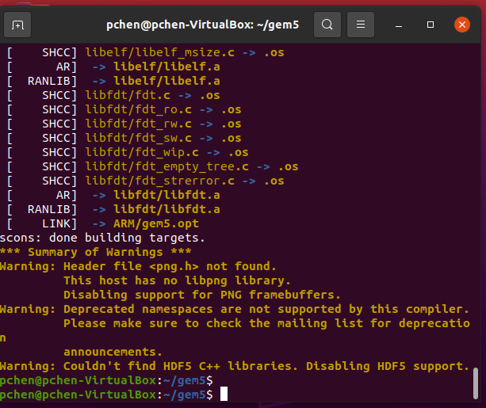
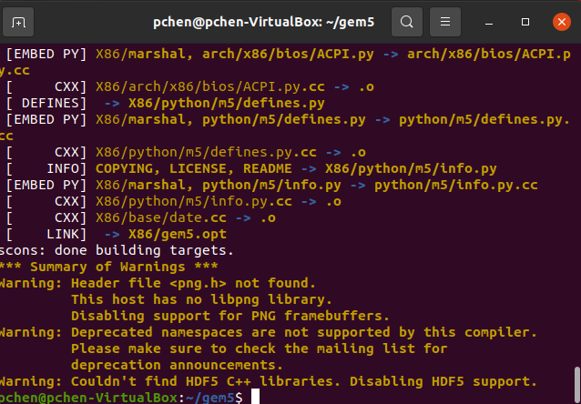
52.7 ARM Architecture
https://github.com/harvard-acc/gem5-aladdin
ARM Architecture
ARM and X86 building done.

Slide 33
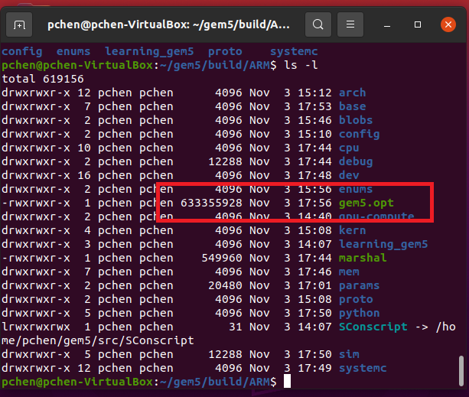
52.7 ARM Architecture
https://github.com/harvard-acc/gem5-aladdin
ARM Architecture
ARM Architecture is the most popular one.
Based gem5.opt based on Ubuntu 20.04, Python 3.6.8.

Slide 34
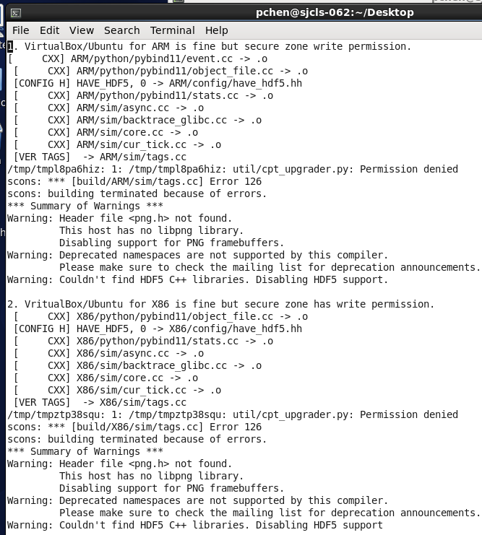
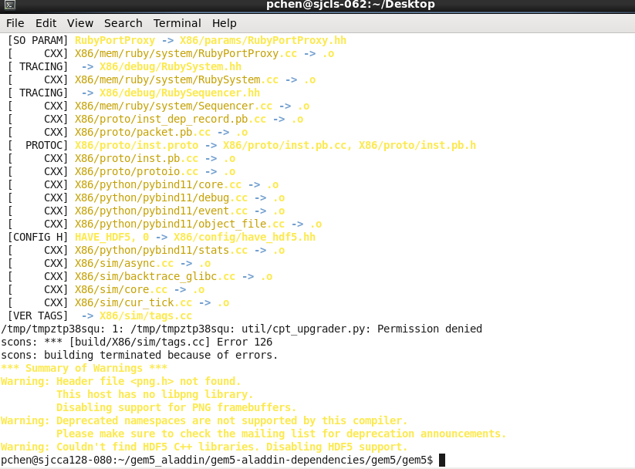
52.7 ARM Architecture
https://github.com/harvard-acc/gem5-aladdin
ARM Architecture
In secure zone, there is a write permission in both X86 and ARM architectures and cannot finish building.

Slide 35
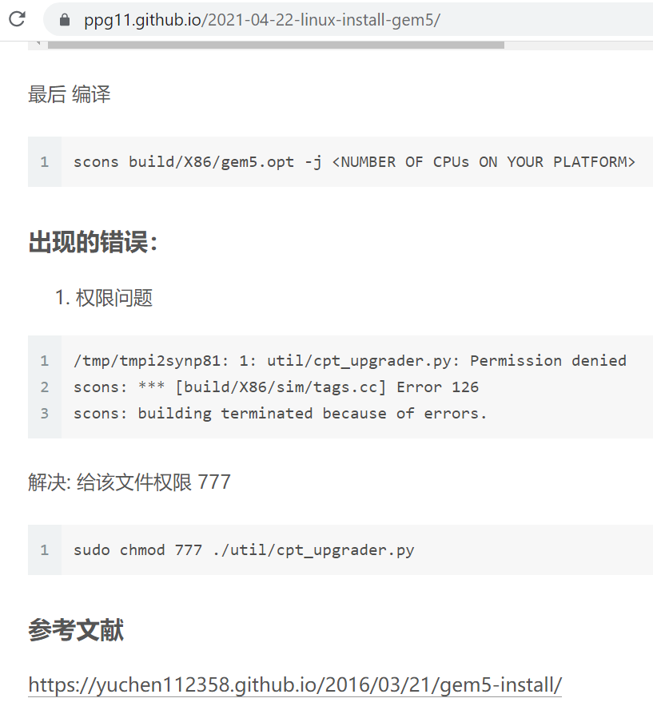
52.7 ARM Architecture
https://github.com/harvard-acc/gem5-aladdin
ARM Architecture
How to fix “permission error”?
https://ppg11.github.io/2021-04-22-linux-install-gem5/

Slide 36
52.8 Build Architectures

Slide 37
52.8 Build Architectures
https://www.rosehosting.com/blog/how-to-install-anaconda-on-ubuntu-20-04/
Build Architectures for X86, ARM, MIPS, POWER, RISCV, and SPARC
> cd ../gem5
> /usr/bin/env python3 $(which scons) build/X86/gem5.opt –j2 PYTHON_CONFIG=/usr/bin/python3-config
> /usr/bin/env python3 $(which scons) build/ARM/gem5.opt –j2 PYTHON_CONFIG=/usr/bin/python3-config
> /usr/bin/env python3 $(which scons) build/MIPS/gem5.opt –j2 PYTHON_CONFIG=/usr/bin/python3-config
> /usr/bin/env python3 $(which scons) build/POWER/gem5.opt –j2 PYTHON_CONFIG=/usr/bin/python3-config
> /usr/bin/env python3 $(which scons) build/RISCV/gem5.opt –j2 PYTHON_CONFIG=/usr/bin/python3-config
> /usr/bin/env python3 $(which scons) build/SPARC/gem5.opt –j2 PYTHON_CONFIG=/usr/bin/python3-config

Slide 38
52.9 Compile C Code

Slide 39
52.9 Compile C Code
https://github.com/harvard-acc/gem5-aladdin
Compile/Run C Code
https://www.rosehosting.com/blog/how-to-install-anaconda-on-ubuntu-20-04/
Now, we try another architecture for x86.
> gcc -static tests/test-progs/hello/hello.c -o test/test-progs/hello/bin/x86/linux/hello

Slide 40
52.10 Run X86 Code

Slide 41
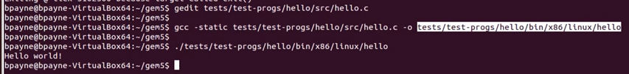
52.10 Run X86 Code
https://github.com/harvard-acc/gem5-aladdin
Run X86 Code
https://www.rosehosting.com/blog/how-to-install-anaconda-on-ubuntu-20-04/
Since we are on x86 machine, we can directory run the binary in the host system.
> ./tests/test-progs/hello/bin/x86/linux/hello

Slide 42
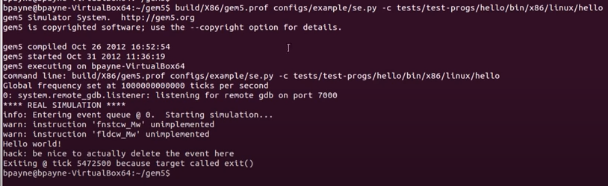
52.10 Run X86 Code
https://github.com/harvard-acc/gem5-aladdin
Run X86 Code
https://www.rosehosting.com/blog/how-to-install-anaconda-on-ubuntu-20-04/
Now, we can run using the x86 architecture.
> build/X86/gem5.prof configs/example/se.py -c tests/test-progs/hello/bin/x86/linux/hello
This is built on x86/gem5.prof and we use the same system emulation mode.
…and then our binary lives in x86 linux hello.

Slide 43
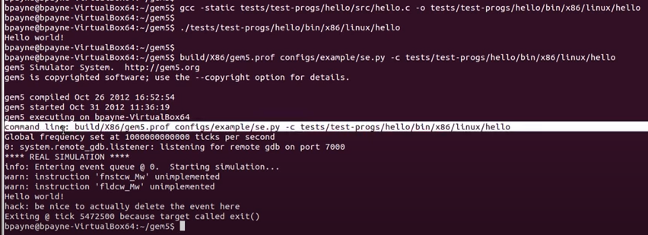
52.10 Run X86 Code
https://github.com/harvard-acc/gem5-aladdin
Run X86 Code
https://www.rosehosting.com/blog/how-to-install-anaconda-on-ubuntu-20-04/
The firs one is we run on host x86 system.
..and the second one is we run on x86 emulator.
1
2

Slide 44
52.11 Summary

Slide 45
52.11 Summary
https://github.com/harvard-acc/gem5-aladdin
Command Summary
Download gem5:
> git clone https://gem5.googlesource.com/public
We just getting some source files and once we get those. We are going to use scons to build the ARM 5 architecture.
Note: on secure zone, I download from windows and used FileZilla to transfer into the secure zone (to_sj_red folder). Then, in secure zone, I used “gftp” to drag-and -drop into the secure zone.
Setup Gem5 environment Packages:
> sudo apt install build-essential git m4 scons zlib1g zlib1g-dev libprotobuf-dev protobuf-compiler libprotoc-dev libgoogle-perftools-dev python3-dev python3-six python-is-python3 libboost-all-dev pkg-config

Slide 46
52.11 Summary
https://github.com/harvard-acc/gem5-aladdin
Command Summary
Build Gem5:
On Ubuntu 20.x for scons
> scons build/ARM/gem5.opt -j2 PYTHON_CONFIG=/usr/bin/python3-config
On Secure zone (reset python 2 into Python3) for scons
/usr/bin/python3 $(which scons) build/ARM/gem5.opt -j2 PYTHON_CONFIG=/usr/bin/python3-config
# Remove character ‘\r’ from python’\r’
#> testVar=$(which python3)
#> MY_NEW_VAR=$(echo $testVar | tr -d ‘\r’)
#> ${MY_NEW_VAR} $(which scons) build/ARM/gem5.opt -j2 PYTHON_CONFIG=/usr/bin/python3-config

Slide 47
End

