Slide 1

51 Download Gen5-Aladdin in Secure Zone
Peter H. Chen

Slide 2
51 Download Gen5-Aladdin in Secure Zone
https://github.com/harvard-acc/gem5-aladdin
Download Gen5-Aladdin in Secure Zone
This document describes how to download Gem5-Aladdin.
We use FileZilla to transfer files from Window to Secure Zone.

Slide 3
51 Download Gen5-Aladdin in Secure Zone
https://github.com/harvard-acc/gem5-aladdin
Download Gen5-Aladdin in Secure Zone
The gem5-aladdin simulator integrate the following dependencies:
gem5-aladdin framework: https://github.com/harvard-acc/gem5-aladdin
gem5-alddin dependencies:
1. gem5 dependencies: https://www.gem5.org/
2. aladdin dependencies:
2.1 Aladdin source code/installation: https://github.com/harvard-acc/ALADDIN
2.2 Boost Graph Library source code and installation
https://www.boost.org/doc/libs/1_72_0/more/getting_started/unix-variants.html
2.3 LLVM Tracer source code/installation: https://github.com/harvard-acc/LLVM-Tracer
2.4 llvm_project for headers and development: https://llvm.org/docs/GettingStarted.html#checkout
3. Xenon Design Sweep Generation
https://github.com/xyzsam/xenon

Slide 4
51 Download Gen5-Aladdin in Secure Zone
https://github.com/harvard-acc/gem5-aladdin
Build Gen5-Aladdin in Secure Zone
Question 1: How to build Gem5-Aladdin?
From Noah:
I built gem5-Aladdin in the following way:
1. Start with xyzsam/gem5-aladdin image,
2. cd gem5-aladdin
3. python2.7 `which scons` build/X86/gem5.opt -j4
Binary is located at /workspace/gem5-aladdin/build/X86/gem5.opt.
The xyzsam/gem5-aladdin image had all of the dependencies required to build already loaded.
Building open-source software has cost many people many, many hours of work because it's usually not a straightforward process, and it is especially difficult in the secure zone due to the lack of internet access.
This is why we decided to rely on Docker images because only one person needs to build it once, and then everyone can use it in any Linux environment.
Concerning the disk space, you can talk to Chao about it; I don't have any control over that.

Slide 5
51 Download Gen5-Aladdin in Secure Zone
https://github.com/harvard-acc/gem5-aladdin
Build Gen5-Aladdin in Secure Zone
Question 2: When you build in image, can we copy the executable file out of Linux? Can you re-compile the application (*.c). Last time, I make change and make, it gave me the error.
Form Noah: Yes, you can copy the executable file out of the container. However, it probably will not run because there will likely be missing dependencies and differences in system libraries.
You should be able to recompile the application inside a container. However, I don't know if you can use make. The instructions I used indicated that it should be compiled with scons.
Question 3: How do you recompile appication inside the container? Is there any documents described how to recompile the application?
From: Noah
You do Steps 2 and 3 above.

Slide 6
51 Download Gen5-Aladdin in Secure Zone
https://github.com/harvard-acc/gem5-aladdin
Build Gen5-Aladdin in Secure Zone
Question 4: I modify the *.c files and make. It does not work.
From Noah:
The application (*.c file) cannot be changed. Only the configuration can be changed.
Question 5: How to change CPU technologies (Cortex M4, M5, A8, and etc.)?
Noah: No sure right now.

Slide 7
51.1 Download Gem5-Aladdin Source Code

Slide 8

51.1 Download Gem5-Aladdin Source Code
https://github.com/harvard-acc/gem5-aladdin
Create gem5_aladdin directory
In secure zone, open Linux terminal
> mkdir gem5_aladdin
> cd gem5_aladdin

Slide 9
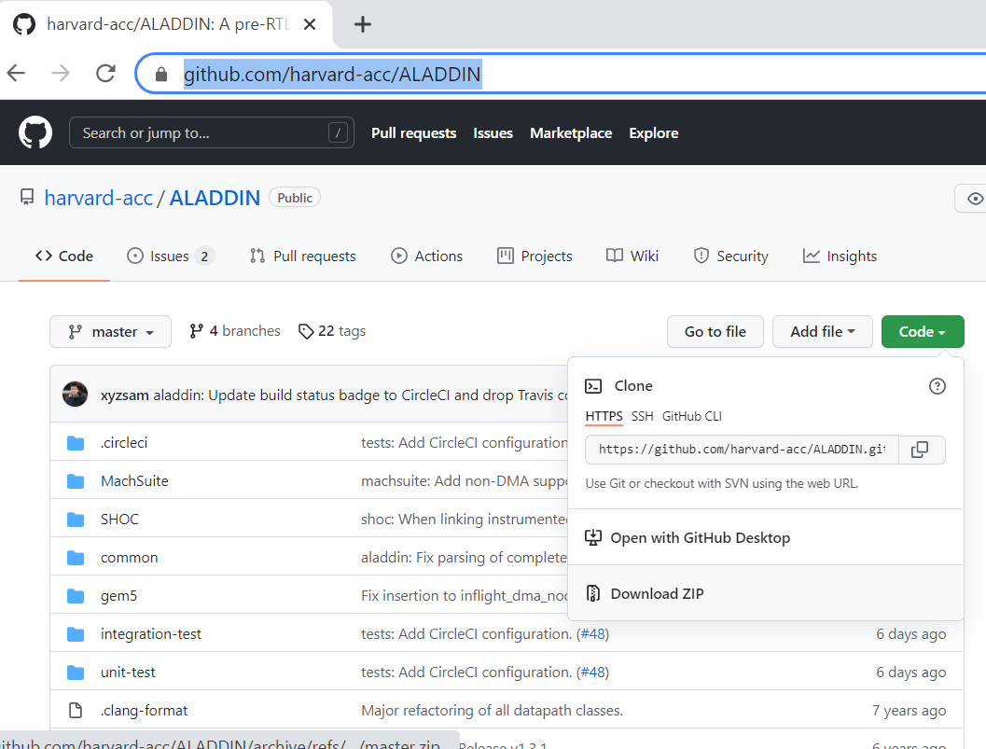
51.1 Download Gem5-Aladdin Source Code
https://github.com/harvard-acc/gem5-aladdin
Download Gem5-Aladdin Source Code
Download Gem5-Aldiin source code.

Slide 10
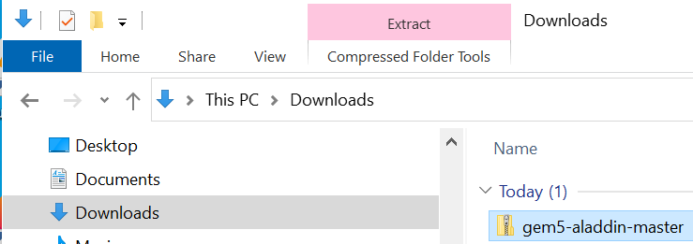
51.1 Download Gem5-Aladdin Source Code
https://github.com/harvard-acc/gem5-aladdin
Download Gem5-Aladdin Source Code
Download Gem5-Aldiin source code.

Slide 11
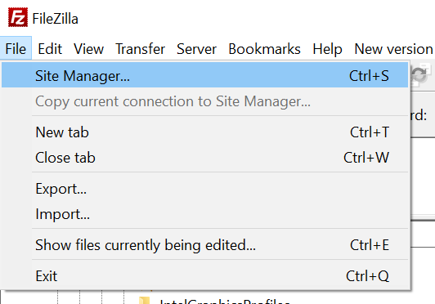
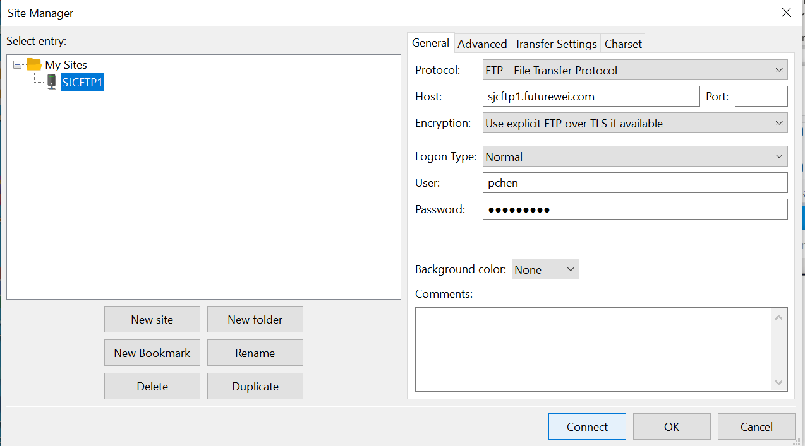
51.1 Download Gem5-Aladdin Source Code
https://github.com/harvard-acc/gem5-aladdin
Transfer Gem5-Aladdin Source Code
Start FileZilla: Site Manager

Slide 12
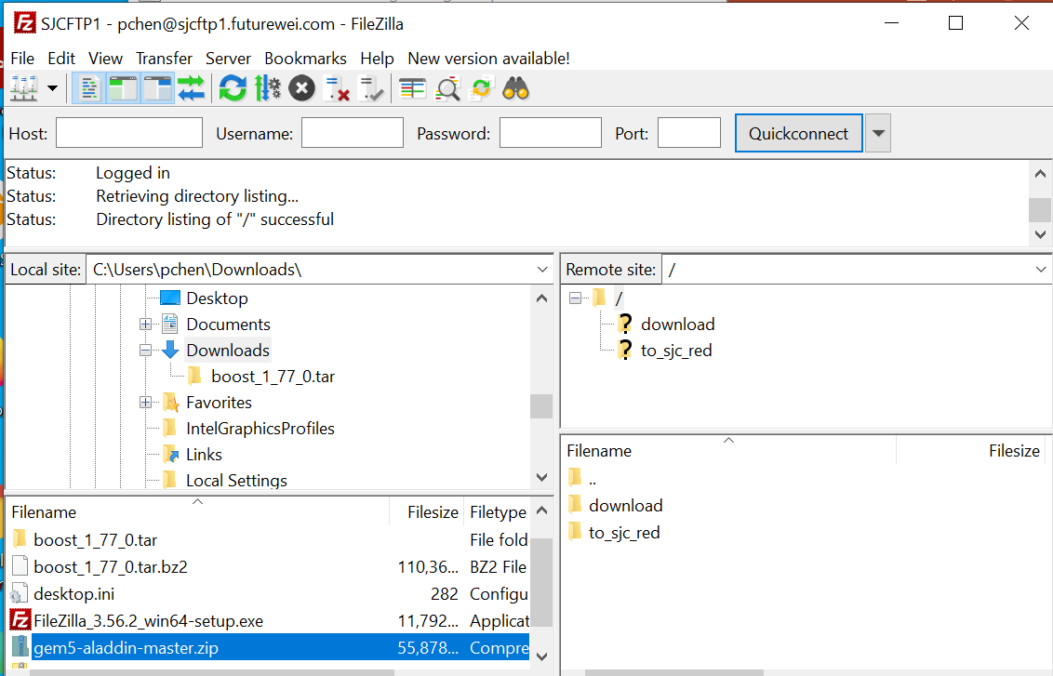
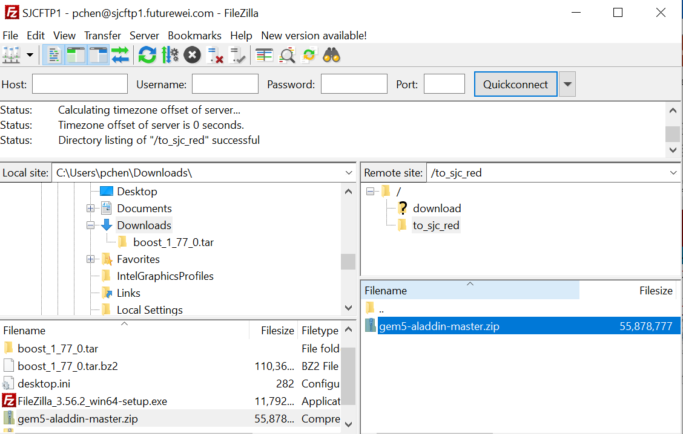
51.1 Download Gem5-Aladdin Source Code
https://github.com/harvard-acc/gem5-aladdin
Transfer Gem5-Aladdin Source Code
Drag and drop the gem5-aladdin.zip into to_sj_red folder.

Slide 13
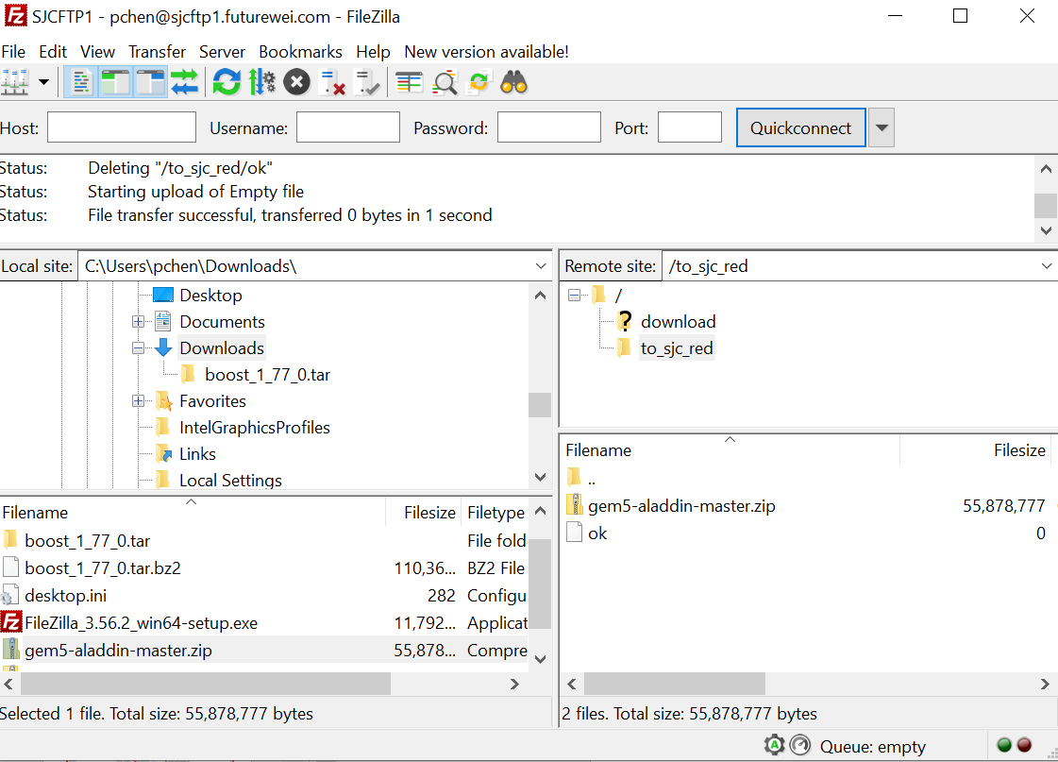
51.1 Download Gem5-Aladdin Source Code
https://github.com/harvard-acc/gem5-aladdin
Transfer Gem5-Aladdin Source Code
To speed up the FTP transfer. In the transferred file directory, create “ok” file.

Slide 14
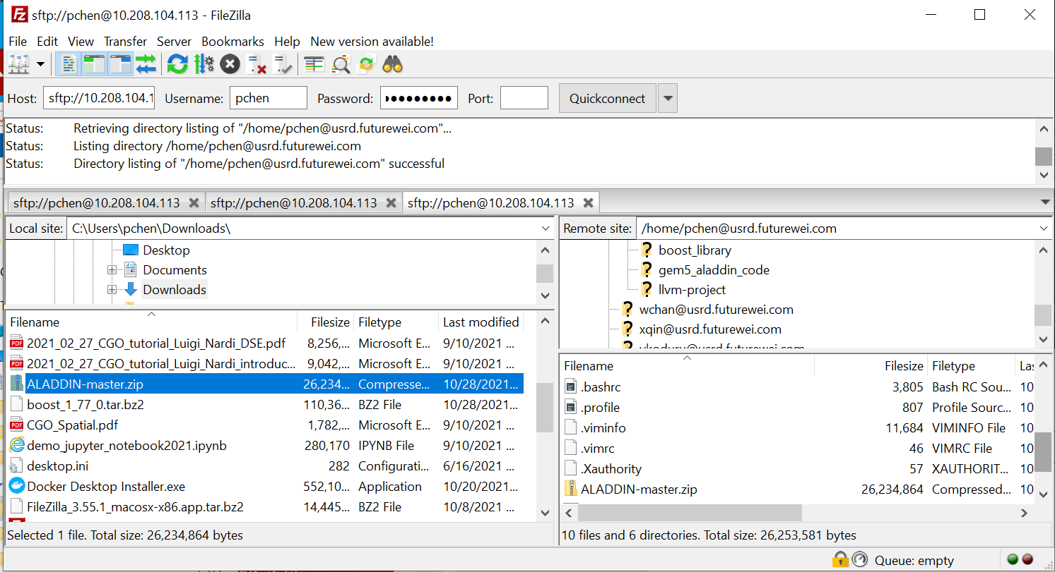
51.1 Download Gem5-Aladdin Source Code
https://github.com/harvard-acc/gem5-aladdin
Download Gem5-Aladdin Source Code
Wait for several minutes to download.

Slide 15
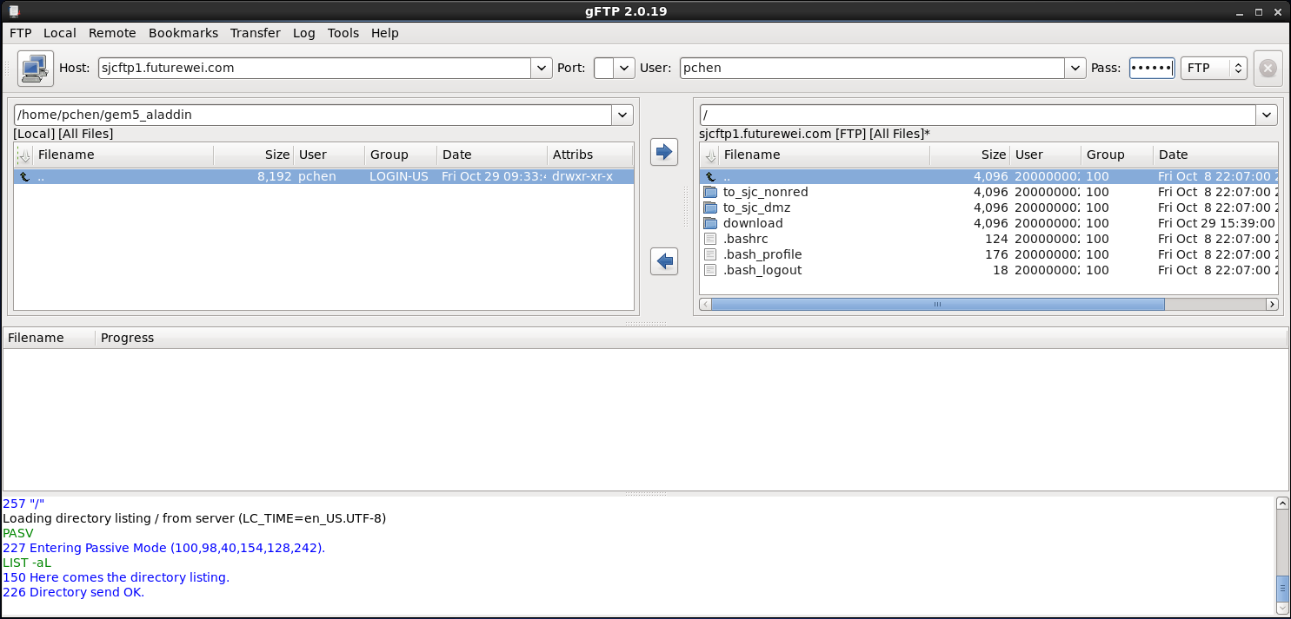
51.1 Download Gem5-Aladdin Source Code
https://github.com/harvard-acc/gem5-aladdin
Download Gem5-Aladdin Source Code
On Linux terminal
> gftp
>>> pass: Future*******

Slide 16
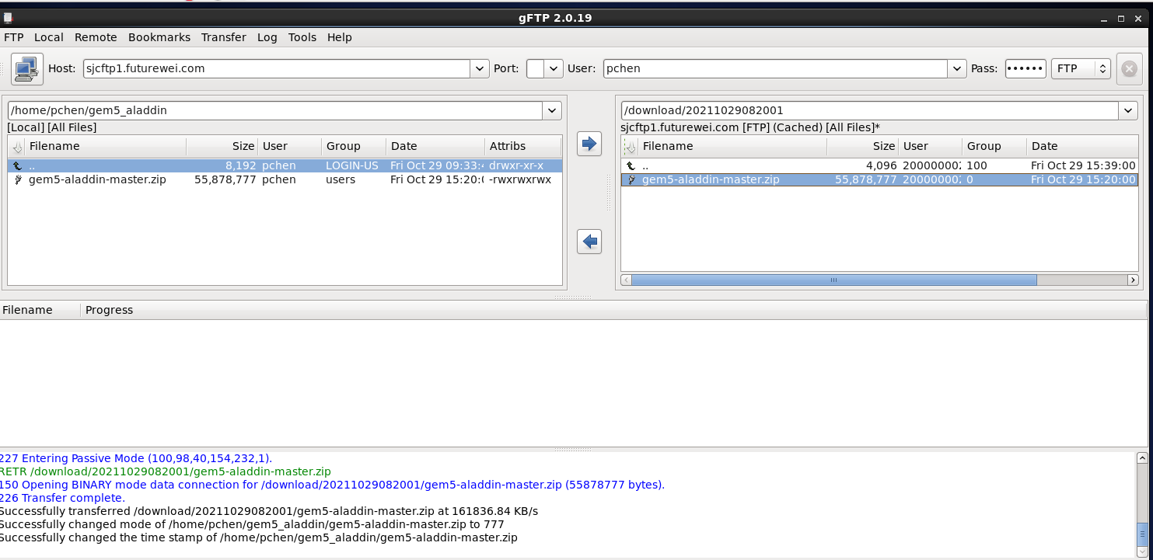
51.1 Download Gem5-Aladdin Source Code
https://github.com/harvard-acc/gem5-aladdin
Download Gem5-Aladdin Source Code
Click the “date”, you will see the file “gem5-aladdin-master.zip” on the right hand panel.
Double click to copy to your left-hand folder.

Slide 17

51.1 Download Gem5-Aladdin Source Code
https://github.com/harvard-acc/gem5-aladdin
Download Gem5-Aladdin Source Code
In Linux terminal, check “gem5_aladdin.zip”

Slide 18
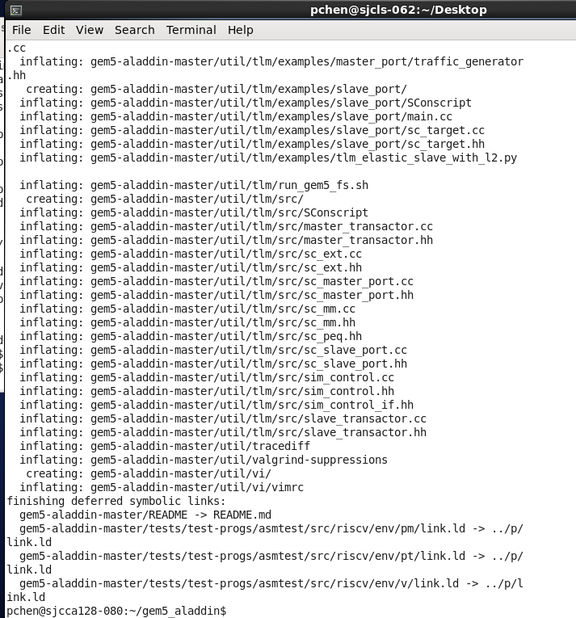
51.1 Download Gem5-Aladdin Source Code
https://github.com/harvard-acc/gem5-aladdin
Download Gem5-Aladdin Source Code
> unzip gem5-aladdin-master.zip

Slide 19
50.2 Download Gem5-Aladdin Dependencies

Slide 20
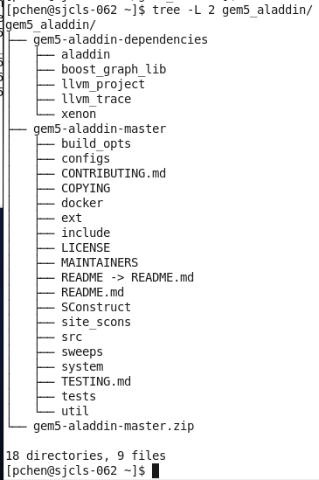
50.2 Download Gem5-Aladdin Dependencies
https://github.com/harvard-acc/gem5-aladdin
Download Aladdin Library
The gem5-aladdin has five dependencies (libraries):
1. aladdin: aladdin library
2. boost_graph_lib: boost graph library
3. llvm_trace: LLVM Tracer Library
4. llvm_project: LLVM headers and clang
5. xenon: sweep generation

Slide 21
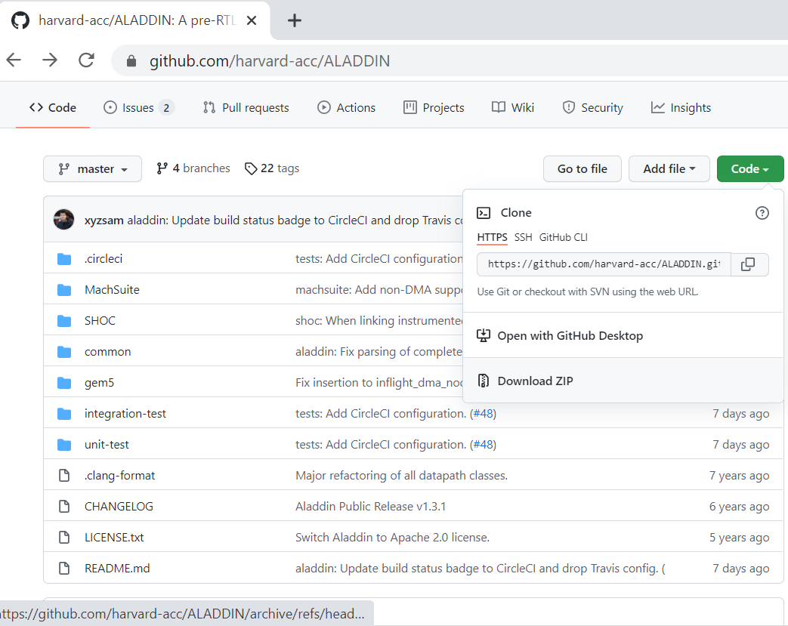
50.2 Download Gem5-Aladdin Dependencies
https://github.com/harvard-acc/gem5-aladdin
Download Aladdin Library
We keep on downloading Aladdin Library.
1. Aladdin Source code from: https://github.com/harvard-acc/ALADDIN

Slide 22
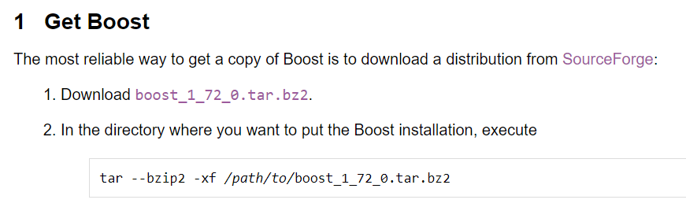
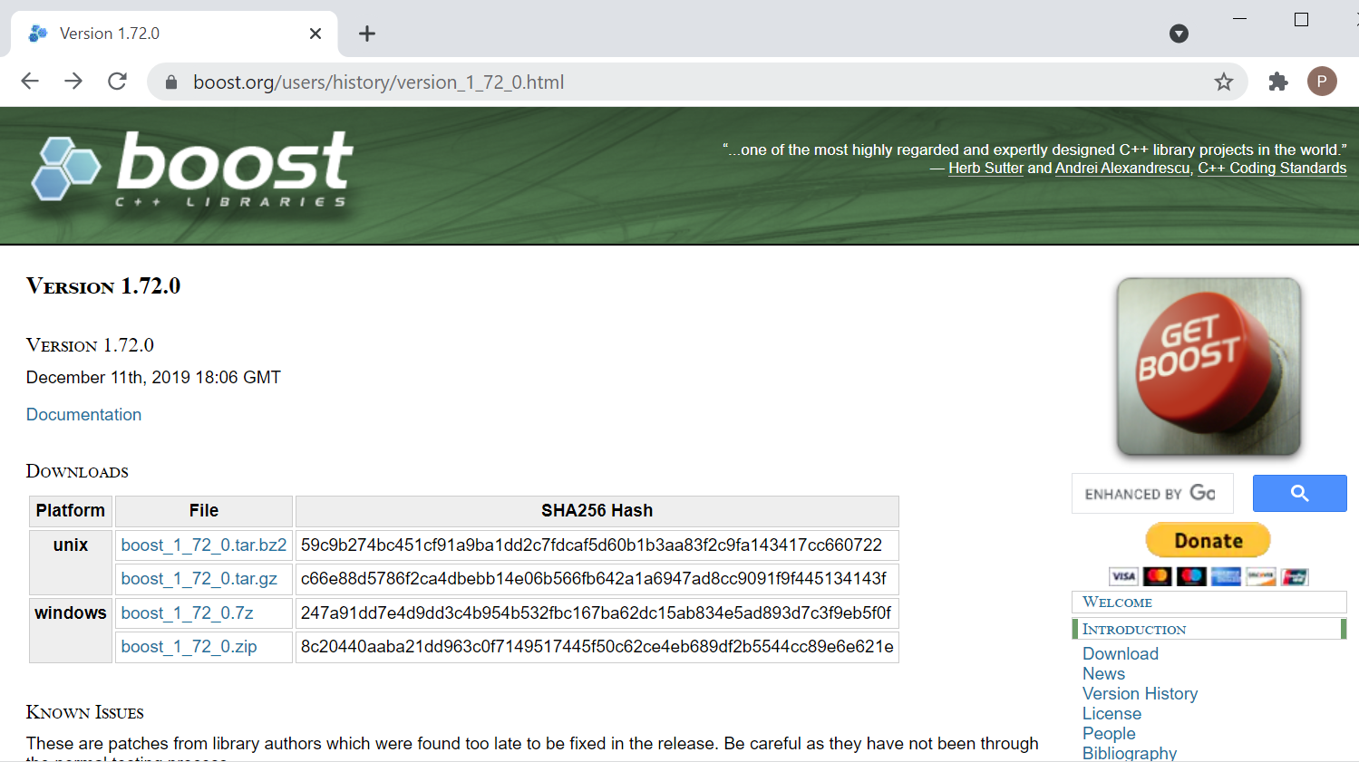
50.2 Download Gem5-Aladdin Dependencies
https://github.com/harvard-acc/gem5-aladdin
Download Boost Graph Library
We keep on downloading Boost Graph Library.
2. Boost Graph Library: https://www.boost.org/doc/libs/1_72_0/more/getting_started/unix-variants.html

Slide 23
50.2 Download Gem5-Aladdin Dependencies
https://github.com/harvard-acc/gem5-aladdin
Download Boost Graph Library
We keep on downloading Boost Graph Library.
2. Boost Graph Library: https://www.boost.org/doc/libs/1_72_0/more/getting_started/unix-variants.html

Slide 24
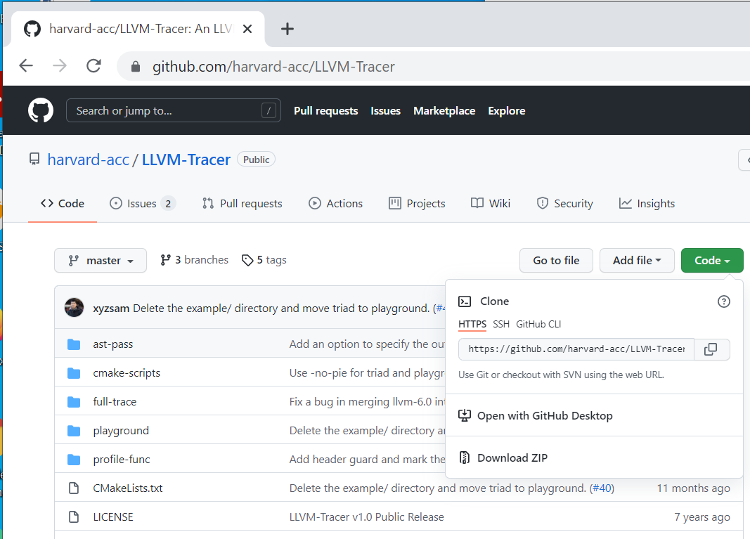
50.2 Download Gem5-Aladdin Dependencies
https://github.com/harvard-acc/gem5-aladdin
Download LLVM Tracer
We keep on downloading LLVM Tracer Library.
3. LLVM Trace Library: https://github.com/harvard-acc/LLVM-Tracer

Slide 25
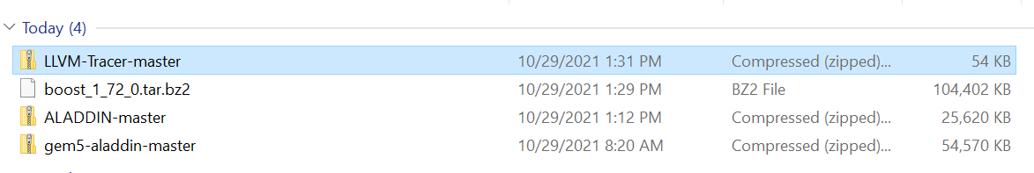
50.2 Download Gem5-Aladdin Dependencies
https://github.com/harvard-acc/gem5-aladdin
Download Gem5-Aladdin Dependencies
Verify download dependencies, we have:
1. Aladdin library: ALADDIN-master
2. Boost Graph Library: boost_1_72_0.tar.bz2
3. LLVM Trace Library: LLVM-Trace-master

Slide 26
50.2 Download Gem5-Aladdin Dependencies
https://github.com/harvard-acc/gem5-aladdin
Download LLVM Tracer
Now, we transfer these three files into secure zone.
Use the FileZilla to transfer all three gem5-aladdin dependencies.

Slide 27
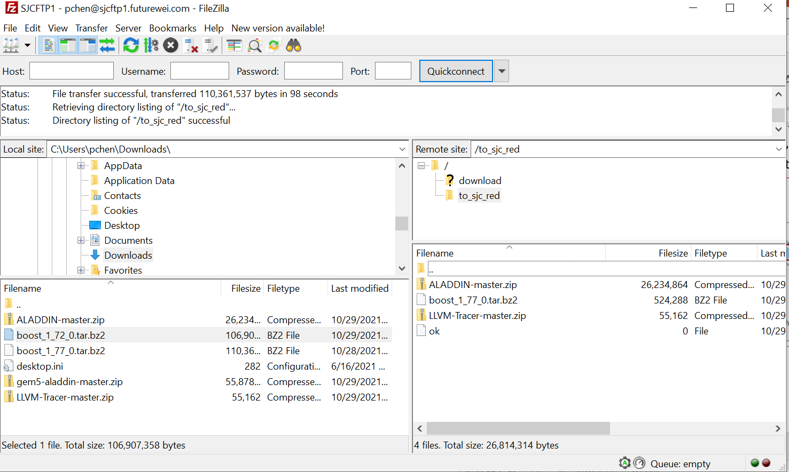
50.2 Download Gem5-Aladdin Dependencies
https://github.com/harvard-acc/gem5-aladdin
Download LLVM Tracer
Now, we transfer these three files into secure zone.
Use the FileZilla and drag-and-drop all three gem5-aladdin dependencies as below.
Create a file “ok” as before to trigger the virus scan and ftp transfer.

Slide 28
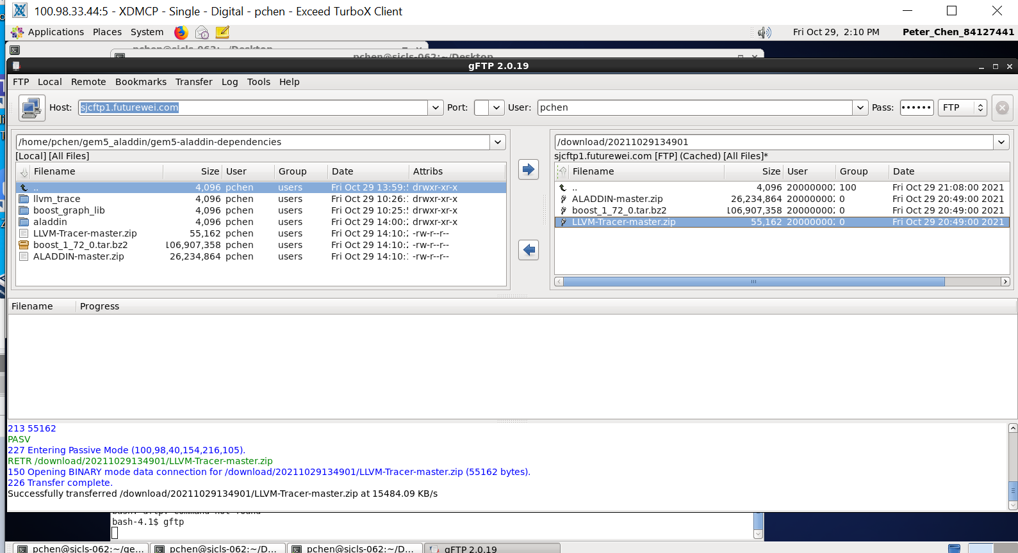
50.2 Download Gem5-Aladdin Dependencies
https://github.com/harvard-acc/gem5-aladdin
Download Gem5-Aladdin Dependencies
FTP server in on server sjc60, sjc61, sjc62, and sjc63. Open Linux Terminal:
> gftp
Clicked the date on right panel as below. We can see FTP server got three files.
Drag and drop three file into the left panel
Linux Terminal
Files on FTP server
Date
Drag and drop files From FTP server to Linux Terminal

Slide 29
50.2 Download Gem5-Aladdin Dependencies
https://github.com/harvard-acc/gem5-aladdin
Download LLVM Tracer
Now, we have done all FTP transfer.
Open Linux Terminal and move the transfer files into each separate library directories.
> unzip ALADIN-master.zip
> bzip2 -d boost_1_72_0.tar.bz2, then tar -xv boost_1_72_0.tar
> unzip LLVM-Trace-master.zip

Slide 30
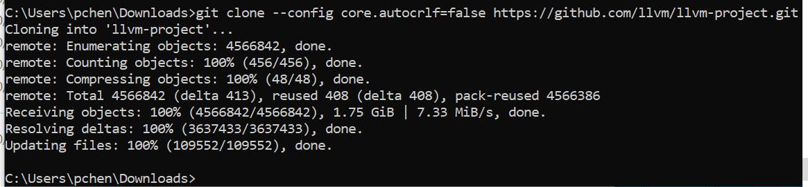
50.2 Download Gem5-Aladdin Dependencies
https://github.com/harvard-acc/gem5-aladdin
Download LLVN Project for Headers and Clang
One more folder: llvm_project for headers and development: https://llvm.org/docs/GettingStarted.html#checkout
Go to C:\Users\pchen\Downloads
> git clone --config core.autocrlf=false https://github.com/llvm/llvm-project.git
Use Window 7-Zip to zip llvm_-project folder into llvm_project.zip.

Slide 31
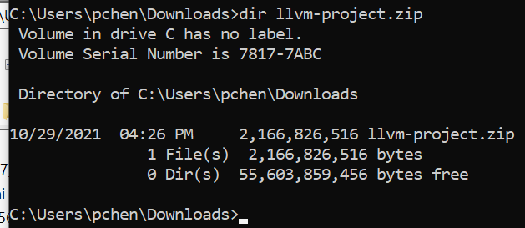
50.2 Download Gem5-Aladdin Dependencies
https://github.com/harvard-acc/gem5-aladdin
Download LLVN Project for Headers and Clang
File size is 2.16 GB

Slide 32
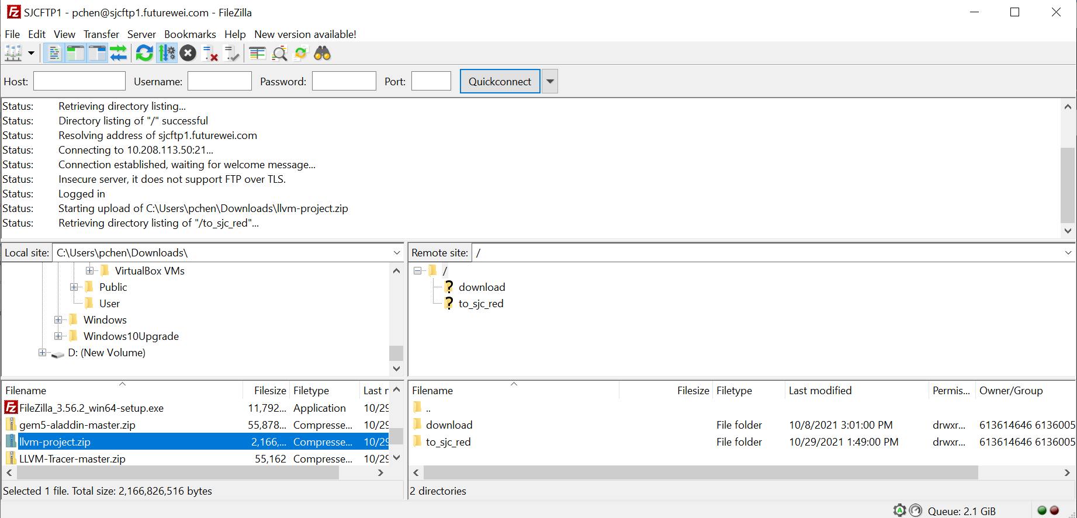
50.2 Download Gem5-Aladdin Dependencies
https://github.com/harvard-acc/gem5-aladdin
Download LLVN Project for Headers and Clang
Use FileZilla to transfer into FTP server and Secure zone.

Slide 33
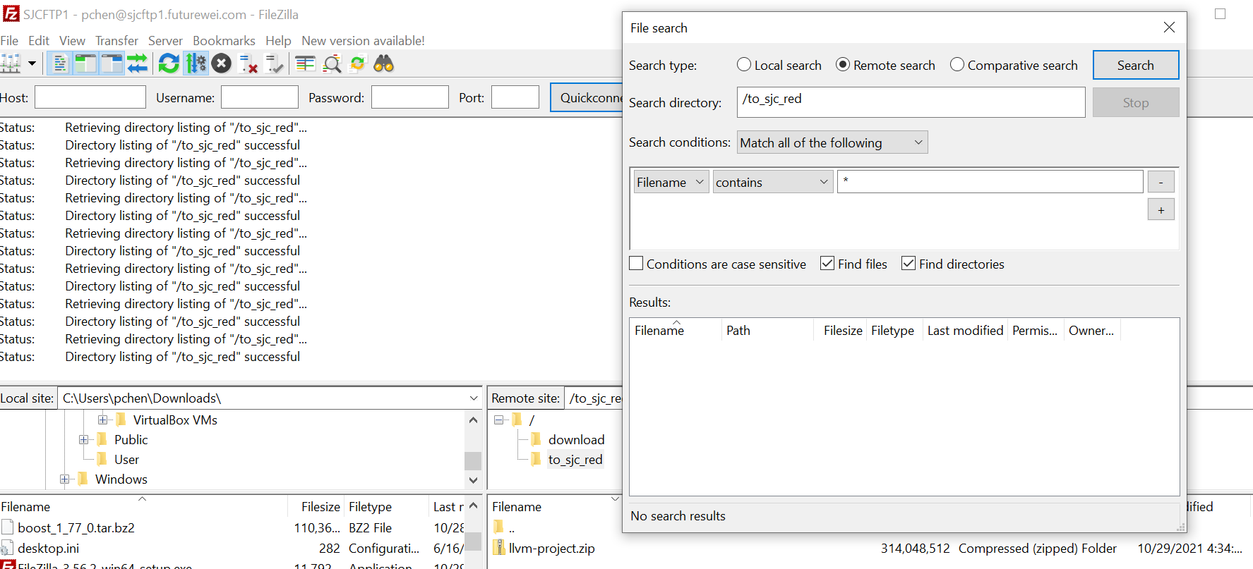
50.2 Download Gem5-Aladdin Dependencies
https://github.com/harvard-acc/gem5-aladdin
Download LLVN Project for Headers and Clang
Takes several hours to transfer.
Use “Server > Search” to find the transfer file size.

Slide 34
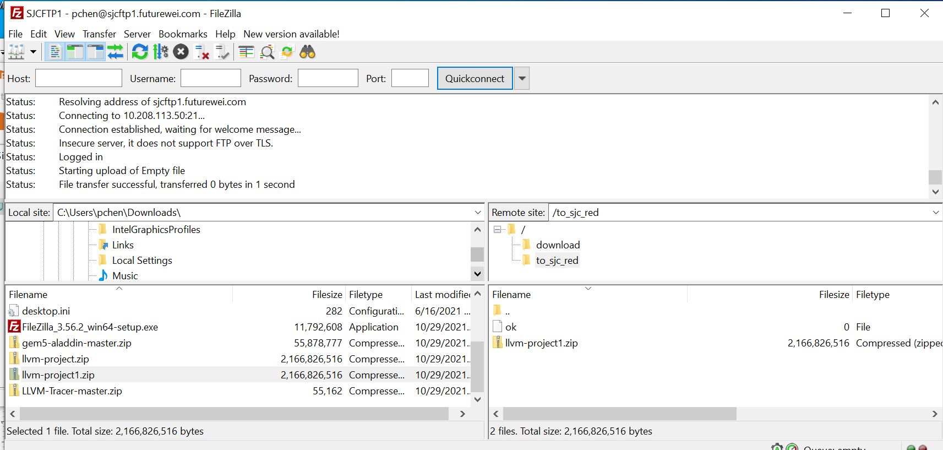
50.2 Download Gem5-Aladdin Dependencies
https://github.com/harvard-acc/gem5-aladdin
Download LLVN Project for Headers and Clang
Finally, 2.16GB is transferred from local Windows system into the FTP server.
Create “ok” for anti-virus scan.

Slide 35
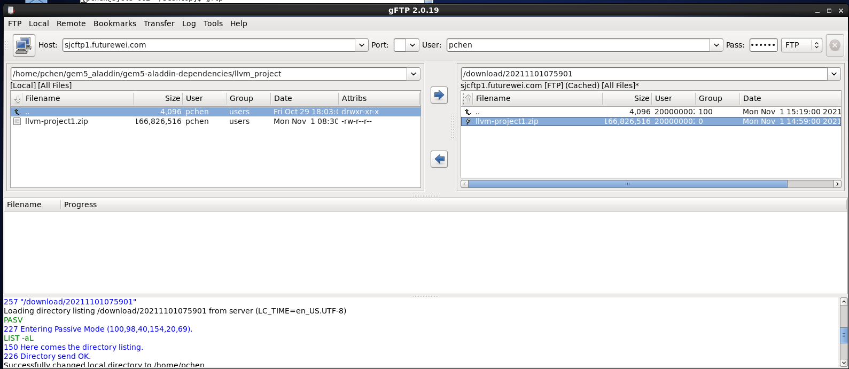
50.2 Download Gem5-Aladdin Dependencies
https://github.com/harvard-acc/gem5-aladdin
Download LLVN Project for Headers and Clang
Now, we move from ftp server into our secure zone. On Secure zone linux,
> gftp
Secure Zone
Drag and drop 2.16GB llvm_project from FTP server to secure zone.
Ftp Server

Slide 36
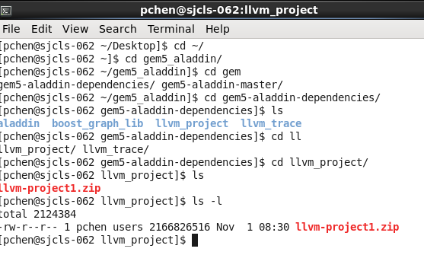
50.2 Download Gem5-Aladdin Dependencies
https://github.com/harvard-acc/gem5-aladdin
Download LLVN Project for Headers and Clang
Verify secure zone.
> cd gem5-alladin/gem5-aladdin-dependencies/llvm_project
> ls -l
It is 2.16GB llvm-project*.zip

Slide 37
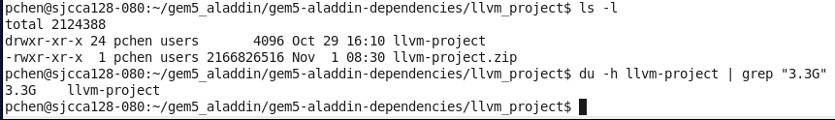
50.2 Download Gem5-Aladdin Dependencies
https://github.com/harvard-acc/gem5-aladdin
Download Prebuilt Binary for LLVN Project for Headers and Clang
Due to Disk Space Quota limitation, we need to ask Richard, Noah, and Chao-Ma to increase disk quota. Chao-Ma gives 100G more.
> unzip llvm-project.zip
> du -h llvm-project

Slide 38
50.3 Verify Directory Structure

Slide 39
50.3 Verify Directory Structure
https://github.com/harvard-acc/gem5-aladdin
Verify Directory Structure
1. gem5-aladdin
2. aladdin dependencies:
2.1 aladdin
2.2 boost_graph_lib
2.3 llvm_project
2.4 llvm_trace
2.5 xenon
Now, we are ready to compile/build Gem5-Alddin (1) and its associated dependencies (2.1-2.5)
2.1 to 2.5
1

Slide 40
End

