Slide 1

3 Python Docker
Peter H. Chen

Slide 2
3 Python Docker
https://www.youtube.com/watch?v=bi0cKgmRuiA
Python Docker
This document describe how to use Docker for Python Application.
We look at two examples and how to dockerize them.
First example is a simple script that needs additional dependencies.
Second example is a web application with Fast API. The second example, also show how to dockerize a virtual environment.
These two examples are the most common use cases for docker.
We should be able to apply these examples for all our projects.

Slide 3

3 Python Docker
https://www.youtube.com/watch?v=bi0cKgmRuiA
Check Docker Installation
First, we need the docker installed
> ssh sjc80
> bash
> source setup_env.sh
> docker --version
or
> docker -v
>> Docker version 19.03.12

Slide 4
3 Python Docker
https://www.youtube.com/watch?v=bi0cKgmRuiA
First Example
We can use any editor for the application implementation.
1. Dockerfile
2. Docker Image
3. Docker container.
Dockerfile is a blueprint for building the image.
An image is a template for running containers.
The container is the actual running process where we have our package project.
First thing, we need to do is to define the Dockerfile.

Slide 5
3.1 Define Dockerfile

Slide 6
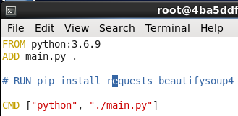
3.1 First Example
https://www.youtube.com/watch?v=bi0cKgmRuiA
First Example
> vi Dockerfile
>> FROM python:3.6.9
This is pulling the image from docker hub which already have python installed. We have Python in our container.
Then, we want to add the main.py file into our container.
>> ADD main.py .
The destination is current directory “.” in our container.
Now, in main.py, we need install the dependency.
>> RUN pip install request
>> CMD [“python”, “./main.py”]

Slide 7
3.2 Create Application

Slide 8

3.2 Create Application
https://www.youtube.com/watch?v=bi0cKgmRuiA
Create Application
Create the main.py
> vi main.py
>> print (“hello world”)

Slide 9
3.3 Build Image

Slide 10
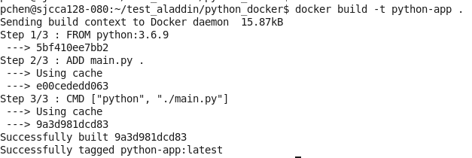
3.3 Build Image
https://www.youtube.com/watch?v=bi0cKgmRuiA
Build Image
Build the image
> docker build -t python-app .
We create the image “python-app”

Slide 11
3.4 Run Image

Slide 12
3.4 Run Image
https://www.youtube.com/watch?v=bi0cKgmRuiA
Run Image
Build the image
> docker run python-app
Or
> docker run –t python-app
The ‘-t” is the pseudo-terminal.

Slide 13
End

