Slide 1

3 Dataset Generation
Peter H. Chen

Slide 2
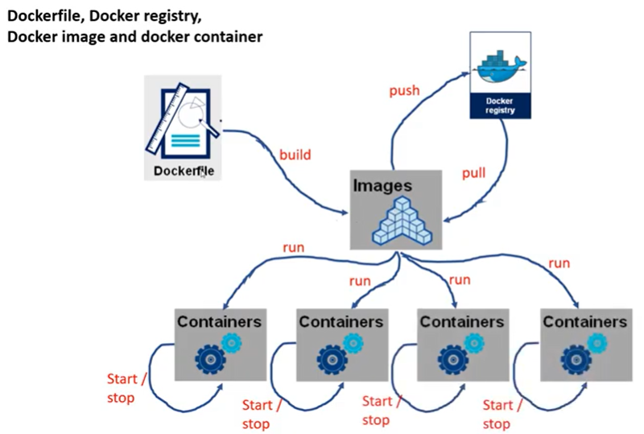
3 Docker Dataset Generation
https://www.youtube.com/watch?v=8uaDoMuDK6E
Dataset Generation
This document describes the dse_dataset_load_store.py

Slide 3
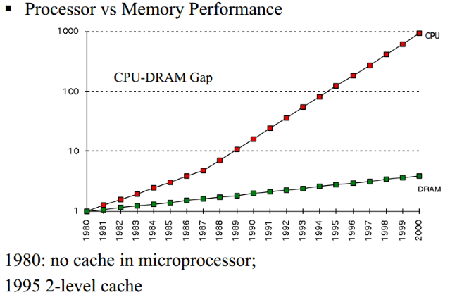
3 Docker Dataset Generation
https://www.hardwaretimes.com/difference-between-l1-l2-and-l3-cache-what-is-cpu-cache/
L1, L2, L3 Cache

Slide 4
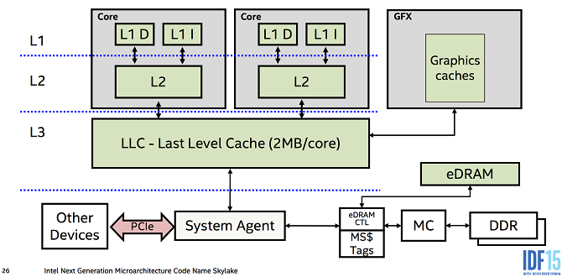
3 Docker Dataset Generation
https://www.hardwaretimes.com/difference-between-l1-l2-and-l3-cache-what-is-cpu-cache/
L1, L2, L3 Cache

Slide 5
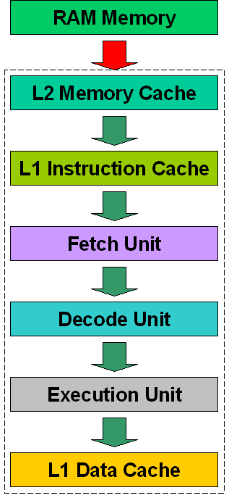
3 Docker Dataset Generation
https://www.hardwaretimes.com/difference-between-l1-l2-and-l3-cache-what-is-cpu-cache/
L1, L2, L3 Cache

Slide 6
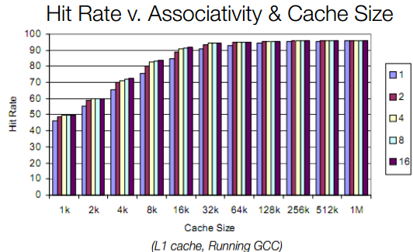
3 Docker Dataset Generation
https://www.hardwaretimes.com/difference-between-l1-l2-and-l3-cache-what-is-cpu-cache/
L1, L2, L3 Cache

Slide 7
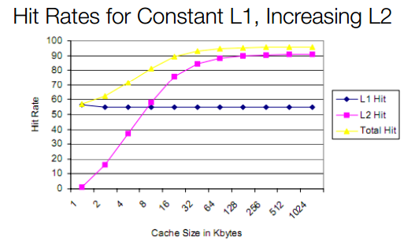
3 Docker Dataset Generation
https://www.hardwaretimes.com/difference-between-l1-l2-and-l3-cache-what-is-cpu-cache/
L1, L2, L3 Cache

Slide 8
3.1 dse_dataset_load_store.py

Slide 9
3.1 dse_dataset_load_store.py
https://www.youtube.com/watch?v=8uaDoMuDK6E
Dse_data_load_store.py
1. Create working folder with app.c, gem5.cfg, app.cfg, and run.sh.base, dse_dataset_load_store.py.
2. import torch, class RunBuilder, class RunManager, Collection, and panda.
3. Compile app.c into app_gem5-accel_instrumented, aladdin trace.
4. Read run.sh_template/run.sh.base, ../../common/test_catci_tlb.base and ../../common/test_catci_cahe.base files
5. Looping by pyTorch class RunBuilder and RunManager
5.1 Match row looping entry.
5.2 Translate defined key/value to ../../common/catci_tlb.base.
5.3 Translate defined key/value to ../../common/catci_cache.base.
5.4 Translate defined key/value to run.sh_template/run.sh.base.
5.5 pyTorch RunManager for Cartesian product of parameters looping.
5.6 run.sh for stats.txt and summary.
7. Post process with outputs/stat.txt and summary into results/IPC (Instruction Per Cycle), power, and area.

Slide 10
3.1 dse_dataset_load_store.py
https://www.youtube.com/watch?v=8uaDoMuDK6E
dse_data_load_store.py
1. Define all the parameters in the params structure.
2. Create the Run with keys.
3. Loop for cartesian products.
4. Get individual runs
5. Use Run Manager to get each run
6. In each run, we use begin_run() and end_end() to process the result.
7. Save the result in csv format.

Slide 11
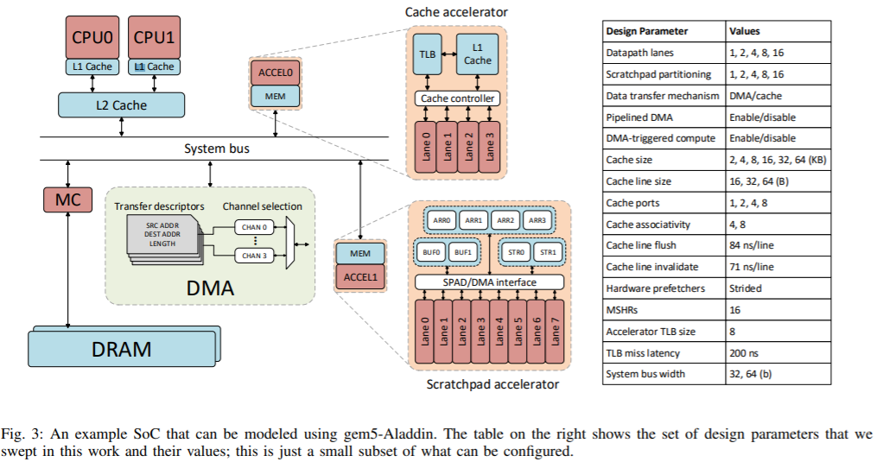
3.1 dse_dataset_load_store.py
http://vlsiarch.eecs.harvard.edu/wp-content/uploads/2016/08/shao_micro2016.pdf
dse_data_load_store.py
Cache Size: 2, 4, 6, 8, 16, 32, 64 KB
CacheLine: 16, 32, 64B

Slide 12
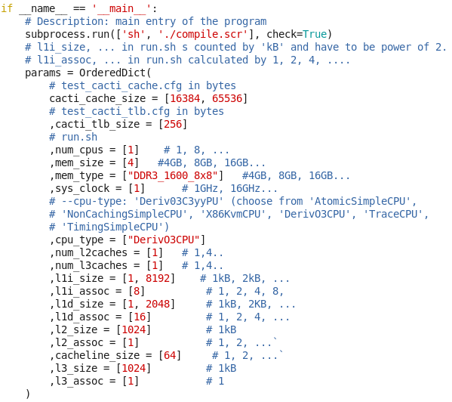
3.1 dse_dataset_load_store.py
https://www.youtube.com/watch?v=8uaDoMuDK6E
dse_data_load_store.py
1. setup tlb (Table Lookahead Buffer) size
2. setup cache size.
3. Setup l1i_size, l1d_size, l2_size, l3_size are size of cache and must be power of 2. The dse_dataset will translate the size into kB unit.

Slide 13
3.2 cacti_cache.cfg, cacti_tlb.cfg, and run.sh

Slide 14
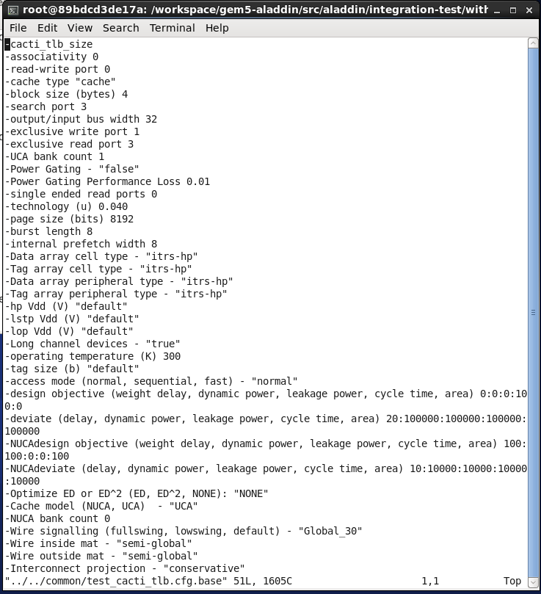
3.2 cacti_tlb.cfg, cacti_cache.cfg, and run.sh
https://www.youtube.com/watch?v=8uaDoMuDK6E
Test_cacti_tlb.cfg.base
Test_cacti_tlb.cfg.base the base template file to generate test_cacti_cache.cfg.

Slide 15
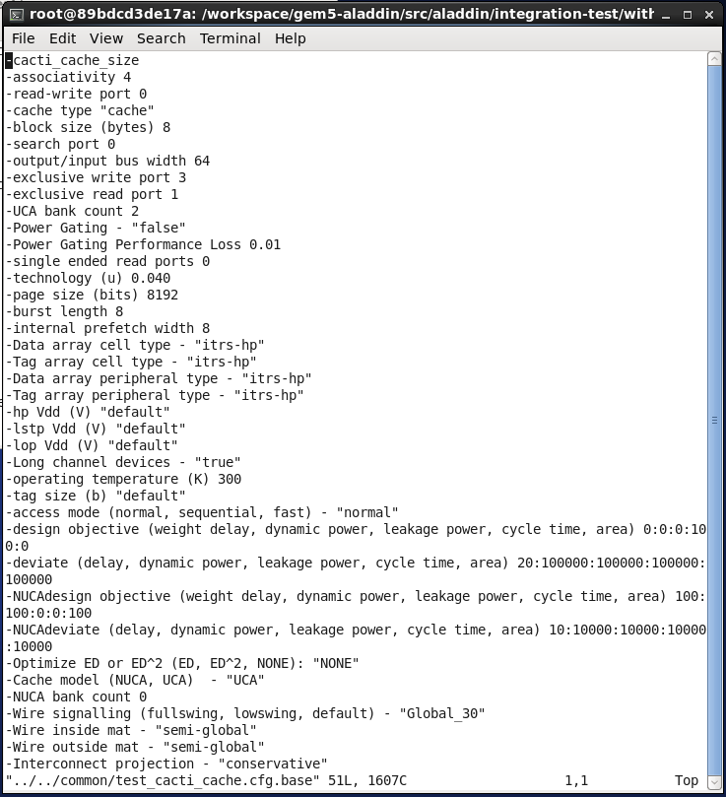
3.2 cacti_tlb.cfg, cacti_cache.cfg, and run.sh
https://www.youtube.com/watch?v=8uaDoMuDK6E
Test_cacti_cache.cfg.base
Test_cacti_cache.cfg.base the base template file to generate test_cacti_cache.cfg.

Slide 16
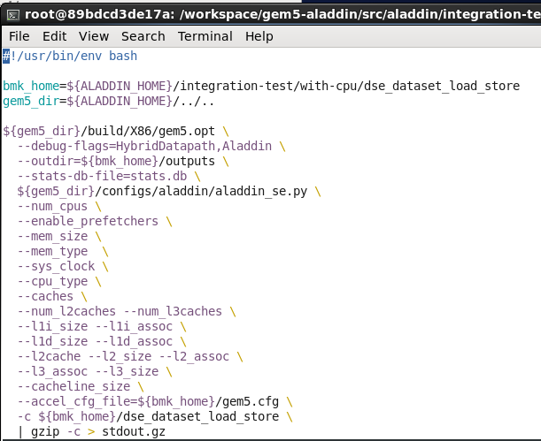
3.2 cacti_tlb.cfg, cacti_cache.cfg, and run.sh
https://www.youtube.com/watch?v=8uaDoMuDK6E
run.sh.base
Run.sh.base the base template file to generate run.sh for each run.

Slide 17
3.3 Process cacti_cache.cfg, cacti_tlb.cfg, and run.sh

Slide 18
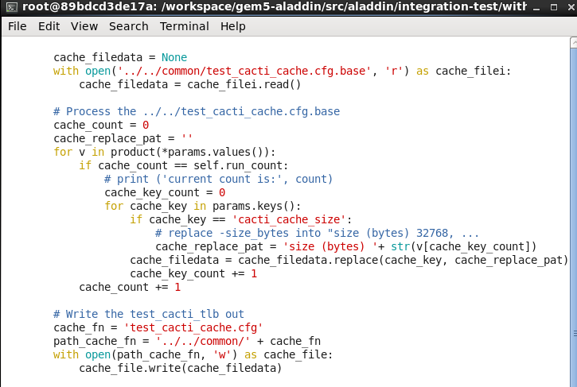
3.3 Process cacti_cache.cfg, cacti_tlb.cfg, and run.sh
https://www.youtube.com/watch?v=8uaDoMuDK6E
Process test_cacti_cache.cfg
The test_cacti_cache.cfg is to control the area size.

Slide 19
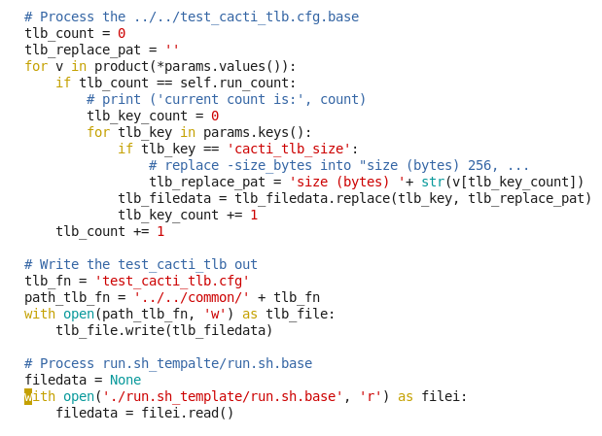
3.3 Process cacti_cache.cfg, cacti_tlb.cfg, and run.sh
https://www.youtube.com/watch?v=8uaDoMuDK6E
Process test_cacti_tlb.cfg
Tlb: Table for lookahead buffer

Slide 20
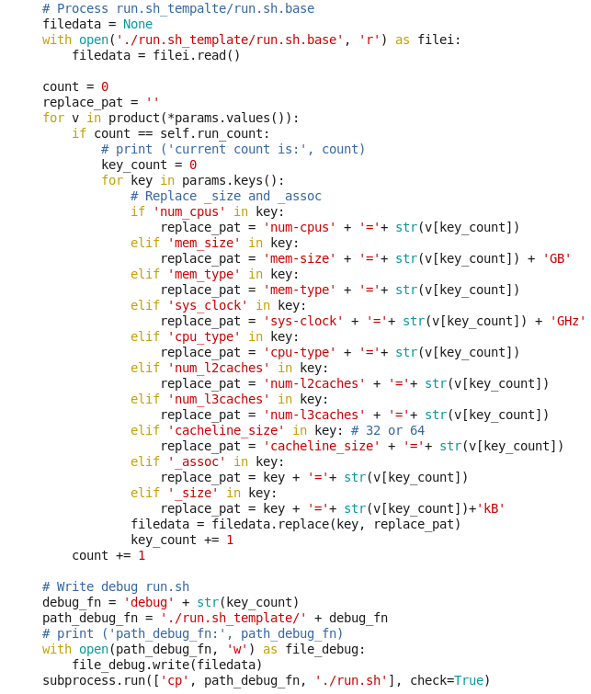
3.3 Process cacti_cache.cfg, cacti_tlb.cfg, and run.sh
https://www.youtube.com/watch?v=8uaDoMuDK6E
Process test_cacti_cache.cfg
The run.sh is for L1, L2, L3 cache.

Slide 21
3.4 Run run.sh

Slide 22

3.4 Run run.sh
https://www.youtube.com/watch?v=8uaDoMuDK6E
Run run.sh

Slide 23
3.5 Process Result

Slide 24
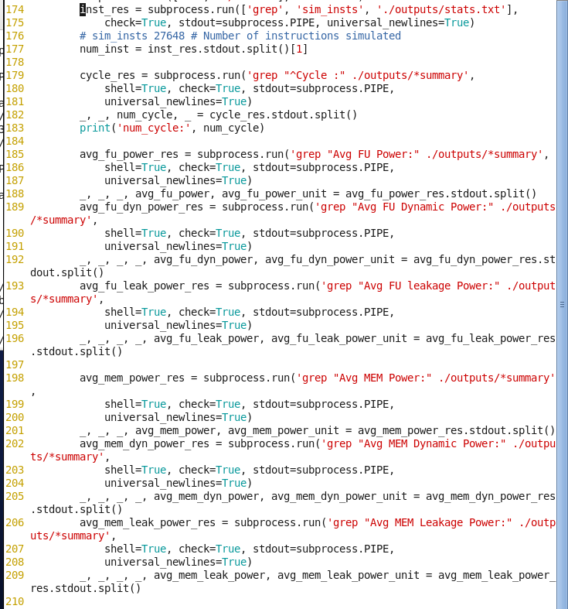
3.5 Process Result
https://www.youtube.com/watch?v=8uaDoMuDK6E
Process Result

Slide 25
3.6 Save Result

Slide 26
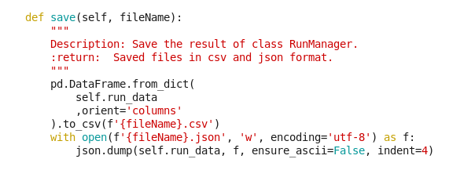
3.6 Save Result
https://www.youtube.com/watch?v=8uaDoMuDK6E
Save Result

Slide 27
3.6 View Result

Slide 28
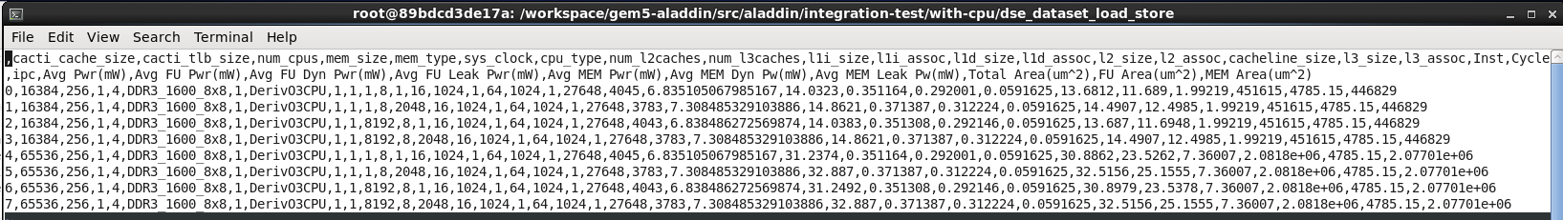
3.6 View Result
https://www.youtube.com/watch?v=8uaDoMuDK6E
View Result

Slide 29
3.7 Commit gem5-aladdin_dataset

Slide 30
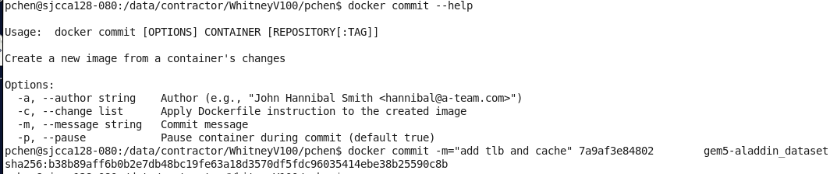
3.7 Commit gem5-aladdin_dataset
https://www.youtube.com/watch?v=8uaDoMuDK6E
Commit gem5-aladdin_dataset
> docker ps -a | grep datatset
>> get the <image ID>
> docker commit -m “add tlb and cache” <Image ID> gem5-aladdin_dataset

Slide 31
End

