Slide 1

3 Dataset Generation
Peter H. Chen

Slide 2
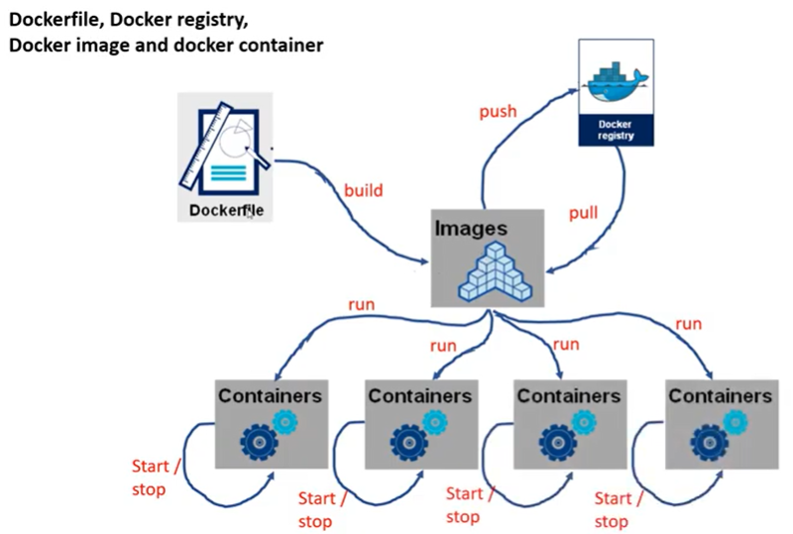
3 Docker Dataset Generation
https://www.youtube.com/watch?v=8uaDoMuDK6E
Dataset Generation
This document describes the dse_dataset_load_store.py

Slide 3
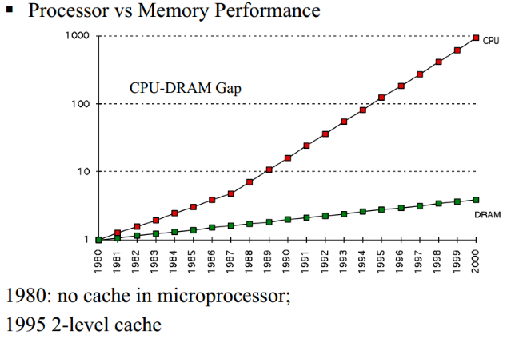
3 Docker Dataset Generation
https://www.hardwaretimes.com/difference-between-l1-l2-and-l3-cache-what-is-cpu-cache/
L1, L2, L3 Cache

Slide 4
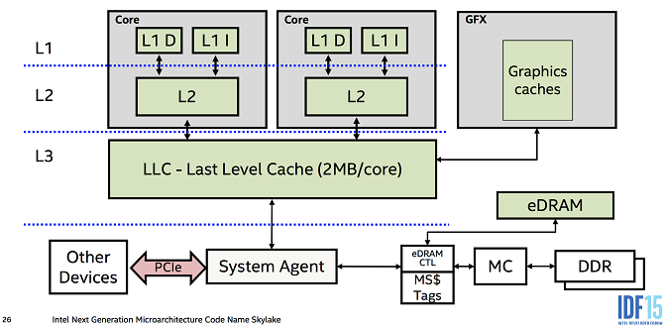
3 Docker Dataset Generation
https://www.hardwaretimes.com/difference-between-l1-l2-and-l3-cache-what-is-cpu-cache/
L1, L2, L3 Cache

Slide 5
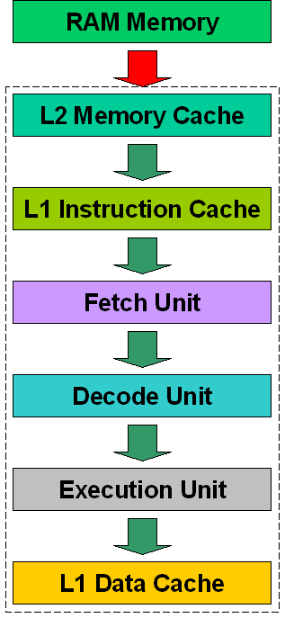
3 Docker Dataset Generation
https://www.hardwaretimes.com/difference-between-l1-l2-and-l3-cache-what-is-cpu-cache/
L1, L2, L3 Cache

Slide 6
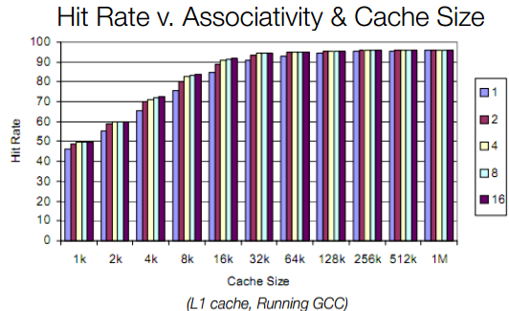
3 Docker Dataset Generation
https://www.hardwaretimes.com/difference-between-l1-l2-and-l3-cache-what-is-cpu-cache/
L1, L2, L3 Cache

Slide 7
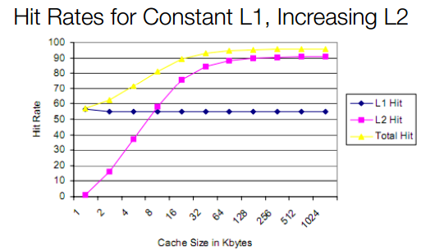
3 Docker Dataset Generation
https://www.hardwaretimes.com/difference-between-l1-l2-and-l3-cache-what-is-cpu-cache/
L1, L2, L3 Cache

Slide 8
3.1 dse_dataset_load_store.py

Slide 9
3.1 dse_dataset_load_store.py
https://www.youtube.com/watch?v=8uaDoMuDK6E
Dse_data_load_store.py
1. Create working folder with app.c, gem5.cfg, app.cfg, and run.sh.base, dse_dataset_load_store.py.
2. import torch, class RunBuilder, class RunManager, Collection, and panda.
3. Compile app.c into app_gem5-accel_instrumented, aladdin trace.
4. Read run.sh_template/run.sh.base into memory
5. Looping by pyTorch class RunBuilder and RunManager
5.1 Match row looping entry.
5.2 Translate defined key/value to run.sh_template/run.sh.base.
5.3 pyTorch RunManager for parameters looping [Cartesian product = L1 x L2 x L3 x CPU x … = 10^Y loop (rows)]
5.4 Copy run.sh to run.sh_template/run.sh.cache1_xxxx_cache2_xxxx.
5.5 run.sh (done) for stats.txt and summary.
7. Post process with outputs/stat.txt and summary into results/IPC (Instruction Per Cycle), power, and area.

Slide 10
3.1 dse_dataset_load_store.py
https://www.youtube.com/watch?v=8uaDoMuDK6E
dse_data_load_store.py
1. Define all the parameters in the params structure.
2. Create the Run with keys.
3. Loop for cartesian products.
4. Get individual runs
5. Use Run Manager to get each run
6. In each run, we use begin_run() and end_end() to process the result.
7. Save the result in csv format.

Slide 11
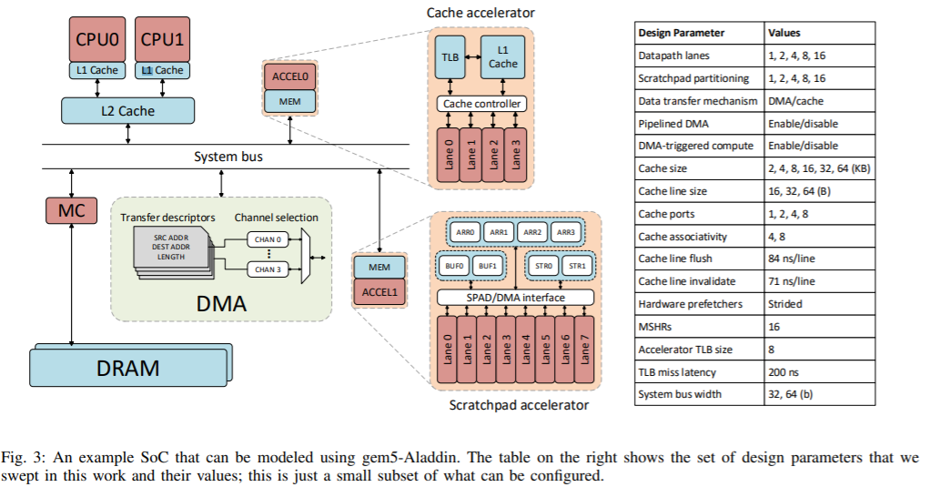
3.1 dse_dataset_load_store.py
http://vlsiarch.eecs.harvard.edu/wp-content/uploads/2016/08/shao_micro2016.pdf
dse_data_load_store.py
Cache Size: 2, 4, 6, 8, 16, 32, 64 KB
CacheLine: 16, 32, 64B

Slide 12
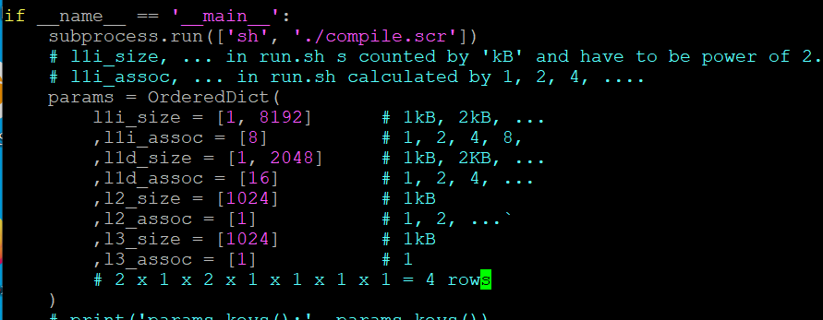
3.1 dse_dataset_load_store.py
https://www.youtube.com/watch?v=8uaDoMuDK6E
dse_data_load_store.py
1. The l1i_size, l1d_size, l2_size, l3_size are size of cache and must be power of 2. The dse_dataset will translate the size into kB unit.
2. The l1i_assoc, l2d_assoc, l2_assoc, l3_assoc are the instruction set and must be the power of 2. max l2_assoc = 16. l2_assoc = 32 will get the error.

Slide 13
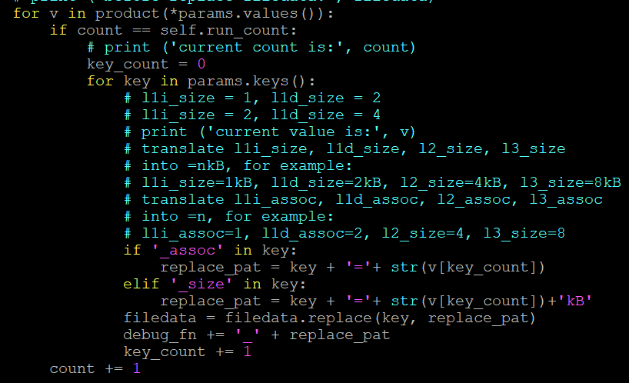
3.1 dse_dataset_load_store.py
https://www.youtube.com/watch?v=8uaDoMuDK6E
dse_data_load_store.py
1. The dse_dataset translate the size into kB unit.

Slide 14
3.2 run.sh.base and run.sh

Slide 15
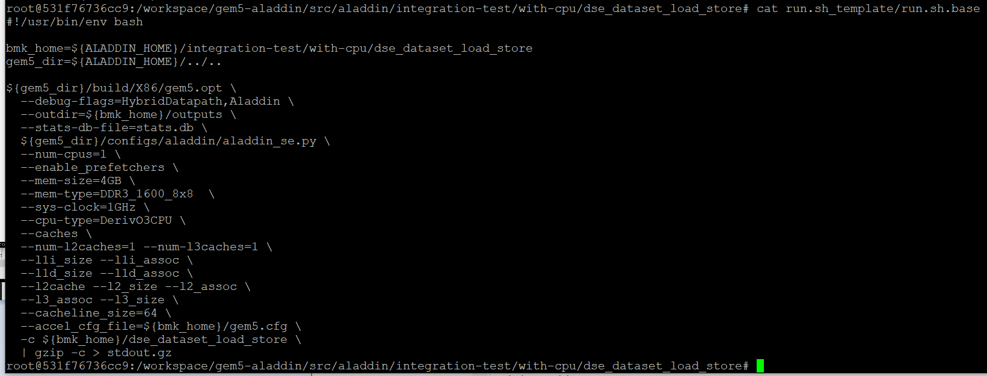
3.2 run.sh.base and run.sh
https://www.youtube.com/watch?v=8uaDoMuDK6E
run.sh.base
Run.sh.base the base template file to generate run.sh for each run.

Slide 16
3.3 Process Each Run

Slide 17
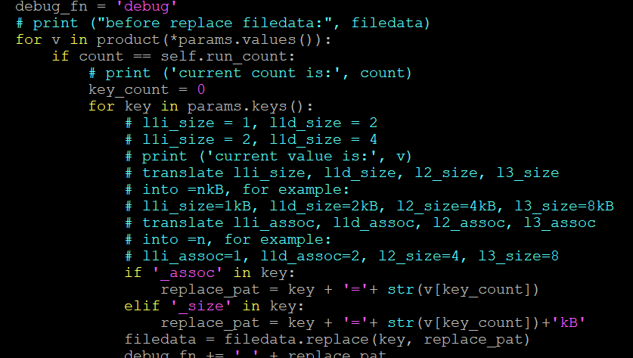
3.3 Process Each Run
https://www.youtube.com/watch?v=8uaDoMuDK6E
Process Each Run
Loop for the cartesian product, i.e., for each row.

Slide 18
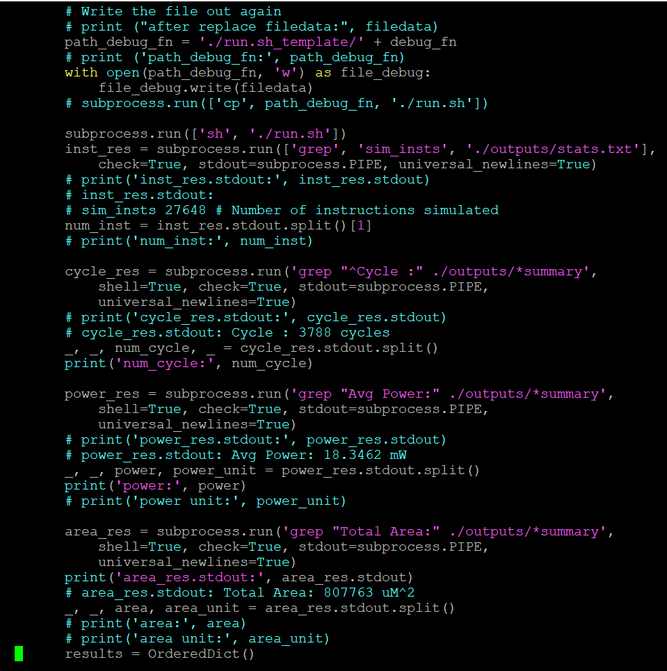
3.3 Process Each Run
https://www.youtube.com/watch?v=8uaDoMuDK6E
Process Each Run
Replace the base pattern into the parameters we specify.
Copy into the individual files for debugging.
Finally, we have run.sh in each run.

Slide 19
3.4 Process Result

Slide 20
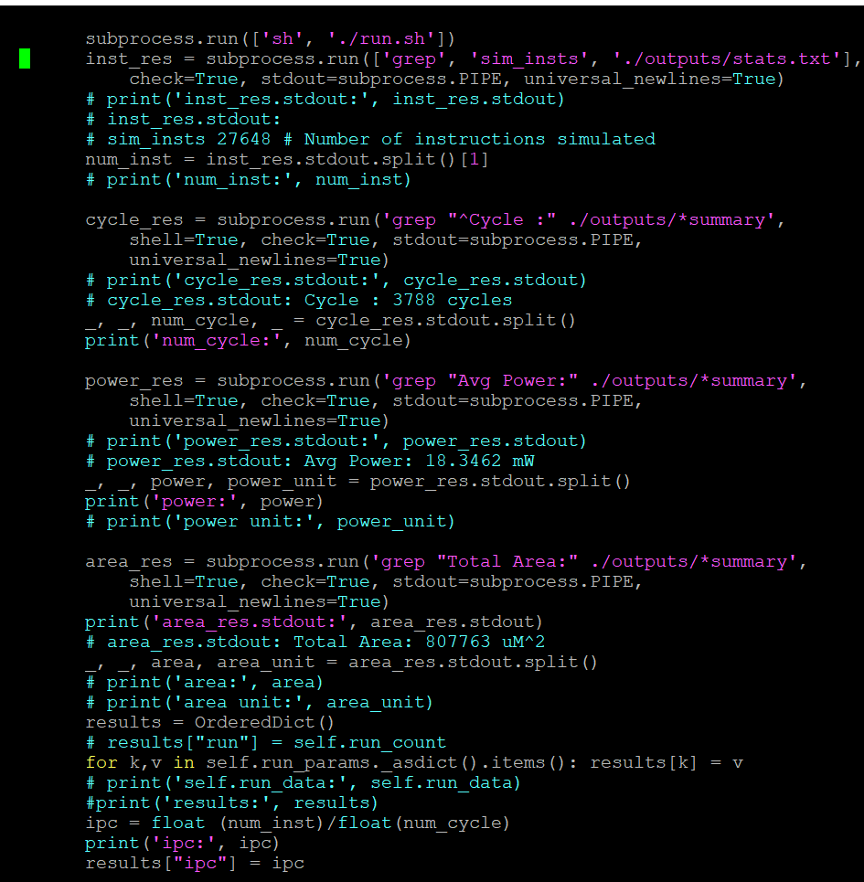
3.4 Process Result
https://www.youtube.com/watch?v=8uaDoMuDK6E
Process Result

Slide 21
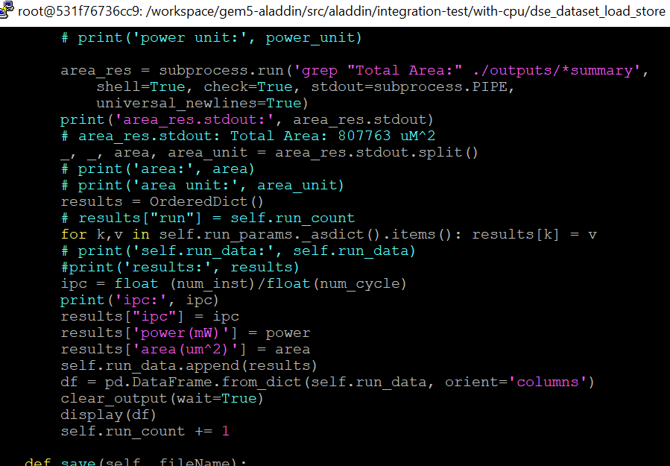
3.4 Process Result
https://www.youtube.com/watch?v=8uaDoMuDK6E
Process Result

Slide 22
3.5 Save Result

Slide 23
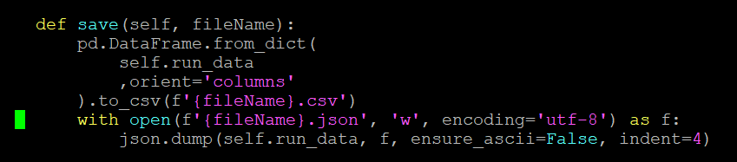
3.5 Save Result
https://www.youtube.com/watch?v=8uaDoMuDK6E
Save Result

Slide 24
3.6 View Result

Slide 25
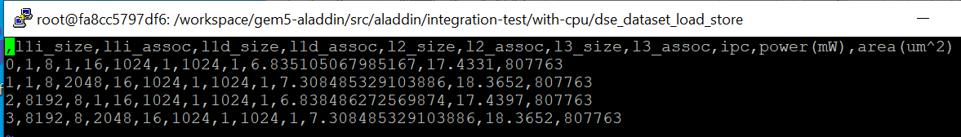
3.6 View Result
https://www.youtube.com/watch?v=8uaDoMuDK6E
View Result

Slide 26
3.7 Max Value Test

Slide 27
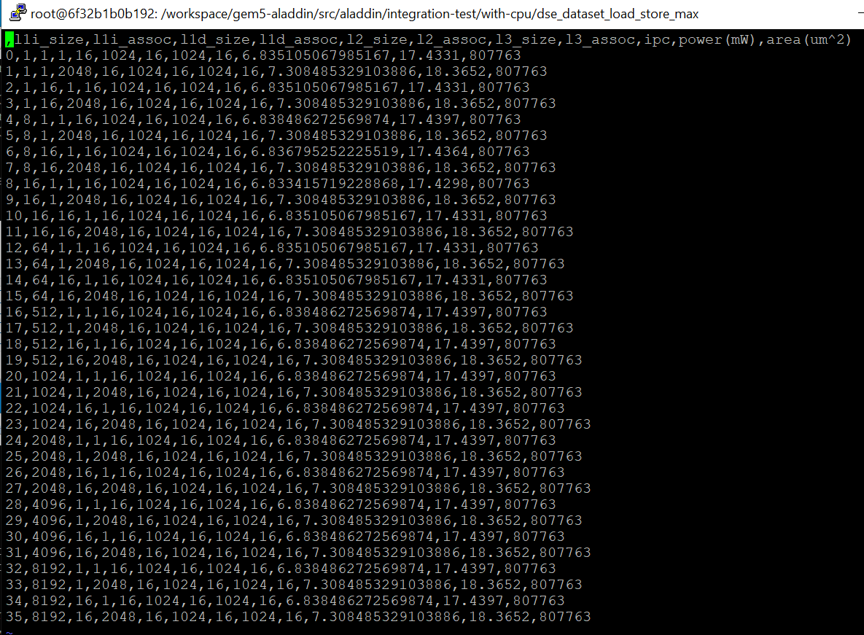
3.7 Max Value Test
https://www.youtube.com/watch?v=8uaDoMuDK6E
More Max Value Test

Slide 28
3.8 Bigger Test

Slide 29
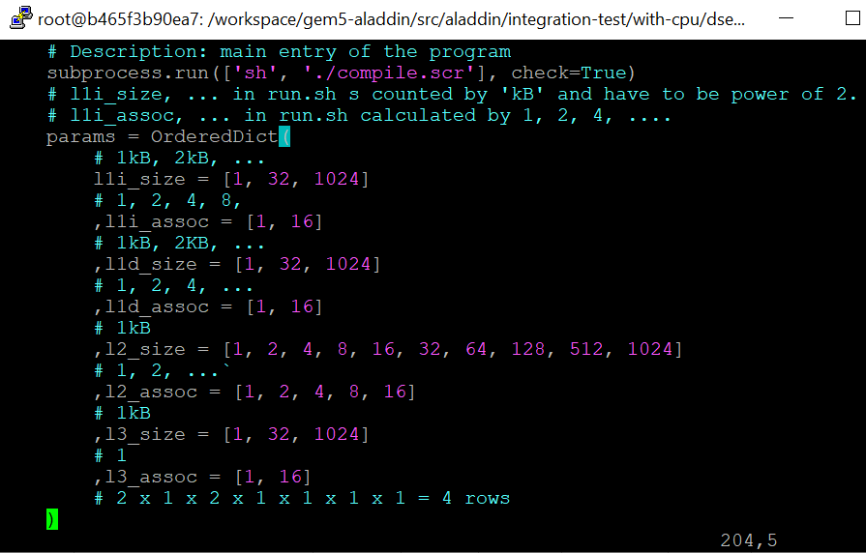
3.8 Bigger Test
https://www.youtube.com/watch?v=8uaDoMuDK6E
Bigger Test
3 x 2 x 3 x 2 x 10 x 5 x 3 x 2 = 10800

Slide 30
End

