Slide 1

9 GPU/Cuda Summary
Peter H. Chen

Slide 2

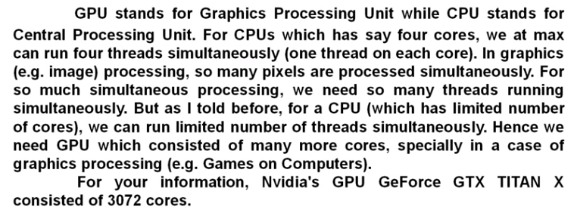
9 CPU/Cuda Summary
https://www.youtube.com/watch?v=FGl9GnO4Z5o&list=PLhbrpS8rYbc0CxUdGR3WoM9xr11WCaSPw&index=9
CPU/Cuda Summary (00:00-01:50/12:57)
Why GPU?
1. CPU has limited number of core (e.g., 4 cores to 288).
2. GPU has thousands of core (e.g., GTX Titan X has 3072 cores, GTX 4090 has 16,384) for image processing simultaneously.

Slide 3

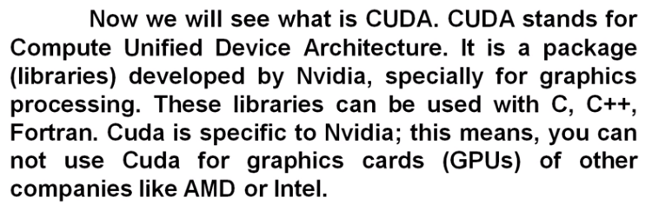
9 CPU/Cuda Summary
https://www.youtube.com/watch?v=FGl9GnO4Z5o&list=PLhbrpS8rYbc0CxUdGR3WoM9xr11WCaSPw&index=9
CPU/Cuda Summary (01:51-02:30/12:57)
What is Cuda?
Cuda is the C/C++/FORTRAN libraries from NVIDIA graphic card.
Cuda is not for AMD and Intel graphics card.

Slide 4
9.2 Host and Device

Slide 5
9.2 Host and Device
https://www.youtube.com/watch?v=FGl9GnO4Z5o&list=PLhbrpS8rYbc0CxUdGR3WoM9xr11WCaSPw&index=9
Host and Device (02:31-02:40/12:56)
Host: CPU
Device: GPU
In CUDA, CPU is called a Host while a GPU is called a Device.

Slide 6
9.3 Kernel

Slide 7

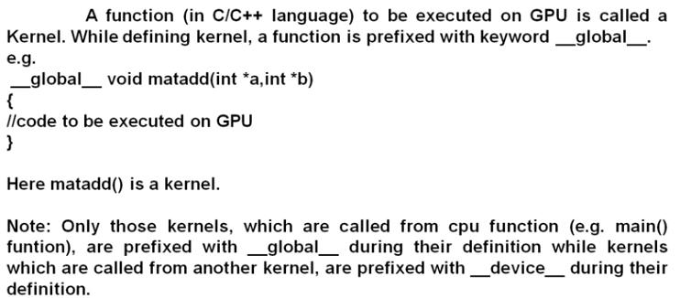
9.3 Kernel
https://www.youtube.com/watch?v=FGl9GnO4Z5o&list=PLhbrpS8rYbc0CxUdGR3WoM9xr11WCaSPw&index=9
Kernel (02:41-03:30/12:56)
Kernel: Function run on GPU.

Slide 8
9.4 SM and SP

Slide 9

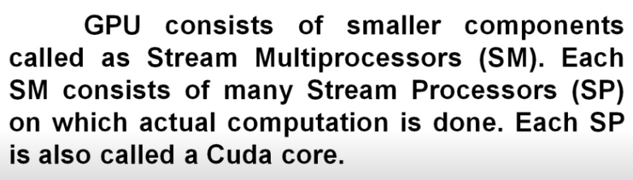
9.4 SM and SP
https://www.youtube.com/watch?v=FGl9GnO4Z5o&list=PLhbrpS8rYbc0CxUdGR3WoM9xr11WCaSPw&index=9
SM and SP (03:31-04:30/12:56)
SM: contains many SP.
SP: Cuda Core to run threads.

Slide 10
9.5 Thread, Block, and Grid

Slide 11

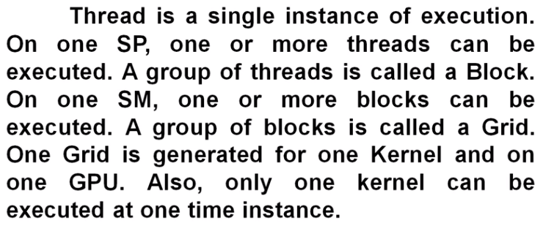
9.5 Thread, Block, and Grid
https://www.youtube.com/watch?v=FGl9GnO4Z5o&list=PLhbrpS8rYbc0CxUdGR3WoM9xr11WCaSPw&index=9
Thread, Block, and Grid (04:31-05:30/12:56)
Thread: single instance of execution on one SP. One SP can run multiple threads.
Block: A group of threads.
Grid: A group of Blocks. A Grid is generated by one Kernel function which is run on GPU.

Slide 12
9.6 Warp

Slide 13

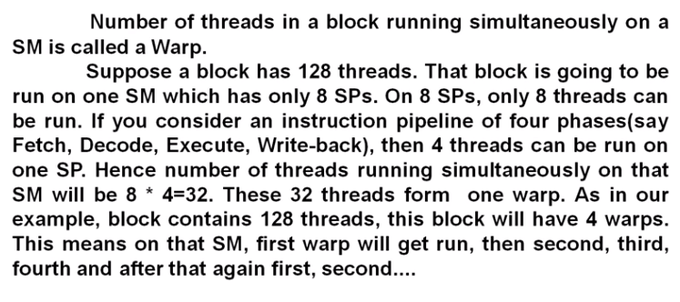
9.6 Warp
https://www.youtube.com/watch?v=FGl9GnO4Z5o&list=PLhbrpS8rYbc0CxUdGR3WoM9xr11WCaSPw&index=9
Warp (06:31-07:10/12:56)
Warp: Number of thread in Block runs simultaneously.

Slide 14
9.7 Memory Architecture

Slide 15
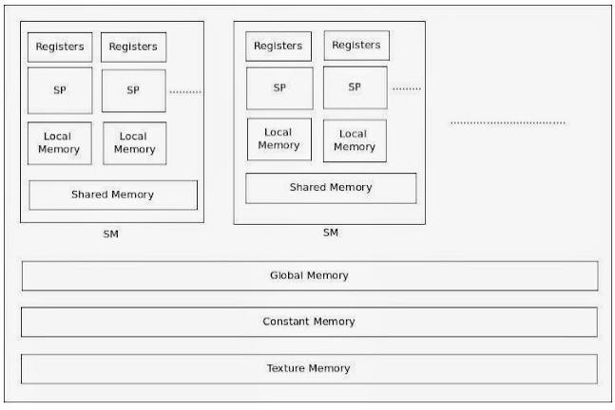
9.7 Memory Architecture
https://www.youtube.com/watch?v=FGl9GnO4Z5o&list=PLhbrpS8rYbc0CxUdGR3WoM9xr11WCaSPw&index=9
Memory Architecture (07:11-08:10/12:56)
Six types of memory architecture.

Slide 16
9.8 Local, Register, Global Memory

Slide 17
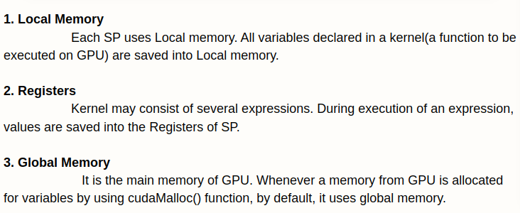
9.8 Local, Register, Global Memory
https://www.youtube.com/watch?v=FGl9GnO4Z5o&list=PLhbrpS8rYbc0CxUdGR3WoM9xr11WCaSPw&index=9
Local, Register, Global Memory (08:11-09:30/12:56)
1. Local Memory: SP (run Threads) use local memory.
2. Registers: Fastest memory for arithmetic computation.
3. Global Memory: Default, largest amounts, slowest memory of GPU.

Slide 18
9.9 Shared Memory

Slide 19
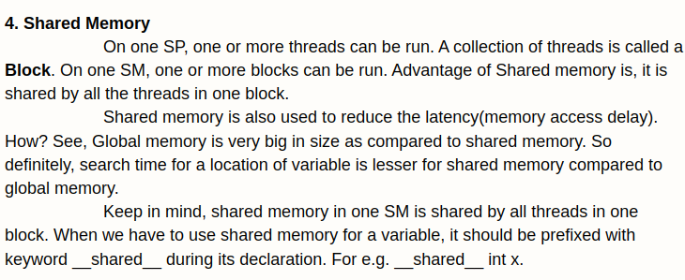
9.9 Shared Memory
https://www.youtube.com/watch?v=FGl9GnO4Z5o&list=PLhbrpS8rYbc0CxUdGR3WoM9xr11WCaSPw&index=9
Shared Memory (09:31-10:30/12:56)
4. Shared Memory: Shared memory by SP (threads in one block).

Slide 20
9.10 Constant Memory

Slide 21
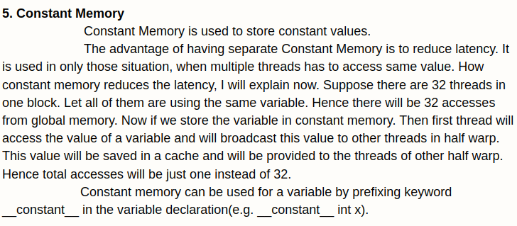
9.10 Constant Memory
https://www.youtube.com/watch?v=FGl9GnO4Z5o&list=PLhbrpS8rYbc0CxUdGR3WoM9xr11WCaSPw&index=9
Constant Memory (11:31-12:56/12:56)
5. Constant Memory: Store constant value

Slide 22
9.11 Texture Memory

Slide 23
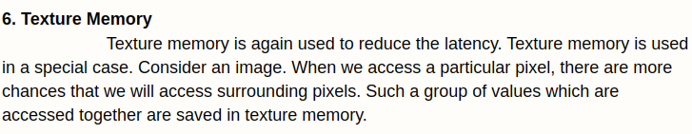
9.11 Texture Memory
https://www.youtube.com/watch?v=FGl9GnO4Z5o&list=PLhbrpS8rYbc0CxUdGR3WoM9xr11WCaSPw&index=9
Texture Memory (05:31-06:06/12:56)
6. Texture Memory: Special Memory to store image and access pixels of image in the Virtual Reality to reduce the latency time.

Slide 24
End

