Slide 1

1 Cuda on Colab
Peter H. Chen

Slide 2
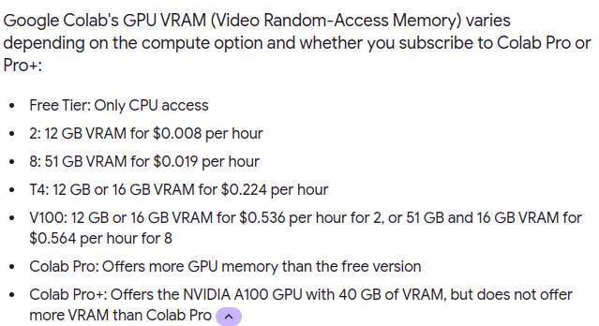
1 Cuda on Colab
https://www.youtube.com/watch?v=gggQ9-_crmU&list=PLhbrpS8rYbc0CxUdGR3WoM9xr11WCaSPw&index=1
Cuda on Colab (00:00-00:30/17:20)
To run cuda, we need the GPU on our machine.
Not everyone have the GPU on our computer.
Google Colab is a online server which provide GPU and compiler.
We can run our cuda program Google Colab.
Colab free tier provide NVIDIA Tesla K80 with 12GB of VRAM (Video RAM-Access Memory).
If we want to have more VRAM if we pay.

Slide 3
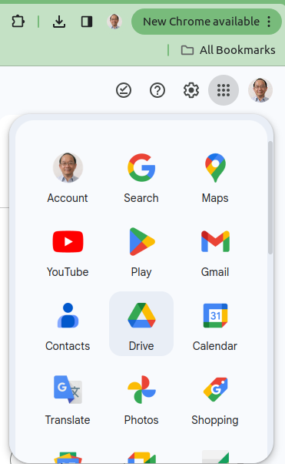
1 Cuda on Colab
https://www.youtube.com/watch?v=gggQ9-_crmU&list=PLhbrpS8rYbc0CxUdGR3WoM9xr11WCaSPw&index=1
Cuda on Colab (00:00-00:30/17:20)
Open Google chrome.
Click Google Drive.
https://github.com/flin3500/Cuda-Google-Colab

Slide 4
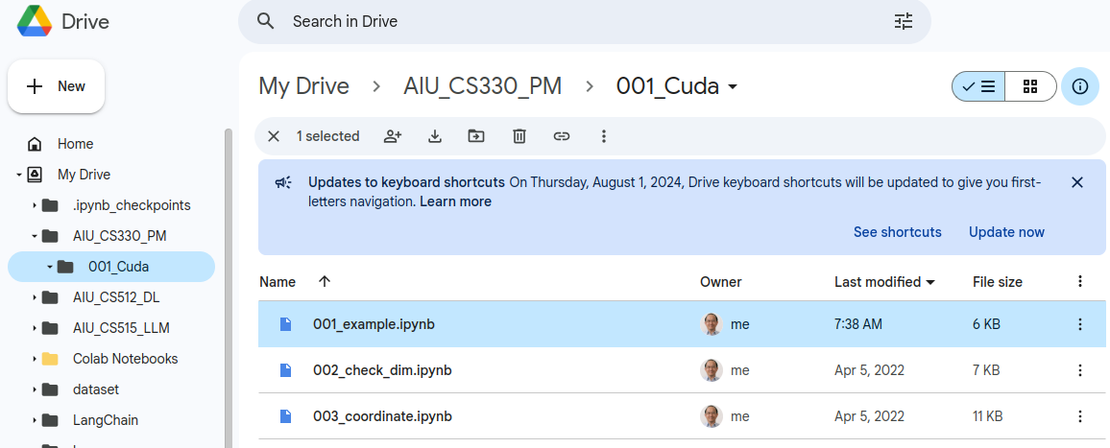
1 Cuda on Colab
https://www.youtube.com/watch?v=gggQ9-_crmU&list=PLhbrpS8rYbc0CxUdGR3WoM9xr11WCaSPw&index=1
Cuda on Colab (00:00-00:30/17:20)
1. Create folder “AIU_CS330_PM/001_Code”
2. drag and drop the “001_exmaple.ipynb”, “002_check_dim.ipynb”, and “003_coordinate.ipynb” to google drive.
https://github.com/flin3500/Cuda-Google-Colab

Slide 5
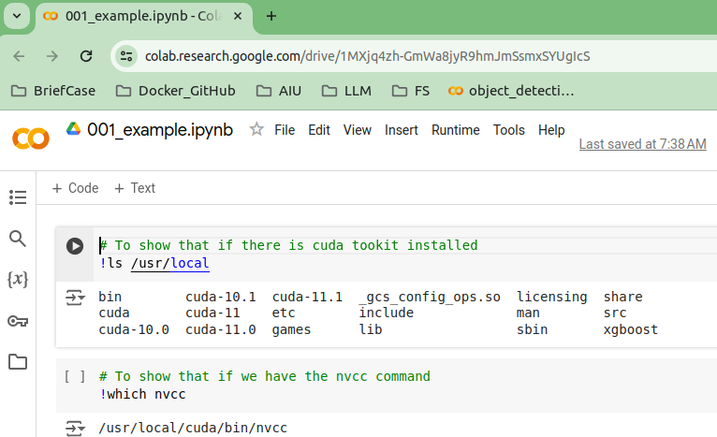
1 Cuda on Colab
https://www.youtube.com/watch?v=gggQ9-_crmU&list=PLhbrpS8rYbc0CxUdGR3WoM9xr11WCaSPw&index=1
Cuda on Colab (00:00-00:01/17:20)
1. Double click the “001_exmaple.ipynb”
https://github.com/flin3500/Cuda-Google-Colab

Slide 6
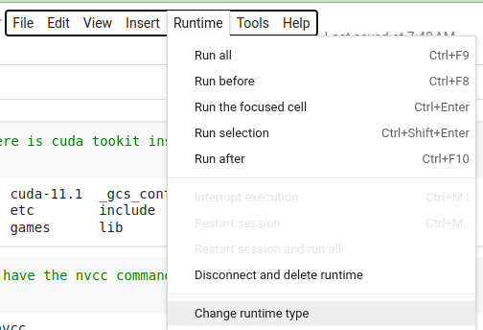
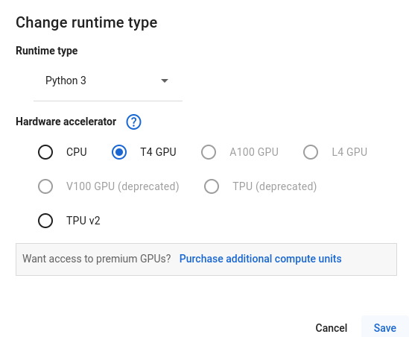
1 Cuda on Colab
https://www.youtube.com/watch?v=gggQ9-_crmU&list=PLhbrpS8rYbc0CxUdGR3WoM9xr11WCaSPw&index=1
Cuda on Colab (00:01-00:02/17:20)
1. > Runtime -> Change runtime type
2. Select “T4 GPU” (Tesla GPU)
https://github.com/flin3500/Cuda-Google-Colab

Slide 7
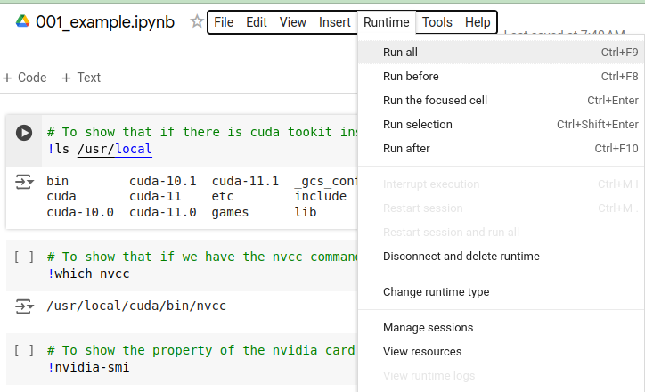
1 Cuda on Colab
https://www.youtube.com/watch?v=gggQ9-_crmU&list=PLhbrpS8rYbc0CxUdGR3WoM9xr11WCaSPw&index=1
Cuda on Colab (00:03-00:04/17:20)
> Runtime -> Run all
https://github.com/flin3500/Cuda-Google-Colab

Slide 8
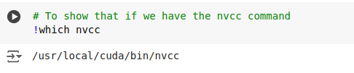
1 Cuda on Colab
https://www.youtube.com/watch?v=gggQ9-_crmU&list=PLhbrpS8rYbc0CxUdGR3WoM9xr11WCaSPw&index=1
Cuda on Colab (00:05-00:06/17:20)
Check Cuda compiler: nvcc
https://github.com/flin3500/Cuda-Google-Colab

Slide 9
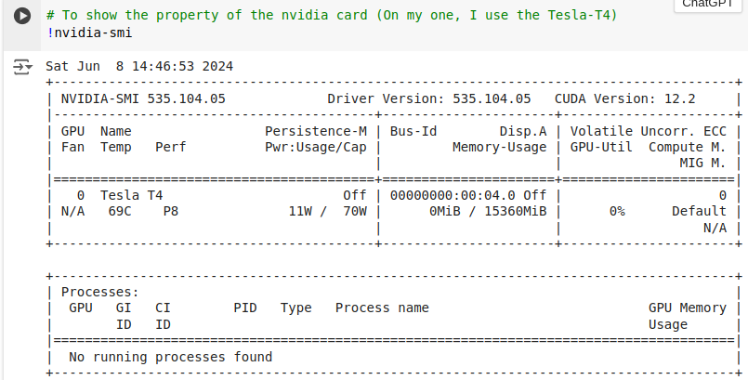
1 Cuda on Colab
https://www.youtube.com/watch?v=gggQ9-_crmU&list=PLhbrpS8rYbc0CxUdGR3WoM9xr11WCaSPw&index=1
Cuda on Colab (00:07-00:08/17:20)
Use Nvidia-smi to check GPU type: Tesla-T4
https://github.com/flin3500/Cuda-Google-Colab

Slide 10
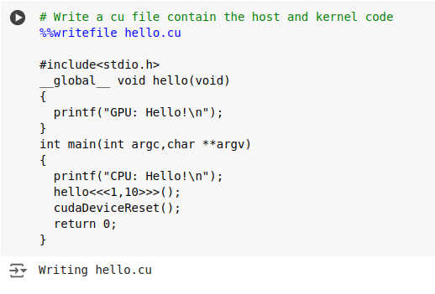
1 Cuda on Colab
https://www.youtube.com/watch?v=gggQ9-_crmU&list=PLhbrpS8rYbc0CxUdGR3WoM9xr11WCaSPw&index=1
Cuda on Colab (00:09-00:10/17:20)
Write Cuda Code with magic command %%writefile hello.cu
The cuda code contains the host (main) and kernel code (__global__ void hello)
https://github.com/flin3500/Cuda-Google-Colab

Slide 11
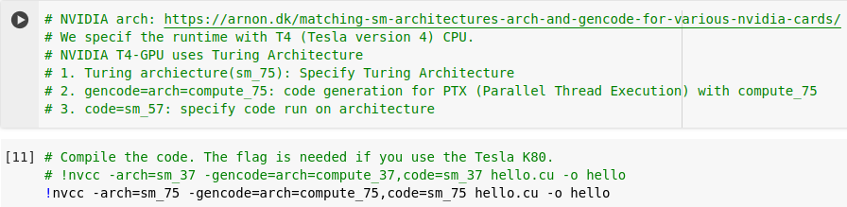
1 Cuda on Colab
https://www.youtube.com/watch?v=gggQ9-_crmU&list=PLhbrpS8rYbc0CxUdGR3WoM9xr11WCaSPw&index=1
Cuda on Colab (00:11-00:12/17:20)
Compilation option:
NVIDIA Architecture:
We specif the runtime with T4 (Tesla version 4) CPU.
NVIDIA T4-GPU uses Turing Architecture
1. Turing architecture (sm_75): Specify Turing Architecture
2. gencode=arch=compute_75: code generation for PTX (Parallel Thread Execution) with compute_75
3. code=sm_57: specify code run on architecture
https://arnon.dk/matching-sm-architectures-arch-and-gencode-for-various-nvidia-cards/

Slide 12
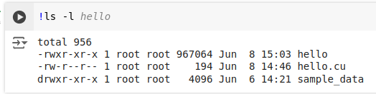
1 Cuda on Colab
https://www.youtube.com/watch?v=gggQ9-_crmU&list=PLhbrpS8rYbc0CxUdGR3WoM9xr11WCaSPw&index=1
Cuda on Colab (00:13-00:15/17:20)
!ls -l

Slide 13
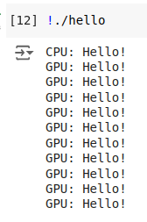
1 Cuda on Colab
https://www.youtube.com/watch?v=gggQ9-_crmU&list=PLhbrpS8rYbc0CxUdGR3WoM9xr11WCaSPw&index=1
Cuda on Colab (00:05-00:06/17:20)
Execution result:

Slide 14
End

