Slide 1

4 Cuda Vector Addition
Peter H. Chen

Slide 2
4 Cuda Vector Addition
https://www.youtube.com/watch?v=vo0eCxoAf68&list=PLhbrpS8rYbc0CxUdGR3WoM9xr11WCaSPw&index=4
Cuda Vector Addition (00:00-06:00/22:12)
In the last several discussions, we discussed different terminologies in Cuda and Cuda memory architecture.
We will discuss Cuda program for addition of two 1-Dimensional Array.
1. n-block and n-threads: 1 thread/block,
2. 1-block and n-threads: n-threads/block,
3. m-blocks and n-threads: n-threads/m-blocks

Slide 3
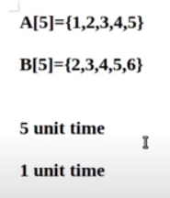
4 Cuda Vector Addition
https://www.youtube.com/watch?v=vo0eCxoAf68&list=PLhbrpS8rYbc0CxUdGR3WoM9xr11WCaSPw&index=4
Cuda Vector Addition (06:01-06:30/22:12)
Suppose we have two arrays:
> A[5] = {1, 2, 3, 4, 5}
> B[5] = {2, 3, 4, 5, 6}
We write a loop to add two arrays together. When we add them, it take 5 units of time.
Instead of add them one-by-one, we can parallel add them in one unit of time.
We can divide the task into five sub-tasks and perform the addition in five threads.
Each thread independently perform addition.

Slide 4
4.1 Check Ubuntu for Cuda

Slide 5
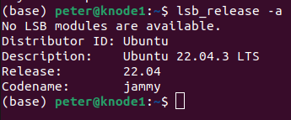
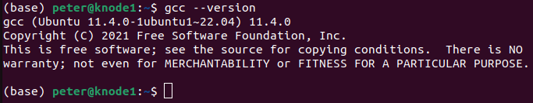
4.1 Check Ubuntu for Cuda
https://www.youtube.com/watch?v=vo0eCxoAf68&list=PLhbrpS8rYbc0CxUdGR3WoM9xr11WCaSPw&index=4
Check Ubuntu for Cuda (06:31-07:00/22:12)
1. Check Ubuntu release version
> lsb_release -a
2. gcc version
>> gcc -- version
>> 22.04.3 LTS
https://docs.nvidia.com/cuda/cuda-installation-guide-linux/
1
2

Slide 6
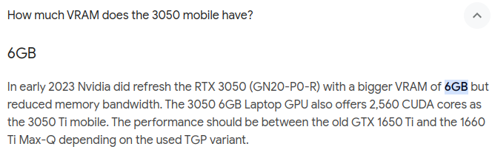
4.1 Check Ubuntu for Cuda
https://www.youtube.com/watch?v=vo0eCxoAf68&list=PLhbrpS8rYbc0CxUdGR3WoM9xr11WCaSPw&index=4
Check Ubuntu for Cuda (07:01-07:30/22:12)
1. Check GPU Video RAM size
> lspci | grep VGA
>> NVIDIA GeForce RTX 3050 Mobile
Mobile graphics chip by NVIDIA with 6GB VRAM
https://developer.nvidia.com/system-management-interface

Slide 7
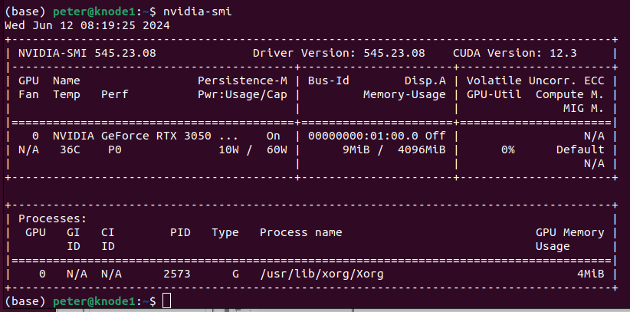
4.1 Check Ubuntu for Cuda
https://www.youtube.com/watch?v=vo0eCxoAf68&list=PLhbrpS8rYbc0CxUdGR3WoM9xr11WCaSPw&index=4
Check Ubuntu for Cuda (07:31-08:00/22:12)
1. Check NVIDIA system requirements
> nvidia-smi
>>GPU Memory Usage: 4MiB (Mebibyte = 1.04 Megabyte) used by Driver.
https://developer.nvidia.com/system-management-interface

Slide 8
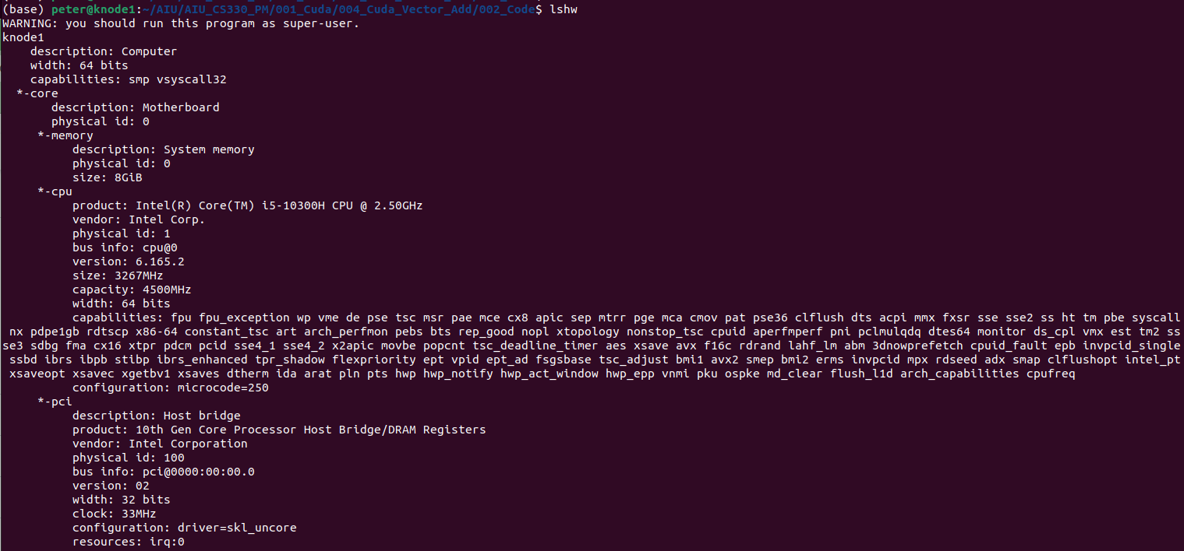
4.1 Check Ubuntu for Cuda
https://www.youtube.com/watch?v=vo0eCxoAf68&list=PLhbrpS8rYbc0CxUdGR3WoM9xr11WCaSPw&index=4
Check Ubuntu for Cuda (08:01-08:30/22:12)
1. See the details of hardware configuration.
> lshw
https://github.com/lyonel/lshw

Slide 9
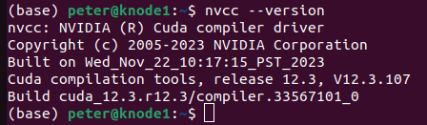
4.1 Check Ubuntu for Cuda
https://www.youtube.com/watch?v=vo0eCxoAf68&list=PLhbrpS8rYbc0CxUdGR3WoM9xr11WCaSPw&index=4
Check Ubuntu for Cuda (08:31-09:00/22:12)
1. Check Cuda Compiler
> nvcc --version
>> V12.3.107
https://docs.nvidia.com/cuda/cuda-installation-guide-linux/

Slide 10
4.2 1-Thread/Block

Slide 11
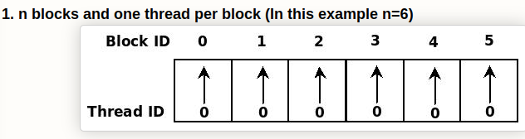
4.2 1-Thread/Block
https://www.youtube.com/watch?v=vo0eCxoAf68&list=PLhbrpS8rYbc0CxUdGR3WoM9xr11WCaSPw&index=4
1-Thread/Block (09:01-09:30/22:12)

Slide 12
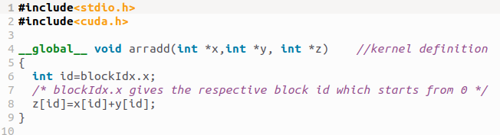
4.2 1-Thread/Block
https://www.youtube.com/watch?v=vo0eCxoAf68&list=PLhbrpS8rYbc0CxUdGR3WoM9xr11WCaSPw&index=4
1-Thread/Block (09:31-10:00/22:12)
> kernel (GPU) Code

Slide 13
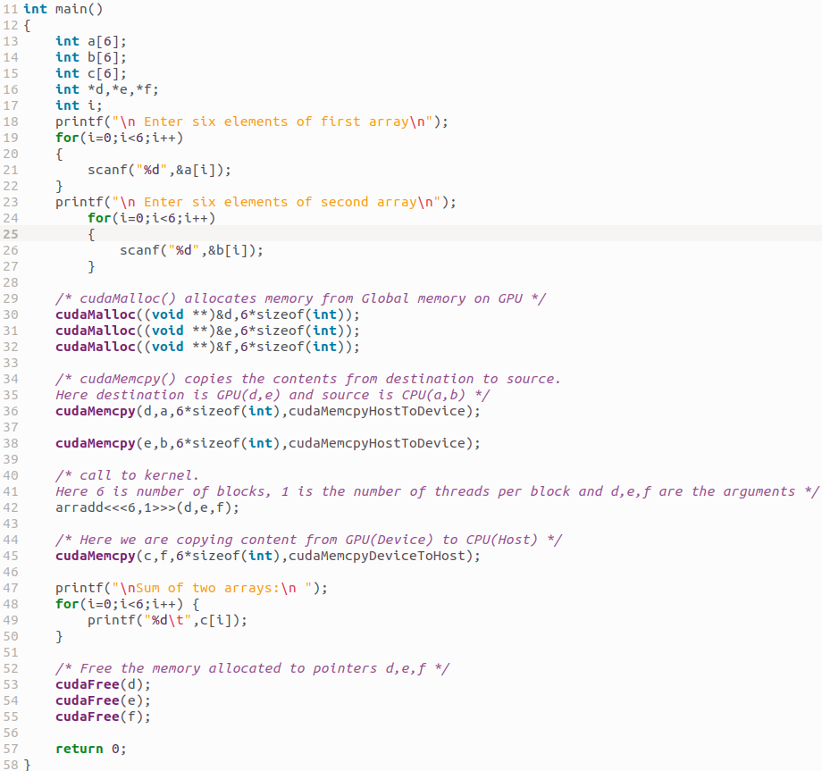
4.2 1-Thread/Block
https://www.youtube.com/watch?v=vo0eCxoAf68&list=PLhbrpS8rYbc0CxUdGR3WoM9xr11WCaSPw&index=4
1-Thread/Block (10:01-10:30/22:12)
> CPU main() Code

Slide 14
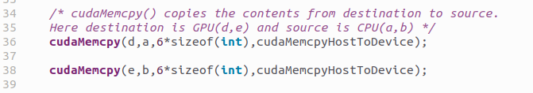
4.2 1-Thread/Block
https://www.youtube.com/watch?v=vo0eCxoAf68&list=PLhbrpS8rYbc0CxUdGR3WoM9xr11WCaSPw&index=4
1-Thread/Block (10:31-11:00/22:12)
Copy Host to Device memory.

Slide 15
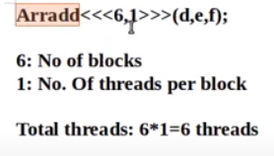
4.2 1-Thread/Block
https://www.youtube.com/watch?v=vo0eCxoAf68&list=PLhbrpS8rYbc0CxUdGR3WoM9xr11WCaSPw&index=4
1-Thread/Block (11:01-13:00/22:12)
arradd <<< 6, 1>>> (d, e, f)
6: number of blocks
1: number of threads per block.
(d, e, f) pass by reference for the output the Kernel function.

Slide 16
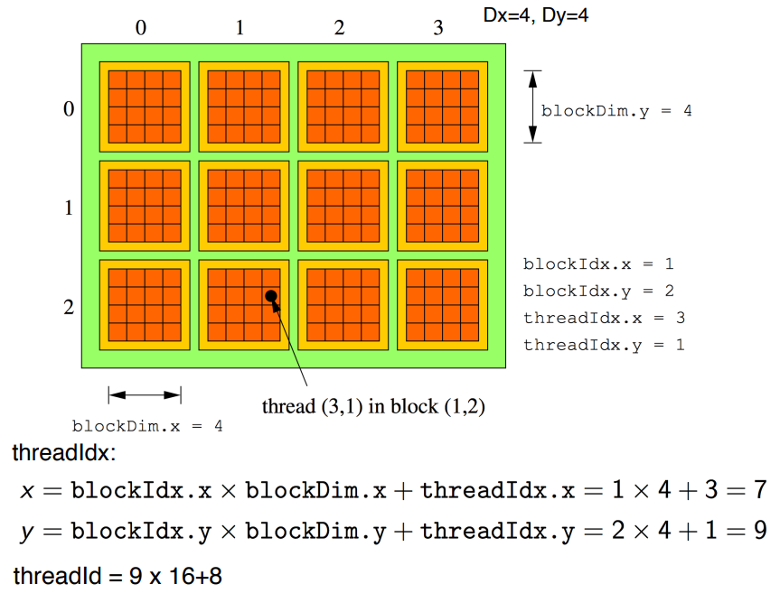
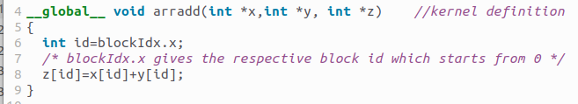
4.2 1-Thread/Block
https://www.youtube.com/watch?v=vo0eCxoAf68&list=PLhbrpS8rYbc0CxUdGR3WoM9xr11WCaSPw&index=4
1-Thread/Block (13:01-14:30/22:12)
Id = blockIdx.x: Start ID from 0.
https://www.ce.jhu.edu/dalrymple/classes/602/Class10.pdf

Slide 17
4.2 1-Thread/Block
https://www.youtube.com/watch?v=vo0eCxoAf68&list=PLhbrpS8rYbc0CxUdGR3WoM9xr11WCaSPw&index=4
1-Thread/Block (14:31-15:30/22:12)
Copy the GPU Device to Host.

Slide 18

4.2 1-Thread/Block
https://www.youtube.com/watch?v=vo0eCxoAf68&list=PLhbrpS8rYbc0CxUdGR3WoM9xr11WCaSPw&index=4
1-Thread/Block (15:31-15:40/22:12)
Print the result at the host.

Slide 19

4.2 1-Thread/Block
https://www.youtube.com/watch?v=vo0eCxoAf68&list=PLhbrpS8rYbc0CxUdGR3WoM9xr11WCaSPw&index=4
1-Thread/Block (15:31-16:00/22:12)
Free the Memory of d, e, f at host.

Slide 20
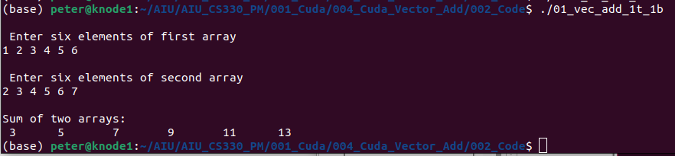
4.2 1-Thread/Block
https://www.youtube.com/watch?v=vo0eCxoAf68&list=PLhbrpS8rYbc0CxUdGR3WoM9xr11WCaSPw&index=4
1-Thread/Block (16:01-16:20/22:12)
> nvcc 01_vec_add_1t_1b.cu -o 01_vec_add_1t_1b
> .01_vec_add_1t_1b

Slide 21
4.4 n-Thread/Block

Slide 22
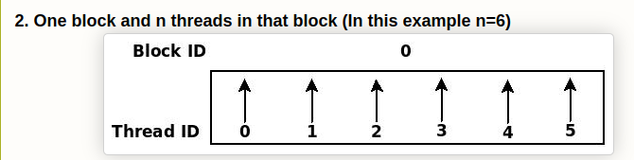
4.4 n-Thread/Block
https://www.youtube.com/watch?v=vo0eCxoAf68&list=PLhbrpS8rYbc0CxUdGR3WoM9xr11WCaSPw&index=4
n-Thread/Block (16:21-16:40/22:12)
Now, we have n-thread run on one block.

Slide 23
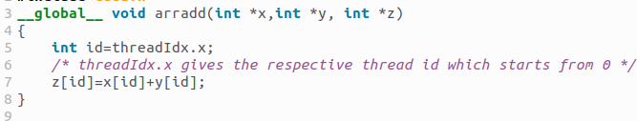
4.4 n-Thread/Block
https://www.youtube.com/watch?v=vo0eCxoAf68&list=PLhbrpS8rYbc0CxUdGR3WoM9xr11WCaSPw&index=4
n-Thread/Block (16:41-17:05/22:12)
What is the difference?
We have only one block (block = 1) and threads (threads = 6).
Others are remain the same.

Slide 24
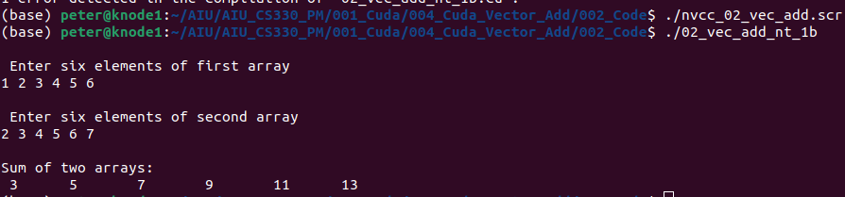
4.4 n-Thread/Block
https://www.youtube.com/watch?v=vo0eCxoAf68&list=PLhbrpS8rYbc0CxUdGR3WoM9xr11WCaSPw&index=4
n-Thread/Block (17:06-18:15/22:12)
1. Compile
2. run
3. results
1
2
3

Slide 25
4.4 n-Thread/m-Block

Slide 26
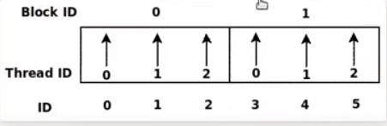
4.4 n-Thread/m-Block
https://www.youtube.com/watch?v=vo0eCxoAf68&list=PLhbrpS8rYbc0CxUdGR3WoM9xr11WCaSPw&index=4
n-Thread/m-Block (18:16-18:30/22:12)
We have two blocks and 6 threads.
Now, how to calculate the block index?

Slide 27
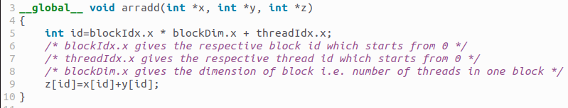
4.4 n-Thread/m-Block
https://www.youtube.com/watch?v=vo0eCxoAf68&list=PLhbrpS8rYbc0CxUdGR3WoM9xr11WCaSPw&index=4
n-Thread/m-Block (18:31-19:30/22:12)
We calculate ID:
ID = (Block ID) * (Block Dimension) + Thread ID

Slide 28
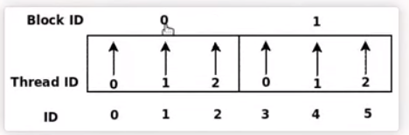
4.4 n-Thread/Block
https://www.youtube.com/watch?v=vo0eCxoAf68&list=PLhbrpS8rYbc0CxUdGR3WoM9xr11WCaSPw&index=4
n-Thread/m-Block (19:31-20:30/22:12)
We Send to GPU with 2 block and 3 threads in each block.
Block ID = 0, 1
Thread ID = 0, 1, 2 in each block.
ID = 0, 1, 2, 3, 4, 5 (same as before)

Slide 29
4.4 n-Thread/Block
https://www.youtube.com/watch?v=vo0eCxoAf68&list=PLhbrpS8rYbc0CxUdGR3WoM9xr11WCaSPw&index=4
n-Thread/m-Block (20:31-21:30/22:12)
ID = 0, 1, 2, 3, 4, 5
We calculate the ID with the formula as below,

Slide 30
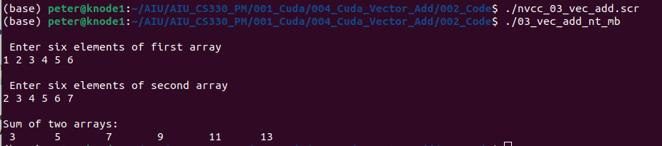
4.4 n-Thread/Block
https://www.youtube.com/watch?v=vo0eCxoAf68&list=PLhbrpS8rYbc0CxUdGR3WoM9xr11WCaSPw&index=4
n-Thread/m-Block (21:31-22:00/22:12)
1. Compile
2. run
3. results
1
3
2

Slide 31
4.5 Summary

Slide 32
4.5 Summary
https://www.youtube.com/watch?v=vo0eCxoAf68&list=PLhbrpS8rYbc0CxUdGR3WoM9xr11WCaSPw&index=4
Summary (22:01-11:12/22:12)
We discussed the Cuda program for addition of two 1-Dimensional Arrays under Ubuntu.
1. n-block and n-threads: 1 thread/block,
2. 1-block and n-threads: n-threads/block,
3. m-blocks and n-threads: n-threads/m-blocks
We calculate the ID based on block ID, Block Dimension, and thread ID.

