Slide 1

6 Cuda Matrix Multiplication
Peter H. Chen

Slide 2
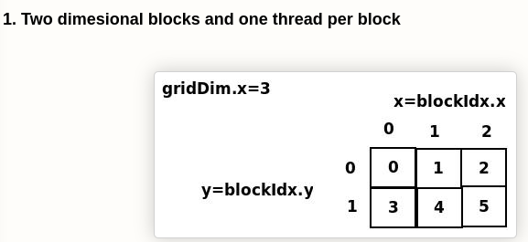
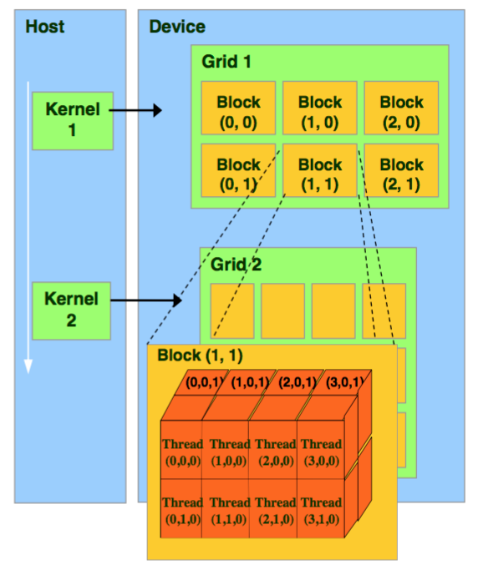
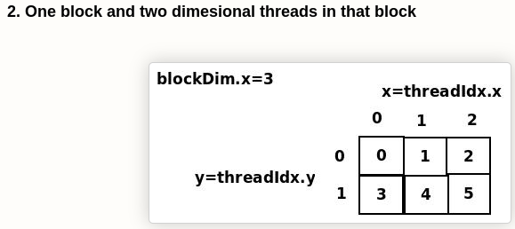
6 Cuda Matrix Multiplication
https://www.youtube.com/watch?v=XeR400_QFXQ&list=PLhbrpS8rYbc0CxUdGR3WoM9xr11WCaSPw&index=6
Cuda Matrix Multiplication (00:00-00:30/24:18)
In the last discussion, we talk about the Cuda Matrix Addition.
1. Two blocks and one thread per block, we use block ID to index.
2. One block and two threads per block, we use thread ID to index.
1
2

Slide 3
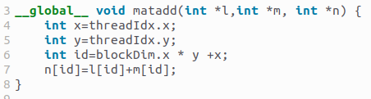
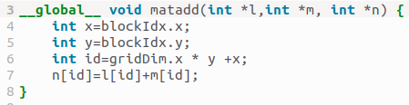


6 Cuda Matrix Multiplication
https://www.youtube.com/watch?v=XeR400_QFXQ&list=PLhbrpS8rYbc0CxUdGR3WoM9xr11WCaSPw&index=6
Cuda Matrix Multiplication (00:31-06:20/24:18)
1. In two blocks and one thread per block. Device uses block ID to index.
2. In one bloc and two threads per block. We use thread ID to index.
1
2

Slide 4
6 Cuda Matrix Multiplication
https://www.youtube.com/watch?v=XeR400_QFXQ&list=PLhbrpS8rYbc0CxUdGR3WoM9xr11WCaSPw&index=6
Cuda Matrix Multiplication (06:21-07:00/24:18)
Below, we have multiplication for
1. 2-Dimensional blocks.
2. 1T/1B: 1 Thread per Block
The ID calculations are same as matrix addition.
1
2

Slide 5
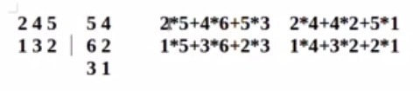
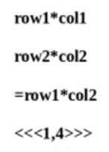

6 Cuda Matrix Multiplication
https://www.youtube.com/watch?v=XeR400_QFXQ&list=PLhbrpS8rYbc0CxUdGR3WoM9xr11WCaSPw&index=6
Cuda Matrix Multiplication (07:01-08:00/24:18)
Below, we have multiplication for two matrices.
Case 1
Case 2

Slide 6
6.1 2-D Blocks: 1T/1B

Slide 7
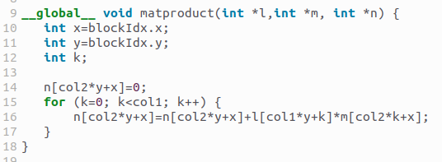
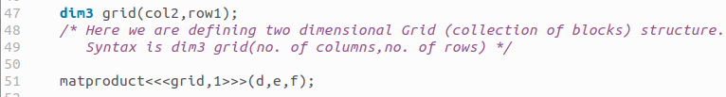
6.1 2-D Blocks: 1T/1B
https://www.youtube.com/watch?v=XeR400_QFXQ&list=PLhbrpS8rYbc0CxUdGR3WoM9xr11WCaSPw&index=6
2-D Blocks: 1T/1B (08:01-12:30/24:18)
Matrix product: Case 1.
Block ID
Case 1
Case 2

Slide 8
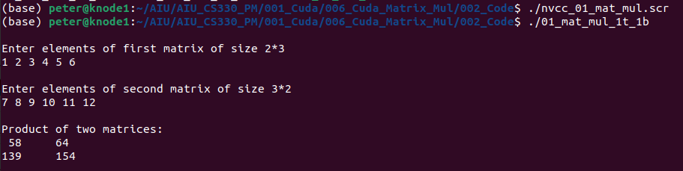
6.1 2-D Blocks: 1T/1B
https://www.youtube.com/watch?v=XeR400_QFXQ&list=PLhbrpS8rYbc0CxUdGR3WoM9xr11WCaSPw&index=6
2-D Blocks: 1T/1B (12:31-13:20/24:18)
Matrix Product: Case 1 Result

Slide 9
6.2 1 Block: 2T/1B

Slide 10
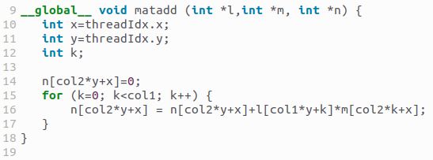

6.2 1 Block: 2T/1B
https://www.youtube.com/watch?v=XeR400_QFXQ&list=PLhbrpS8rYbc0CxUdGR3WoM9xr11WCaSPw&index=6
1 Block: 2T/1B (13:21-14:00/24:18)
Matrix product: case 2.
Thread ID
Case 1
Case 2

Slide 11
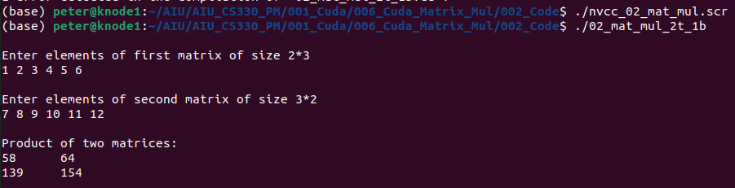
6.2 1 Block: 2T/1B
https://www.youtube.com/watch?v=XeR400_QFXQ&list=PLhbrpS8rYbc0CxUdGR3WoM9xr11WCaSPw&index=6
1 Block: 2T/1B (14:01-14:30/24:18)
Result

Slide 12
6.3 2-D Blocks: 1T/1B Shared Memory

Slide 13
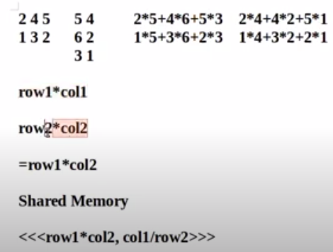
6.3 2-D Blocks: 1T/1B Shared Memory
https://www.youtube.com/watch?v=XeR400_QFXQ&list=PLhbrpS8rYbc0CxUdGR3WoM9xr11WCaSPw&index=6
2-D Blocks: 1T/1B Shared Memory (14:31-15:00/24:18)
We have considered two matrices of sizes row1*col1 and row2*col2.
Resultant matrix (product), definitely will be of size row1*col2.
That is why, we have considered a two dimensional grid having row1*col2 blocks.
Each block will be responsible to calculate one value of product.

Slide 14
6.3 2-D Blocks: 1T/1B Shared Memory
https://www.youtube.com/watch?v=XeR400_QFXQ&list=PLhbrpS8rYbc0CxUdGR3WoM9xr11WCaSPw&index=6
2-D Blocks: 1T/1B Shared Memory (15:01-18:00/24:18)
To find each value in product, there will be col1 or row2 number of multiplications.
So we considered, Col1 number of threads in each block;
So one thread for one multiplication. In short, total number of blocks = row1*col2 and in each block, number of threads = col1(or row2).

Slide 15
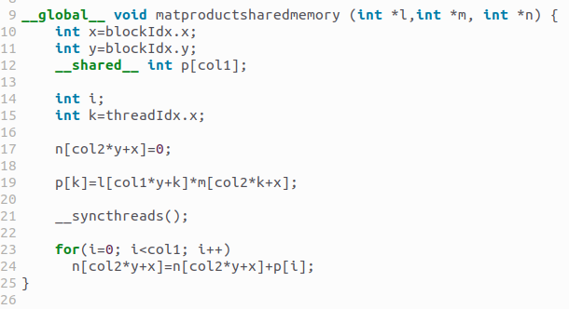

6.3 2-D Blocks: 1T/1B Shared Memory
https://www.youtube.com/watch?v=XeR400_QFXQ&list=PLhbrpS8rYbc0CxUdGR3WoM9xr11WCaSPw&index=6
2-D Blocks: 1T/1B Shared Memory (18:01-24:00/24:18)
We have used shared array p[] to save intermediate multiplication values.
In each block, each thread will find out value of p[i].
__syncthreads() will make sure that all threads has finished their computation, i.e., all values of array p[] are available which will be added together to get one value of product.

Slide 16
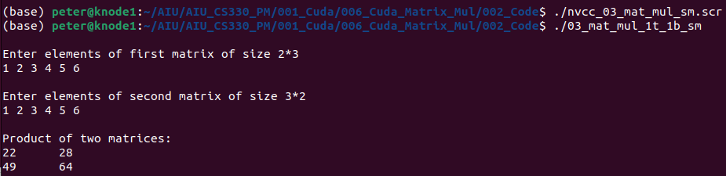
6.3 2-D Blocks: 1T/1B Shared Memory
https://www.youtube.com/watch?v=XeR400_QFXQ&list=PLhbrpS8rYbc0CxUdGR3WoM9xr11WCaSPw&index=6
2-D Blocks: 1T/1B Shared Memory (24:01-24:18/24:18)
Result

Slide 17
End

