Slide 1

3 GPU Memory Architecture
Peter H. Chen

Slide 2

2 GPU Memory Architecture
https://www.youtube.com/watch?v=9zeAcO2Etlk&list=PLhbrpS8rYbc0CxUdGR3WoM9xr11WCaSPw&index=3
CPU Memory Architecture (00:00-00:30/7:51)
We discussed several terminologies of Cuda: Host, Device, Kernel, SM (Stream Multiprocessor), SP (Stream Processor), Thread, Block, Grid, and Warp.
In this discussion, we will discuss about GPU Memory Architecture.
https://www.comrevo.com/2015/05/what-is-cuda-basics-gpu-host-device-kernel-stream-multiprocessor-thread-block-grid-warp-memory-architecture-global-shared-constant-texture-local-registers.html#google_vignette

Slide 3
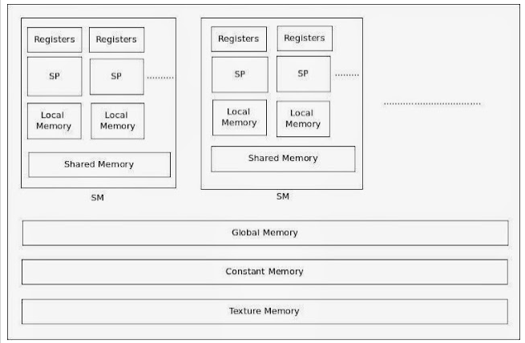
2 GPU Memory Architecture
https://www.youtube.com/watch?v=9zeAcO2Etlk&list=PLhbrpS8rYbc0CxUdGR3WoM9xr11WCaSPw&index=3
CPU Memory Architecture (00:31-01:00/7:51)
Now, we look at the Memory architecture of GPU. The following diagrams show all types of memories in a GPU. The GPU consists of many SM (Stream multiprocessor). That means there are many stream processors. That is why the name is called Stream Multi-Processor.
https://www.comrevo.com/2015/05/what-is-cuda-basics-gpu-host-device-kernel-stream-multiprocessor-thread-block-grid-warp-memory-architecture-global-shared-constant-texture-local-registers.html#google_vignette

Slide 4
2 GPU Memory Architecture
https://www.youtube.com/watch?v=9zeAcO2Etlk&list=PLhbrpS8rYbc0CxUdGR3WoM9xr11WCaSPw&index=3
CPU Memory Architecture (00:31-01:40/7:51)
In the below GPU diagram, we have various types of memory:
1. Inside the SM, we have registers, SP (Stream Processor), Local memory, and Shared Memory.
2. Outside the SM, we have Global memory, constant memory, and Texture Memory.
https://www.comrevo.com/2015/05/what-is-cuda-basics-gpu-host-device-kernel-stream-multiprocessor-thread-block-grid-warp-memory-architecture-global-shared-constant-texture-local-registers.html#google_vignette

Slide 5
2 GPU Memory Architecture
https://www.youtube.com/watch?v=9zeAcO2Etlk&list=PLhbrpS8rYbc0CxUdGR3WoM9xr11WCaSPw&index=3
CPU Memory Architecture (01:41-02:00/7:51)
The SP is the Cuda Core. There are several thousands of Cuda Cores.
One Cuda Core mean one SP.
Now, we can see the GPU is similar to a processor of CPU system.
https://www.comrevo.com/2015/05/what-is-cuda-basics-gpu-host-device-kernel-stream-multiprocessor-thread-block-grid-warp-memory-architecture-global-shared-constant-texture-local-registers.html#google_vignette

Slide 6
3.1 Local Memory

Slide 7

2.1 Local Memory
https://www.youtube.com/watch?v=9zeAcO2Etlk&list=PLhbrpS8rYbc0CxUdGR3WoM9xr11WCaSPw&index=3
Local Memory (02:21-02:40/7:51)
Whenever we define the any variables in a Kernel, the local memory is used to store the variables.
So, registers and local memory are particular to the SP (Stream Processor).

Slide 8
3.2 Register

Slide 9

2.2 Register
https://www.youtube.com/watch?v=9zeAcO2Etlk&list=PLhbrpS8rYbc0CxUdGR3WoM9xr11WCaSPw&index=3
Register (02:01-02:20/7:51)
In the GPU processor, we have registers for arithmetic operation, for example, if we want to add tow numbers, then one number is saved in one register, the other is saved in anther register. Then, those numbers are added together. These registers are only for arithmetic operation only.

Slide 10
3.3 Shared Memory

Slide 11
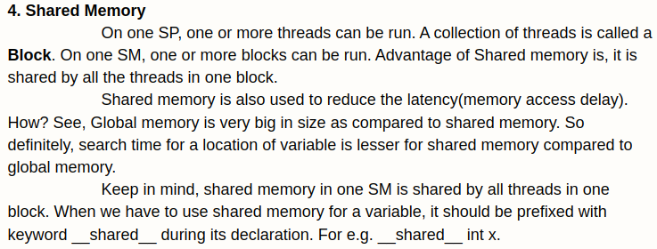
2.3 Shared Memory
https://www.youtube.com/watch?v=9zeAcO2Etlk&list=PLhbrpS8rYbc0CxUdGR3WoM9xr11WCaSPw&index=3
Shared Memory (02:41-03:00/7:51)
In one SM (Stream Multiprocessor), there is a shared memory.
The shared memory is shared by all the threads which are running in the SP (and other SP).

Slide 12
2.3 Shared Memory
https://www.youtube.com/watch?v=9zeAcO2Etlk&list=PLhbrpS8rYbc0CxUdGR3WoM9xr11WCaSPw&index=3
Shared Memory (03:01-03:10/7:51)
Whatever the threads running in the SP (and other SP), all the threads share the memory. The shared memory is particular for SM (Stream Multiprocessor).

Slide 13
2.3 Shared Memory
https://www.youtube.com/watch?v=9zeAcO2Etlk&list=PLhbrpS8rYbc0CxUdGR3WoM9xr11WCaSPw&index=3
Shared Memory (03:11-03:20/7:51)
If we launch one SM (Stream Multiprocessor), the Shared memory is for one SM. The other SM has their own shared memory.

Slide 14
3.4 Global Memory

Slide 15

2.4 Global Memory
https://www.youtube.com/watch?v=9zeAcO2Etlk&list=PLhbrpS8rYbc0CxUdGR3WoM9xr11WCaSPw&index=3
Global Memory (03:21-03:50/7:51)
Now, we look at the global memory. Global memory is the main memory of GPU sytem.
It is similar to main memory of CPU system,
Whenever we allocate the variables with cudaMalloc (), at that time, we allocate the memory from the global memory.

Slide 16
3.5 Constant Memory

Slide 17
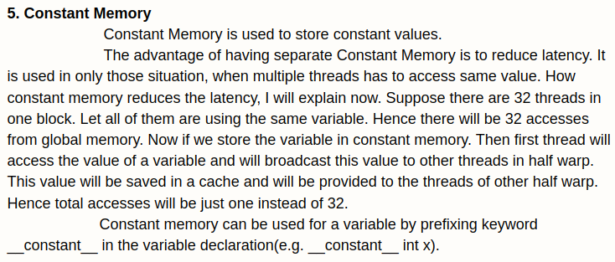
2.5 Constant Memory
https://www.youtube.com/watch?v=9zeAcO2Etlk&list=PLhbrpS8rYbc0CxUdGR3WoM9xr11WCaSPw&index=3
Constant Memory (03:51-04:30/7:51)
Then, we have another type memory that is constant memory.
The reason that we have many types of memory:
The global memory has large memory size. Whenever we access anything from the global memory.
The compiler searches for global memory takes longer time. Global memory is very big in size.
Different types of memory for different purpose.

Slide 18
2.5 Constant Memory
https://www.youtube.com/watch?v=9zeAcO2Etlk&list=PLhbrpS8rYbc0CxUdGR3WoM9xr11WCaSPw&index=3
Constant Memory (04:31-05:10/7:51)
The constant memory is used to save constant.
Constant is different from variables. Variables value get change at a time or over a period of time.
Constant memory keep the same value throughout the program. For example, we have 32 threads (Warp) executed in the block. The constant value inside the 32 threads never change the value.
Why do you require access those value? That is why we save the constant values separately in the constant memory to reduce the search time from compiler.

Slide 19
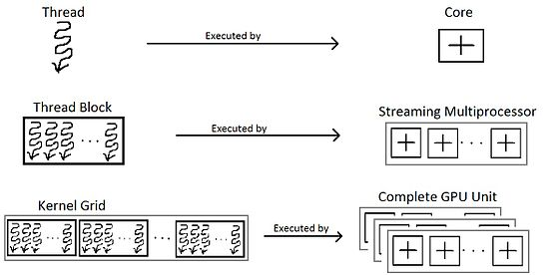
2.5 Constant Memory
https://www.youtube.com/watch?v=9zeAcO2Etlk&list=PLhbrpS8rYbc0CxUdGR3WoM9xr11WCaSPw&index=3
Constant Memory (05:11-05:40/7:51)
What is half-warp?
A Warp is a set of 32 threads executed in a block. Half-warp is 16 threads. Normally, 16 threads are group together to executed.
How the constant memory access done?
One thread inside the warp access the constant value and then broadcast to the other threads in the warp.
One thread of half-warp (16 threads) access this constant value, then it broadcasts to the other threads in the half-warp.

Slide 20
2.5 Constant Memory
https://www.youtube.com/watch?v=9zeAcO2Etlk&list=PLhbrpS8rYbc0CxUdGR3WoM9xr11WCaSPw&index=3
Constant Memory (05:41-06:00/7:51)
This constant values are saved in the cache memory.
Cache memory is part of global memory.
Then, threads from others get access the constant value.

Slide 21
3.6 Texture Memory

Slide 22
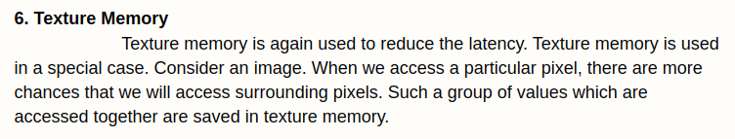

2.6 Texture Memory
https://www.youtube.com/watch?v=9zeAcO2Etlk&list=PLhbrpS8rYbc0CxUdGR3WoM9xr11WCaSPw&index=3
Texture Memory (06:01-07:00/7:51)
Texture memory is used to reduce the latency time.
In 3D graphics processing, we save 3-D effect, shadows, textures, etc. in the texture memory to speed up the display. These group of memory are ready to access during the rendering (渲染).
What is rendering?
Rendering is the finalization process of a digital image or a 3D model using computer software. Rendering bring visuals effect: shadows, lighting effects, textures, and generate the final result.

Slide 23
3.7 Summary

Slide 24
2.7 Summary
https://www.youtube.com/watch?v=9zeAcO2Etlk&list=PLhbrpS8rYbc0CxUdGR3WoM9xr11WCaSPw&index=3
Texture Memory (07:01-07:51/7:51)
We have several types of memory. Each memory has their special uses.
1. Global memory is the main memory of the GPU. It has a big size but takes a lot of time to search.
2. Constant memory: saved and constants for fast access.
3. Texture memory: 3D-graphics rendering available to reduce the latency time.
4. Share memory: Share memory between the threads or in SM (Stream Multiprocessor).
5. Local memory: Local memory inside each thread or SP (Stream Processor).
6. Register: Arithmetic operation inside each thread or SP (Stream Processor).

Slide 25
End

