Slide 1

8 GPU Memory Architecture
Peter H. Chen

Slide 2

8 GPU Memory Architecture
https://www.youtube.com/watch?v=XL1nvGnoi3Y&list=PLhbrpS8rYbc0CxUdGR3WoM9xr11WCaSPw&index=8
Introduction of GPU Memory Architecture (00:00-00:05/6:06)

Slide 3
8.1 Six Types of Memory

Slide 4
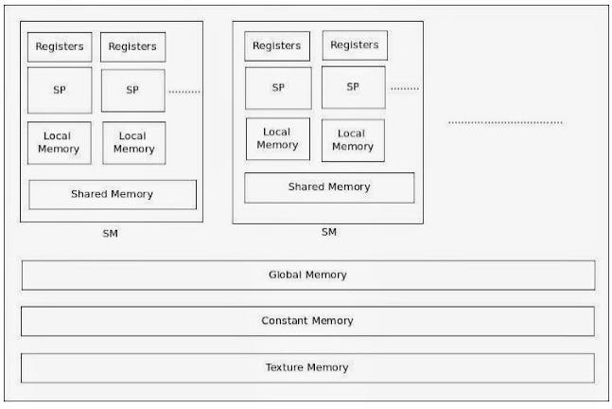
8.1 Six Types of Memory
https://www.youtube.com/watch?v=XL1nvGnoi3Y&list=PLhbrpS8rYbc0CxUdGR3WoM9xr11WCaSPw&index=8
Six Types of Memory (00:06-00:30/6:06)
The following diagram shows six types of memories in GPU.

Slide 5
8.2 Local, Register, Global Memory

Slide 6
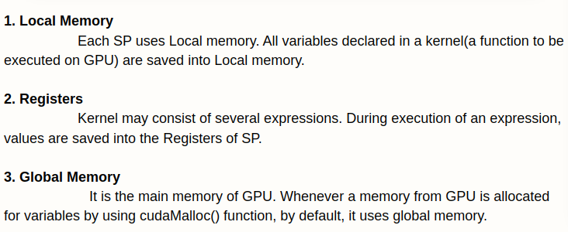
8.2 Local, Register, Global Memory
https://www.youtube.com/watch?v=XL1nvGnoi3Y&list=PLhbrpS8rYbc0CxUdGR3WoM9xr11WCaSPw&index=8
Local, Register, Global Memory (00:31-01:30/6:06)
1. Local Memory: SP (run Threads) use local memory.
2. Registers: Fastest memory for arithmetic computation.
3. Global Memory: Default, largest amounts, slowest memory of GPU.

Slide 7
8.3 Shared Memory

Slide 8
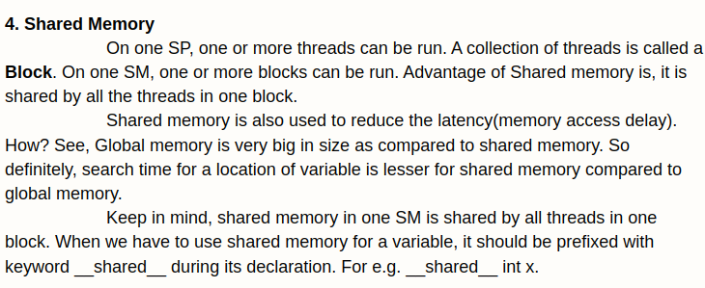
8.3 Shared Memory
https://www.youtube.com/watch?v=XL1nvGnoi3Y&list=PLhbrpS8rYbc0CxUdGR3WoM9xr11WCaSPw&index=8
Shared Memory (01:31-03:30/6:06)
4. Shared Memory: Shared memory by SP (threads in one block).

Slide 9
8.4 Constant Memory

Slide 10
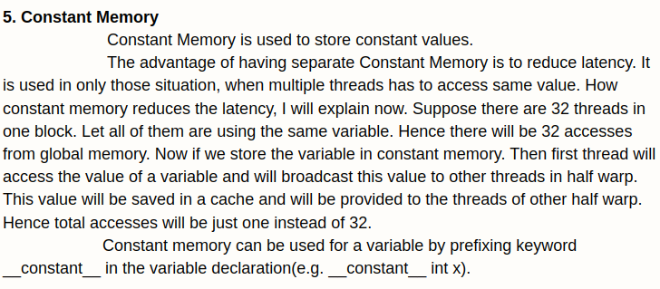
8.4 Constant Memory
https://www.youtube.com/watch?v=XL1nvGnoi3Y&list=PLhbrpS8rYbc0CxUdGR3WoM9xr11WCaSPw&index=8
Constant Memory (03:31-05:30/6:06)
5. Constant Memory: Store constant value

Slide 11
8.5 Texture Memory

Slide 12
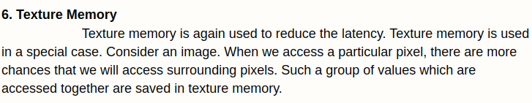
8.5 Texture Memory
https://www.youtube.com/watch?v=XL1nvGnoi3Y&list=PLhbrpS8rYbc0CxUdGR3WoM9xr11WCaSPw&index=8
Texture Memory (05:31-06:06/6:06)
6. Texture Memory: Special Memory to store image and access pixels of image in the Virtual Reality to reduce the latency time.

Slide 13
End

