Slide 1

1 Cuda on Colab
Peter H. Chen

Slide 2
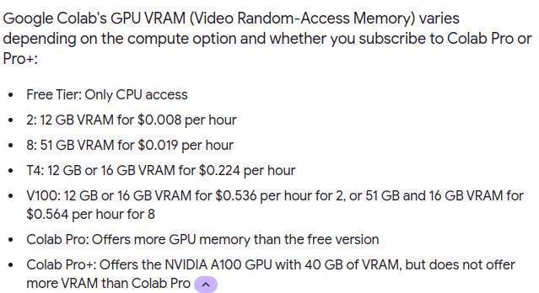
1 Cuda on Colab
https://www.youtube.com/watch?v=gggQ9-_crmU&list=PLhbrpS8rYbc0CxUdGR3WoM9xr11WCaSPw&index=1
Cuda on Colab (00:00-01:10/17:20)
To run cuda, we need the GPU on our machine.
Not everyone have the GPU on our computer.
Google Colab is a online server which provide GPU and compiler.
We can run our cuda program Google Colab online without GPU on local machine.
Colab free tier provide NVIDIA Tesla K80 with 12GB of VRAM (Video RAM-Access Memory).
If we want to have more VRAM if we pay.

Slide 3
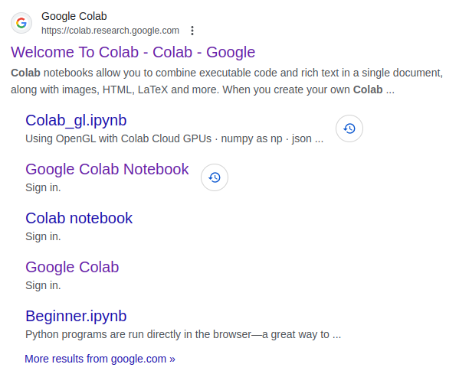
1 Cuda on Colab
https://www.youtube.com/watch?v=gggQ9-_crmU&list=PLhbrpS8rYbc0CxUdGR3WoM9xr11WCaSPw&index=1
Cuda on Colab (01:11-01:20/17:20)
1. Google search “google colab”
2. Click “Google Colab Notebook”.
https://github.com/flin3500/Cuda-Google-Colab

Slide 4
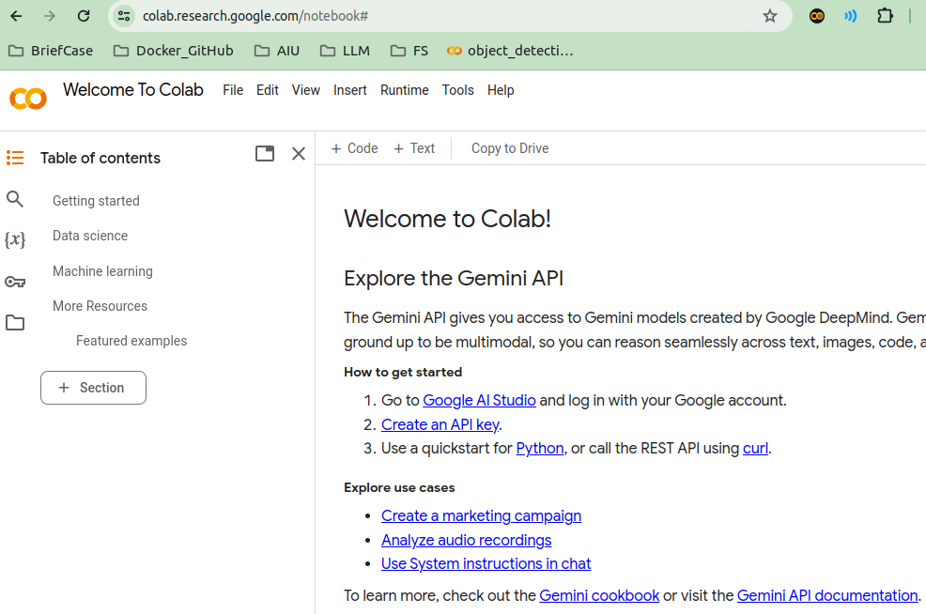
1 Cuda on Colab
https://www.youtube.com/watch?v=gggQ9-_crmU&list=PLhbrpS8rYbc0CxUdGR3WoM9xr11WCaSPw&index=1
Cuda on Colab (01:21-01:30/17:20)
1. Google search “google colab”
2. Click “Google Colab Notebook”.
https://github.com/flin3500/Cuda-Google-Colab

Slide 5
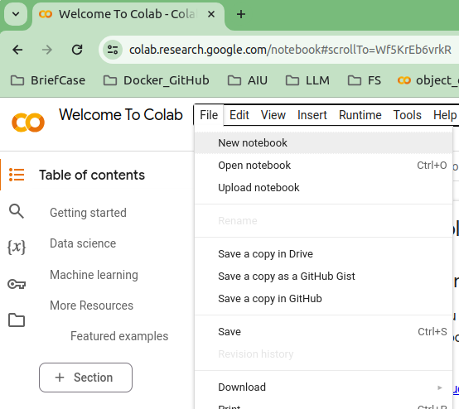
1 Cuda on Colab
https://www.youtube.com/watch?v=gggQ9-_crmU&list=PLhbrpS8rYbc0CxUdGR3WoM9xr11WCaSPw&index=1
Cuda on Colab (01:31-02:00/17:20)
1. File > New Notebook
https://github.com/flin3500/Cuda-Google-Colab

Slide 6
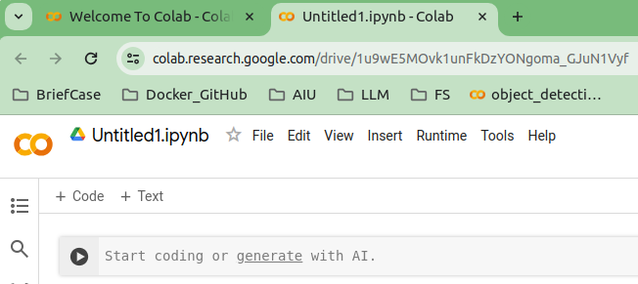
1 Cuda on Colab
https://www.youtube.com/watch?v=gggQ9-_crmU&list=PLhbrpS8rYbc0CxUdGR3WoM9xr11WCaSPw&index=1
Cuda on Colab (01:01-02:20/17:20)
We can start to write the Cuda Program.
https://github.com/flin3500/Cuda-Google-Colab

Slide 7
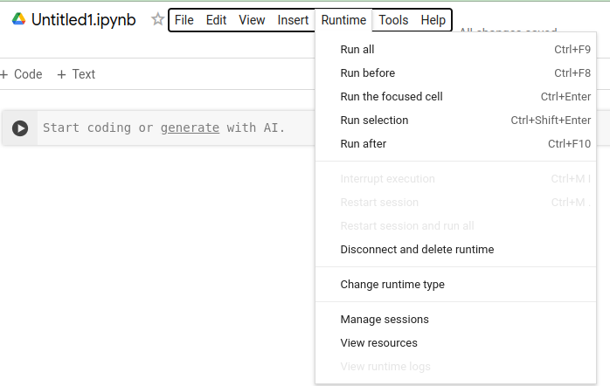
1 Cuda on Colab
https://www.youtube.com/watch?v=gggQ9-_crmU&list=PLhbrpS8rYbc0CxUdGR3WoM9xr11WCaSPw&index=1
Cuda on Colab (02:21-02:30/17:20)
First, we need to “Change runt time type”.
https://github.com/flin3500/Cuda-Google-Colab

Slide 8
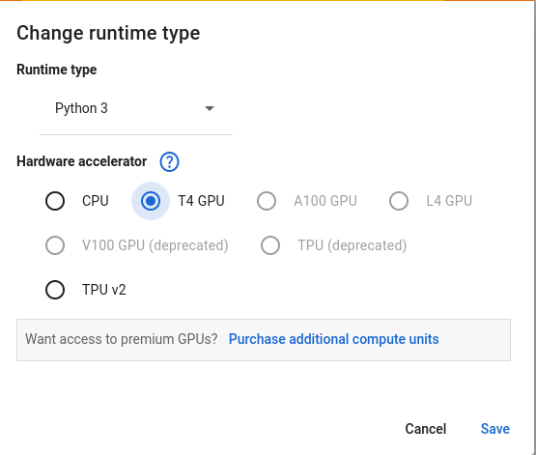
1 Cuda on Colab
https://www.youtube.com/watch?v=gggQ9-_crmU&list=PLhbrpS8rYbc0CxUdGR3WoM9xr11WCaSPw&index=1
Cuda on Colab (02:31-02:40/17:20)
We select “T4 (Tesla Architecture) GPU” ans save.
https://github.com/flin3500/Cuda-Google-Colab

Slide 9
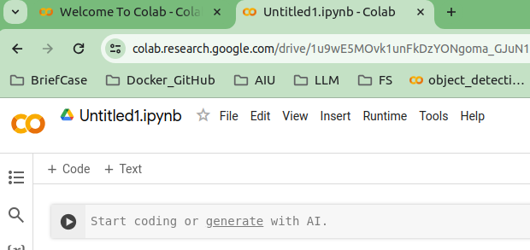
1 Cuda on Colab
https://www.youtube.com/watch?v=gggQ9-_crmU&list=PLhbrpS8rYbc0CxUdGR3WoM9xr11WCaSPw&index=1
Cuda on Colab (02:41-02:50/17:20)
Whenever we want to write the code, we can click “+ Code” to write.
https://github.com/flin3500/Cuda-Google-Colab

Slide 10
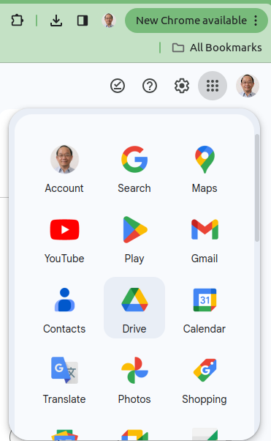
1 Cuda on Colab
https://www.youtube.com/watch?v=gggQ9-_crmU&list=PLhbrpS8rYbc0CxUdGR3WoM9xr11WCaSPw&index=1
Cuda on Colab (02:51-03:00/17:20)
First, We download the code (as below) from github to your local drive.
Click the “Google Drive”
Create a folder on drive.
Drag and Drop the the folder.
https://github.com/peterhchen/AIU_CS330_PM

Slide 11
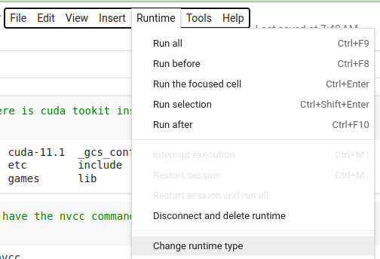
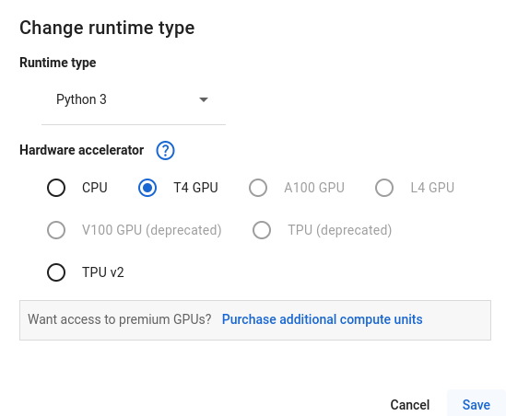
1 Cuda on Colab
https://www.youtube.com/watch?v=gggQ9-_crmU&list=PLhbrpS8rYbc0CxUdGR3WoM9xr11WCaSPw&index=1
Cuda on Colab (03:01-03:30/17:20)
Make sure the run time type is “T4 GPU”.
1. > Runtime -> Change runtime type
2. Select “T4 GPU” (Tesla GPU)
https://github.com/flin3500/Cuda-Google-Colab

Slide 12


1 Cuda on Colab
https://www.youtube.com/watch?v=gggQ9-_crmU&list=PLhbrpS8rYbc0CxUdGR3WoM9xr11WCaSPw&index=1
Cuda on Colab (03:31-08:10/17:20)
Below is the command that colab. We do not have to install again. Juts for reference.
1. Installed the cuda (Submit Cuda to GPU Thread) and
2. Installed nvcc (Compile code Cuda into C code) for us.
https://github.com/flin3500/Cuda-Google-Colab
1
Install cuda
2
Install nvcc

Slide 13
1.1 Cuda: CPU/GPU Hello

Slide 14
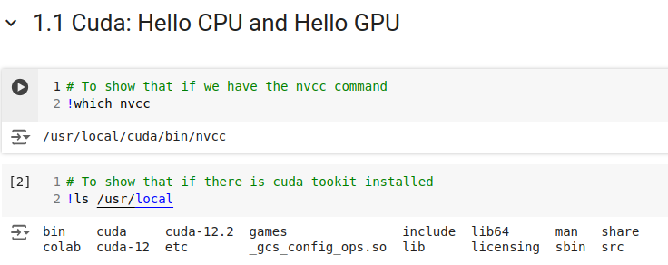
1.1 Cuda: CPU/GPU Hello
https://www.youtube.com/watch?v=gggQ9-_crmU&list=PLhbrpS8rYbc0CxUdGR3WoM9xr11WCaSPw&index=1
Cuda: CPU/GPU Hello (08:11-08:15/17:20)
1.1 Cuda: Hello CPU and Hello GPU
https://github.com/flin3500/Cuda-Google-Colab

Slide 15
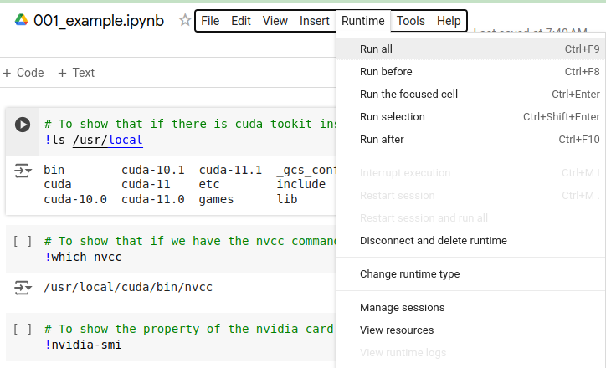
1.1 Cuda: CPU/GPU Hello
https://www.youtube.com/watch?v=gggQ9-_crmU&list=PLhbrpS8rYbc0CxUdGR3WoM9xr11WCaSPw&index=1
Cuda: CPU/GPU Hello (08:15-08:20/17:20)
Colab already installed the cuda for us.
We check the Colab installation.
> !ls /usr/local
https://github.com/flin3500/Cuda-Google-Colab

Slide 16
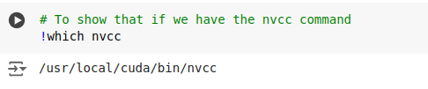
1.1 Cuda: CPU/GPU Hello
https://www.youtube.com/watch?v=gggQ9-_crmU&list=PLhbrpS8rYbc0CxUdGR3WoM9xr11WCaSPw&index=1
Cuda: CPU/GPU Hello (08:21-08:30/17:20)
Check Cuda compiler: nvcc
https://github.com/flin3500/Cuda-Google-Colab

Slide 17
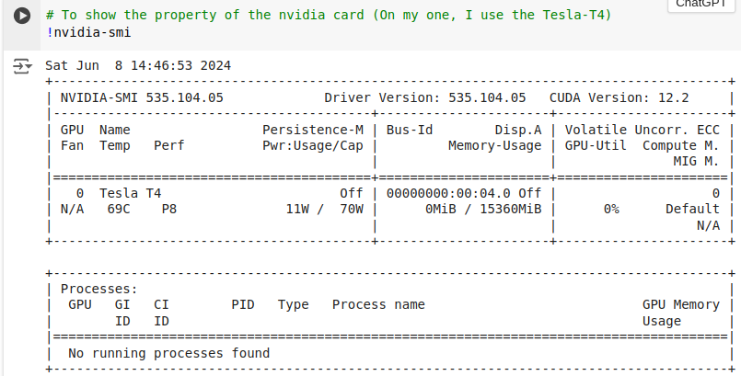
1.1 Cuda: CPU/GPU Hello
https://www.youtube.com/watch?v=gggQ9-_crmU&list=PLhbrpS8rYbc0CxUdGR3WoM9xr11WCaSPw&index=1
Cuda: CPU/GPU Hello (08:31-09:00/17:20)
Use Nvidia-smi to check GPU type: Tesla-T4
https://github.com/flin3500/Cuda-Google-Colab

Slide 18
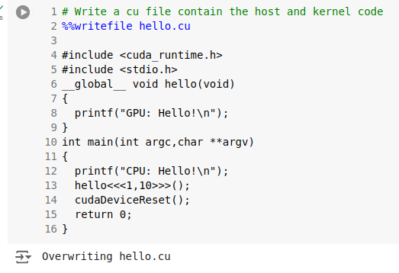
1.1 Cuda: CPU/GPU Hello
https://www.youtube.com/watch?v=gggQ9-_crmU&list=PLhbrpS8rYbc0CxUdGR3WoM9xr11WCaSPw&index=1
Cuda: CPU/GPU Hello (09:01-09:30/17:20)
Write Cuda Code with magic command
1. %%writefile hello.cu
2. Kernel function __global__ void hello() run on GPU. We print message “GPU: Hello!”
3. main function run on local CPU. We print message “CPU:Hello!”
We pass in 1: number of block, 10: number of thread.
https://github.com/flin3500/Cuda-Google-Colab

Slide 19
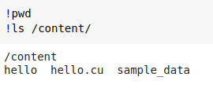
1.1 Cuda: CPU/GPU Hello
https://www.youtube.com/watch?v=gggQ9-_crmU&list=PLhbrpS8rYbc0CxUdGR3WoM9xr11WCaSPw&index=1
Cuda: CPU/GPU Hello (09:01-09:30/17:20)
Check the files generated in Google Drive:
> !pwd
> !ls /content
https://github.com/flin3500/Cuda-Google-Colab

Slide 20
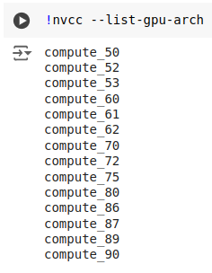
1.1 Cuda: CPU/GPU Hello
https://www.youtube.com/watch?v=gggQ9-_crmU&list=PLhbrpS8rYbc0CxUdGR3WoM9xr11WCaSPw&index=1
Cuda: CPU/GPU Hello (09:31-10:00/17:20)
> !nvcc --list-gpu-arch
https://github.com/flin3500/Cuda-Google-Colab

Slide 21

1.1 Cuda: CPU/GPU Hello
https://www.youtube.com/watch?v=gggQ9-_crmU&list=PLhbrpS8rYbc0CxUdGR3WoM9xr11WCaSPw&index=1
Cuda: CPU/GPU Hello (10:11-10:20/17:20)
Compilation option:
NVIDIA Architecture:
We specif the runtime with T4 (Tesla version 4) CPU.
NVIDIA T4-GPU uses Turing Architecture
1. Turing architecture (sm_75): Specify Turing Architecture
2. gencode=arch=compute_75: code generation for PTX (Parallel Thread Execution) with compute_75
3. code=sm_57: specify code run on architecture
https://arnon.dk/matching-sm-architectures-arch-and-gencode-for-various-nvidia-cards/

Slide 22
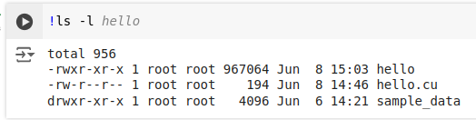
1.1 Cuda: CPU/GPU Hello
https://www.youtube.com/watch?v=gggQ9-_crmU&list=PLhbrpS8rYbc0CxUdGR3WoM9xr11WCaSPw&index=1
Cuda: CPU/GPU Hello (10:21-10:30/17:20)
!ls -l

Slide 23
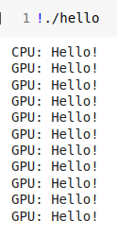
1.1 Cuda: CPU/GPU Hello
https://www.youtube.com/watch?v=gggQ9-_crmU&list=PLhbrpS8rYbc0CxUdGR3WoM9xr11WCaSPw&index=1
Cuda: CPU/GPU Hello (10:31-11:30/17:20)
Execution result:
We have 10 threads in GPU

Slide 24
1.2 Add 2 Numbers

Slide 25
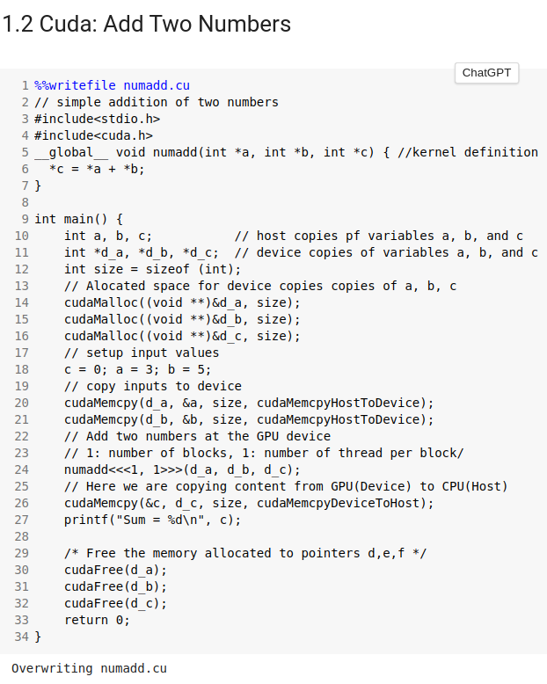
1.2 Add 2 Numbers
https://www.youtube.com/watch?v=gggQ9-_crmU&list=PLhbrpS8rYbc0CxUdGR3WoM9xr11WCaSPw&index=1
Add 2 Number (11:31-12:30/17:20)
Example of add 2 numbers

Slide 26
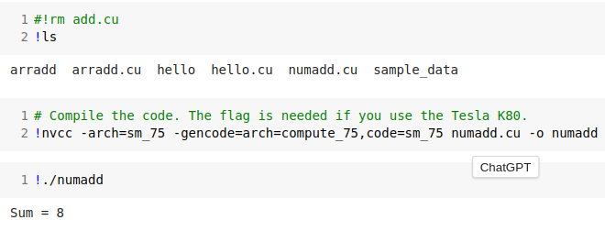
1.2 Add 2 Numbers
https://www.youtube.com/watch?v=gggQ9-_crmU&list=PLhbrpS8rYbc0CxUdGR3WoM9xr11WCaSPw&index=1
Add 2 Number (12:31-13:30/17:20)
Example of add 2 numbers

Slide 27
1.3 Addition of 2 1-D Arrays

Slide 28
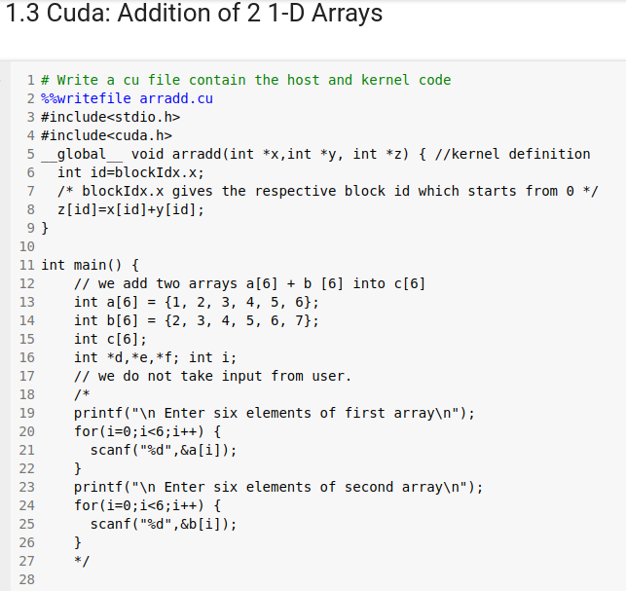
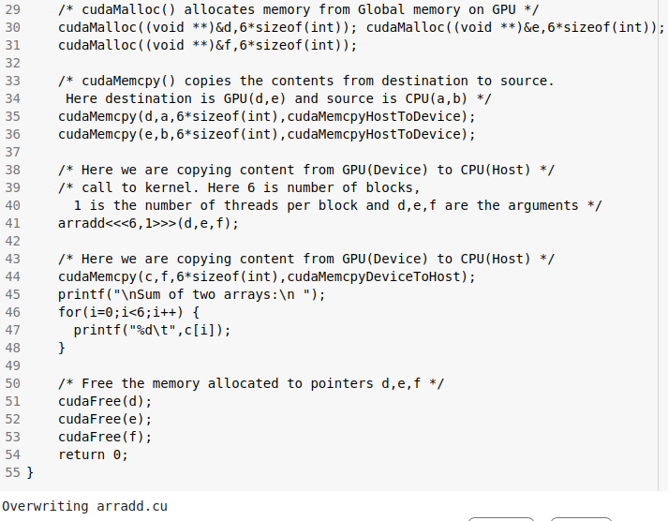
1.3 Addition of 2 1-D Arrays
https://www.youtube.com/watch?v=gggQ9-_crmU&list=PLhbrpS8rYbc0CxUdGR3WoM9xr11WCaSPw&index=1
Addition 2 1-D Arrays (13:31-14:30/17:20)

Slide 29
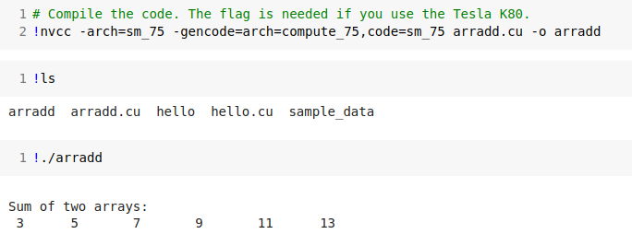
1.3 Addition of 2 1-D Arrays
https://www.youtube.com/watch?v=gggQ9-_crmU&list=PLhbrpS8rYbc0CxUdGR3WoM9xr11WCaSPw&index=1
Addition 2 1-D Arrays (14:31-15:30/17:20)
Result

Slide 30
1.4 Find GPU Information

Slide 31
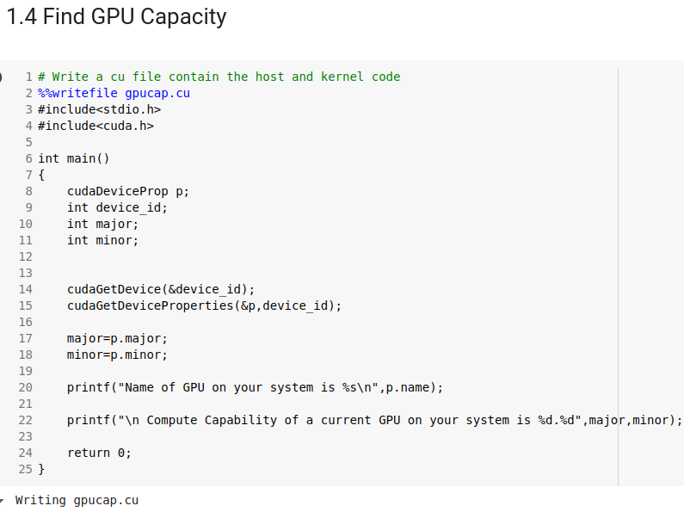
1.4 Find GPU Information
https://www.youtube.com/watch?v=gggQ9-_crmU&list=PLhbrpS8rYbc0CxUdGR3WoM9xr11WCaSPw&index=1
Find GPU Information (15:31-16:30/17:20)

Slide 32
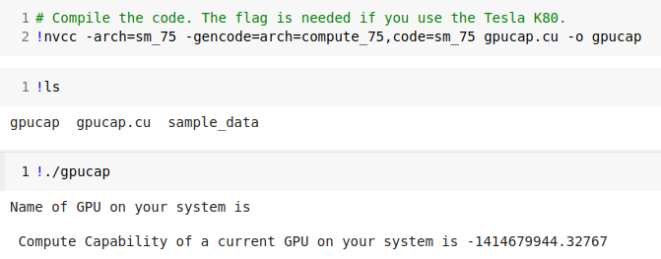
1.4 Find GPU Information
https://www.youtube.com/watch?v=gggQ9-_crmU&list=PLhbrpS8rYbc0CxUdGR3WoM9xr11WCaSPw&index=1
Find GPU Information (16:31-17:00/17:20)
I run out of colab time today.
Below result is that I run without GPU.
GeForce, Tesla K80, etc
1.2, 3.7. etc

Slide 33
1.5 Summary

Slide 34
1.5 Summary
https://www.youtube.com/watch?v=gggQ9-_crmU&list=PLhbrpS8rYbc0CxUdGR3WoM9xr11WCaSPw&index=1
Summary (17:01-17:20/17:20)
We use Colab to run the Cuda program.
1. Hello CPU/GPU: Hello on CPU and Hello on GPU for 10 times with threads.
2. Add two numbers on GPU: Submit GPU to to addition the return to CPU to print out.
3. Add two 1-D Array on GPU: Submit GPU multi-thread addition and return CPU to print out.
4. Find GPU Information.
5. Summary of Cuda on Colab.

Slide 35
End

