Slide 1

7 Cuda Terminology
Peter H. Chen

Slide 2

7 Cuda Terminology
https://www.youtube.com/watch?v=8woRPbFGMZM&list=PLhbrpS8rYbc0CxUdGR3WoM9xr11WCaSPw&index=7
Cuda Terminology (00:00-00:10/5:08)

Slide 3
7.1 What is Cuda?

Slide 4

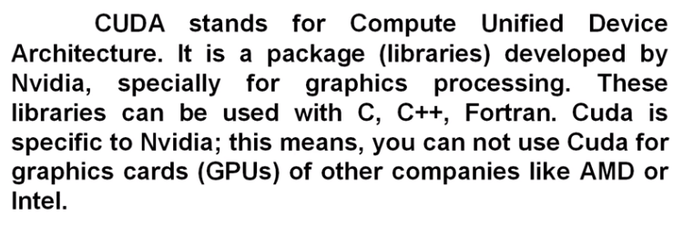
7.1 What is Cuda?
https://www.youtube.com/watch?v=8woRPbFGMZM&list=PLhbrpS8rYbc0CxUdGR3WoM9xr11WCaSPw&index=7
What is Cuda? (00:11-00:50/5:08)
1. Cuda (Compute Unified Device Architecture) is a package (libraries) developed by NVIDIA for graphical processing.
2. Cuda is for graphics processing.
3. Cuda libraries can be used with C, C++, and FORTRAN.
4. Cuda is specific for NVIDIA only. You cannot use Cuda for AMD or Intel graphic card.
5. Cuda competitor: OpenCL (Open Computing Language), OpenMP (Open Multi-Processing), and Zluda is AMD Cuda [Zluda is Polish mean Delusion (妄想)].

Slide 5
7.2 Host and Device

Slide 6


7.2 Host and Device
https://www.youtube.com/watch?v=8woRPbFGMZM&list=PLhbrpS8rYbc0CxUdGR3WoM9xr11WCaSPw&index=7
Host and Device (00:51-01:00/5:08)
In Cuda, CPU is called a Host.
In Cuda, GPU is called device.

Slide 7
7.3 Kernel

Slide 8

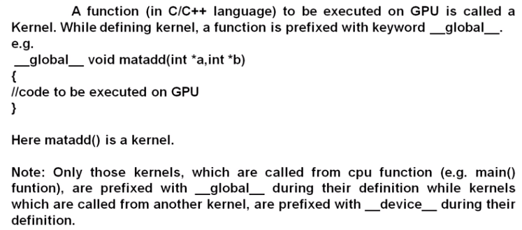
7.3 Kernel
https://www.youtube.com/watch?v=8woRPbFGMZM&list=PLhbrpS8rYbc0CxUdGR3WoM9xr11WCaSPw&index=7
Kernel (01:01-02:20/5:08)
1. Kernel is Function run on GPU.
2. Kernel keyword: “__global__”
3. Kernel is called by main() with keyword “__kernel__” or by other kernel function with keyword “__device__”.

Slide 9
7.4 SM and SP

Slide 10

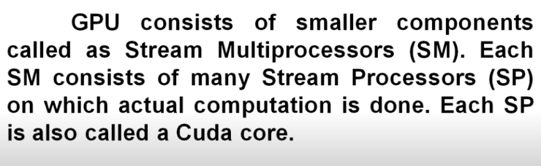
7.4 SM and SP
https://www.youtube.com/watch?v=8woRPbFGMZM&list=PLhbrpS8rYbc0CxUdGR3WoM9xr11WCaSPw&index=7
SM and SP (02:21-02:50/5:08)
1. SM (Stream Multi-Processor): smaller components of GPU.
2. SP (Stream Processor): Each SP is called a Cuda Core.

Slide 11
7.5 Thread, Block, and Grid

Slide 12

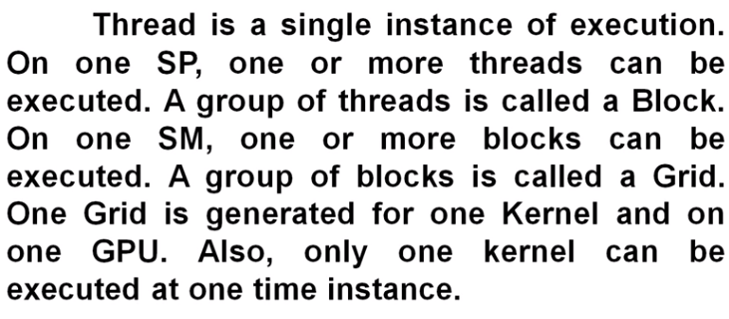
7.5 Thread, Block, and Grid
https://www.youtube.com/watch?v=8woRPbFGMZM&list=PLhbrpS8rYbc0CxUdGR3WoM9xr11WCaSPw&index=7
Thread, Block, and Grid (02:51-03:40/5:08)
1. Thread: Single instance of execution. On one SP, one or more threads can be executed.
2. Block: group of threads. On one SM, one or more blocks can be executed.
3. Grid: A group of blocks. Grid is generated for one Kernel on one GPU. Only one Kernel can be executed at one time instance.

Slide 13
7.6 Warp

Slide 14

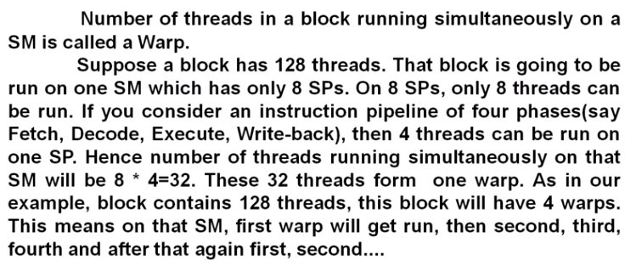
7.5 Warp
https://www.youtube.com/watch?v=8woRPbFGMZM&list=PLhbrpS8rYbc0CxUdGR3WoM9xr11WCaSPw&index=7
Warp (03:41-05:08/5:08)
1. Warp: Number of threads in a block running simultaneously on a SM.
2. For Example: 128 threads run on one SM.
3. For example, SM has 8 SP. Only 8 threads can be run on 8 SP.
4. We can run pipeline of four phases (Fetch, Decode, Execute, Write-back), then 4 threads can be run on one SP.
5. SM can run 8 (SP) * 4 (threads/SP) = 32 threads. This 32 threads is one Warp.
6. We have 128 threads. 128 threads / (32 threads/Warp) = 4 warps.

Slide 15
End

