Slide 1

2 Cuda Basics
Peter H. Chen

Slide 2
2 Cuda Basics
https://www.youtube.com/watch?v=lwA4SK-82rI&list=PLhbrpS8rYbc0CxUdGR3WoM9xr11WCaSPw&index=2
Cuda Basics (00:00-00:30/22:54)
In this discussion, we will discuss the following topics:
1. Why do we need GPU?
2. What is cuda?
3. What is cuda cores?
4. What is cuda cores in graphics cards?
5. What is cuda gpu?
6. What is cuda programming?
7. What is cuda and opencl?
8. What is cuda toolkit?
9. What is cuda nvidia?
10. What is cuda cores in gpu?
https://www.comrevo.com/2015/05/what-is-cuda-basics-gpu-host-device-kernel-stream-multiprocessor-thread-block-grid-warp-memory-architecture-global-shared-constant-texture-local-registers.html

Slide 3

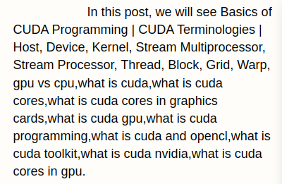
2 Cuda Basics
https://www.youtube.com/watch?v=lwA4SK-82rI&list=PLhbrpS8rYbc0CxUdGR3WoM9xr11WCaSPw&index=2
Cuda Basics (00:31-01:30/22:54)
In this discussion, we will see the Basics of CUDA Programming.
In CUDA Terminologies, we use Host, Device, Kernel, Stream Multiprocessor, Stream Processor, Thread, Block, Grid, Warp, GPU vs CPU.
We discuss one-by one.
https://www.comrevo.com/2015/05/what-is-cuda-basics-gpu-host-device-kernel-stream-multiprocessor-thread-block-grid-warp-memory-architecture-global-shared-constant-texture-local-registers.html

Slide 4
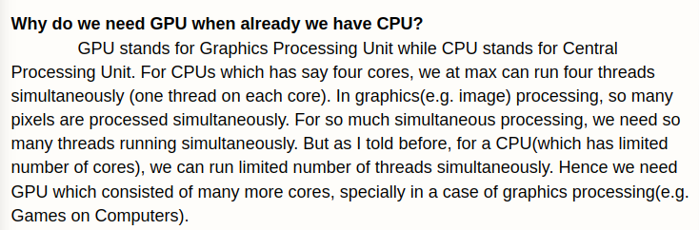
2 Cuda Basics
https://www.youtube.com/watch?v=lwA4SK-82rI&list=PLhbrpS8rYbc0CxUdGR3WoM9xr11WCaSPw&index=2
Cuda Basics (01:31-02:30/22:54)
The first question, “Why do we need GPU when already have CPU?”
CPU (Central Processing Unit) is the thread process unit. GPU (Graphics Processing Unit) is the graphical image Process unit. Bot CPU and GPU are processors.
Sometimes, we buy Graphics Card for our computers to speed up playing the video game or any image processing in the application we run.
https://www.comrevo.com/2015/05/what-is-cuda-basics-gpu-host-device-kernel-stream-multiprocessor-thread-block-grid-warp-memory-architecture-global-shared-constant-texture-local-registers.html

Slide 5
2.1 Why Need GPU?

Slide 6
2.1 Why Need GPU?
https://www.youtube.com/watch?v=lwA4SK-82rI&list=PLhbrpS8rYbc0CxUdGR3WoM9xr11WCaSPw&index=2
Cuda Basics (02:31-03:30/22:54)
Now, the question arise: “If both CPU and GPS are processors, we already have CPU in our system, why do we need GPU?”
The answer is:
CPU has a limited number of cores.
For example, Intel i3 (2-cores), i5 (2/4-cores), i7 (4/6/8-cores), i9 (8-cores). They have 2-8 number of cores. Each core can only rub on thread.
For CPU, 4-cores, we can run four threads simultaneously, one thread on one core.
https://www.comrevo.com/2015/05/what-is-cuda-basics-gpu-host-device-kernel-stream-multiprocessor-thread-block-grid-warp-memory-architecture-global-shared-constant-texture-local-registers.html

Slide 7

2.1 Why Need GPU?
https://www.youtube.com/watch?v=lwA4SK-82rI&list=PLhbrpS8rYbc0CxUdGR3WoM9xr11WCaSPw&index=2
Cuda Basics (03:31-04:00/22:54)
If we want to run more than 8 threads, for exmaple, we have 1024 threads simultaneously, how can we run simultaneously?
We can run first 4 threads in CPU with 4-cores, then we can run rest of the thousand of threads in the NVIDIA GPU RTX 3050 with 2560-cores or H100 with 14,592 cores.
In Image processing, each pixel can be a thread computed in GPU cores.
The number of cores in CPU is fixed to 4 to 8. But the number of cores in GPU can be extended to any number.
For NVIDIA GPU,
1. GeForce RTX 3050 has 2560 cores,
2. RTX 4070 has 9,728 Cores,
3. H100 has 14,592 core, etc.
https://www.comrevo.com/2015/05/what-is-cuda-basics-gpu-host-device-kernel-stream-multiprocessor-thread-block-grid-warp-memory-architecture-global-shared-constant-texture-local-registers.html

Slide 8

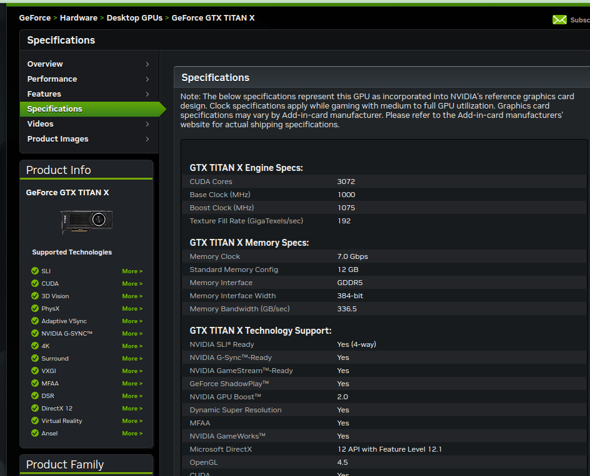
2.1 Why Need GPU?
https://www.youtube.com/watch?v=lwA4SK-82rI&list=PLhbrpS8rYbc0CxUdGR3WoM9xr11WCaSPw&index=2
Cuda Basics (04:01-04:10/22:54)
What is GTX Titan X specification?
RTX Titan has around 3702 cores and 1 GPU.
That is the reason we use GPU to for thread computation.
https://www.nvidia.com/en-us/geforce/graphics-cards/geforce-gtx-titan-x/specifications/

Slide 9
2.2 What is Cuda?

Slide 10
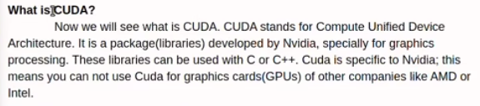
2.2 What is Cuda?
https://www.youtube.com/watch?v=lwA4SK-82rI&list=PLhbrpS8rYbc0CxUdGR3WoM9xr11WCaSPw&index=2
Cuda Basics (04:11-06:30/22:54)
Now, what is Cuda?
Cuda is not a programming language. Cuda is not the hardware.
Cuda is a API library. This library used the exiting Programming language, for example, C++. C++ is an existing programming language and Cuda is a C++ API Library.
Nowadays, almost all GPUs are provided by NVIDIA. You may find out Cuda by AMD and Intel.
The datapath are circuits for addition, subtraction, multiplication, and division.
We have algorithm for parallel looping. We can use cuda for both CPU and GPU parallel computation.
https://www.comrevo.com/2015/05/what-is-cuda-basics-gpu-host-device-kernel-stream-multiprocessor-thread-block-grid-warp-memory-architecture-global-shared-constant-texture-local-registers.html

Slide 11
2.2 What is Cuda?
https://www.youtube.com/watch?v=lwA4SK-82rI&list=PLhbrpS8rYbc0CxUdGR3WoM9xr11WCaSPw&index=2
What is Cuda? (04:11-07:30/22:54)
The NVIDIA company give us the Cuda API Library to write the parallel computation.
There are some other libraries, such as, OpenCL for the parallel computation.
Since Cuda only support NVIDIA graphics card, we cannot use Cuda for the Graphics Card from other companies, such as, AMD or Intel.
However, you can use OpenCL for NVIDIA, AMD, and Intel Graphics Card.
So, Cuda is basically a API Library provided by NVIDIA for NVIDIA Graphics Card.
https://www.comrevo.com/2015/05/what-is-cuda-basics-gpu-host-device-kernel-stream-multiprocessor-thread-block-grid-warp-memory-architecture-global-shared-constant-texture-local-registers.html

Slide 12
2.3 Host and Device

Slide 13

2.3 Host and Device
https://www.youtube.com/watch?v=lwA4SK-82rI&list=PLhbrpS8rYbc0CxUdGR3WoM9xr11WCaSPw&index=2
Host and Device (07:31-07:40/22:54)
Now, there is another concept about Host and Device.
In Cuda, the CPU is the main processor and GPU is another processor along with CPU, the main processor.
CPU is called Host and GPU is called Device.
https://www.comrevo.com/2015/05/what-is-cuda-basics-gpu-host-device-kernel-stream-multiprocessor-thread-block-grid-warp-memory-architecture-global-shared-constant-texture-local-registers.html

Slide 14
2.4 Kernel

Slide 15
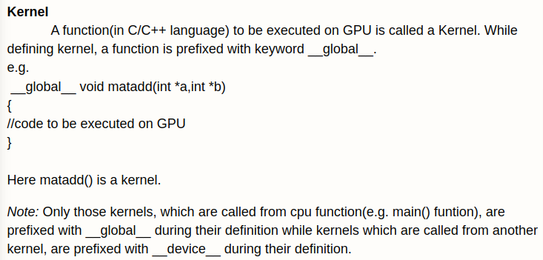
2.4 Kernel
https://www.youtube.com/watch?v=lwA4SK-82rI&list=PLhbrpS8rYbc0CxUdGR3WoM9xr11WCaSPw&index=2
Kernel (07:31-08:00/22:54)
Now, we move to next concept that is Kernel.
Kernel is a function. Kernel is a C/C++ function.
https://www.comrevo.com/2015/05/what-is-cuda-basics-gpu-host-device-kernel-stream-multiprocessor-thread-block-grid-warp-memory-architecture-global-shared-constant-texture-local-registers.html

Slide 16
2.4 Kernel
https://www.youtube.com/watch?v=lwA4SK-82rI&list=PLhbrpS8rYbc0CxUdGR3WoM9xr11WCaSPw&index=2
Kernel (08:01-08:30/22:54)
How do we write the Kernel function?
Kernel function start with keyword “__global__”, Kernel function has the return type void, and the function name, kernel function accept some parameters, and return the result.
The keyword “__global__” is for compiler to know this is the Kernel function to be executed on GPU.
https://www.comrevo.com/2015/05/what-is-cuda-basics-gpu-host-device-kernel-stream-multiprocessor-thread-block-grid-warp-memory-architecture-global-shared-constant-texture-local-registers.html

Slide 17
2.4 Kernel
https://www.youtube.com/watch?v=lwA4SK-82rI&list=PLhbrpS8rYbc0CxUdGR3WoM9xr11WCaSPw&index=2
Kernel (08:31-11:00/22:54)
1. In C/C++, we start the main () function in CPU. In main() function, we can call add() function.
2. In order to run add() function on GPU, we have to add keyword “__global__” and return type void.
3. In add() function, we may call another function sub(). We have to specify “__device__”. This is called by GPU function “__global__”
https://www.comrevo.com/2015/05/what-is-cuda-basics-gpu-host-device-kernel-stream-multiprocessor-thread-block-grid-warp-memory-architecture-global-shared-constant-texture-local-registers.html
3
__device__ void sub() {
...
}
__global__ void add() {
sub();
...
}
void main () {
add ();
…
...
}
2
1

Slide 18
2.4 Kernel
https://www.youtube.com/watch?v=lwA4SK-82rI&list=PLhbrpS8rYbc0CxUdGR3WoM9xr11WCaSPw&index=2
Kernel (11:01-12:20/22:54)
1. So, main() function is a CPU function.
2. From CPU function, we call add() GPU function. The add() function will be executed on GPU. The “__global__ void” function is called by CPU function. From the GPU function “__global__”, we can call another GPU function specified by “__device__”.
3. The “__device__” is used for GPU function called by another GPU function.
The add() and sub() functions are kernels. These functions are executed on GPU.
https://www.comrevo.com/2015/05/what-is-cuda-basics-gpu-host-device-kernel-stream-multiprocessor-thread-block-grid-warp-memory-architecture-global-shared-constant-texture-local-registers.html
// add() and sub() functions are kernels.
__device__ void sub() {
...
}
__global__ void add() {
sub();
...
}
void main () {
add ();
…
...
}
3
2
1

Slide 19
2.5 SM and SP

Slide 20
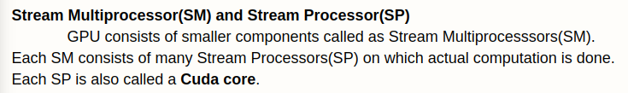
2.5 SM and SP
https://www.youtube.com/watch?v=lwA4SK-82rI&list=PLhbrpS8rYbc0CxUdGR3WoM9xr11WCaSPw&index=2
SM and SP (12:21-12:40/22:54)
Now, we move to another concept: Stream Multi-processing (SM) and Stream Processor (SP).
https://www.comrevo.com/2015/05/what-is-cuda-basics-gpu-host-device-kernel-stream-multiprocessor-thread-block-grid-warp-memory-architecture-global-shared-constant-texture-local-registers.html

Slide 21
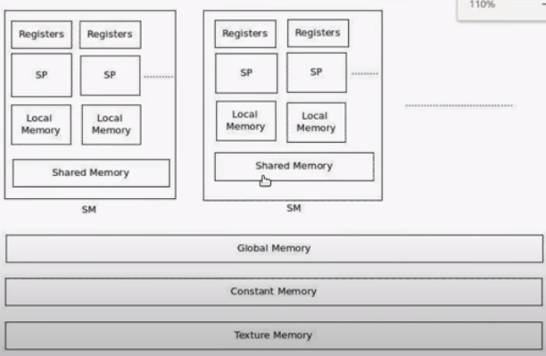
2.5 SM and SP
https://www.youtube.com/watch?v=lwA4SK-82rI&list=PLhbrpS8rYbc0CxUdGR3WoM9xr11WCaSPw&index=2
SM and SP (12:41-14:10/22:54)
We have several SM which contains the registers, SP, local memory, shared memory.
MP (Multiprocessor) is a collection of processor. SM contain many SP (Stream Processor).
https://www.comrevo.com/2015/05/what-is-cuda-basics-gpu-host-device-kernel-stream-multiprocessor-thread-block-grid-warp-memory-architecture-global-shared-constant-texture-local-registers.html

Slide 22
2.5 SM and SP
https://www.youtube.com/watch?v=lwA4SK-82rI&list=PLhbrpS8rYbc0CxUdGR3WoM9xr11WCaSPw&index=2
SM and SP (14:11-14:50/22:54)
When we say, we have 100 cores. What is that mean? It means that we have 1000 SP or 1000 Cuda Core.
One Cuda Core is one SP. Each SP Processor is called a Cuda Core.
https://www.comrevo.com/2015/05/what-is-cuda-basics-gpu-host-device-kernel-stream-multiprocessor-thread-block-grid-warp-memory-architecture-global-shared-constant-texture-local-registers.html

Slide 23
2.6 Thread, Block, and Grid

Slide 24
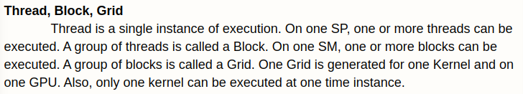
2.6 Thread, Block, and Grid
https://www.youtube.com/watch?v=lwA4SK-82rI&list=PLhbrpS8rYbc0CxUdGR3WoM9xr11WCaSPw&index=2
Thread, Block, and Grid (14:51-15:30/22:54)
Now, we move to another concept: Thread, Block, and Grid.
A thread is a single instance of execution. A thread is the smallest part of execution.
The smallest execution part in computation is called the thread.
A collection of thread is called a Block.
A collection of block is called a Grid.
Keep in mind, the smallest computation unit is called thread.
A group of thread is called a block.
A group of block is called a grid.
https://www.comrevo.com/2015/05/what-is-cuda-basics-gpu-host-device-kernel-stream-multiprocessor-thread-block-grid-warp-memory-architecture-global-shared-constant-texture-local-registers.html

Slide 25
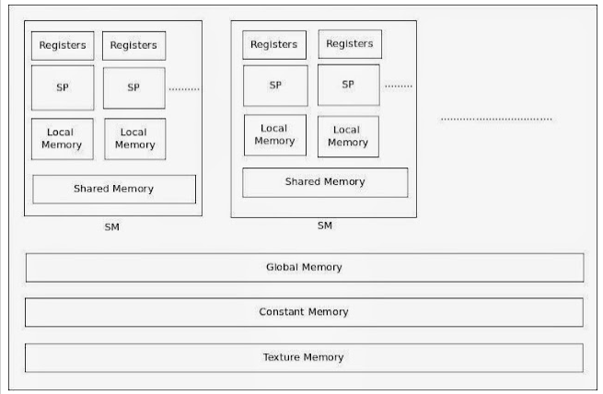
2.6 Thread, Block, and Grid
https://www.youtube.com/watch?v=lwA4SK-82rI&list=PLhbrpS8rYbc0CxUdGR3WoM9xr11WCaSPw&index=2
Grid: Group of Blocks (one GPU)
Block: Group of Threads (one SM)
Thread: Run one thread on one Core (or one SP)
SM (Stream Multiprocessor): 1 block is run or multiple blocks in the list are run.
SP (Stream Processor): 1 thread is run or multiple threads in the list are run.
// add() and sub() functions are kernels.
__device__ void sub() {
...
}
__global__ void add() {
sub();
...
}
void main () {
add ();
…
...
}
Thread, Block, and Grid (15:31-18:30/22:54)
Previously, we have main run in CPU and add() and sub() run on GPU.
We add() and sub() are thread run in SP (Stream Processes) or core. They can be in the list and run one at a time.
We can group threads into block and run in SM (Stream Processor) or multiple-core. We can run multiple blocks in the list, one block at a time.
One gird is run for one Kernel and one GPU.
https://www.comrevo.com/2015/05/what-is-cuda-basics-gpu-host-device-kernel-stream-multiprocessor-thread-block-grid-warp-memory-architecture-global-shared-constant-texture-local-registers.html
thread
block

Slide 26
2.7 Warp

Slide 27
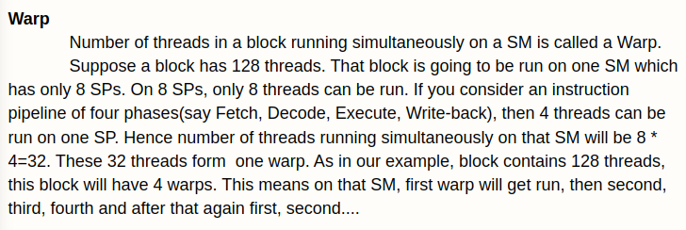
2.7 Warp
https://www.youtube.com/watch?v=lwA4SK-82rI&list=PLhbrpS8rYbc0CxUdGR3WoM9xr11WCaSPw&index=2
Warp (18:31-18:50/22:54)
Now, we move to another concept: Warp
What is Warp?
There are number of threads in a block run simultaneously on a SM (Stream Multiprocessor) is called a Warp.
https://www.comrevo.com/2015/05/what-is-cuda-basics-gpu-host-device-kernel-stream-multiprocessor-thread-block-grid-warp-memory-architecture-global-shared-constant-texture-local-registers.html

Slide 28
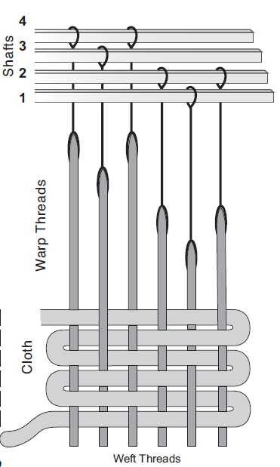
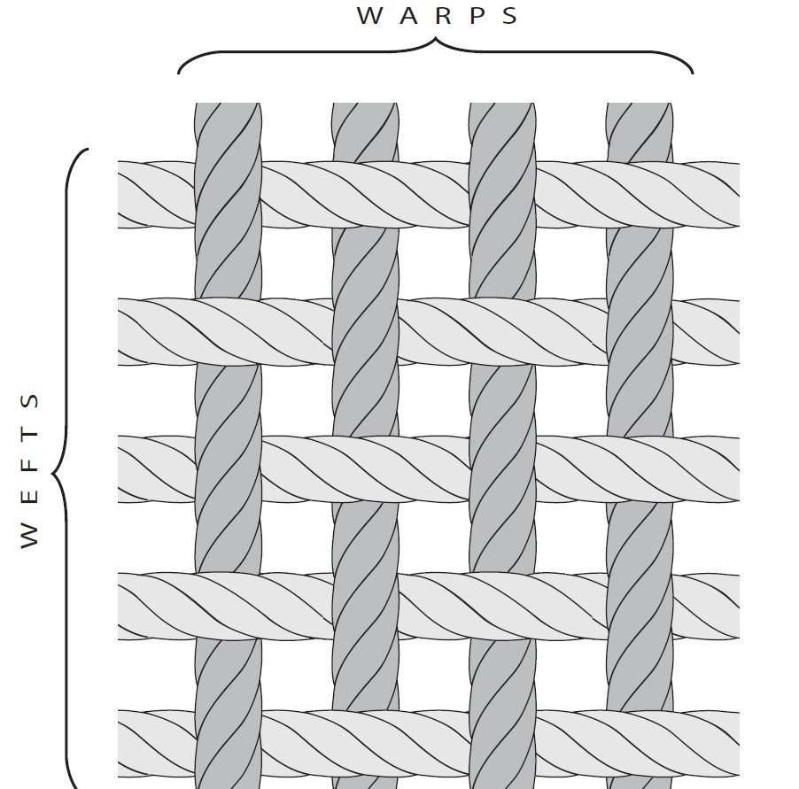
2.7 Warp
https://www.youtube.com/watch?v=lwA4SK-82rI&list=PLhbrpS8rYbc0CxUdGR3WoM9xr11WCaSPw&index=2
Warp (18:51-19:00/22:54)
What is a Warp?
1. Warps are the threads that are measured out and put on the loom (织布机).
2. The weft weaves over and under the warps that are on the loom already to make cloth.
https://peggyosterkamp.com/2022/12/warp-and-weft-another-spelling-situation/#:~:text=Warps%20are%20the%20threads%20that,the%20warp%20threads%20during%20weaving.

Slide 29
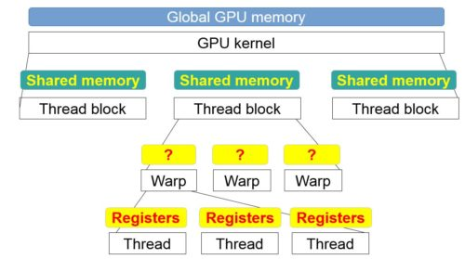
2.7 Warp
https://www.youtube.com/watch?v=lwA4SK-82rI&list=PLhbrpS8rYbc0CxUdGR3WoM9xr11WCaSPw&index=2
Warp (19:01-20:20/22:54)
We have 1 SM (Stream Multiprocessor) which contains 8 SP (Stream Processor).
Here, we can run 8 threads. Each SP run one thread.
Suppose, we have instruction pipeline of 4 stages.
Because of we have 4 stages, the thread can be divided into 8 * 4 threads. We can run 8 * 4 threads or 32 threads on one SM (Stream Multiprocessor) simultaneously.
https://developer.nvidia.com/blog/register-cache-warp-cuda/
Grid: Group of Blocks (one GPU)
Block: Group of Threads (one SM)
Thread: Run one thread on one Core (or one SP)
SM (Stream Multiprocessor): 1 block is run or multiple blocks in the list are run.
SP (Stream Processor): 1 thread is run or multiple threads in the list are run.
Instruction Pipeline of 4 stages
1 SM with 8 SP: we run 8 threads. We can run 8 * 4 (stage) threads or 32 threads on one SM (Stream Multiprocessor) simultaneously.
We call this one Warp.

Slide 30
2.7 Warp
https://www.youtube.com/watch?v=lwA4SK-82rI&list=PLhbrpS8rYbc0CxUdGR3WoM9xr11WCaSPw&index=2
Warp (20:21-21:30/22:54)
Suppose we have 128 threads in 4 warps.
How do we launch 128 threads in 1SM?
1 warp is executed in 1 SM (Stream multi-processor)
1 warp means threads (128 threads) in one SM (Stream Multi-Processor).
4 warps means threads run in 4 SM (Stream Multi-Processor).
Grid: Group of Blocks (one GPU)
Block: Group of Threads (one SM)
Thread: Run one thread on one Core (or one SP)
SM (Stream Multiprocessor): 1 block is run or multiple blocks in the list are run.
SP (Stream Processor): 1 thread is run or multiple threads in the list are run.
Instruction Pipeline of 4 stages
1 SM with 8 SP: we run 8 threads. We can run 8 * 4 (stage) threads or 32 threads on one SM (Stream Multiprocessor) simultaneously.
We call this one Warp.
1 Warp: Number of Threads running simultaneously on one SM (Stream Multi-Processor)
Suppose we have 128 threads in 4 warps.

Slide 31
2.8 Summary

Slide 32

2.8 Summary
https://www.youtube.com/watch?v=lwA4SK-82rI&list=PLhbrpS8rYbc0CxUdGR3WoM9xr11WCaSPw&index=2
Summary (22:31-22:54/22:54)
We discussed the following topics:
1. Why do we need GPUs?
2. What is cuda and how to do the Cuda Programming?
3. What are cuda cores?
4. What are cuda cores in graphics cards?
5. What is cuda gpu, Host, Device, Kernel, SM (Stream Multi-Processor), SP (Stream Processor), Thread, Block, Grid, Warp?
https://www.comrevo.com/2015/05/what-is-cuda-basics-gpu-host-device-kernel-stream-multiprocessor-thread-block-grid-warp-memory-architecture-global-shared-constant-texture-local-registers.html

Slide 33
End

