Slide 1

5 Cuda Matrix Addition in Ubuntu
Peter H. Chen

Slide 2
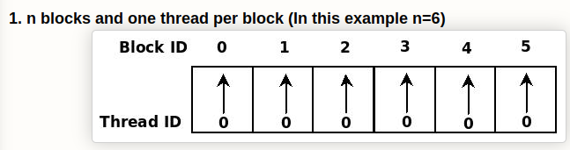
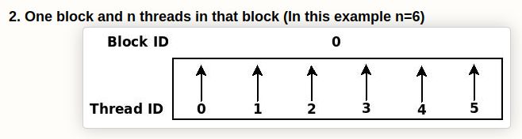
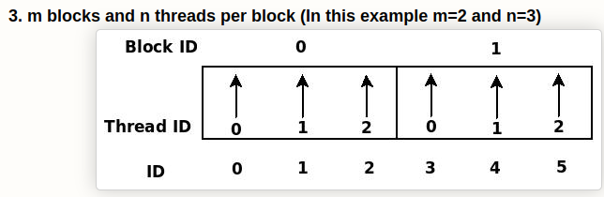
5 Cuda Matrix Addition in Ubuntu
https://www.youtube.com/watch?v=jTAxCbcxwJA&list=PLhbrpS8rYbc0CxUdGR3WoM9xr11WCaSPw&index=5
Cuda Matrix Addition in Ubuntu (00:00-01:00/16:27)
Vector is 1-Dimensional Arrays and Matrix ix 2-Dimensional Arrays.
In the right diagram, vector addition, we have two vectors (one-dimensional arrays).
We add two vectors
1. n blocks and with 1 thread per block.
2. 1 block and with n threads in that block.
3. m blocks and n threads per block.
1
2
3

Slide 3
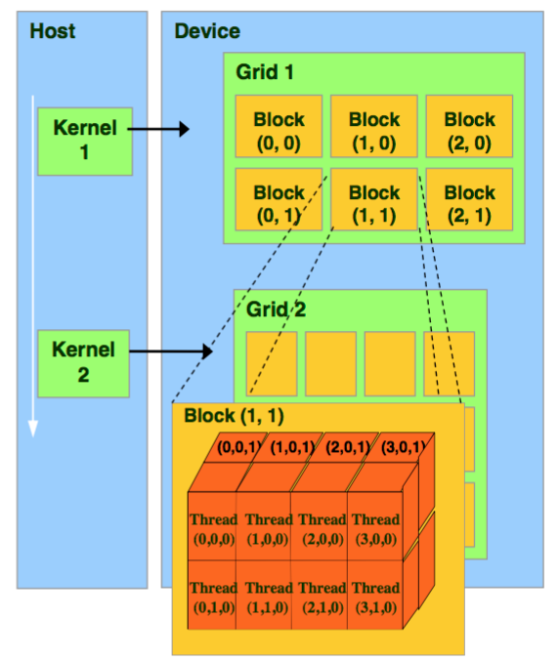
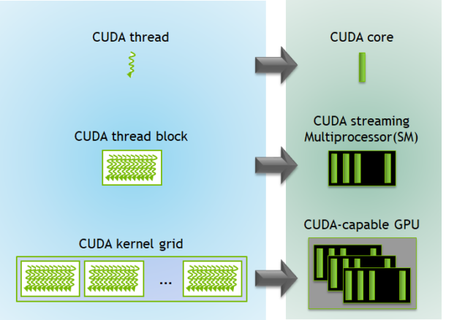
5 Cuda Matrix Addition in Ubuntu
https://www.youtube.com/watch?v=jTAxCbcxwJA&list=PLhbrpS8rYbc0CxUdGR3WoM9xr11WCaSPw&index=5
Cuda Matrix Addition in Ubuntu (01:01-02:00/16:27)
Question:
What is difference of Gird and Block in Cuda?
Answer:
A group of threads is called a CUDA block. CUDA blocks are grouped into a grid.

Slide 4

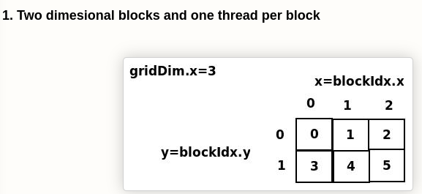
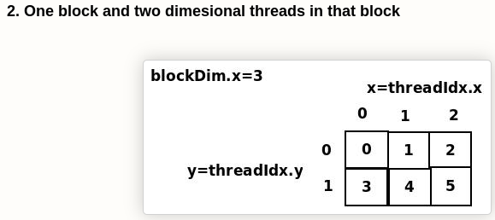
5 Cuda Matrix Addition in Ubuntu
https://www.youtube.com/watch?v=jTAxCbcxwJA&list=PLhbrpS8rYbc0CxUdGR3WoM9xr11WCaSPw&index=5
Cuda Matrix Addition in Ubuntu (02:01-02:20/16:27)
Note that Vector is one-dimensional array and matrix is two-dimensional array.
Now, we have matrix addition:
1. Two dimensional blocks and one thread of per block.
2. One block and two dimensional threads in that block.
1
2

Slide 5
5.1 2-D Blocks: 2T/2B

Slide 6
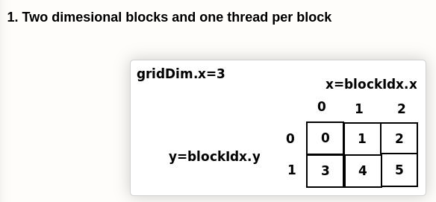
5.1 2-D Blocks: 2T/2B
https://www.youtube.com/watch?v=jTAxCbcxwJA&list=PLhbrpS8rYbc0CxUdGR3WoM9xr11WCaSPw&index=5
2-D Blocks: 2T/2B (02:21-02:22/16:27)
Matrix is a two-dimensional
1. 2-Dimensional blocks.
2. 2T/2B: 2 Thread per 2-Block

Slide 7
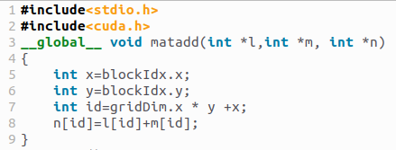
5.1 2-D Blocks: 1T/1B
https://www.youtube.com/watch?v=jTAxCbcxwJA&list=PLhbrpS8rYbc0CxUdGR3WoM9xr11WCaSPw&index=5
2-D Blocks: 1T/1B (02:23-02:24/16:27)
GPU Kernel code:

Slide 8

5.1 2-D Blocks: 1T/1B
https://www.youtube.com/watch?v=jTAxCbcxwJA&list=PLhbrpS8rYbc0CxUdGR3WoM9xr11WCaSPw&index=5
2-D Blocks: 1T/1B (02:25-02:26/16:27)
CPU Main Code, we define grid (3, 2) and pass to kernel matadd <<< grid size, block size>>>.
First parameter is number of grid and second parameter is number of block.
https://docs.nvidia.com/cuda/cuda-c-programming-guide/

Slide 9
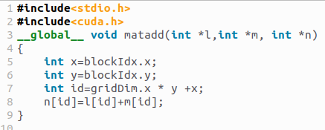
5.1 2-D Blocks: 1T/1B
https://www.youtube.com/watch?v=jTAxCbcxwJA&list=PLhbrpS8rYbc0CxUdGR3WoM9xr11WCaSPw&index=5
2-D Blocks: 1T/1B (02:27-11:30/16:27)
How to calculate the ID of each thread?
CPU Main Code, we define
grid size = grid (number of column = 3, number of row = 2) and
Dimension = 3 in each block.
We get the ID for each thread from the block ID of Dimension and block ID.
https://docs.nvidia.com/cuda/cuda-c-programming-guide/

Slide 10
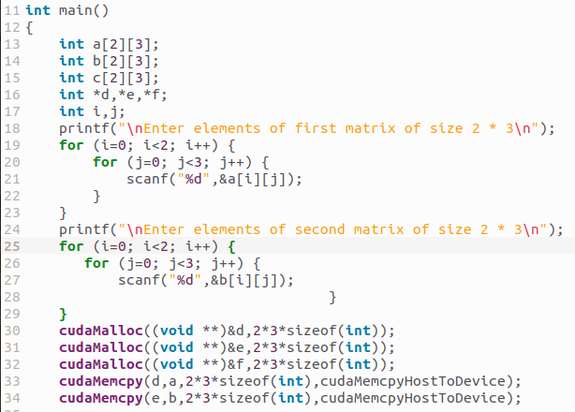
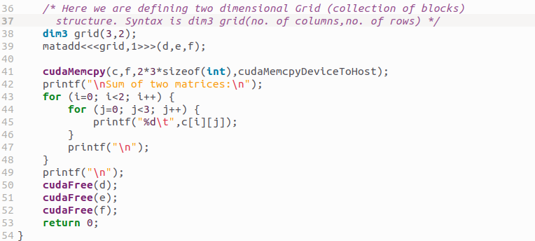
5.1 2-D Blocks: 1T/1B
https://www.youtube.com/watch?v=jTAxCbcxwJA&list=PLhbrpS8rYbc0CxUdGR3WoM9xr11WCaSPw&index=5
2-D Blocks: 1T/1B (11:31-11:32/16:27)
CPU Main Code, we pass to kernel matadd <<< grid size, 1 >>>.
First parameter is number of grid and second parameter is number of block.
https://docs.nvidia.com/cuda/cuda-c-programming-guide/

Slide 11
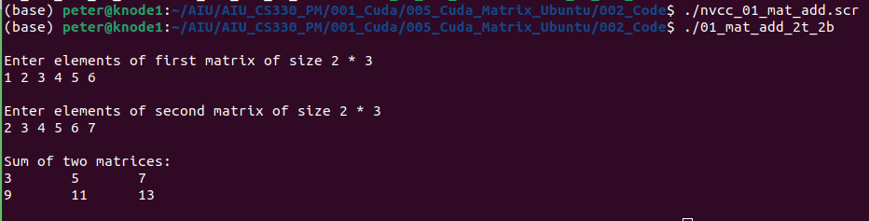
5.1 2-D Blocks: 1T/1B
https://www.youtube.com/watch?v=jTAxCbcxwJA&list=PLhbrpS8rYbc0CxUdGR3WoM9xr11WCaSPw&index=5
2-D Blocks: 1T/1B (11:33-12:00/16:27)
Below, we have
1. 2-Dimensional blocks.
2. 2T/2B: 2 Thread per 2 Block

Slide 12
5.2 1 Block: 2T/1B

Slide 13
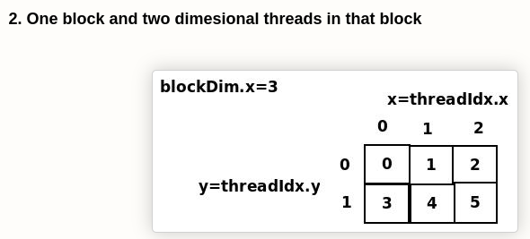
5.2 1 Block: 2T/1B
https://www.youtube.com/watch?v=jTAxCbcxwJA&list=PLhbrpS8rYbc0CxUdGR3WoM9xr11WCaSPw&index=5
1 Block: 2T/1B (12:01-12:02/16:27)
Below, we have
1. 2-Dimensional blocks.
2. 2T/2B: 2 Thread per 1-Block

Slide 14
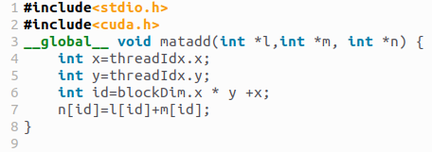
5.2 1 Block: 2T/1B
https://www.youtube.com/watch?v=jTAxCbcxwJA&list=PLhbrpS8rYbc0CxUdGR3WoM9xr11WCaSPw&index=5
1 Block: 2T/1B (12:03-12:04/16:27)
GPU Kernel code:

Slide 15
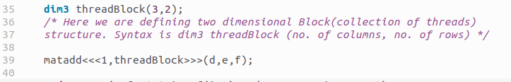
5.2 1 Block: 2T/1B
https://www.youtube.com/watch?v=jTAxCbcxwJA&list=PLhbrpS8rYbc0CxUdGR3WoM9xr11WCaSPw&index=5
1 Block: 2T/1B (12:05-16:00/16:27)
GPU Kernel code:
We pass in 1 Grid and number of block define as threadBlock (3, 2).
We calculate the thread ID by (block ID) * (block Dimension) + thread ID.

Slide 16
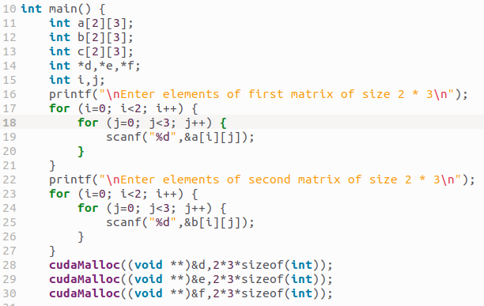
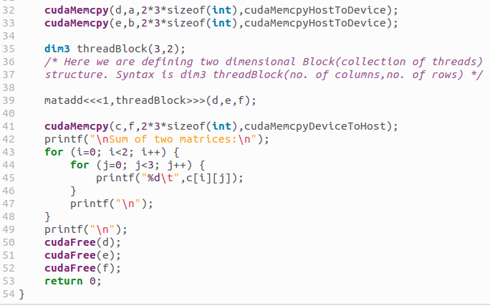
5.2 1 Blocks: 2T/1B
https://www.youtube.com/watch?v=jTAxCbcxwJA&list=PLhbrpS8rYbc0CxUdGR3WoM9xr11WCaSPw&index=5
1 Block: 2T/1B (16:01-16:02/16:27)
CPU Main Code:

Slide 17
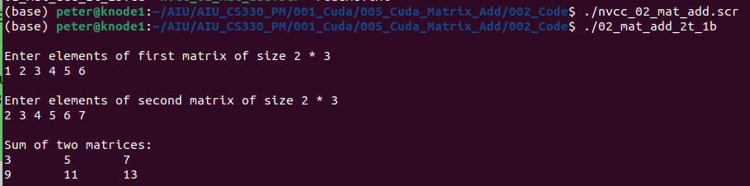
5.2 1 Blocks: 2T/1B
https://www.youtube.com/watch?v=jTAxCbcxwJA&list=PLhbrpS8rYbc0CxUdGR3WoM9xr11WCaSPw&index=5
1 Block: 2T/1B (16:03-16:27/16:27)
Below, we have
1. 2-Dimensional blocks.
2. 2T/1B: 2 Thread per 1 Block

Slide 18
END

