Slide 1

1 GCP Introduction
Peter H. Chen

Slide 2
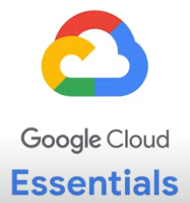
1 GCP Introduction
https://www.youtube.com/watch?v=kzKFuHk8ovk&list=PLIivdWyY5sqKh1gDR0WpP9iIOY00IE0xL&index=1
GCP Introduction (00:00-00:20/5:29)
We discuss GCP (Google Cloud Platform) essentials:
1. What is GCP?
2. How the GCP helps the developer?

Slide 3
1.1 Cloud Computing

Slide 4
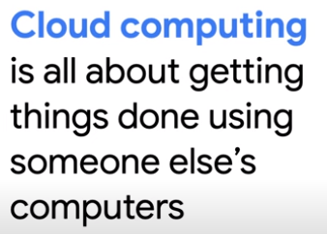
1.1 Cloud Computing
https://www.youtube.com/watch?v=kzKFuHk8ovk&list=PLIivdWyY5sqKh1gDR0WpP9iIOY00IE0xL&index=1
Cloud Computing (00:21-00:30/5:29)
Cloud Computing is get someone computer to do our work.
If we use Google Cloud, we get our work done by Google computers.

Slide 5
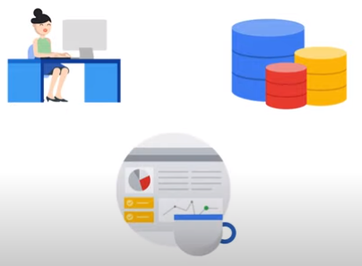
1.1 Cloud Computing
https://www.youtube.com/watch?v=kzKFuHk8ovk&list=PLIivdWyY5sqKh1gDR0WpP9iIOY00IE0xL&index=1
Cloud Computing (00:31-01:40/5:29)
Cloud cloud build and host applications, store data, and analyze data.
All in google highly scalable and reliable computing infrastructure.

Slide 6
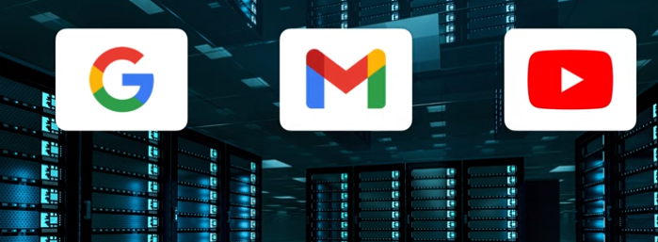
1.1 Cloud Computing
https://www.youtube.com/watch?v=kzKFuHk8ovk&list=PLIivdWyY5sqKh1gDR0WpP9iIOY00IE0xL&index=1
Cloud Computing (00:41-01:05/5:29)
There are many Google Data Centers. They are located all around the world.
The data centers do the compute, storage, and networking capabilities.
The data centers do google’s own products and services, such as, search, gmail, and youtube.
With google cloud, Google shares these computing resources with developers like us.
We can build and run applications using Google Computing infrastructure.
One of they advantages if cloud computing is scale.

Slide 7
1.2 Retailer Database

Slide 8
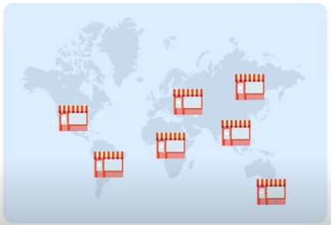
1.2 Retailer Database
https://www.youtube.com/watch?v=kzKFuHk8ovk&list=PLIivdWyY5sqKh1gDR0WpP9iIOY00IE0xL&index=1
Retailer Database (01:06-01:10/5:29)
For example, we have retailer looking for a database server to manage their inventory, pricing, and demand across thousands of stores around the world.

Slide 9
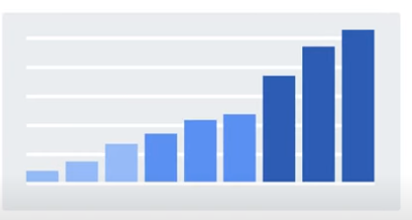
1.2 Retailer Database
https://www.youtube.com/watch?v=kzKFuHk8ovk&list=PLIivdWyY5sqKh1gDR0WpP9iIOY00IE0xL&index=1
Retailer Database (01:11-01:20/5:29)
One of the biggest challenge is to figure out how to handle massive seasonal spikes during the holiday season.

Slide 10
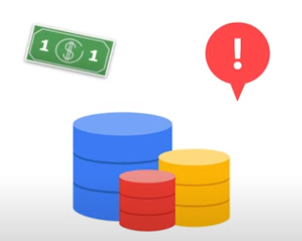
1.2 Retailer Database
https://www.youtube.com/watch?v=kzKFuHk8ovk&list=PLIivdWyY5sqKh1gDR0WpP9iIOY00IE0xL&index=1
Retailer Database (01:21-01:45/5:29)
If we try to set up and manage our own on-premised database, it would likely be expensive and inefficient to provide additional hardware to do so.
We have to pay larger upfront costs to set up the need of database infrastructure which we may not use the hardware all the time.
We also need to worry about implement our own database server, database charting, managing backup, meeting performance requirements, security, and etc.

Slide 11
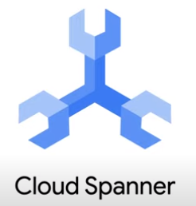
1.2 Retailer Database
https://www.youtube.com/watch?v=kzKFuHk8ovk&list=PLIivdWyY5sqKh1gDR0WpP9iIOY00IE0xL&index=1
Retailer Database (01:46-02:10/5:29)
We can use fully managed database, like Cloud Spanner. The Cloud Spanner will all above tasks manage for you.
Google Cloud would manage scaling for you so that you only pay for the data storage you actually need.

Slide 12
1.3 Run Code

Slide 13
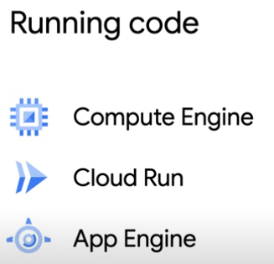
1.3 Run Code
https://www.youtube.com/watch?v=kzKFuHk8ovk&list=PLIivdWyY5sqKh1gDR0WpP9iIOY00IE0xL&index=1
Run Code (02:11-02:30/5:29)
Google cloud solve problems for developers and located all around the world.
We take hours to discuss about the functionality of Google Cloud.
1. Compute Engine: We can run code of our application. Compute Engine gives you virtual machine that run in Google Data Centers.
2. Cloud Run: We can deploy containerized applications on a fully managed serverless platform.
3. App Engine: we can deploy highly scalable web apps and other backend services.

Slide 14
1.4 Store Data

Slide 15
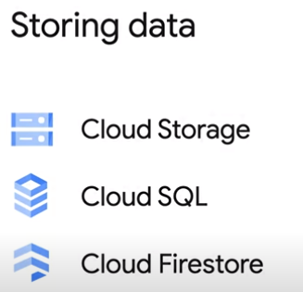
1.4 Store Data
https://www.youtube.com/watch?v=kzKFuHk8ovk&list=PLIivdWyY5sqKh1gDR0WpP9iIOY00IE0xL&index=1
Store Data (02:31-03:05/5:29)
We need to store data, some data are structured and some data are unstructured.
1. Cloud Storage: It is used for unstructured data, such as, images, videos, and audio files.
2. Cloud SQL: It hosts Google-managed versions of MySQL, Postgres, and SQL Server. We can run the same relational database for all the database management.
3. Cloud Firestore: It is a NoSQL document-based Realtime Database. It is popular for use cases like gaming, where it is very important for users to have the most up-to-date version of data in realtime

Slide 16
1.5 AI and ML

Slide 17
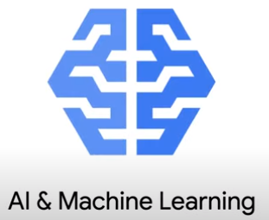
1.5 AI and ML
https://www.youtube.com/watch?v=kzKFuHk8ovk&list=PLIivdWyY5sqKh1gDR0WpP9iIOY00IE0xL&index=1
AI and ML (03:06-03:10/5:29)
Google Cloud provides AI and ML (Machine Learning) Tools.
They are very helpful for machine learning developer.

Slide 18
1.6 Extract Image Information

Slide 19
1.6 Extract Image Information
https://www.youtube.com/watch?v=kzKFuHk8ovk&list=PLIivdWyY5sqKh1gDR0WpP9iIOY00IE0xL&index=1
Extract Image Information (03:06-03:10/5:29)
Suppose we have a lot of images on our application,
We want to enhance our application by knowing what is in each image.

Slide 20
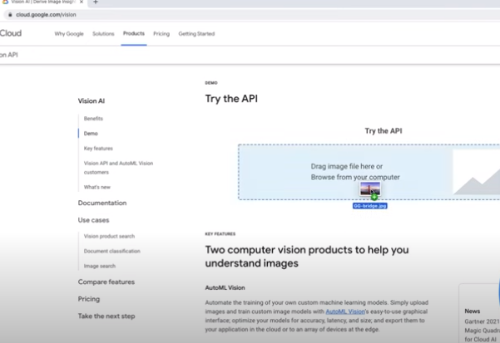
1.6 Extract Image Information
https://www.youtube.com/watch?v=kzKFuHk8ovk&list=PLIivdWyY5sqKh1gDR0WpP9iIOY00IE0xL&index=1
Extract Image Information (03:06-03:10/5:29)
Vision AI will help us.
We can drag and drop the image.

Slide 21
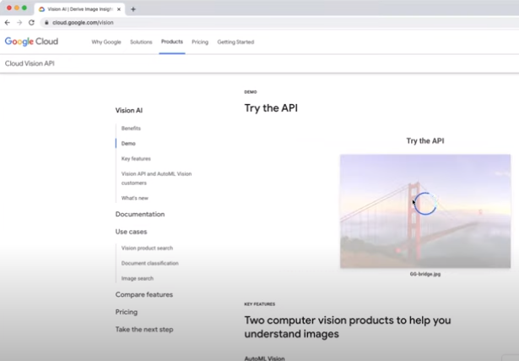
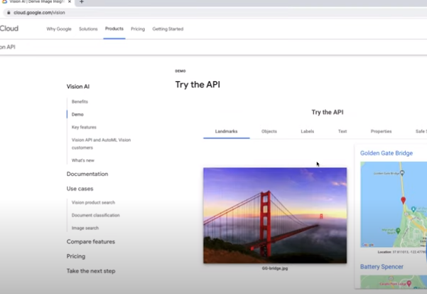
1.6 Extract Image Information
https://www.youtube.com/watch?v=kzKFuHk8ovk&list=PLIivdWyY5sqKh1gDR0WpP9iIOY00IE0xL&index=1
Extract Image Infroamtion (03:11-03:30/5:29)
Vision AI tells us what is the image and where is the image located.

Slide 22
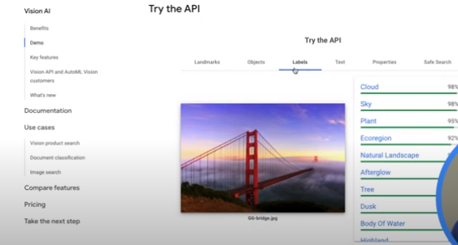
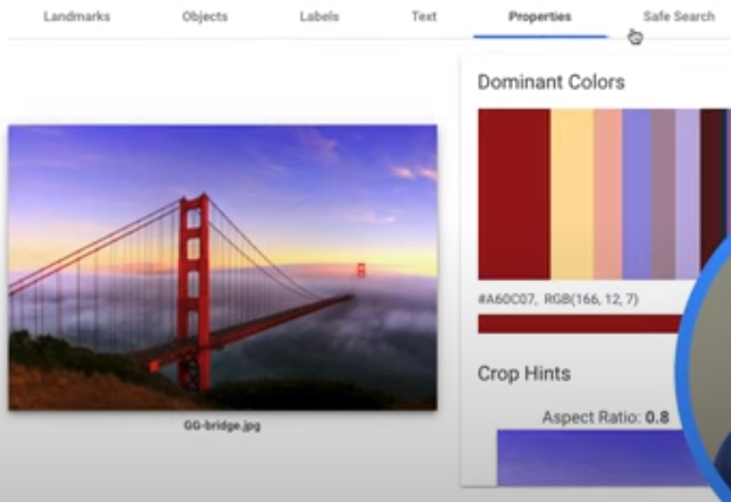
1.6 Extract Image Information
https://www.youtube.com/watch?v=kzKFuHk8ovk&list=PLIivdWyY5sqKh1gDR0WpP9iIOY00IE0xL&index=1
Extract Image Information (03:11-03:30/5:29)
Vision AI take the image and run object detection, find landmarks, extract texts, color analysis, and etc.

Slide 23
1.7 Language Processing

Slide 24
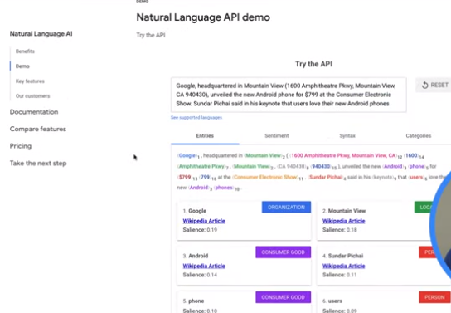
1.7 Language Processing
https://www.youtube.com/watch?v=kzKFuHk8ovk&list=PLIivdWyY5sqKh1gDR0WpP9iIOY00IE0xL&index=1
Language Processing (03:46-03:50/5:29)
With Cloud Natural Language, we can analyze the user comments by natural language processing.
,

Slide 25
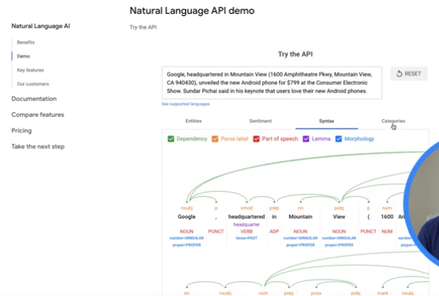
1.7 Language Processing
https://www.youtube.com/watch?v=kzKFuHk8ovk&list=PLIivdWyY5sqKh1gDR0WpP9iIOY00IE0xL&index=1
Language Processing (03:51-03:55/5:29)
We can analyze a piece of texts and get information about its entities, sentiment, syntax, and content categorization.
,

Slide 26
1.8 ML Model

Slide 27
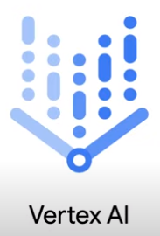
1.8 ML Model
https://www.youtube.com/watch?v=kzKFuHk8ovk&list=PLIivdWyY5sqKh1gDR0WpP9iIOY00IE0xL&index=1
ML Model (03:56-04:10/5:29)
We can use Vertex AI to build and deploy our own ML (Machine Learning) Model.
Vertex AI is an unified Machine Learning platform provided by Google Cloud.
Vertex AI is for training, hosting, and managing machine learning Model.
,

Slide 28
1.9 Integrate Products

Slide 29
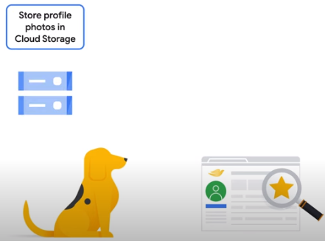
1.9 Integrate Products
https://www.youtube.com/watch?v=kzKFuHk8ovk&list=PLIivdWyY5sqKh1gDR0WpP9iIOY00IE0xL&index=1
Integrate Products (04:11-04:25/5:29)
Google Cloud gives us seamlessly integration of multiple products to suit our own unique use case.
For example, if we want to build a social networking site regarding dogs.
We can start out by storing profile photos in Cloud storage.

Slide 30
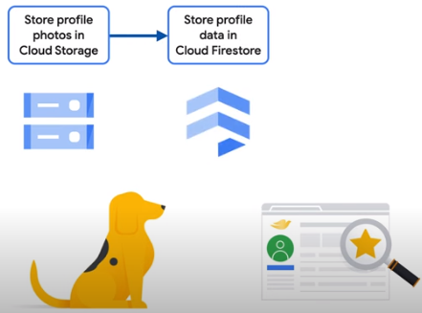
1.9 Integrate Products
https://www.youtube.com/watch?v=kzKFuHk8ovk&list=PLIivdWyY5sqKh1gDR0WpP9iIOY00IE0xL&index=1
Integrate Products (04:26-04:35/5:29)
Then, we can store profile data in Cloud Firestore database, such as, dog names, locations, and hobbies.

Slide 31
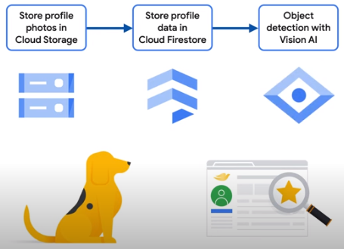
1.9 Integrate Products
https://www.youtube.com/watch?v=kzKFuHk8ovk&list=PLIivdWyY5sqKh1gDR0WpP9iIOY00IE0xL&index=1
Integrate Products (04:36-04:45/5:29)
Next, we can use Vision AI to detect objects in each photo, such as, balls, stuffed animals, bones, and etc.
These machine machine-powered data insights can help users find other furry friends with similar interests.

Slide 32
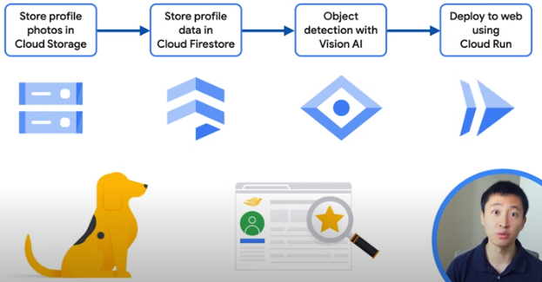

1.9 Integrate Products
https://www.youtube.com/watch?v=kzKFuHk8ovk&list=PLIivdWyY5sqKh1gDR0WpP9iIOY00IE0xL&index=1
Integrate Products (04:46-04:55/5:29)
Finally, we can deploy our application to the web using Cloud Run.
This will make it easy for your app to scale automatically as you gain more users.

Slide 33
1.10 Summary

Slide 34
1.10 Summary
https://www.youtube.com/watch?v=kzKFuHk8ovk&list=PLIivdWyY5sqKh1gDR0WpP9iIOY00IE0xL&index=1
Summary (05:01-05:29/5:29)
What GCP (Google Cloud Platform) can provide?
1. Cloud Firestore: Cloud Database to store data.
2. Vertex AI: for Intelligence, Machine Learning, Deep Learning, Reinforcement Learning, LLM (Large Language Model), etc.
3. Cloud Run: Deploy web application.

Slide 35
End

