Slide 1

2 Get Started GCP
Peter H. Chen

Slide 2
2 Get Started GCP
https://www.youtube.com/watch?v=GKEk1FzAN1A&list=PLIivdWyY5sqKh1gDR0WpP9iIOY00IE0xL&index=2
Get Started GCP (00:00-00:20/7:30)
We will build below for GCP (Google Cloud Platform):
1. Compute
2. Storage,
3. Networking
4. Operations,
5. Tools,
6. Big Data Analytics
7. Artificial Intelligence,
8. Machine Learning,
9. Kubernetes
10. Serverless
11. Machine Learning

Slide 3
2.1 Walkthrough cloud.google.com

Slide 4
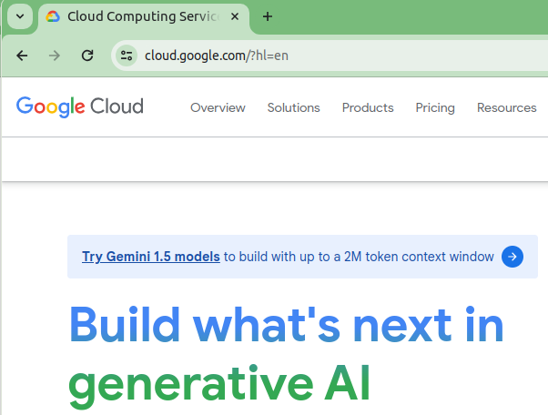
2.1 Walkthrough cloud.google.com
https://www.youtube.com/watch?v=GKEk1FzAN1A&list=PLIivdWyY5sqKh1gDR0WpP9iIOY00IE0xL&index=2
Walkthrough cloud.google.com (00:21-00:30/7:30)
The starting point of GCP is:
> cloud.google.com
This web site provide the information about the GCP product and offers.

Slide 5
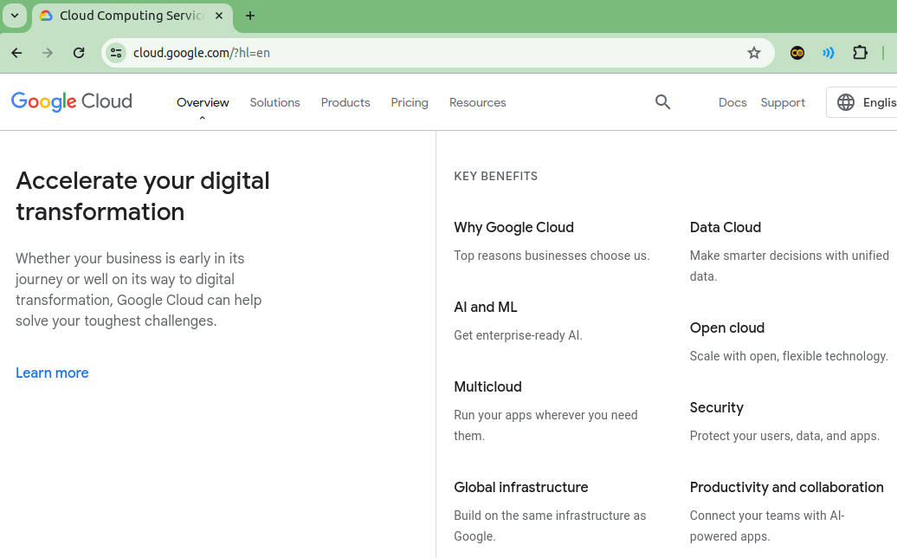
2.1 Walkthrough cloud.google.com
https://www.youtube.com/watch?v=GKEk1FzAN1A&list=PLIivdWyY5sqKh1gDR0WpP9iIOY00IE0xL&index=2
Walkthrough cloud.google.com (00:31-00:40/7:30)
Click “Overview”. We can see

Slide 6
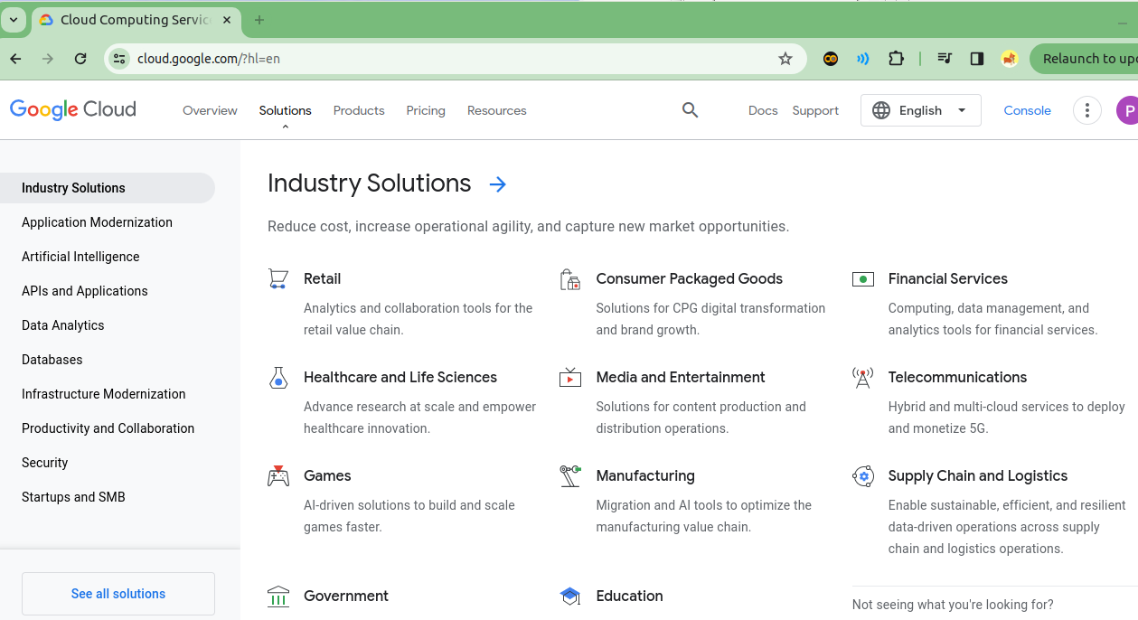
2.1 Walkthrough cloud.google.com
https://www.youtube.com/watch?v=GKEk1FzAN1A&list=PLIivdWyY5sqKh1gDR0WpP9iIOY00IE0xL&index=2
Walkthrough cloud.google.com (00:241-00:50/7:30)
Click “Solutions”. We can see Industrial Solutions

Slide 7
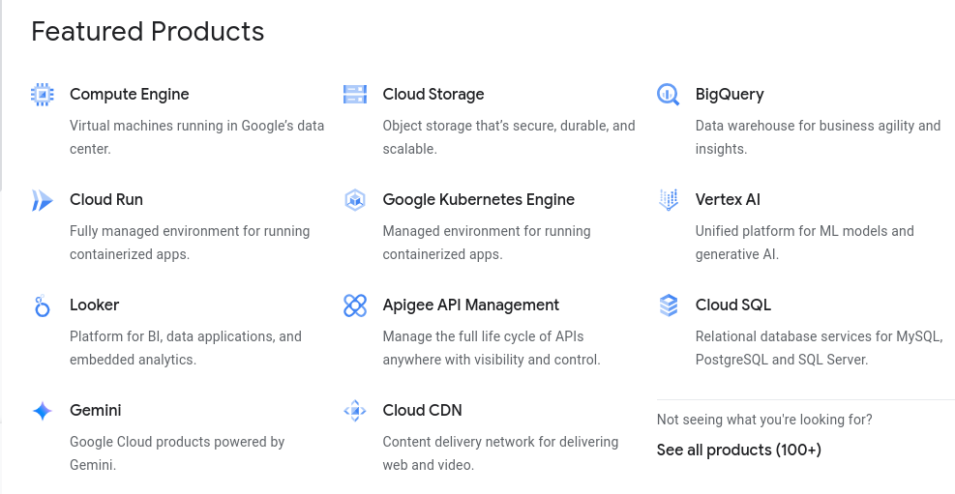
2.1 Walkthrough cloud.google.com
https://www.youtube.com/watch?v=GKEk1FzAN1A&list=PLIivdWyY5sqKh1gDR0WpP9iIOY00IE0xL&index=2
Walkthrough cloud.google.com (00:52-01:00/7:30)
Click “Products”. We can see Featured Products: Compute Engine, Cloud Storage, Big Query, Cloud Run (for deployment), Kubernetes Engines. Vertex AI, Looker (BI), Gemini (LLM),

Slide 8
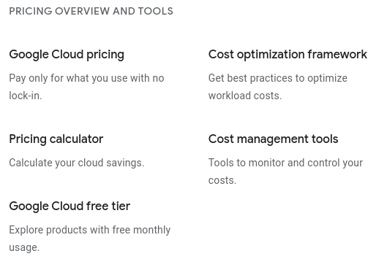
2.1 Walkthrough cloud.google.com
https://www.youtube.com/watch?v=GKEk1FzAN1A&list=PLIivdWyY5sqKh1gDR0WpP9iIOY00IE0xL&index=2
Walkthrough cloud.google.com (01:01-01:05/7:30)
Click “Price”.
> “Google Cloud free tier” is the entrance point.

Slide 9
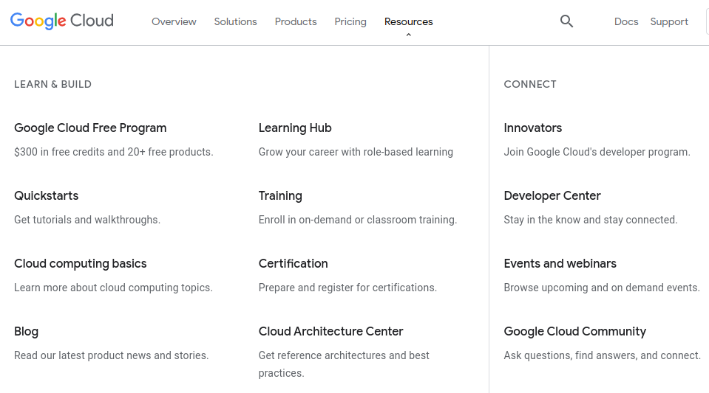
2.1 Walkthrough GCP
https://www.youtube.com/watch?v=GKEk1FzAN1A&list=PLIivdWyY5sqKh1gDR0WpP9iIOY00IE0xL&index=2
Walkthrough cloud.google.com (01:06-01:10/7:30)
Click “Resources”.

Slide 10
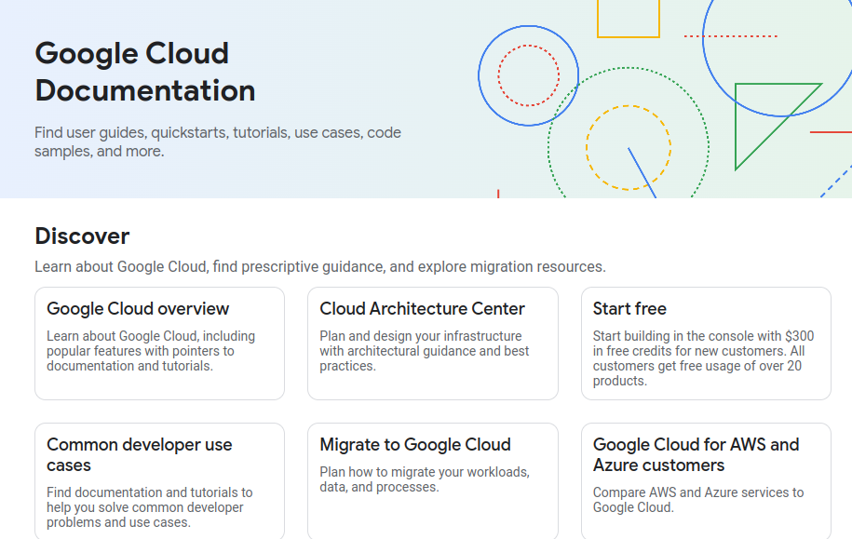
2.1 Walkthrough GCP
https://www.youtube.com/watch?v=GKEk1FzAN1A&list=PLIivdWyY5sqKh1gDR0WpP9iIOY00IE0xL&index=2
Walkthrough cloud.google.com (01:11-01:15/7:30)
Click “Docs”.

Slide 11
2.2 Walkthrough Cloud Console

Slide 12
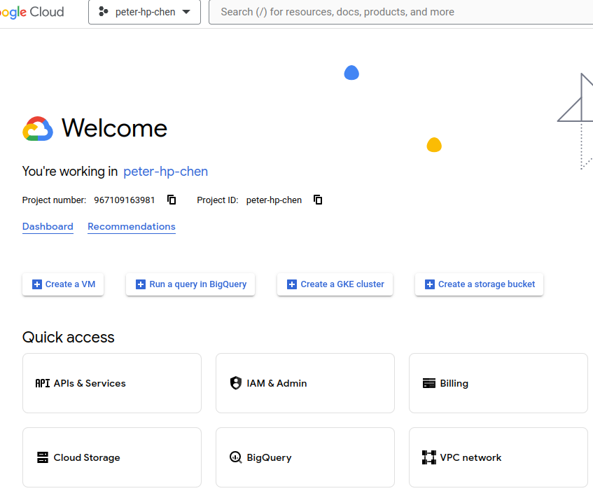
2.2 Walkthrough Cloud Console
https://www.youtube.com/watch?v=GKEk1FzAN1A&list=PLIivdWyY5sqKh1gDR0WpP9iIOY00IE0xL&index=2
Walkthrough Cloud Console (01:16-03:50/7:30)
Click “Console”: This is the most time user used.

Slide 13
2.3 SDK and Shell

Slide 14
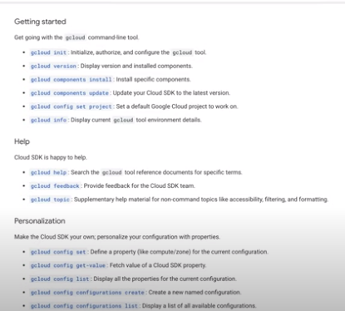
2.3 SDK and Shell
https://www.youtube.com/watch?v=GKEk1FzAN1A&list=PLIivdWyY5sqKh1gDR0WpP9iIOY00IE0xL&index=2
SDK and Shell (03:51-04:20/7:30)
SDK

Slide 15
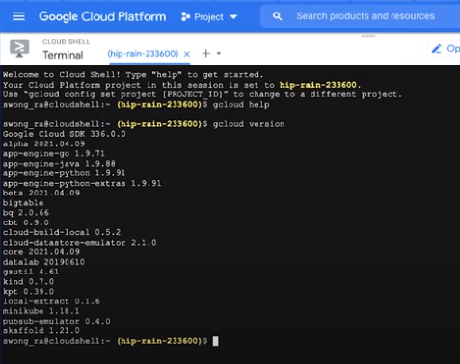
2.3 SDK and Shell
https://www.youtube.com/watch?v=GKEk1FzAN1A&list=PLIivdWyY5sqKh1gDR0WpP9iIOY00IE0xL&index=2
SDK and Shell (04:21-04:50/7:30)
Shell

Slide 16
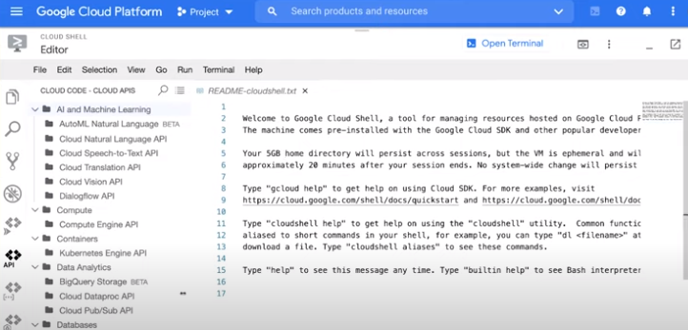
2.3 SDK and Shell
https://www.youtube.com/watch?v=GKEk1FzAN1A&list=PLIivdWyY5sqKh1gDR0WpP9iIOY00IE0xL&index=2
SDK and Shell (04:31-04:50/7:30)
Editor

Slide 17
2.4 Signup

Slide 18
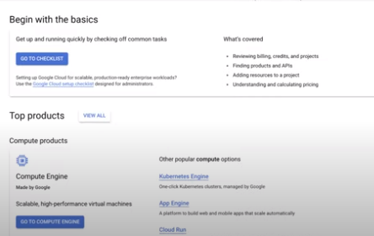
2.4 Signup
https://www.youtube.com/watch?v=GKEk1FzAN1A&list=PLIivdWyY5sqKh1gDR0WpP9iIOY00IE0xL&index=2
Signup (04:51-05:50/7:30)

Slide 19
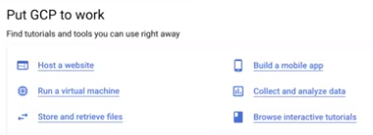
2.4 Signup
https://www.youtube.com/watch?v=GKEk1FzAN1A&list=PLIivdWyY5sqKh1gDR0WpP9iIOY00IE0xL&index=2
Signup (05:51-06:20/7:30)

Slide 20
2.5 Resources

Slide 21
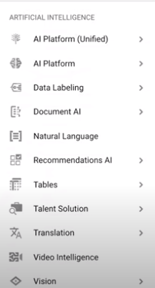
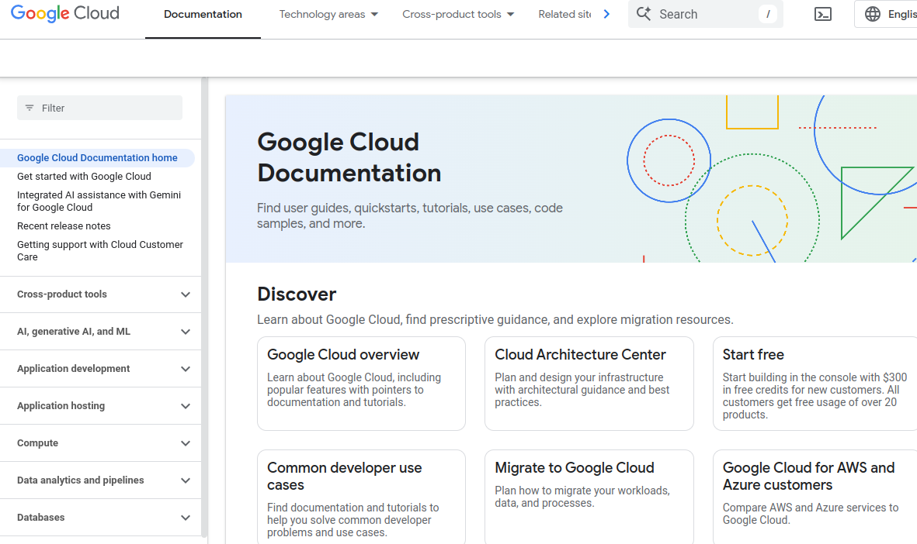
2.5 Resources
https://www.youtube.com/watch?v=GKEk1FzAN1A&list=PLIivdWyY5sqKh1gDR0WpP9iIOY00IE0xL&index=2
Resources (06:21-06:50/7:30)

Slide 22
2.6 Conclusion

Slide 23
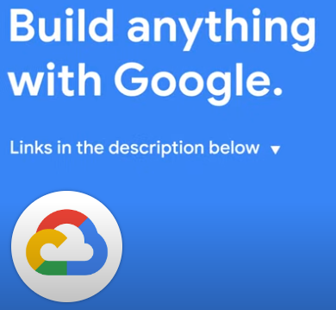
2.6 Conclusion
https://www.youtube.com/watch?v=GKEk1FzAN1A&list=PLIivdWyY5sqKh1gDR0WpP9iIOY00IE0xL&index=2
Conclusion (06:56-07:30/7:30)

Slide 24
End

